Slide 1

Foralgebra 2e
2. kafli Tungumál algebrunnar

Slide 2
Yfirlit kaflans
Notkun tungumáls algebrunnar
Reikna gildi, einfalda og setja fram stæður
Jöfnur leystar með frádráttar- og samlagningareiginleikum jafnaðar
Finna margfeldi og þætti
Frumþáttun og minnsta samfeldi

Slide 3
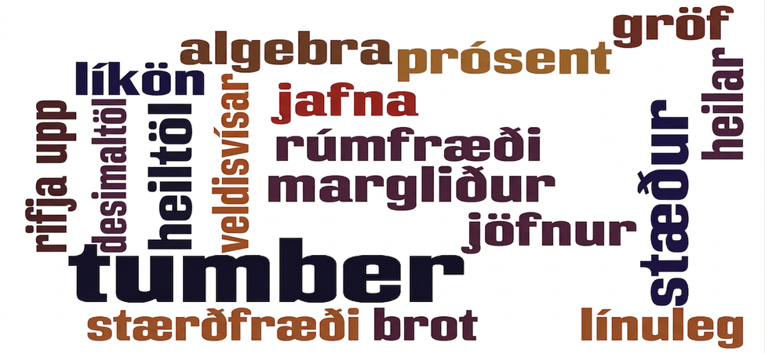
Mynd 2.1
Algebra á sér sitt eigið tungumál. Á myndinni má sjá nokkur þeirra orða sem þú kynnist og notar við nám í foralgebru.
Notes:
The image shows a collage of mathematical terms such as algebra, decimals, equations, numbers etcetera. The words are written horizontally, vertically, and in different colors.

Slide 4
2.1 Notkun tungumáls algebrunnar
Námsmarkmið
Nota breytur og algebrutákn
Þekkja stæður og jöfnur
Einfalda stæður með veldisvísum
Einfalda stæður samkvæmt forgangsröð reikniaðgerða

Slide 5
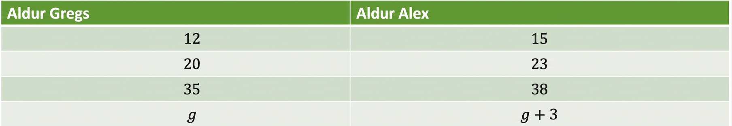
Tafla 2.1
Aldur Gregs | Aldur Alex
$$12$$ | $$15$$
$$20$$ | $$23$$
$$35$$ | $$38$$
$$g$$ | $$g+3$$

Slide 6
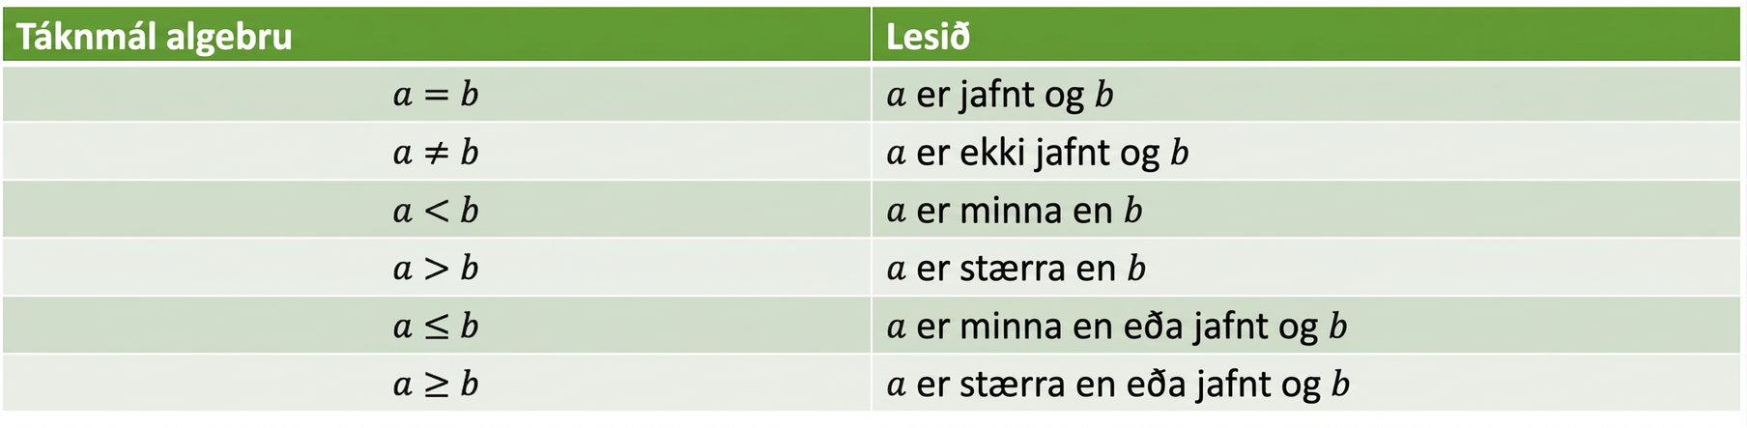
Tafla 2.2
Algebruritháttur | Lesið
$$a=b$$ | $a$ er jafnt og $b$
$$a≠b$$ | $a$ er ekki jafnt og $b$
$$a<b$$ | $a$ er minna en $b$
$$a>b$$ | $a$ er stærra en $b$
$$a≤b$$ | $a$ er minna en eða jafnt og $b$
$$a≥b$$ | $a$ er stærra en eða jafnt og $b$

Slide 7
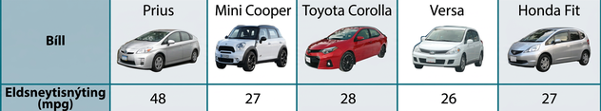
Mynd 2.2
(mynd: aðlagað verk eftir Bernard Goldbach, Wikimedia Commons)
Notes:
This table has two rows and six columns. The first column is a header column and it labels each row The first row is labeled “Car” and the second “Fuel economy (mpg)”. To the right of the ‘Car’ row are the labels: “Prius”, “Mini Cooper”, “Toyota Corolla”, “Versa”, “Honda Fit”. Each of these columns contains an image of the labeled car model. To the right of the “Fuel economy (mpg)” row are the algebraic equations: the letter p, the equals symbol, the number forty-eight; the letter m, the equals symbol, the number twenty-seven; the letter c, the equals symbol, the number twenty-eight; the letter v, the equals symbol, the number twenty-six; and the letter f, the equals symbol, the number twenty-seven.

Slide 8
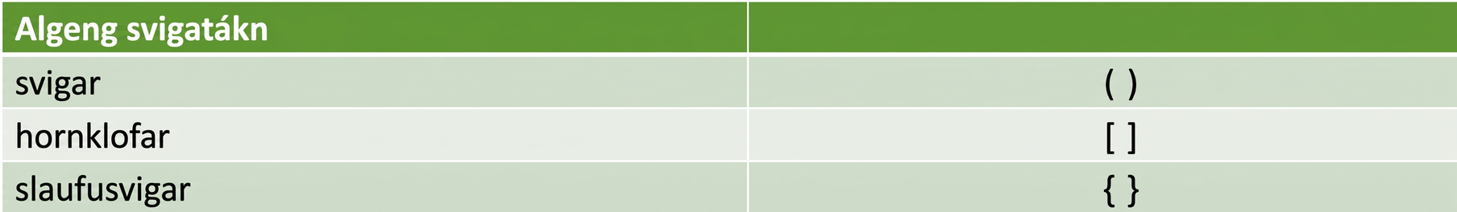
Tafla 2.3
Algeng hópunartákn
svigar
hornklofar | $$[ ]$$
slaufusvigar | $$\{ \}$$

Slide 9
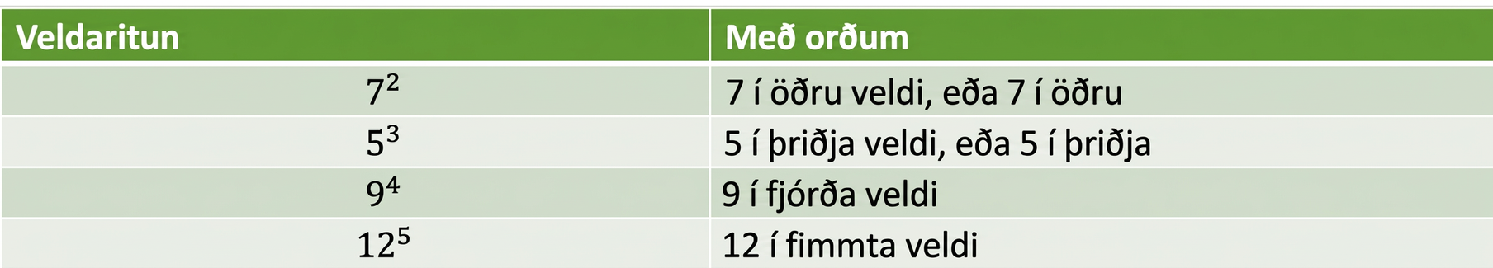
Tafla 2.4
Veldaritháttur | Með orðum
$$7^{2}$$ | $7$ í öðru veldi eða $7$ í öðru veldi
$$5^{3}$$ | $5$ í þriðja veldi eða $5$ í þriðja veldi
$$9^{4}$$ | $9$ í fjórða veldi
$${12}^{5}$$ | $12$ í fimmta veldi

Slide 10
2.2 Reikna gildi, einfalda og setja fram stæður
Námsmarkmið
Reikna gildi algebrustæða
Þekkja liði, stuðla og samkynja liði
Einfalda stæður með því að sameina samkynja liði
Setja orðasambönd fram sem algebrustæður

Slide 11
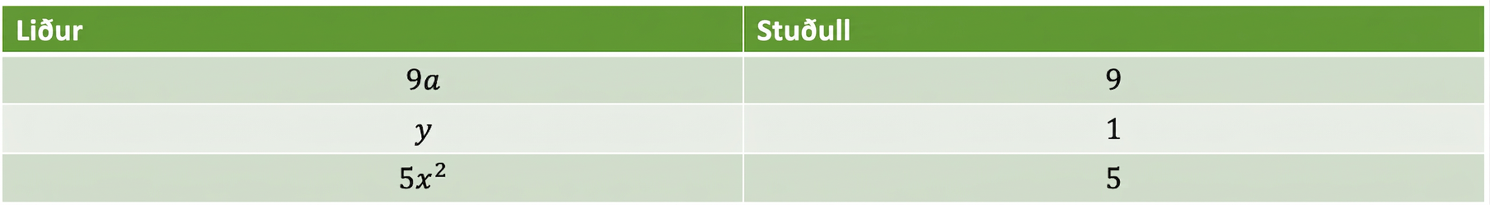
Tafla 2.5
Liður | Stuðull
$$9a$$ | $$9$$
$$y$$ | $$1$$
$$5x^{2}$$ | $$5$$

Slide 12
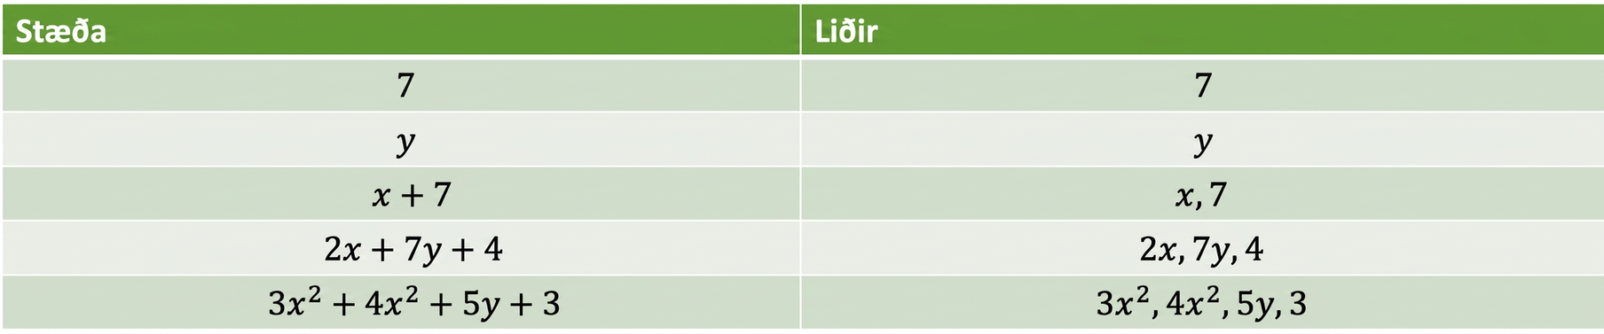
Tafla 2.6
Stæða | Liðir
$$7$$ | $$7$$
$$y$$ | $$y$$
$$x+7$$ | $$x,7$$
$$2x+7y+4$$ | $$2x,7y,4$$
$$3x^{2}+4x^{2}+5y+3$$ | $$3x^{2},4x^{2},5y,3$$

Slide 13
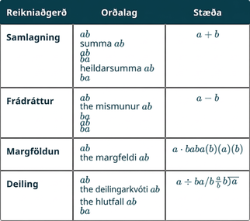
Tafla 2.7
Notes:
Table 2.7; Columns: Operation, Phrase, Expression; Row 1: Addition, a plus b
the sum of a and b
a increased by b
b more than a
the total of a and b
b added to a, a+b; Row 2: Subtraction, a minus b
the difference of a and b
b subtracted from a
a decreased by b
b less than a, a−b; Row 3: Multiplication, a times b
the product of a and b, a⋅b, ab, a(b), (a)(b); Row 4: Division, a divided by b
the quotient of a and b
the ratio of a and b
b divided into a, a÷b, a/b, ab, ba

Slide 14
2.3 Jöfnur leystar með frádráttar- og samlagningareiginleikum jafnaðar
Námsmarkmið
Ákvarða hvort tala sé lausn jöfnu
Setja frádráttareiginleika jafnaðar fram með líkani
Leysa jöfnur með frádráttareiginleika jafnaðar
Leysa jöfnur með samlagningareiginleika jafnaðar
Þýða orðasambönd yfir á algebrujöfnur
Setja upp jöfnu og leysa hana

Slide 15
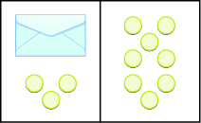
Mynd 2.3
Myndinni er skipt í tvennt með lóðréttri línu. Vinstra megin er umslag og þrjár talningarskífur fyrir neðan það. Hægra megin eru átta talningarskífur.
Notes:
The image is divided in half vertically. On the left side is an envelope with three counters below it. On the right side is 8 counters.

Slide 16
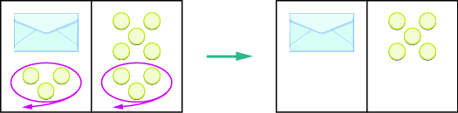
Mynd 2.4
Myndin er í tveimur hlutum. Vinstra megin er rétthyrningur sem skipt er í tvennt með lóðréttri línu. Í vinstri hluta hans er umslag og þrjár talningarskífur fyrir neðan það. Rauður hringur er utan um skífurnar þrjár og ör vísar út úr rétthyrningnum. Í hægri hlutanum eru átta talningarskífur. Rauður hringur er utan um neðstu þrjár skífurnar og ör vísar út úr rétthyrningnum. Hringmerktu skífurnar þrjár eru fjarlægðar úr báðum hlutum rétthyrningsins. Þá fæst nýi rétthyrningurinn hægra megin á myndinni, sem einnig er skipt í tvennt með lóðréttri línu. Í vinstri hluta hans er aðeins umslag en í hægri hlutanum eru fimm talningarskífur.
Notes:
The image is in two parts. On the left is a rectangle divided in half vertically. On the left side of the rectangle is an envelope with three counters below it. The 3 counters are circled in red with an arrow pointing out of the rectangle. On the right side is 8 counters. The bottom 3 counters are circled in red with an arrow pointing out of the rectangle. The 3 circled counters are removed from both sides of the rectangle, creating the new rectangle on the right of the image which is also divided in half vertically. On the left side of the rectangle is just an envelope. On the right side is 5 counters.

Slide 17
Mynd 2.5
Myndinni er skipt í tvennt með lóðréttri línu. Vinstra megin er umslag og þrjár talningarskífur fyrir neðan það. Hægra megin eru átta talningarskífur.
Notes:
The image is divided in half vertically. On the left side is an envelope with three counters below it. On the right side is 8 counters.

Slide 18
2.4 Finna margfeldi og þætti
Námsmarkmið
Þekkja margfeldi talna
Beita algengum deilanleikareglum
Finna alla þætti tölu
Þekkja frumtölur og samsettar tölur

Slide 19
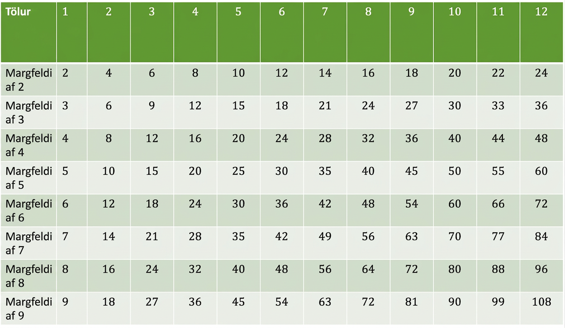
Tafla 2.8
Talningartala | $$1$$ | $$2$$ | $$3$$ | $$4$$ | $$5$$ | $$6$$ | $$7$$ | $$8$$ | $$9$$ | $$10$$ | $$11$$ | $$12$$
$$\text{Multiples} \text{of} 2$$ | $$2$$ | $$4$$ | $$6$$ | $$8$$ | $$10$$ | $$12$$ | $$14$$ | $$16$$ | $$18$$ | $$20$$ | $$22$$ | $$24$$
$$\text{Multiples} \text{of} 3$$ | $$3$$ | $$6$$ | $$9$$ | $$12$$ | $$15$$ | $$18$$ | $$21$$ | $$24$$ | $$27$$ | $$30$$ | $$33$$ | $$36$$
$$\text{Multiples} \text{of} 4$$ | $$4$$ | $$8$$ | $$12$$ | $$16$$ | $$20$$ | $$24$$ | $$28$$ | $$32$$ | $$36$$ | $$40$$ | $$44$$ | $$48$$
$$\text{Multiples} \text{of} 5$$ | $$5$$ | $$10$$ | $$15$$ | $$20$$ | $$25$$ | $$30$$ | $$35$$ | $$40$$ | $$45$$ | $$50$$ | $$55$$ | $$60$$
$$\text{Multiples} \text{of} 6$$ | $$6$$ | $$12$$ | $$18$$ | $$24$$ | $$30$$ | $$36$$ | $$42$$ | $$48$$ | $$54$$ | $$60$$ | $$66$$ | $$72$$
$$\text{Multiples} \text{of} 7$$ | $$7$$ | $$14$$ | $$21$$ | $$28$$ | $$35$$ | $$42$$ | $$49$$ | $$56$$ | $$63$$ | $$70$$ | $$77$$ | $$84$$
$$\text{Multiples} \text{of} 8$$ | $$8$$ | $$16$$ | $$24$$ | $$32$$ | $$40$$ | $$48$$ | $$56$$ | $$64$$ | $$72$$ | $$80$$ | $$88$$ | $$96$$
$$\text{Multiples} \text{of} 9$$ | $$9$$ | $$18$$ | $$27$$ | $$36$$ | $$45$$ | $$54$$ | $$63$$ | $$72$$ | $$81$$ | $$90$$ | $$99$$ | $$108$$

Slide 20

Mynd 2.6
Margfeldi af 2 á bilinu 1 til 50
Notes:
The image shows a chart with five rows and ten columns. The first row lists the numbers from 1 to 10. The second row lists the numbers from 11 to 20. The third row lists the numbers from 21 to 30. The fourth row lists the numbers from 31 and 40. The fifth row lists the numbers from 41 to 50. All factors of 2 are highlighted in blue.

Slide 21

Mynd 2.7
Margfeldi af 5 á bilinu 1 til 50
Notes:
The image shows a chart with five rows and ten columns. The first row lists the numbers from 1 to 10. The second row lists the numbers from 11 to 20. The third row lists the numbers from 21 to 30. The fourth row lists the numbers from 31 and 40. The fifth row lists the numbers from 41 to 50. All factors of 5 are highlighted in blue.

Slide 22

Mynd 2.8
Margfeldi af 10 á bilinu 1 til 50
Notes:
The image shows a chart with five rows and ten columns. The first row lists the numbers from 1 to 10. The second row lists the numbers from 11 to 20. The third row lists the numbers from 21 to 30. The fourth row lists the numbers from 31 and 40. The fifth row lists the numbers from 41 to 50. All factors of 10 are highlighted in blue.

Slide 23

Mynd 2.9
Margfeldi af 3 á bilinu 1 til 50
Notes:
The image shows a chart with five rows and ten columns. The first row lists the numbers from 1 to 10. The second row lists the numbers from 11 to 20. The third row lists the numbers from 21 to 30. The fourth row lists the numbers from 31 and 40. The fifth row lists the numbers from 41 to 50. All factors of 3 are highlighted in blue.

Slide 24
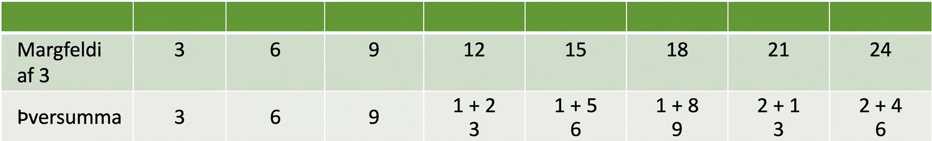
Tafla 2.9
$$\text{Multiple} \text{of}\text{ 3}$$ | $$3$$ | $$6$$ | $$9$$ | $$12$$ | $$15$$ | $$18$$ | $$21$$ | $$24$$
$$\text{Sum} \text{of} \text{digits}$$ | $$3$$ | $$6$$ | $$9$$ | $$\begin{matrix}1+2 \\ 3\end{matrix}$$ | $$\begin{matrix}1+5 \\ 6\end{matrix}$$ | $$\begin{matrix}1+8 \\ 9\end{matrix}$$ | $$\begin{matrix}2+1 \\ 3\end{matrix}$$ | $$\begin{matrix}2+4 \\ 6\end{matrix}$$

Slide 25
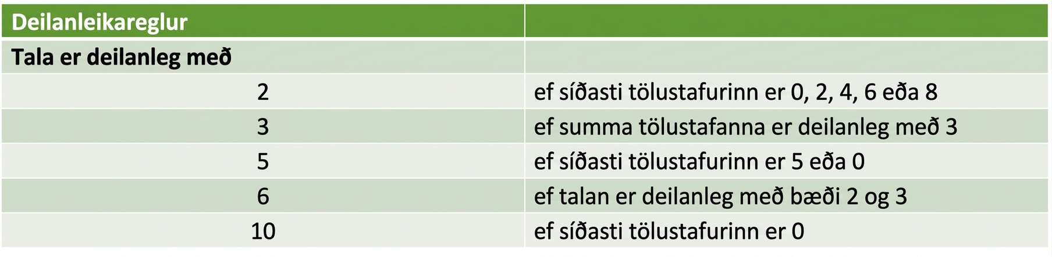
Tafla 2.10
Deilanleikareglur
Tala er deilanleg með
$$2$$ | ef síðasti tölustafurinn er $0, 2, 4, 6, \text{or} 8$
$$3$$ | ef þversumman er deilanleg með $3$
$$5$$ | ef síðasti tölustafurinn er $5$ eða $0$
$$6$$ | ef talan er deilanleg bæði með $2$ og $3$
$$10$$ | ef síðasti tölustafurinn er $0$

Slide 26
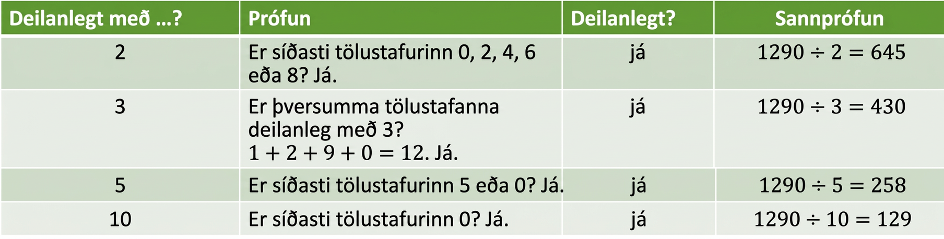
Tafla 2.11
Deilanleg með …? | Próf | Deilanleg? | Athugun
$$2$$ | Er síðasti tölustafurinn $0, 2, 4, 6, \text{or} 8?$ Já. | já | $$1290÷2=645$$
$$3$$ | $$\text{Is} \text{sum} \text{of} \text{digits} \text{divisible} \text{by} 3?$$ $1+2+9+0=12$ Já. | já | $$1290÷3=430$$
$$5$$ | Er síðasti tölustafurinn $5$ eða $0?$ Já. | já | $$1290÷5=258$$
$$10$$ | Er síðasti tölustafurinn $0?$ Já. | já | $$1290÷10=129$$

Slide 27
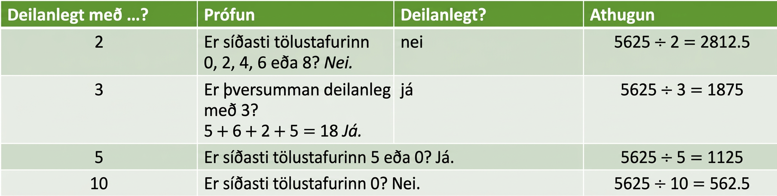
Tafla 2.12
Deilanleg með …? | Próf | Deilanleg? | Athugun
$$2$$ | Er síðasti tölustafurinn $0, 2, 4, 6, \text{or} 8?$ Nei. | nei | $$5625÷2=2812.5$$
$$3$$ | $$\text{Is} \text{sum} \text{of} \text{digits} \text{divisible} \text{by} 3?$$ $5+6+2+5=18$ Já. | já | $$5625÷3=1875$$
$$5$$ | Er síðasti tölustafurinn $5$ eða $0?$ Já. | já | $$5625÷5=1125$$
$$10$$ | Er síðasti tölustafurinn $0?$ Nei. | nei | $$5625÷10=562.5$$

Slide 28
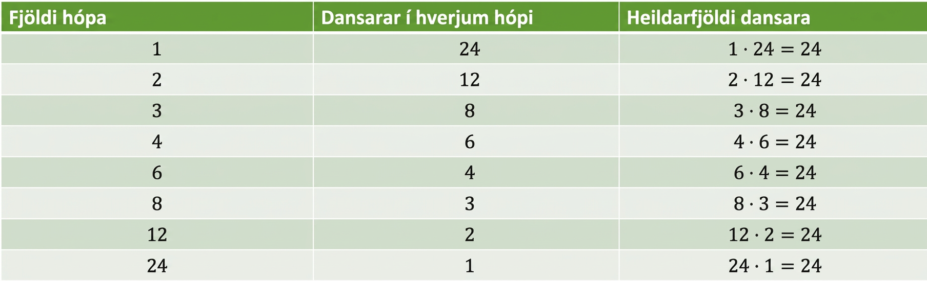
Tafla 2.13
Fjöldi hópa | Dansarar í hverjum hópi | Dansarar alls
$$1$$ | $$24$$ | $$1⋅24=24$$
$$2$$ | $$12$$ | $$2⋅12=24$$
$$3$$ | $$8$$ | $$3⋅8=24$$
$$4$$ | $$6$$ | $$4⋅6=24$$
$$6$$ | $$4$$ | $$6⋅4=24$$
$$8$$ | $$3$$ | $$8⋅3=24$$
$$12$$ | $$2$$ | $$12⋅2=24$$
$$24$$ | $$1$$ | $$24⋅1=24$$

Slide 29
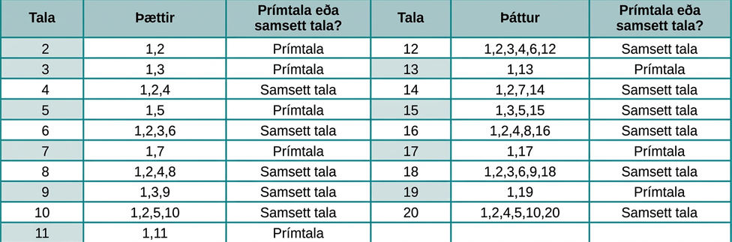
Mynd 2.10
Þættir talnanna frá 2 til 20; prímtölur eru auðkenndar
Notes:
This figure shows a table with twenty rows and three columns. The first row is a header row. It labels the columns as “Number”, “Factor” and “Prime or composite?” The second row lists the number 2, in red, under the “Number” column, the numbers 1 and 2 under the “Factors” column and the word prime under the “Prime or Composite?” column. The third row lists the number 3, in red, under the “Number” column, the numbers 1 and 3 under the “Factors” column and the word prime under the “Prime or Composite?” column. The fourth row lists the number 4 under the “Number” column, the numbers 1, 2 and 4 under the “Factors” column and the word composite under the “Prime or Composite?” column. The fifth row lists the number 5, in red, under the “Number” column, the numbers 1 and 5 under the “Factors” column and the word prime under the “Prime or Composite?” column. The sixth row lists the number 6 under the “Number” column, the numbers 1, 2, 3 and 6 under the “Factors” column and the word composite under the “Prime or Composite?” column. The seventh row lists the number 7, in red, under the “Number” column, the numbers 1 and 7 under the “Factors” column and the word prime under the “Prime or Composite?” column. The eighth row lists the number 8 under the “Number” column, the numbers 1, 2, 4 and 8 under the “Factors” column and the word composite under the “Prime or Composite?” column. The ninth row lists the number 9 under the “Number” column, the numbers 1, 3 and 9 under the “Factors” column and the word composite under the “Prime or Composite?” column. The tenth row lists the number 10 under the “Number” column, the numbers 1, 2, 5 and 10 under the “Factors” column and the word composite under the “Prime or Composite?” column. The eleventh row lists the number 11, in red, under the “Number” column, the numbers 1 and 11 under the “Factors” column and the word prime under the “Prime or Composite?” column. The twelfth row lists the number 12 under the “Number” column, the numbers 1, 2, 3, 4, 6 and 12 under the “Factors” column and the word composite under the “Prime or Composite?” column. The thirteenth row lists the number 13, in red, under the “Number” column, the numbers 1 and 13 under the “Factors” column and the word prime under the “Prime or Composite?” column. The fourteenth row lists the number 14 under the “Number” column, the numbers 1, 2, 7 and 14 under the “Factors” column and the word composite under the “Prime or Composite?” column. The fifteenth row lists the number 15 under the “Number” column, the numbers 1, 2, 3, 5 and 15 under the “Factors” column and the word composite under the “Prime or Composite?” column. The sixteenth row lists the number 16 under the “Number” column, the numbers 1, 2, 4, 8 and 16 under the “Factors” column and the word composite under the “Prime or Composite?” column. The seventeenth row lists the number 17, in red, under the “Number” column, the numbers 1 and 17 under the “Factors” column and the word prime under the “Prime or Composite?” column. The eighteenth row lists the number 18 under the “Number” column, the numbers 1, 2, 3, 6, 9 and 18 under the “Factors” column and the word composite under the “Prime or Composite?” column. The nineteenth row lists the number 19, in red, under the “Number” column, the numbers 1 and 19 under the “Factors” column and the word prime under the “Prime or Composite?” column. The twentieth row lists the number 20 under the “Number” column, the numbers 1, 2, 4, 5, 10 and 20 under the “Factors” column and the word composite under the “Prime or Composite?” column.

Slide 30
2.5 Frumþáttun og minnsta sameiginlega margfeldi
Námsmarkmið
Finna frumþáttun samsettrar tölu
Finna minnsta sameiginlega margfeldi (MSM) tveggja talna

Slide 31
Notkunarleyfi
Þetta ítarefni frá OpenStax er © Rice University og gefið út samkvæmt alþjóðlega CC BY-NC-SA 4.0-notkunarleyfinu. Aðeins má afrita það eða breyta því í óviðskiptalegum tilgangi, enda sé OpenStax og Rice University getið og allar breytingar tilgreindar. Öllum aðlöguðum útgáfum skal deilt með sams konar notkunarleyfi.

