Slide 1
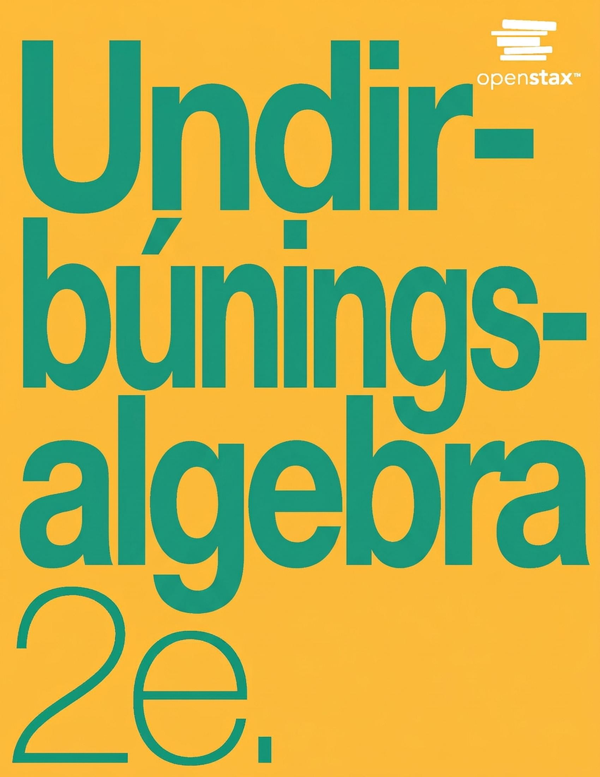
Undirbúningsalgebra 2e
9. kafli: Stærðfræðilíkön og rúmfræði

Slide 2
Yfirlit kaflans
Beitum lausnaleið við verkefni
Leysum dæmi um peninga
Notum eiginleika horna og þríhyrninga og reglu Pýþagórasar
Notum eiginleika rétthyrninga, þríhyrninga og trapisna
Leysum rúmfræðiverkefni: hringir og óreglulegar myndir
Leysum rúmfræðiverkefni: rúmmál og yfirborðsflatarmál
Einangrum tiltekna breytu í formúlu

Slide 3
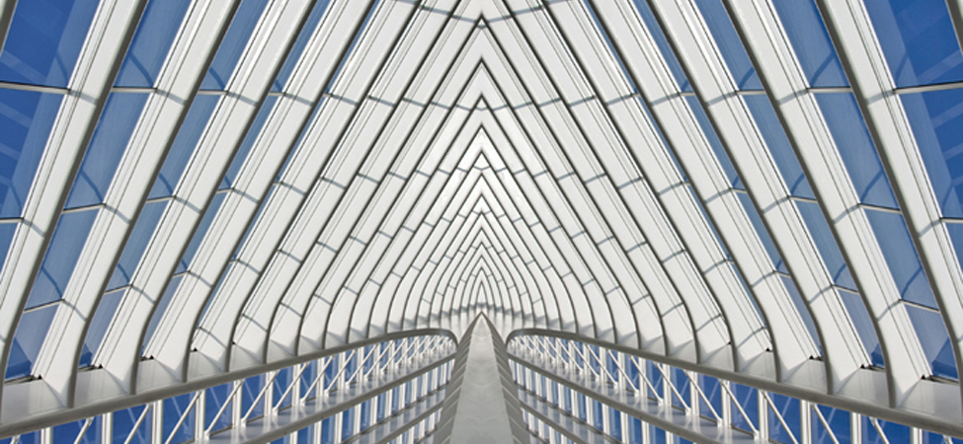
Mynd 9.1
Takið eftir hinum fjölmörgu einstöku formum í þessari byggingu. (mynd: Bert Kaufmann, Flickr)
Notes:
Part of a glass building is shown. The structure is made up of individual shapes.

Slide 4
9.1 Beitum lausnaleið við verkefni
Hæfniviðmið
Tökumst á við orðadæmi með jákvæðu hugarfari
Beitum lausnaleið við orðadæmi
Leysum talnadæmi

Slide 5
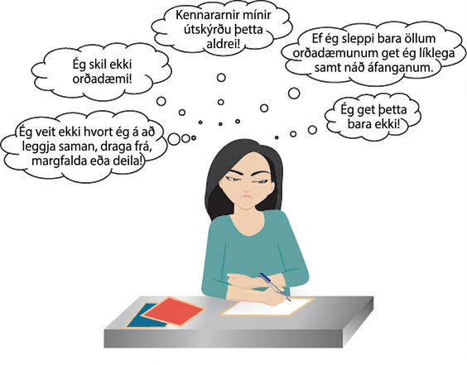
Mynd 9.2
Neikvæðar hugsanir um orðadæmi geta staðið í vegi fyrir árangri.
Notes:
A cartoon image of a girl with a sad expression writing on a piece of paper is shown. There are 5 thought bubbles. They read, “I don't know whether to add, subtract multiply, or divide!,” then “I don't understand word problems!,” then “My teachers never explained this!,” then “If I just skip all the word problems, I can probably still pass the class,” and lastly, “I just can't do this!”

Slide 6
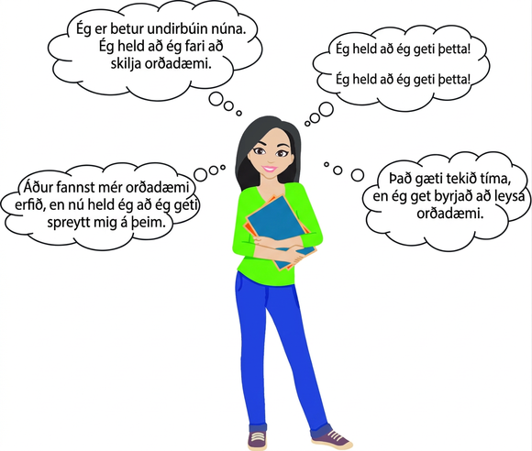
Mynd 9.3
Jákvætt hugarfar er stórt skref í átt að árangri við lausn orðadæma.
Notes:
A cartoon image of a girl with a confident expression holding some books is shown. There are 4 thought bubbles. They read, “While word problems were hard in the past, I think I can try them now,” then “I am better prepared now. I think I will begin to understand word problems,” then “I think I can! I think I can!,” and lastly, “It may take time, but I can begin to solve word problems.”

Slide 7
9.2 Leysum dæmi um peninga
Hæfniviðmið
Leysum orðadæmi um myntir
Leysum orðadæmi um miða og frímerki

Slide 8
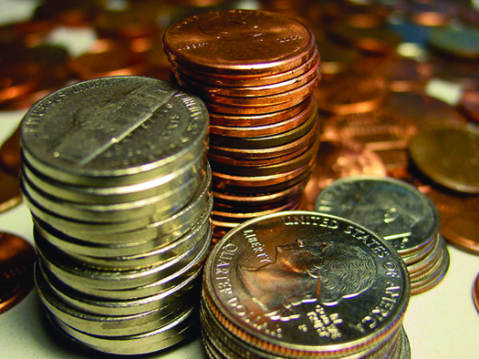
Mynd 9.4
Heildarverðmæti stafla af fimm senta myntum fæst með því að margfalda fjölda myntanna með verðmæti einnar myntar. (mynd: Darren Hester, ppdigital)
Notes:
An image of a large stack of pennies, a large stack of nickels, a shorter stack of dimes, and a stack of quarters is shown. There are several coins in the background.

Slide 9
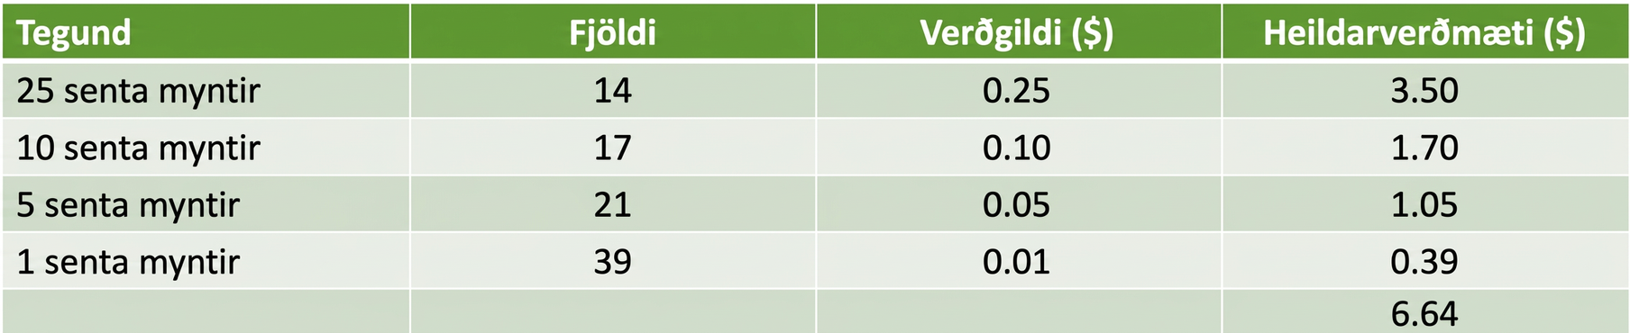
Tafla 9.1
Tegund | $$\text{Number}$$ | $$\text{Value}\text{ (\$)}$$ | $$\text{Total} \text{Value}\text{ (\$)}$$
25 senta myntir | $$14$$ | $$0.25$$ | $$3.50$$
10 senta myntir | $$17$$ | $$0.10$$ | $$1.70$$
5 senta myntir | $$21$$ | $$0.05$$ | $$1.05$$
1 senta myntir | $$39$$ | $$0.01$$ | $$0.39$$
 |  |  | $$6.64$$

Slide 10
Tafla 9.2
Tegund | Fjöldi | Verðmæti ($) | Heildarverðmæti

Slide 11
9.3 Notum eiginleika horna og þríhyrninga og reglu Pýþagórasar
Hæfniviðmið
Notum eiginleika horna
Notum eiginleika þríhyrninga
Notum reglu Pýþagórasar

Slide 12

Mynd 9.5
Myndin sýnir beina línu með ör á hvorum enda og punkt í miðjunni. Ör liggur frá annarri hlið punktsins yfir á hina og hornið er merkt 180 gráður.
Notes:
The image is a straight line with an arrow on each end. There is a dot in the center. There is an arrow pointing from one side of the dot to the other, and the angle is marked as 180 degrees.

Slide 13

Mynd 9.6
∠A er hornið með hornpunkt í punktinum A.
Notes:
The image is an angle made up of two rays. The angle is labeled with letter A.

Slide 14
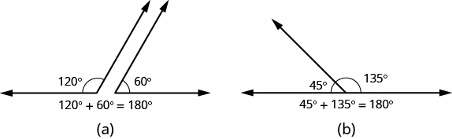
Mynd 9.7
Summa stærða grannhorna er 180°.
Notes:
Part a shows a 120 degree angle next to a 60 degree angle. Together, the angles form a straight line. Below the image, it reads 120 degrees plus 60 degrees equals 180 degrees. Part b shows a 45 degree angle attached to a 135 degree angle. Together, the angles form a straight line. Below the image, it reads 45 degrees plus 135 degrees equals 180 degrees.

Slide 15
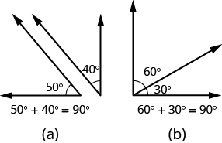
Mynd 9.8
Summa stærða fyllihorna er 90°.
Notes:
Part a shows a 50 degree angle next to a 40 degree angle. Together, the angles form a right angle. Below the image, it reads 50 degrees plus 40 degrees equals 90 degrees. Part b shows a 60 degree angle attached to a 30 degree angle. Together, the angles form a right angle. Below the image, it reads 60 degrees plus 30 degrees equals 90 degrees.

Slide 16
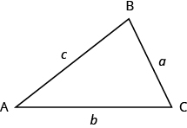
Mynd 9.9
ΔABC hefur hornpunktana A, B og C og hliðarnar a, b og c.
Notes:
The vertices of the triangle on the left are labeled A, B, and C. The sides are labeled a, b, and c.

Slide 17

Mynd 9.10
Myndin sýnir rétthyrndan þríhyrning. Rétta hornið er afmarkað með ferningi og merkt 90 gráður.
Notes:
A right triangle is shown. The right angle is marked with a box and labeled 90 degrees.

Slide 18
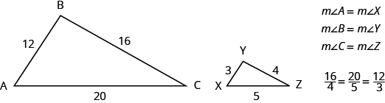
Mynd 9.11
ΔABC og ΔXYZ eru einslaga þríhyrningar. Hlutföll samsvarandi hliða eru jöfn og samsvarandi horn eru jafnstór.
Notes:
Two triangles are shown. They appear to be the same shape, but the triangle on the right is smaller. The vertices of the triangle on the left are labeled A, B, and C. The side across from A is labeled 16, the side across from B is labeled 20, and the side across from C is labeled 12. The vertices of the triangle on the right are labeled X, Y, and Z. The side across from X is labeled 4, the side across from Y is labeled 5, and the side across from Z is labeled 3. Beside the triangles, it says that the measure of angle A equals the measure of angle X, the measure of angle B equals the measure of angle Y, and the measure of angle C equals the measure of angle Z. Below this is the proportion 16 over 4 equals 20 over 5 equals 12 over 3.

Slide 19
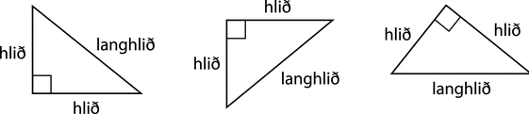
Mynd 9.12
Í rétthyrndum þríhyrningi nefnist hliðin á móti 90° horninu langhlið en hinar tvær hliðarnar nefnast skammhliðar.
Notes:
Three right triangles are shown. Each has a box representing the right angle. The first one has the right angle in the lower left corner, the next in the upper left corner, and the last one at the top. The two sides touching the right angle are labeled “leg” in each triangle. The sides across from the right angles are labeled “hypotenuse.”

Slide 20
9.4 Notum eiginleika rétthyrninga, þríhyrninga og trapisa
Námsmarkmið
Skilja lengdarmál, flatarmál og rúmmál
Nota eiginleika rétthyrninga
Nota eiginleika þríhyrninga
Nota eiginleika trapisa

Slide 21
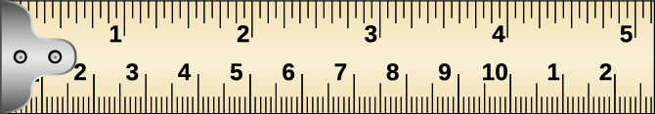
Mynd 9.13
Málbandið sýnir tommur efst og sentímetra neðst.
Notes:
A picture of a portion of a tape measure is shown. The top shows the numbers 1 through 5. The portion from the beginning to the 1 has a red circle and an arrow to a picture from 0 to 1 inch, with 1 sixteenth, 1 eighth, 3 eighths, 1 half, and 3 fourths labeled. Above this, it is labeled “Standard Measures.” The bottom of the tape measure shows the numbers 1 through 10, then 1 and 2. The region from the edge to about 3 and a half has a red circle with an arrow pointing to a picture from 0 to 3.5. It is labeled 0, 1 cm, 1.7 cm, 2.3 cm and 3.5 cm. Above this, it is labeled “Metric (S).”

Slide 22
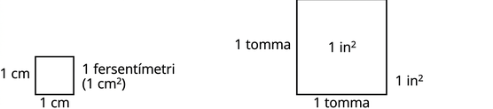
Mynd 9.14
Flatarmálseiningar eru ferningar með hliðar sem eru 1 lengdareining hver.
Notes:
Two squares are shown. The smaller one has sides labeled 1 cm and is 1 square centimeter. The larger one has sides labeled 1 inch and is 1 square inch.

Slide 23
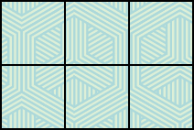
Mynd 9.15
Teppið skiptist í sex ferninga sem hver er 1 ferfet og er flatarmál þess því samtals 6 ferfet.
Notes:
A rectangle is shown. It has 3 squares across and 2 squares down, a total of 6 squares.

Slide 24
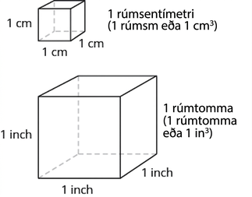
Mynd 9.16
Rúmmálseiningar eru teningar með brúnir sem eru 1 lengdareining hver.
Notes:
Two cubes are shown. The smaller one has sides labeled 1 cm and is labeled as 1 cubic centimeter. The larger one has sides labeled 1 inch and is labeled as 1 cubic inch.

Slide 25

Mynd 9.17
Teningur með 3 tommu langar brúnir er samsettur úr 27 teningum sem hafa 1 tommu langar brúnir og rúmmál hans er því 27 rúmtommur.
Notes:
A cube is shown, comprised of smaller cubes. Each side of the cube has 3 smaller cubes across, for a total of 27 smaller cubes.

Slide 26
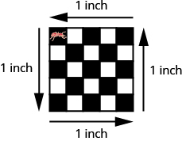
Mynd 9.18
Ummál = 4 tommur Flatarmál = 1 fertomma Þegar maurinn gengur allan hringinn eftir jaðri flísarinnar fylgir hann ummáli hennar. Flatarmál flísarinnar er 1 fertomma.
Notes:
A 5 square by 5 square checkerboard is shown with each side labeled 1 inch. An image of an ant is shown on the top left square.

Slide 27
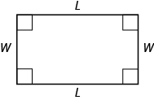
Mynd 9.19
Rétthyrningur hefur fjórar hliðar og fjögur rétt horn. Hliðarnar eru merktar L fyrir lengd og W fyrir breidd.
Notes:
A rectangle is shown. Each angle is marked with a square. The top and bottom are labeled L, the sides are labeled W.

Slide 28
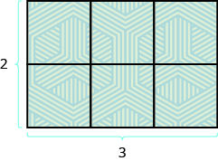
Mynd 9.20
Flatarmál þessa rétthyrnda teppis er 6 ferfet, það er lengdin margfölduð með breiddinni.
Notes:
A rectangle is shown. It is made up of 6 squares. The bottom is 2 squares across and marked as 2, the side is 3 squares long and marked as 3.

Slide 29

Mynd 9.21
Flatarmál rétthyrnings er grunnlínan, b, margfölduð með hæðinni, h.
Notes:
A rectangle is shown. The side is labeled h and the bottom is labeled b. The center says A equals bh.

Slide 30
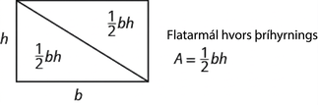
Mynd 9.22
Skipta má rétthyrningi í tvo þríhyrninga með sama flatarmál. Flatarmál hvors þríhyrnings er helmingur af flatarmáli rétthyrningsins.
Notes:
A rectangle is shown. A diagonal line is drawn from the upper left corner to the bottom right corner. The side of the rectangle is labeled h and the bottom is labeled b. Each triangle says one-half bh. To the right of the rectangle, it says “Area of each triangle,” and shows the equation A equals one-half bh.

Slide 31
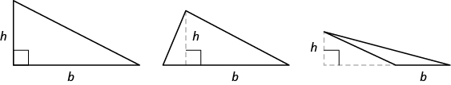
Mynd 9.23
Hæð þríhyrnings, h, er lengd línustriks sem liggur frá grunnlínunni að mótlæga hornpunktinum og myndar 90° horn við grunnlínuna.
Notes:
Three triangles are shown. The triangle on the left is a right triangle. The bottom is labeled b and the side is labeled h. The middle triangle is an acute triangle. The bottom is labeled b. There is a dotted line from the top vertex to the base of the triangle, forming a right angle with the base. That line is labeled h. The triangle on the right is an obtuse triangle. The bottom of the triangle is labeled b. The base has a dotted line extended out and forms a right angle with a dotted line to the top of the triangle. The vertical line is labeled h.

Slide 32
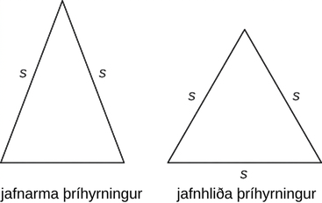
Mynd 9.24
Í jafnarma þríhyrningi eru tvær hliðar jafnlangar og þriðja hliðin er grunnlínan. Í jafnhliða þríhyrningi eru allar þrjár hliðarnar jafnlangar.
Notes:
Two triangles are shown. All three sides of the triangle on the left are labeled s. It is labeled “equilateral triangle”. Two sides of the triangle on the right are labeled s. It is labeled “isosceles triangle”.

Slide 33
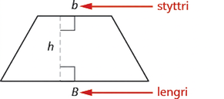
Mynd 9.25
Trapisa hefur lengri grunnlínu, B, og styttri grunnlínu, b. Hæðin h er fjarlægðin milli grunnlínanna.
Notes:
A trapezoid is shown. The top is labeled b and marked as the smaller base. The bottom is labeled B and marked as the larger base. A vertical line forms a right angle with both bases and is marked as h.

Slide 34
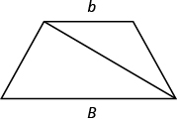
Mynd 9.26
Auðveldara getur verið að skilja flatarmálsformúlu trapisu ef henni er skipt í tvo þríhyrninga.
Notes:
An image of a trapezoid is shown. The top is labeled with a small b, the bottom with a big B. A diagonal is drawn in from the upper left corner to the bottom right corner.

Slide 35
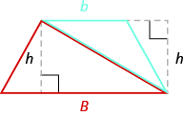
Mynd 9.27
Myndin sýnir trapisu. Efri grunnlínan er merkt með litlu b en sú neðri með stóru B. Hornalína liggur frá efra vinstra horninu að neðra hægra horninu. Ör vísar að annarri trapisu. Efri hægri hluti hennar myndar bláan þríhyrning og hæð trapisunnar er sýnd með punktalínu. Neðri vinstri hlutinn myndar rauðan þríhyrning og hæð trapisunnar er einnig sýnd með punktalínu.
Notes:
An image of a trapezoid is shown. The top is labeled with a small b, the bottom with a big B. A diagonal is drawn in from the upper left corner to the bottom right corner. There is an arrow pointing to a second trapezoid. The upper right-hand side of the trapezoid forms a blue triangle, with the height of the trapezoid drawn in as a dotted line. The lower left-hand side of the trapezoid forms a red triangle, with the height of the trapezoid drawn in as a dotted line.

Slide 36
9.5 Leysum rúmfræðidæmi: hringir og óreglulegar myndir
Námsmarkmið
Nota eiginleika hringa
Finna flatarmál óreglulegra mynda

Slide 37
9.6 Leysum rúmfræðidæmi: rúmmál og yfirborðsflatarmál
Námsmarkmið
Finna rúmmál og yfirborðsflatarmál ferstrendinga
Finna rúmmál og yfirborðsflatarmál kúlna
Finna rúmmál og yfirborðsflatarmál sívalninga
Finna rúmmál keilna

Slide 38

Mynd 9.28
Þessi trékassi er í laginu eins og ferstrendingur.
Notes:
This is an image of a wooden crate.

Slide 39
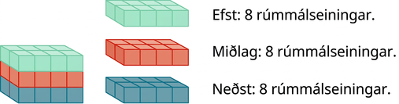
Mynd 9.29
Með því að skipta ferstrendingi í lög er auðveldara að sjá hve margar rúmmálseiningar hann inniheldur. Þessi ferstrendingur, sem er 4 sinnum 2 sinnum 3, inniheldur 24 rúmmálseiningar.
Notes:
A rectangular solid is shown. Each layer is composed of 8 cubes, measuring 2 by 4. The top layer is pink. The middle layer is orange. The bottom layer is green. Beside this is an image of the top layer that says “The top layer has 8 cubic units.” The orange layer is shown and says “The middle layer has 8 cubic units.” The green layer is shown and says, “The bottom layer has 8 cubic units.”

Slide 40
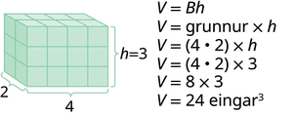
Mynd 9.30
Myndin sýnir ferstrending sem er samsettur úr teningum. Málin eru merkt 2 sinnum 4 sinnum 3. Við hlið ferstrendingsins stendur V jafnt og Bh. Þar fyrir neðan stendur V jafnt og grunnflötur sinnum hæð. Undir grunnfleti stendur innan sviga 4 sinnum 2. Í næstu línu stendur V jafnt og, innan sviga, 4 sinnum 2, sinnum 3. Þar fyrir neðan stendur V jafnt og 8 sinnum 3 og loks V jafnt og 24 rúmmálseiningar.
Notes:
An image of a rectangular solid is shown. It is made up of cubes. It is labeled as 2 by 4 by 3. Beside the solid is V equals Bh. Below this is V equals Base times height. Below Base is parentheses 4 times 2. The next line says V equals parentheses 4 times 2 times 3. Below that is V equals 8 times 3, then V equals 24 cubic units.

Slide 41
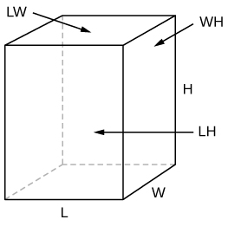
Mynd 9.31
Á móti hverjum fleti ferstrendingsins sem snýr að þér er annar flötur á gagnstæðri hlið. Fletirnir eru alls 6.
Notes:
A rectangular solid is shown. The sides are labeled L, W, and H. One face is labeled LW and another is labeled WH.

Slide 42
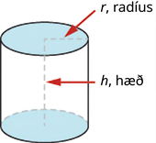
Mynd 9.32
Sívalningur hefur tvo jafnstóra hringlaga grunnfleti. Hæðin er fjarlægðin milli grunnflatanna.
Notes:
An image of a cylinder is shown. There is a red arrow pointing to the radius of the top labeling it r, radius. There is a red arrow pointing to the height of the cylinder labeling it h, height.

Slide 43
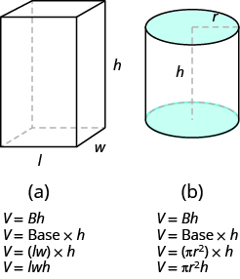
Mynd 9.33
Auðveldara getur verið að skilja rúmmálsformúlu sívalnings með því að skoða hvað sívalningur og ferstrendingur eiga sameiginlegt.
Notes:
In (a), a rectangular solid is shown. The sides are labeled L, W, and H. Below this is V equals capital Bh, then V equals Base times h, then V equals parentheses lw times h, then V equals lwh. In (b), a cylinder is shown. The radius of the top is labeled r, the height is labeled h. Below this is V equals capital Bh, then V equals Base times h, then V equals parentheses pi r squared times h, then V equals pi times r squared times h.

Slide 44
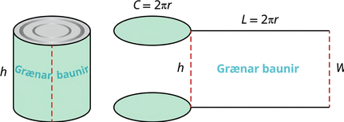
Mynd 9.34
Þegar miðinn á niðursuðudós er klipptur og flattur út sést að hliðaryfirborð sívalnings er rétthyrningur. Lengd rétthyrningsins er jöfn ummáli grunnflatar sívalningsins og breiddin er jöfn hæð hans.
Notes:
A cylindrical can of green beans is shown. The height is labeled h. Beside this are pictures of circles for the top and bottom of the can and a rectangle for the other portion of the can. Above the circles is C equals 2 times pi times r. The top of the rectangle says l equals 2 times pi times r. The left side of the rectangle is labeled h, the right side is labeled w.

Slide 45
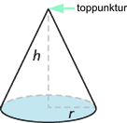
Mynd 9.35
Hæð keilu er fjarlægðin milli grunnflatar hennar og topppunkts.
Notes:
An image of a cone is shown. The top is labeled vertex. The height is labeled h. The radius of the base is labeled r.

Slide 46
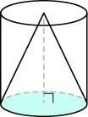
Mynd 9.36
Rúmmál keilu er minna en rúmmál sívalnings með sama grunnflöt og sömu hæð.
Notes:
An image of a cone is shown. There is a cylinder drawn around it.

Slide 47
9.7 Einangrun tiltekinnar breytu í formúlu
Námsmarkmið
Nota formúluna fyrir vegalengd, hraða og tíma
Einangra tiltekna breytu í formúlu

Slide 48
Notkunarleyfi
Þetta viðbótarefni OpenStax er © Rice University og gefið út samkvæmt alþjóðlega CC BY-NC-SA 4.0 notkunarleyfinu. Heimilt er að afrita það eða breyta því, en aðeins í tilgangi sem ekki er viðskiptalegs eðlis. Tilgreina verður OpenStax og Rice University sem rétthafa og geta allra breytinga. Öllum aðlöguðum útgáfum verður að deila með sams konar notkunarleyfi.

