Slide 1


Psychology 2e
Chapter 2 PSYCHOLOGICAL RESEARCH
PowerPoint Image Slideshow

Slide 2
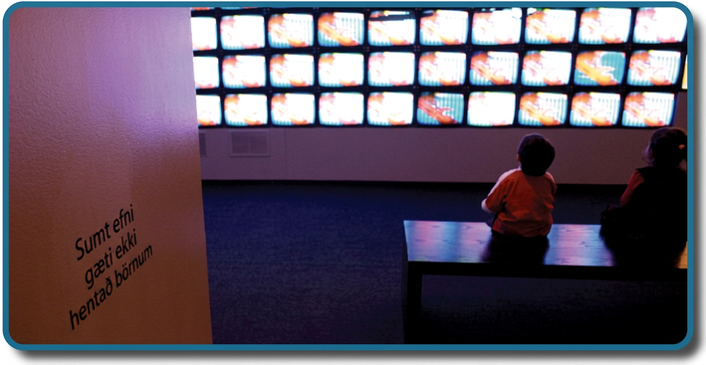
How does television content impact children’s behavior? (credit: modification of work by “antisocialtory”/Flickr)

Slide 3

Why is research important?
At one time in history, people believed the earth was flat and that mental illnesses were caused by possession.
People can be very wrong in their ideas about the world when they do not rely on evidence to support their claims.
Research is a mandatory process in validating claims.
Scientific research is empirical; it is grounded in objective, tangible evidence that can be observed time and time again, regardless of who is observing.
Without research, we would only have intuition and groundless assumptions.
Through research we are able to prove certain ideas through study and testing.
Psychology is a science, therefore, research is required to not only further investigate something but provide verification and support of the findings.
Figure 2.2 Some of our ancestors, across the world and over the centuries, believed that trephination—the practice of making a hole in the skull, as shown here—allowed evil spirits to leave the body, thus, curing mental illness and other disorders. (credit: “taiproject”/Flickr)

Slide 4

Use of research information
Advertising campaigns often claim to be based on “scientific evidence” when in reality it is based off of belief.
Thinking critically about claims:
What is the expertise of the person making the claim?
What might they gain if the claim is valid?
Does the claim seem justified given the evidence?
What do other researchers think of the claim?

Slide 5
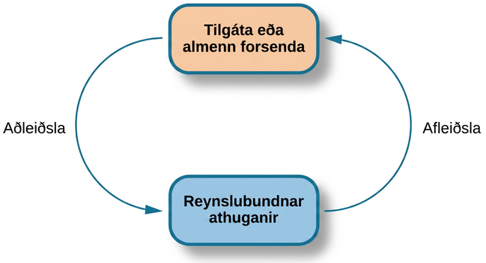
The process of scientific research:
Inductive vs Deductive reasoning
Deductive reasoning - results are predicted based on a general premise.
All living things require energy to survive (premise), ducks are living things, therefore ducks require energy to survive (conclusion).
Inductive reasoning - conclusions are drawn from observations.
You see many fruit growing on trees and therefore assume all fruit grows on trees.
Scientists form ideas (theories/hypotheses) through deductive reasoning.
Hypotheses are then tested through empirical observations and scientists form conclusions through inductive reasoning.
These conclusions lead to new theories and hypotheses (or more broad generalizations).
Psychological research relies on both inductive and deductive reasoning.

Slide 6
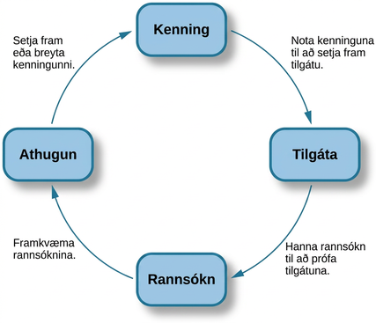
The scientific method
Scientists use inductive reasoning to form theories which then generate hypotheses.
Theory – well-developed set of ideas that propose an explanation for observed phenomena.
Hypothesis – tentative and testable statement (prediction) about the relationship between two or more variables.
Predicts how the world will behave if the theory is correct.
Usually an “if-then” statement.
Is falsifiable (capable of being shown to be incorrect).
The scientific method of research includes proposing hypotheses, conducting research, and creating or modifying theories based on results.

Slide 7
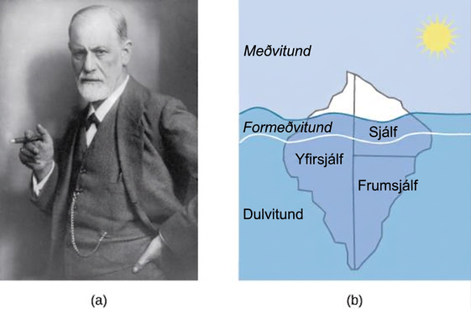
Figure 2.6
Many of the specifics of (a) Freud's theories, such as (b) his division of the mind into id, ego, and superego, have fallen out of favor in recent decades because they are not falsifiable. In broader strokes, his views set the stage for much of psychological thinking today, such as the unconscious nature of the majority of psychological processes.

Slide 8
2.2 Approaches to research
Clinical or case studies
Naturalistic Observation
Surveys
Archival Research
Longitudinal and Cross-Sectional Research

Slide 9
Clinical or case studies
Clinical or case studies focus on one individual.
The studied individual is typically in a extreme or unique psychological circumstance that differentiates them for the general public.
Allows for a lot of insight into a case.
Difficult to generalize results to the larger population.
Example: Genie
Genie was studied by psychologists after she was found at age 13, having suffered severe abuse and social isolation. Psychologists were interested in the effect social isolation had on her development.
(Credit: Captive Humans)

Slide 10

Figure 2.7
Observation of behavior in its natural setting.
Naturalistic behavior is generally hidden under scrutiny or observation.
Seeing a police car behind you would probably affect your driving behavior.
To study the most accurate and genuine behaviors, naturalistic observation has proven most effective.
Through naturalistic observations, any feeling of performance or anxiety of the studied individuals is eliminated.
Observer bias - when observations may be skewed to align with observer expectations.
Establishment of clear criteria to observe should help eliminate observer bias.
Seeing a police car behind you would probably affect your driving behavior. (credit: Michael Gil)

Slide 11
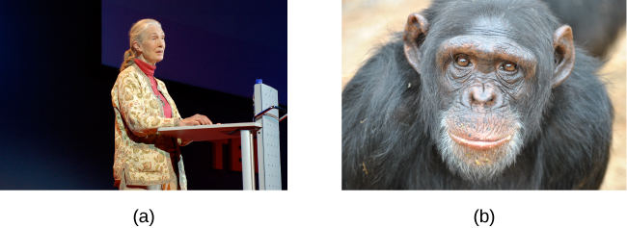
Figure 2.8
Jane Goodall made a career of conducting naturalistic observations of
chimpanzee behavior. (credit “Jane Goodall”: modification of work by Erik Hersman; “chimpanzee”: modification of work by “Afrika Force”/Flickr.com)

Slide 12
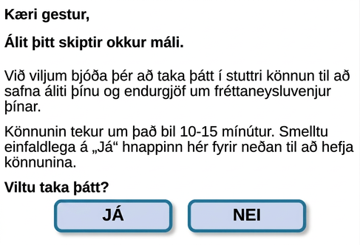
surveys
A list of questions that can be delivered in many ways:
Paper-and-pencil
Electronically
Verbally
Surveys can be used to gather a large amount of data from a sample (subset of individuals) from a larger population.
Surveys can be administered in a number of ways, including electronically administered research, like the survey shown here. (credit: Robert Nyman)

Slide 13
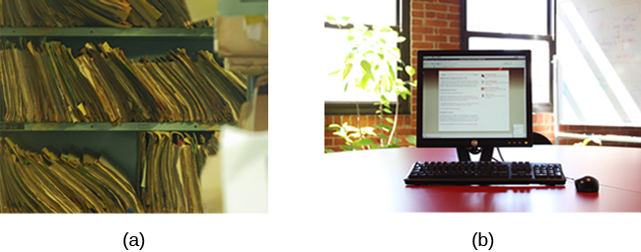
Archival research
Uses past records or data sets to answer various research questions, or to search for interesting patterns or relationships.
A researcher doing archival research examines records, whether archived as a (a) hardcopy or (b) electronically. (credit “paper files”: modification of work by “Newtown graffiti”/Flickr; “computer”: modification of work by INPIVIC Family/Flickr)

Slide 14
Longitudinal and Cross-Sectional
Research
Cross-Sectional Research – Compares multiple segments of a population at a single time (such as different age groups).
Longitudinal - Studies in which the same group of individuals is surveyed or measured repeatedly over an extended period of time.
Researchers often expect some participants to drop out, particularly in this type of study and therefore often initially recruit a lot of participants.
Attrition - reduction in number of research participants as some drop out of the study over time.
Longitudinal research like the CPS-3 help us to better understand how smoking is associated with cancer and other diseases. (credit: CDC/Debora Cartagena)

Slide 15
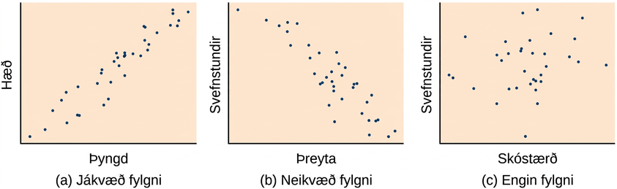
Correlational research
Correlation – Relationship between two or more variables; when two variables are correlated, one variable changes as the other does.
Correlation Coefficient - number from -1 to +1, indicating the strength and direction of the relationship between variables, and usually represents by r.
Positive Correlation – Two variables change in the same direction, both becoming either larger or smaller.
Negative Correlation - two variables change in different directions, with one becoming larger as the other becomes smaller; a negative correlation is not the same thing as no correlation.
Scatterplots are a graphical view of the strength and direction of correlations. The stronger the correlation, the closer the data points are to a straight line.

Slide 16
Correlation does not indicate causation
Cause-and-effect relationship - changes in one variable cause the changes in the other variable; can be determined only through an experimental research design.
Confounding variable - unanticipated outside factor that affects both variables of interest, often giving the false impression that changes in one variable causes changes in the other variable..
Example:
As ice-cream sales increase, so does the overall rate in crime.
A relationship exists between ice-cream and crime but is it correlation or does one cause the other?
In this example, temperature is a confounding variable. As the temperature increases, ice-cream sales increase and people are more likely to be outside increasing crime rates.

Slide 17

Correlation does not indicate causation
Does eating cereal really cause someone to be a healthy weight? (credit: Tim Skillern)

Slide 18
Illusory correlations
As well as mistaking correlation for causation, people can also make false correlations.
Illusory Correlations - Seeing relationships between two things when in reality no such relationship exists.
Confirmation bias - tendency to ignore evidence that disproves ideas or beliefs.
Illusory correlations can be involved in the formation of prejudicial attitudes that can lead to discriminatory behavior.
Many people believe that a full moon makes people behave oddly. Research demonstrates that this relationship does not exist.
Many people believe that a full moon makes people behave oddly. (credit: Cory Zanker)

Slide 19
Causality: conducting experiments
& using the data
The only way to establish that there is a cause-and-effect relationship between two variables is to conduct a scientific experiment.
A scientific experiment has precise requirements for design and implementation.
THE EXPERIMENTAL HYPOTHESIS
Hypotheses can be formulated through:
Observation
After review of previous research

Slide 20
Designing an experiment
EXPERIMENTAL AND CONTROL GROUPS
Experimental group - The participants that experience the manipulated variable (group designed to answer the research question).
Control group - Participants that do not experience the manipulated variable.
Serve as a basis for comparison and controls for chance factors that might influence the results of the study
Experimental manipulation is the only difference between the experimental and control groups, so any differences between the two are due to experimental manipulation rather than chance.
DEFINING VARIABLES AND HOW THEY WILL BE MEASURED
Operational definition - description of what actions and operations will be used to measure the dependent variables and manipulate the independent variables.

Slide 21
Designing an experiment
AVOIDING BIAS AND THE PLACEBO EFFECT
Experimenter bias - researcher expectations skew the results of the study.
Participant bias – participant expectations skew the results of the study.
Single-blind study - experiment in which the researcher knows which participants are in the experimental group and which are in the control group but participants do not. (Controls for participant expectations).
Double-blind Study - experiment in which both the researchers and the participants are blind to group assignments. (Controls for both participant and experimenter expectations).
Placebo effect - people’s expectations or beliefs influencing or determining their experience in a given situation.
When people are given a pill to improve their mood their mood may increase just because they believe it will.
To know if a medication is really having an effect or whether it us a placebo effect, the experimental group receive the medication and the control group receive a placebo treatment (a sugar pill). This is a double-blind study.
Any differences between the groups will be due to the medication.

Slide 22
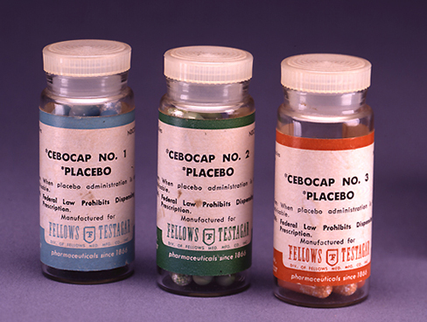
Figure 2.16
Providing the control group with a placebo treatment protects against bias caused by expectancy. (credit: Elaine and Arthur Shapiro)

Slide 23
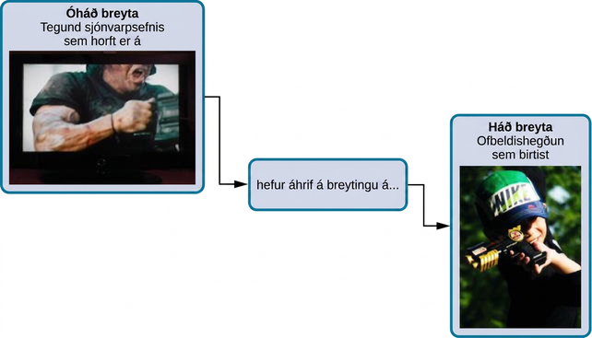
variables
Independent Variable – Variable that is influenced/controlled by the experimenter. Ideally this should be the only important difference between the experimental and control group.
Dependent Variable – Variable that the researcher measures to see how much effect the independent variable had.
In an experiment, manipulations of the independent variable are expected to result in changes in the dependent variable. (credit “automatic weapon”: modification of work by Daniel Oines; credit “toy gun”: modification of work by Emran Kassim)

Slide 24
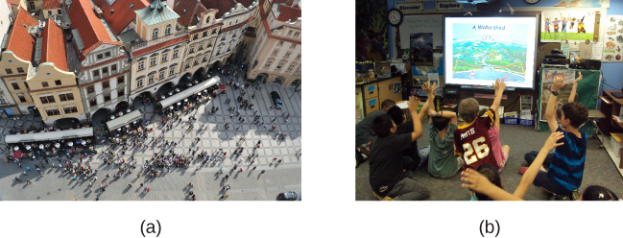
Selecting participants
Participants – Subjects of psychological research.
Populations are too large for a researcher to include everyone so samples are used.
Sample - subset of individuals selected from the larger population.
Population – overall group of individuals that the researcher is interested in (e.g. College students).
Random Sample - subset of a larger population in which every member of the population has an equal chance of being selected.
This form of sampling is preferred because it is more likely that the selected participants will be representative of the larger population (sex, ethnicity, social economic status etc).
Researchers may work with (a) a large population or (b) a sample group that is a subset of the larger population. (credit “crowd”: modification of work by James Cridland; credit “students”: modification of work by Laurie Sullivan)

Slide 25
assigning participants TO GROUPS: eXPERIMENTAL OR CONTROL
Random Assignment – Method of experimental group assignment in which all participants have an equal chance of being assigned to either group.
Can be achieved using statistical software or by simply flipping a coin.
Prevents systematic differences between groups such as gender or age.
Without random assignment, an experiment cannot find a true cause-and-effect relationship. Any relationship could be due to preexisting differences between the groups.
Random assignment helps to avoid preexisting systematic differences so that any significant differences between groups can be said to be the result of the manipulation.

Slide 26
Issues to consider
MANIPULATING VARIABLES
As stated, random assignment is required to state causation. Once randomly assigned, each group is then manipulated in some way. However, some experimental designs are more complicated.
Example: The effect of sex (male/female) on spatial memory.
Sex (independent variable) cannot be manipulated.
Males and females cannot be randomly assigned.
This kind of an experiment is therefore called quasi-experimental.
A cause-and-effect relationship cannot be determined from this type of experiment.
ETHICS
Some questions cannot be answered using an experimental design because they would be unethical.
Example: The effect of experiencing abuse as a child on levels of self-esteem.
You cannot randomly assign participants to receive abuse.
This would need to be studied using other approaches such as case studies or surveys.

Slide 27
Interpreting experimental findings
Once data has been collected, a statistical analysis is conducted.
Statistical analysis - determines how likely any difference between experimental groups is due to chance.
Psychologists usually discuss results as significant or non-significant.
If the odds that the differences occurred by chance are 5% or less, then the results are significant.
A true experiment, including random assignment, manipulation of the independent variable and control of extraneous variables reduce the odds of results occurring by chance.

Slide 28
Reporting findings
Research is usually reported in scientific journals.
Usually aimed at an audience of professionals/scholars.
Articles published are peer-reviewed journal articles.
Peer-reviewed journal article – article read by several other scientists (usually anonymously) with expertise in the subject matter, who provide feedback regarding the quality of the manuscript before it is accepted for publication.
Helps to weed out poorly conceived or executed studies.
Improves articles with suggested revisions.
Determines whether the research is described clearly enough to be replicated by other researchers.
Replication:
Determines reliability of original research design.
Can include additional measures that expand on the original findings.
Provide more evidence to support the original finding or to cast doubt on those findings.

Slide 29
Bad science & Retraction:
The vaccine-autism myth
Many peer-reviewed publications published research making claims that routine childhood vaccines cause some children to develop autism.
Since these reports, large-scale research was carried out suggesting that vaccinations are not responsible for causing autism.
Many of the original studies have since been retracted.
It was found that the leading research in the original study had a financial interest in establishing a link between childhood vaccines and autism.
Unfortunately the initial claims were publicized and many people still think vaccinations cause autism.

Slide 30
Reliability and validity
Reliability - consistency and reproducibility of a given result.
Would the same test give the same results every time?
Do the instruments/tools used to collect data do so in consistent, reproducible ways?
When a study involves observations by multiple people, it is important that they all make observations and record them in the same way.
  Inter-rater reliability - measure of agreement among observers on how they record and classify a particular event.
A reliable, consistent measurement does not always meant that it is measuring something correctly.
Validity - accuracy of a given result in measuring what it is designed to measure.
Does a test measure what it is meant to measure?
A valid measure is always reliable but a reliable measure is not always valid.

Slide 31

Ethics: research involving human participants
Research involving human participants must adhere to strict guidelines.
Institutional Review Board (IRB) – Committee of administrators, scientists, and community members that reviews proposals for research involving human participants.
Exist at any research institution that receives federal support for research involving human participants.
Generally, IRB must approve research proposal before it can proceed.
Informed consent - process of informing a research participant about what to expect during an experiment and then obtaining the person’s consent to participate. Includes:
Potential risks involved
Implications of the research
Notification that participation is voluntary
Notification that any data collected will be kept confidential
An institution’s IRB meets regularly to review experimental proposals that involve human participants. (credit: modification of work by Lowndes Area Knowledge Exchange (LAKE)/Flickr)

Slide 32
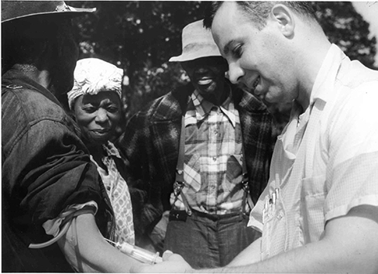
Deception
Sometimes deception is necessary to prevent the participant’s knowledge of the research question affecting the results as long as it is not considered harmful.
Deception – Purposely misleading experiment participants in order to maintain the integrity of the experiment.
Debriefing - when an experiment involved deception, participants are told complete and truthful information about the experiment at its conclusion.
The Tuskegee Syphilis study
Ethical guidelines have not always existed.
In 1932, participants were recruited in an experiment studying syphilis in black men.
Participants that tested positive were not informed that they had the disease.
Although no cure existed at the beginning of the study, a cure was found in 1947 (penicillin), but it was not administered to participants.
Many participants unknowingly spread the disease and many died.
A participant in the Tuskegee Syphilis Study receives an injection.

Slide 33
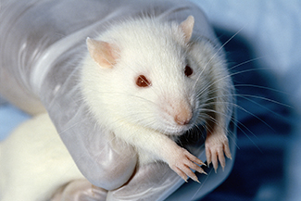
Ethics:
Research involving animal subjects
90% of psychological research involving animal subjects uses rodents or birds.
Animals make good substitutes because many of their basic processes are sufficiently similar to those in humans.
Animals are used when the research would be unethical in human participants.
Researchers must still aim to minimize pain or distress.
Institutional Animal Care and Use Committee (IACUC) - committee of administrators, scientists, veterinarians, and community members that reviews proposals for research involving non-human animals.
Rats, like the one shown here, often serve as the subjects of animal research.

