Slide 1


Psychology 2e
Chapter 1 INTRODUCTION TO PSYCHOLOGY
PowerPoint Image Slideshow

Slide 2

What Is psychology
Psychology is the scientific study of mind and behavior. (credit "background": modification of work by Nattachai Noogure; credit "top left": modification of work by U.S. Navy; credit "top middle-left": modification of work by Peter Shanks; credit "top middle-right": modification of work by "devinf"/Flickr; credit "top right": modification of work by Alejandra Quintero Sinisterra; credit "bottom left": modification of work by Gabriel Rocha; credit "bottom middle-left”: modification of work by Caleb Roenigk; credit "bottom middle-right": modification of work by Staffan Scherz; credit "bottom right": modification of work by Czech Provincial Reconstruction Team)

Slide 3

What is psychology
Antonio Canova's sculpture depicts Eros and Psyche.

Slide 4
What is psychology?
Psych – Soul
Ology – Scientific study of
Psychology – Scientific study of the mind and behavior.
Psychologists study everything about the human experience from the basic workings of the human brain to consciousness, memory, language, reasoning, personality and mental health.

Slide 5
hISTORY OF PSYCHOLOGY
Psychological perspectives
Structuralism – understanding the conscious experience through introspection.
Wilhelm Wundt
Functionalism – focused on how mental activities helped an organism adapt to its environment.
William James
Psychoanalytic Theory – focuses on the role of the unconscious in affecting conscious behavior.
Sigmund Freud
Gestalt Psychology – Focuses on humans as a whole rather than individual parts.
Wertheimer, Koffka, Kohler
Behaviorism – focuses on observing and controlling behavior.
Pavlov, Watson, Skinner
Humanism - emphasizes the potential for good that is innate to all humans.
Abraham Maslow and Carl Rogers

Slide 6
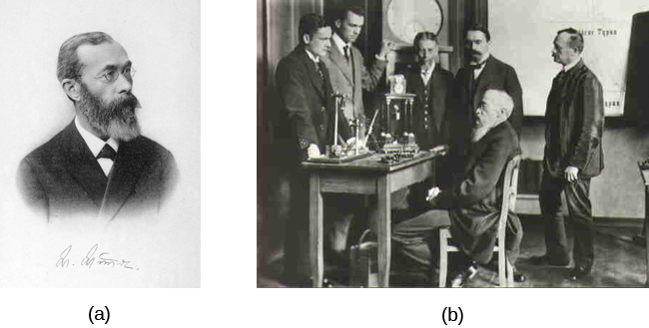
wILHELM WUNDT (structuralism)
Wilhelm Wundt is credited as one of the founders of psychology. He created the first laboratory for psychological research.
Wundt emphasized structuralism. He focused on understanding the structure and characteristics of the mind through introspection.
Introspection - Process by which someone examines their own conscious experience in an attempt to break it into its component parts

Slide 7
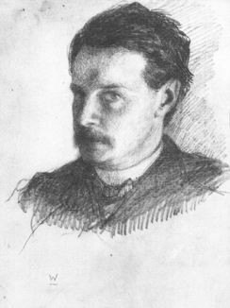
WILLIAM JAMES (functionalism)
William James, shown here in a self-portrait, was the first American psychologist.
James drew from the functionality of cognitive processes, establishing functionalism.
Functionalism - emphasized how mental activities contributed to basic environmental survival.

Slide 8
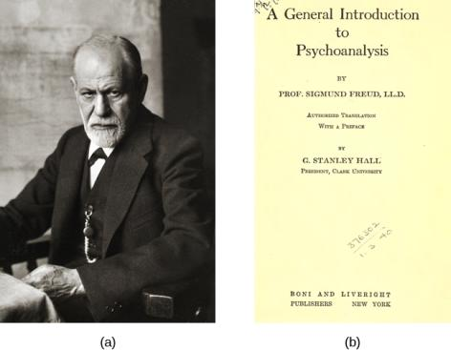
SIGMUND FREUD
Sigmund Freud was a highly influential figure in the history of psychology.
One of his many books, A General Introduction to Psychoanalysis, shared his ideas about psychoanalytical therapy; it was published in 1922.

Slide 9
SIGMUND FREUD
(psychoanalytic theory)
Founded Psychoanalytic theory, a perspective which dominated clinical psychology for many decades.
Studied “hysteria” and neurosis.
Theorized that many of his patients’ problems arose from the unconscious mind.
Believed that one way the unconscious mind could be accessed was through dream analysis.
Psychoanalytic theory focuses on the role of a person’s unconscious and early childhood experiences.
Freud’s Couch (credit: BBC)

Slide 10
Gestalt psychology
Kohler, Koffka and Wertheimer were German psychologists who immigrated to the U.S. to escape Nazi Germany.
Gestalt – “Whole”
Based on the idea that although a sensory experience can be broken down into individual parts, how those parts relate to each other as a whole is often what the individual responds to in perception.
Ideas of Gestalt continue to influence research on sensation and perception.
Kohler, Koffka, Wertheimer (credit: Elearning Industry)

Slide 11
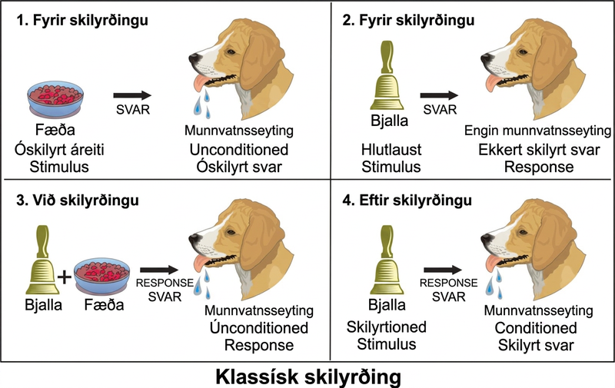
IVAN PAVLOV (CLASSICAL CONDITIONING)
Discovered the concept of classical conditioning.
Studied conditioned reflexes in which an animal produced a reflex (unconscious) response to a stimulus (salivating in the presence of food) and, over time, was conditioned to produce the response to a different stimulus (salivating to the sound of a bell) that the experimenter associated with the original stimulus (Food and bell became associated).
(Credit: Emaze)

Slide 12

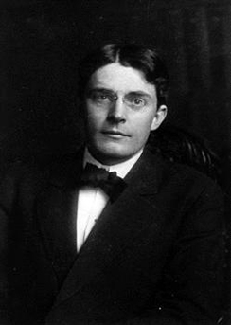
John b. watson (BEHAVIORISM)
John B. Watson is known as the father of behaviorism within psychology.
Believed that objective analysis of the mind was impossible.
Instead he focused on observable behavior and ways to bring that behavior under control.
Today, behaviorism is used in behavioral and cognitive-behavioral therapy.

Slide 13
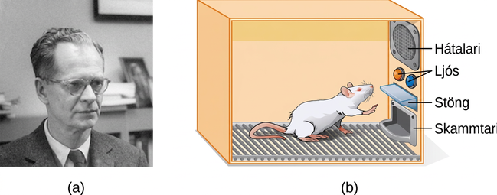
B. F. Skinner
Concentrated on how behavior was affected by its consequences.
Studied the principles of modifying behavior through reinforcement and punishment which he saw as major factors in driving behavior (operant conditioning).

Slide 14
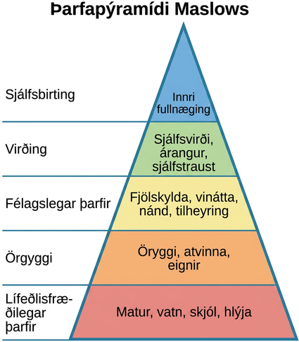
ABRAHAM MASLOW (humanism)
Proposed a hierarchy of human needs in motivating behavior.
Maslow asserted that so long as basic needs necessary for survival were met (e.g., food, water, shelter), higher-level needs (e.g., social needs) would begin to motivate behavior.

Slide 15
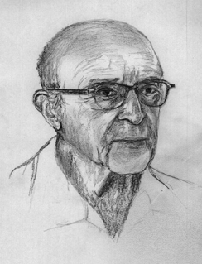
CARL ROGERS (humanism)
Carl Rogers developed a client-centered therapy method that has been influential in clinical settings.
Client-centered therapy involves the patient taking a lead role in the therapy session.
Rogers believed therapists need:
unconditional positive regard
genuineness
empathy
(credit: "Didius"/Wikimedia Commons)

Slide 16
The cognitive Revolution
By the 1950’s, new disciplinary perspectives in linguistics, neuroscience, and computer science were emerging.
The mind became the new focus of scientific inquiry.
Noam Chomsky
Noam Chomsky was very influential in beginning the cognitive revolution.
He believed psychology needed to incorporate mental functioning into its focus in order to fully understand human behavior.

Slide 17
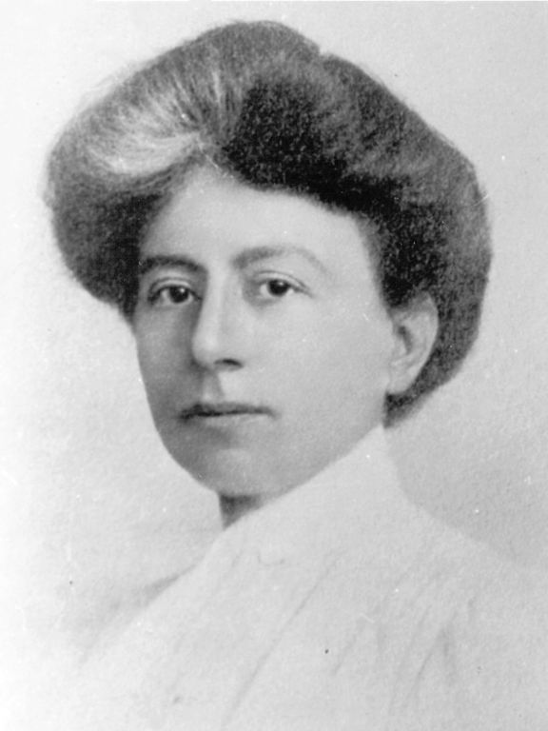
Margaret Floy Washburn
First woman to earn a doctorate in Psychology
Researched on animal behavior, and published an authoritative text on the subject.

Slide 18
Contemporary psychology
Branches of psychology
Biopsychology and Evolutionary Psychology
Sensation and Perception
Cognitive Psychology
Developmental Psychology
Personality Psychology
Social Psychology
Health Psychology
Industrial-Organizational Psychology
Sports and Exercise Psychology
Clinical Psychology
Forensic Psychology

Slide 19
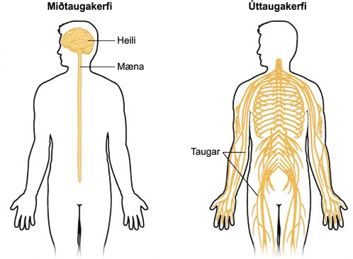
biopsychology
Biological psychologists study how the structure and function of the nervous system generate behavior.
Research can include:
Sensory and motor systems
Sleep
Drug use and abuse
Ingestive behavior
Reproductive behavior
Neurodevelopment
Plasticity of the nervous system
Biological correlates of psychological disorders

Slide 20
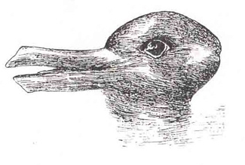
Sensation and perception
This area of study focuses on both physiological aspects of sensory systems and the psychological experience of sensory information.
Sensation – Sensory information (sights, sounds, touch, smell).
Perception – Experience of the world which is influenced by where we focus our attention, our previous experiences, and our cultural backgrounds.
When you look at this image, you may see a duck or a rabbit. The sensory information remains the same, but your perception can vary dramatically.

Slide 21
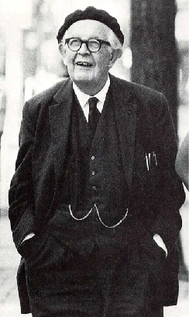
dEVELOPMENTAL PSYCHOLOGY
Developmental psychology studies the physical and mental attributes of aging and maturation.
This can include various skills that are acquired throughout growth.
Moral Reasoning
Cognitive Skills
Social Skills
Jean Piaget is famous for his theories regarding changes in cognitive ability that occur as we move from infancy to adulthood.

Slide 22
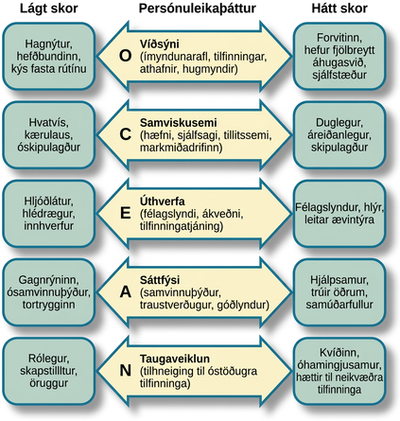
Personality psychology
Focuses on behaviors and thought patterns that are unique to each individual.
Studies in this field include conscious and unconscious thinking and identifying personality traits.
FIVE FACTOR MODEL Figure 1.14
Each of the dimensions of the Five Factor model is shown in this figure.
The provided description would describe someone who scored highly on that given dimension. Someone with a lower score on a given dimension could be described in opposite terms.

Slide 23
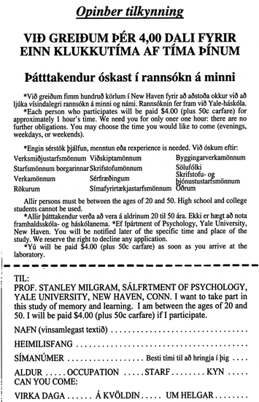
Social psychology
How individuals interact and relate with others and how such interactions can affect behavior.
Prejudice
Attraction
Interpersonal conflicts
Obedience

Slide 24
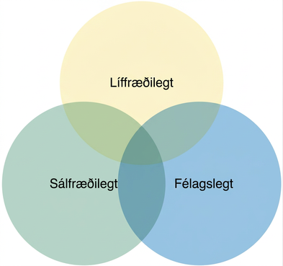
Health psychology
Branch that focuses on how individual health is directly related or affected by biological, psychological, and sociocultural influences.
The biopsychosocial model suggests that health/illness is determined by an interaction of these three factors.

Slide 25
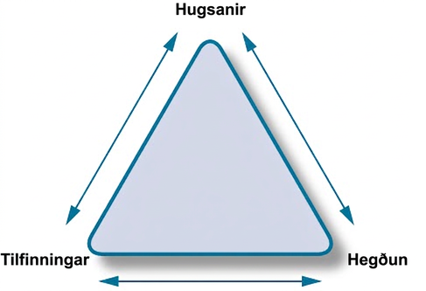
Clinical psychology
Focuses on diagnosis and treatment of psychological disorders and problematic patterns of behavior.
Study involves clinical therapy and counseling.
Cognitive-behavioral therapists take cognitive processes and behaviors into account when providing psychotherapy. This is one of several strategies that may be used by practicing clinical psychologists.

Slide 26
Industrial-organizational
Branch that applies psychological theories, principles and research to industrial and organizational settings.
Involves issues related to personnel management, organizational structure and workplace environment.
SPORTS & EXERCISE PSYCHOLOGY
Focus on psychological aspects regarding sports and physical performance.
Study includes motivation, performance related anxiety, and general mental well being.
FORENSIC PSYCHOLOGY
Branch of psychology dealing with justice system.
Tasks of Forensic Psychologists include assessment of individuals' mental competency to stand in trial, sentencing and treatment suggestions, and advisement regarding eyewitness testimonies.
This field of psychology requires a strong understanding of the legal system.

Slide 27
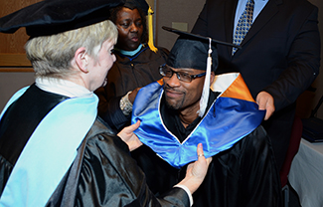
Careers in psychology
Most careers in psychology require a PhD or a Masters degree.
A few career options:
Teaching
Research
Clinical psychologist
Counseling psychologist
Social Work
Corporate and Marketing jobs
Doctoral degrees are generally conferred in formal ceremonies involving special attire and rites. (credit: Public Affairs Office Fort Wainwright)

Slide 28
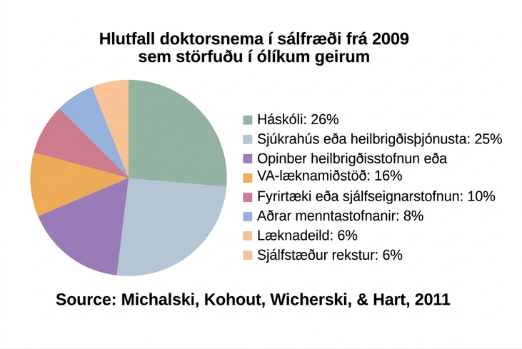
Employment in different sectors
Individuals earning a PhD in psychology have a range of employment options.

Slide 29
Job opportunities
Top Occupations Employing Graduates with a BA in Psychology (Fogg, Harrington, Harrington, & Shatkin, 2012)
Ranking | Occupation
1 | Mid- and top-level management (executive, administrator)
2 | Sales
3 | Social work
4 | Other management positions
5 | Human resources (personnel, training)
6 | Other administrative positions
7 | Insurance, real estate, business
8 | Marketing and sales
9 | Healthcare (nurse, pharmacist, therapist)
10 | Finance (accountant, auditor)

