Slide 1


PSYCHOLOGY 2e
Chapter 9 LIFESPAN DEVELOPMENT
PowerPoint Image Slideshow

Slide 2

LIFESPAN DEVELOPMENT
(credit: modification of work by Giles Cook)
Lifespan development studies how you change as well as how you remain the same over the course of your life.

Slide 3
WHAT IS LIFESPAN DEVELOPMENT?
Developmental psychologists study lifelong development across three domains:
Physical development – growth and changes in the body and brain, senses, motor skills, and health and wellness.
Cognitive development – learning, attention, memory, language, thinking, reasoning and creativity.
Psychosocial development – emotions, personality and social relationships.
Normative approach
What is “normal” development?”
Normative psychologists have studied large numbers of children to determine norms (average ages) of when most children reach specific developmental milestones (e.g. crawling, walking, speaking in sentences, starting puberty).
Biological milestones such as starting puberty are universal.
Social milestones such as starting school vary across cultures.

Slide 4
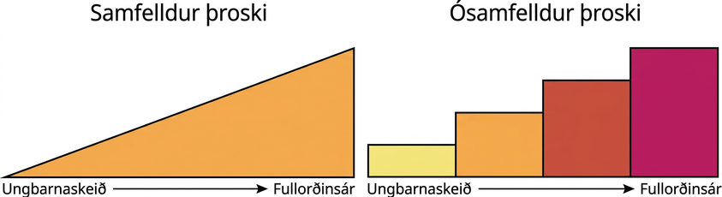
CONTINUOUS V DISCONTINUOUS
DEVELOPMENT
Developmental psychologists have different views on the process of lifespan development.
Continuous development – views development as a cumulative process, gradually improving on existing skills.
E.g. Adding inches to height each year.
Discontinuous development – views development as occurring in unique stages (specific times or ages).

Slide 5
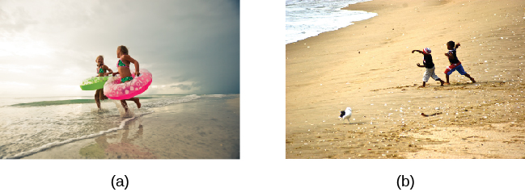
IS THERE ONE COURSE OF DEVELOPMENT
OR MANY?
Is development universal for all children or is it individual, depending on each child’s genetics and environment?
Stage theories believe that the process of development is universal.
Evidence for one course - Studies show that children from all around the world reach language milestones in a similar sequence.
Evidence for many courses - Cultural differences in child care practices – different practices can accelerate or inhibit achievement of developmental milestones.
All children across the world love to play. Whether in (a) Florida or (b) South Africa, children enjoy exploring sand, sunshine, and the sea.
(credit a: modification of work by “Visit St. Pete/Clearwater”/Flickr; credit b: modification of work by “stringer_bel”/Flickr)

Slide 6

NATURE V NURTURE
Nature – biology and genetics.
Nurture – environment and culture.
The nature vs nurture debate considers how our personalities and traits are the result of our genetics and biological factors, and how they are shaped by our environment.
Why are siblings sometimes so different?
Are adopted children more like their biological or adopted parents?
Is intelligence inherited, is it shaped by our learning experiences or is it a combination of both?
These questions can be answered by looking at the interaction between both nature and nurture, usually in twin and adoption studies.
Both nature and nurture are important in development but psychologists debate the relative contributions of each.
(Credit: Psychrod)

Slide 7

THEORIES OF DEVELOPMENT
PSYCHOSEXUAL THEORY
PYCHOSOCIAL THEORY
COGNITIVE THEORY
THEORY OF MORAL DEVELOPMENT

Slide 8
PSYCHOSEXUAL THEORY (FREUD)
Sigmund Freud:
Believed that childhood experiences shape our personalities and behavior as adults.
Viewed development as discontinuous.
Developed stages of psychosexual development.
Believed lack of proper nurturance and parenting during a stage could lead to a child becoming stuck/fixated in that stage.
Claimed that children’s pleasure-seeking urges are focused on different erogenous zones at each of the 5 stages of development.
Oral
Anal
Phallic
Latency
Genital

Slide 9
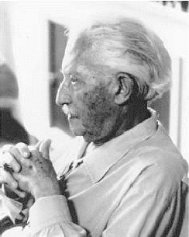
PSYCHOSOCIAL THEORY (ERIKSON)
Erik Erikson
Emphasizes the social nature of development.
Argues that personality development takes place across the lifespan, not just in childhood.
Based on his belief that social interactions affect our sense of self (ego identity).
In each stage of Erikson’s theory, there is a psychosocial task that we must master in order to feel a sense of competence.
8 Stages.

Slide 10
ERIKSON’S PSYCHOSOCIAL STAGES OF DEVELOPMENT
1 | Trust vs. mistrust | 0-1 years | Trust (or mistrust) that basic needs, such as nourishment and affection, will be met.
2 | Autonomy vs shame/doubt | 1-3 years | Develop a sense of independence in many tasks.
3 | Initiative vs guilt | 3-6 years | Take initiative on some activities - may develop guilt when unsuccessful or boundaries overstepped.
4 | Industry vs inferiority | 7-11 years | Develop self-confidence in abilities when competent or sense of inferiority when not.
5 | Identity vs confusion | 12-18 years | Experiment with and develop identity and roles.
6 | Intimacy vs isolation | 19-29 years | Establish intimacy and relationships with others.
7 | Generativity vs stagnation | 30-64 years | Contribute to society and be part of a family.
8 | Integrity vs despair | 65+ | Assess and make sense of life and meaning of contributions.

Slide 11
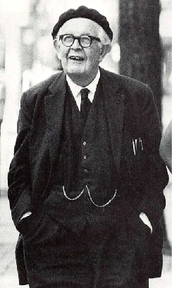
COGNITIVE THEORY (PIAGET)
Piaget
Focused on children’s cognitive growth and theorized that cognitive abilities develop through specific stages.
Piaget believed children develop schemata (concepts used to categorize and interpret information) to help them understand the world.
When children learn new information they adjust their schemata through assimilation and accommodation.
Assimilation – incorporates information into existing schemata.
Accommodation – Change schemata based on new information.

Slide 12
PIAGET’S STAGES OF COGNITIVE DEVELOPMENT
Age (Yrs) | Stage | Description | Developmental issues
0-2 | Sensorimotor | World experienced through senses and actions. | Object permanence – understanding that even if something’s out of sight, it still exists Stranger anxiety
2-6 | Preoperational | Use words and images to represent things, but lack logical reasoning. | Pretend play Egocentrism – unable to take the perspective of others. Language development
7-11 | Concrete operational | Understand concrete events and analogies logically; perform arithmetical operations. | Conversation Mathematical transformations
12+ | Formal operational | Formal operations. Utilize abstract reasoning. | Abstract logic Moral reasoning

Slide 13
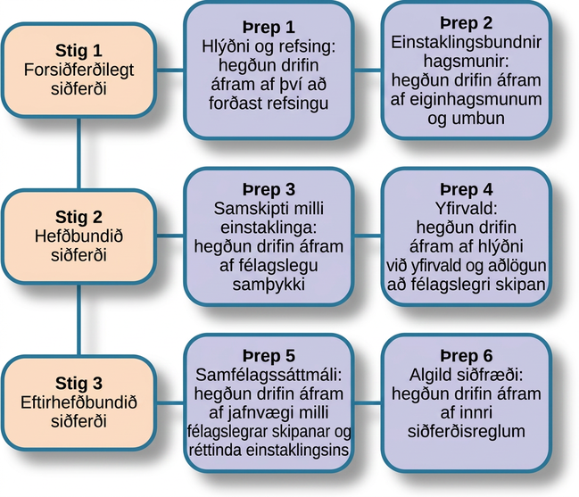
THEORY OF MORAL DEVELOPMENT
(KOHLBERG)
Lawrence Kohlberg identified 3 stages of moral development (learning to discern right from wrong).

Slide 14
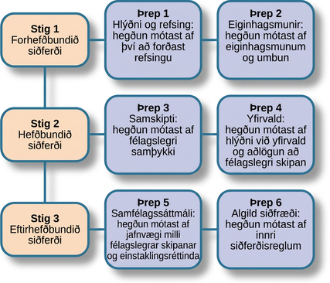
Figure 9.6
Kohlberg identified three levels of moral reasoning: pre-conventional, conventional, and post-conventional: Each level is associated with increasingly complex stages of moral development.

Slide 15
STAGES OF DEVELOPMENT
PRENATAL
INFANCY THROUGH CHILDHOOD
ADOLESCENCE
EMERGING ADULTHOOD
ADULTHOOD

Slide 16
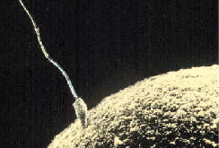
PRENATAL DEVELOPMENT
Germinal Stage (Weeks 1-2)
Conception occurs when sperm fertilizes an egg and forms a zygote (one-cell structure).
Mitosis – process of cell division.
The zygote divides and cells become more specialized, forming organs and body parts.
Figure 9.7 Sperm and ovum fuse at the point of conception.
Embryonic Stage (Weeks 3-8)
After the zygote has 150 cells it travels down the fallopian tubes and implants itself in the lining of the uterus.
The zygote is now an embryo (multi-cellular organism).
Organs begin to function (heart begins to beat).
Basic structures develop that will become the head, chest and abdomen.
Placenta – structure connected to the uterus that provides nourishment and oxygen from the mother to the embryo via the umbilical cord.

Slide 17
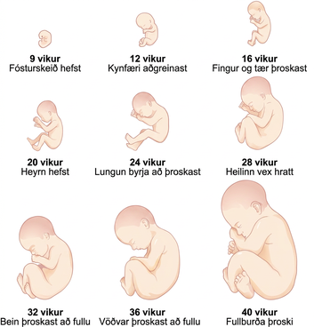
PRENATAL DEVELOPMENT
Fetal Stage (Weeks 9-40)
During the fetal stage, the baby's brain develops and the body adds size and weight, until the fetus reaches full-term development.

Slide 18
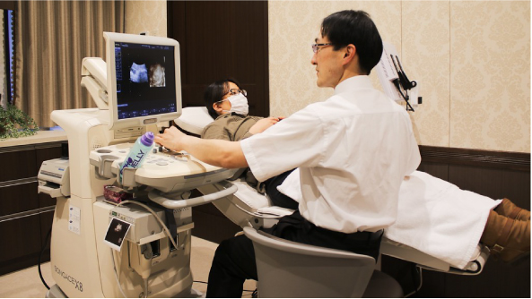
PRENATAL INFLUENCES
Genetic and environmental factors can affect development during each prenatal stage.
It is important for the mother to receive prenatal care, (medical care during pregnancy), to monitor the health of the mother and fetus.
Teratogen – any environmental agent (biological, chemical, or physical) that causes damage to the developing embryo or fetus.
Alcohol – can cause fetal-alcohol syndrome.
Smoking – can result in premature birth, low-birth weight, stillbirths, sudden infant death syndrome.
Drugs – heroine, cocaine, methamphetamine as well as prescription drugs.
Radiation, viruses (e.g., HIV, Herpes, Rubella).
(credit: "MIKI Yoshihito_Flickr"/Flickr)

Slide 19
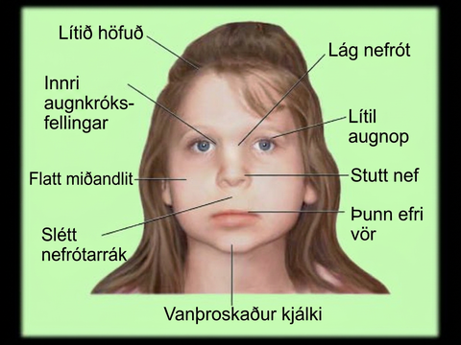
PRENATAL INFLUENCES:
FETAL-ALCOHOL SYNDROME
Collection of birth defects associated with heavy consumption of alcohol during pregnancy.
Research has found alcohol to be the leading preventable cause of mental retardation in children in the U.S.
Physical:
Small head size.
Abnormal facial features.
Cognitive:
Poor judgement.
Poor impulse control.
Higher rates of ADHD.
Learning issues.
Lower IQ scores.
(Credit: Fetal Alcohol Syndrome, Youtube)

Slide 20
NEWBORNS
Newborn reflexes – inborn automatic responses to particular forms of stimulation (help the newborn survive).
Rooting reflex – baby turns its head towards something that touches its cheek.
Sucking reflex – suck on objects placed by the mouth.
Grasping reflex – cling to objects placed in hands.
Moro reflex – baby spreads arms and pulls them back in when they are startled/feel like they are falling.
Sensory abilities:
Not yet fully developed at birth.
Vision is the least developed sense.
Prefer human voices, specifically their mothers over a stranger’s.
Can distinguish between the smell of their mother and others.

Slide 21
PHYSICAL DEVELOPMENT
Growth
Occurs rapidly during infancy.
Slows down at around ages 4-6.
Girls have a growth spurt at age 8/9 – about 12.
Nervous System
Blooming period - neural pathways form thousands of new connections during infancy and toddlerhood.
Pruning period – neural connections are reduced during childhood and adolescence to allow the brain to function more efficiently.
Size of the brain increases rapidly (especially the frontal lobe duirng ages 3-6).
55% of adult size at age 2, 90% of adult size at age 6.
Motor Development
Motor skills – ability to move our bodies and manipulate objects.
Occurs in an orderly sequence – becomes more advanced.
Fine motor skills – focus on the muscles in our fingers, toes, and eyes, and enable coordination of small actions (e.g., gripping a pencil).
Gross motor skills – focus on large muscle groups that control arms and legs and involve larger movements (e.g., balancing, running).

Slide 22
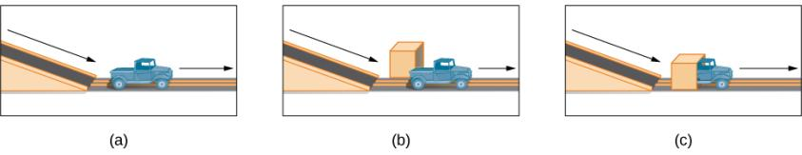
COGNITIVE DEVELOPMENT
Piaget thought that children’s ability to understand objects developed slowly as a child matures and interacts with the environment.
Today, developmental psychologists think Piaget was incorrect.
Baillargeon (1987):
Very young children understand objects and how they work long before they have experience with those objects.
In Baillargeon’s study, infants observed a truck (a) roll down an unobstructed track, (b) roll down an unobstructed track with an obstruction (box) beside it, and (c) roll down and pass through what appeared to be an obstruction.
Infants spent more time looking at (c) suggesting that they knew solid objects cannot pass through each other.

Slide 23
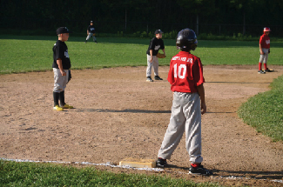
COGNITIVE DEVELOPMENT
Cognitive Milestones
6-9 months – can shake their head “no”.
9-12 months – respond to verbal requests (e.g., wave bye-bye).
8 months - understand object permanence.
Toddlers – understand someone will come back when they leave the room, will look in appropriate places when asked to find objects.
Because they understand luck and fairness, children in middle and late childhood (6–11 years old) are able to follow rules for games.
(credit: Edwin Martinez)
3-5 years – learn to count, name colors, know their name and age, can make small decisions, understand basic time concepts and sequencing, enjoy pretend play (can think symbolically), become more curious (always asking ”why?”), develop theory of mind.
6-11 years – Thinking becomes more logical and organized, understand past, present, and future, can plan and work towards goals, understand cause-and-effect relationships, basic math skills.
Attention span is limited until approximately age 11.

Slide 24
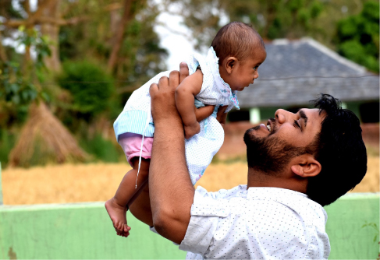
PSYCHOSOCIAL DEVELOPMENT:
ATTACHMENT
Psychosocial development occurs as children form relationships, interact with others, and understand and manage their feelings.
Attachment
Attachment – a long-standing connection or bond with others.
Forming health attachments is one of the main psychosocial milestones of infancy.
How do parent and infant attachment bonds form?
How does neglect affect these bonds?
What accounts for children’s attachment differences?
The most influential studies conducted to answer these questions were by Harry Harlow, John Bowlby and Mary Ainsworth.
Mutually enjoyable interactions promote the mother-infant bond. (credit: "balouriarajesh_Pixabay"/Pixabay)

Slide 25
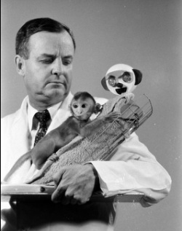
PSYCHOSOCIAL DEVELOPMENT:
ATTACHMENT
Harlow
Separated newborn monkeys from their mothers and presented them with two surrogate mothers.
  One made out of wire mesh, could dispense milk.
  One made from cloth, did not dispense milk.
Monkeys spent time clinging to the cloth monkey and only went to the wire monkey for food.
Results suggest that feelings of comfort and security are the critical components to maternal-infant bonding.
(Credit: Harlow’s Monkey experiments – Mr McNabb)

Slide 26
PSYCHOSOCIAL DEVELOPMENT:
ATTACHMENT
Bowlby (Attachment Theory)
Defined attachment as the affectional bond/tie that an infant forms with the mother.
Bond must be made with primary care giver in order to have normal social and emotional development.
Saw attachment as an all-or-nothing process.
Secure base – parental presence that gives the child a sense of safety as he explores his surroundings.
Requirements for a healthy attachment:
Caregiver must be responsive to the child’s physical, social, and emotional needs.
The caregiver and child must engage in mutually enjoyable interactions.

Slide 27
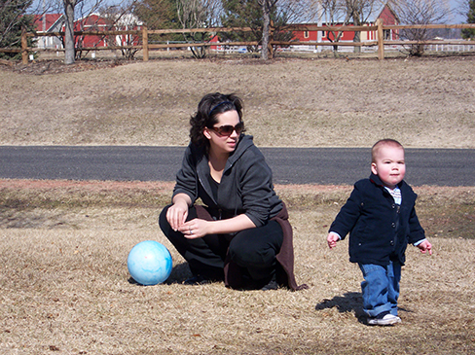
PSYCHOSOCIAL DEVELOPMENT:
ATTACHMENT
Mary Ainsworth (1970)
Do children differ in the way they bond, and if so, why?
Ainsworth looked to answer this question through a procedure known as the Strange Situation.
Strange Situation:
Mother (caregiver) and infant are placed in a room together, with toys.
Stranger enters the room and mother leaves.
After a few minutes, mother returns to the room to comfort the child.
Through the Strange Situation, Ainsworth identified 3 styles of attachment. A fourth was later identified.
Secure 3. Resistant
Avoidant 4. Disorganized
(credit: Kerry Ceszyk)

Slide 28
PSYCHOSOCIAL DEVELOPMENT:
ATTACHMENT
Secure – child uses the parent as a secure base from which to explore.
Child was distressed when mother left, happy to see them when they returned.
Common when caregivers are sensitive and responsive to needs.
Avoidant – unresponsive to parent, does not use the parent as a secure base, and does not care if parent leaves.
Child was slow to show positive reaction when mother returned.
Common when caregivers are insensitive and inattentive to needs.
Resistant – show clingy behavior, but then reject mothers attempts to interact with them.
Child did not explore the toys, became extremely disturbed and angry when mother left, were difficult to comfort when mother returned.
Common when caregiver is inconsistent with level of response.
Disorganized – show odd behavior around caregiver.
Behaved oddly when mother left (froze/ran around erratically), tried to run away when mother returned.
Common when child has been abused.

Slide 29
PSYCHOSOCIAL DEVELOPMENT:
SELF-CONCEPT
Self-Concept (Self-Awareness)
Development of a positive sense of self is the main psychosocial milestone of childhood.
Children with a positive self-concept tend to be more confident, more independent, do better in school and are more willing to try new activities.
By 18 months a baby can recognize themselves in the mirror.
By 24-46 months they can recognize themselves in a photo.
Self-Concept & Social Behavior
Children display increased social behavior after establishing a self-concept.
Age 2-4:
Enjoy playing with other children.
Can label themselves as boy or girl - through play, children explore and come to understand gender roles
Age 4:
Can cooperate and share.
Can initiate tasks and carry out plans.
Age 6:
Can identify themselves in terms of group membership.

Slide 30
PSYCHOSOCIAL DEVELOPMENT:
PARENTING STYLES
The development of a healthy self-concept can depend on parenting styles.
Baumrind (1971)
Authoritative style – parents give children reasonable demands and consistent limits, express warmth and affection, and listen to the child’s point of view.
Authoritarian style – parents place a high value on conformity and obedience, are often rigid, and express little warmth to the child.
Permissive style – parents make few demands and rarely use punishment.
Uninvolved style – parents are indifferent, uninvolved, and sometimes referred to as neglectful; they don’t respond to the child’s needs and make relatively few demands.

Slide 31
PSYCHOSOCIAL DEVELOPMENT:
TEMPERAMENT
Parenting style can depend on the temperament of a child.
Temperament – innate traits that influence how one thinks, behaves, and reacts with the environment.
Easy temperament – positive emotions, adapt well to change, and capable of regulating emotions.
More likely to elicit warm and responsive parenting.
Difficult temperament – negative emotions, difficulty adapting to change and regulating emotions.
More likely to evoke irritation and cause parents to withdraw.

Slide 32

Adolescence
Peers are a primary influence on our development in adolescence.
(credit: "manseok_Pixabay"/ Pixabay)

Slide 33

PHYSICAL DEVELOPMENT
Puberty
Adrenarche – maturing of the adrenal glands.
Gonadarche – maturing of the sex glands.
Secondary sexual characteristics develop.
Breasts and hips in girls.
Facial hair and deepened voice in boys.
Menarche – beginning of menstrual periods (usually around 12-13 years old).
Spermarche – first ejaculation (around 13-14 years old).
Growth spurts in both sexes.
Girls reach their adult height by 16.
Boys reach their adult height by 17.
(Credit: Puberty – Evolving Sciences)

Slide 34
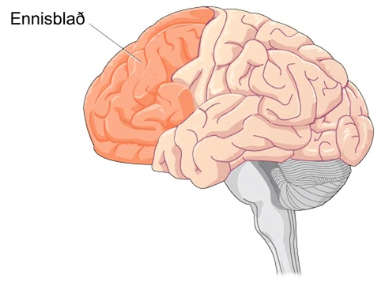
PHYSICAL DEVELOPMENT
Brain growth continues into the early 20s. The development of the frontal lobe, in particular, is important during this stage.
The frontal lobe is responsible for judgement, impulse control, and planning.
May explain why adolescents engage in increased risk-taking behaviors and emotional outbursts.

Slide 35
COGNITIVE DEVELOPMENT
Teenage thinking is characterized by the ability to reason logically and solve hypothetical problems such as how to design, plan, and build a structure.
Some researchers believe this is due to an increase in mental capacity (development of new skills).
Some researchers believe this is due to increases in processing speed and efficiency (improvements to existing skills).
Cognitive Empathy (theory of mind) – the ability to take the perspective of others and feel concern for others.
Increases in adolescence.
An important part of social problem solving and conflict avoidance.

Slide 36
PSYCHOSOCIAL DEVELOPMENT
Adolescents refine their sense of self as they relate to others.
Who am I?
Who do I want to be?
May adopt the values and roles that parents expect for them.
May develop identities that are in opposition to their parents but align with a peer group.
Peer relationships become a central focus in adolescents’ lives.
According to Erikson, adolescents are in the identity vs role confusion stage. Teens may experiment while they figure out their identity.
Parent-Child Relationships
Warm, healthy parent-child relationships have been associated with:
Better grades.
Fewer school behavior problems.

Slide 37
EMERGING ADULTHOOD
Emerging adulthood is a relatively newly defined period of lifespan development.
18 years to mid 20s.
Identity exploration is focused on work and love.
Why are people taking longer to grow up?
Product of Western culture and current times.
People are living longer allowing them extra time to start a career and family.
Higher levels of education are required for careers.
Higher cultural value placed on taking time to explore options.

Slide 38

ADULTHOOD: PHYSICAL DEVELOPMENT
Early Adulthood (20s-40s): Physical abilities are at their peak.
Middle Adulthood (40s-60s):
Physical decline is gradual.
Skin loses elasticity (wrinkles form).
Visual acuity decreases.
Women experience menopause.
Men and women both tend to gain weight.
Hair begins to thin and turn gray.
Late Adulthood (60s +):
Skin continues to lose elasticity.
Reaction time slows further.
Muscle strength diminishes.
Smell, taste, hearing, vision decline.
Physical declines of middle and late adulthood can be minimized with proper exercise, nutrition, and an active lifestyle.
(credit: modification of work by Peter Stevens)

Slide 39
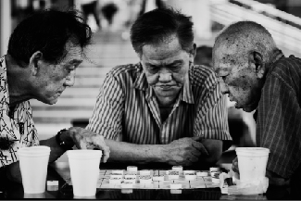
COGNITIVE DEVELOPMENT
Cognitive abilities remain steady throughout early and middle adulthood.
Crystalized intelligence (information, skills, and strategies gathered through experience) remains steady or improves.
Fluid intelligence (information processing abilities, reasoning, and memory) begins to decline.
Cognitive activities such as playing mahjong, chess, or other games, can keep you mentally fit and delay cognitive decline. The same is true for solo pastimes like reading and completing crossword puzzles.
(credit: Philippe Put)

Slide 40

PSYCHOSOCIAL DEVELOPMENT
Theorists believe that as we age we need to continue to have meaning in our lives. Many adults define themselves by their job, or relationships with family.
Employment and Well-Being
Job satisfaction is closely tied to work that:
Involves contact with other people.
Is interesting.
Provides opportunities for advancement.
Allows some independence.
Relationships and Well-Being
Positive influences on well-being include:
Having a stable marriage.
Having children (initially stressful but rewarding later).
Socioemotional selectivity theory – as we get older, our social support and friendships dwindle in number, but remain as close, if not more close than in our earlier years.
(credit: Gabriel Rocha)

Slide 41
DEATH AND DYING
Culture and individual backgrounds influence how we view death.
Elizabeth Kubler-Ross (1969)
5 stages of grief:
Denial
Anger
Bargaining
Depression
Acceptance

Slide 42
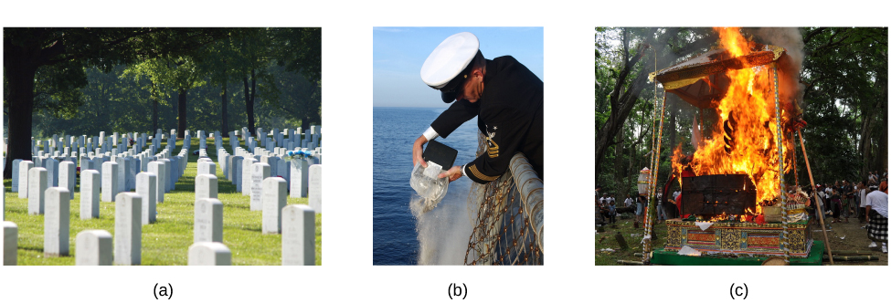
DEATH AND DYING
Different cultures, societies, and religions have varying practices surrounding death.
For example, people’s bodies may be (a) buried in a cemetery, (b) cremated and buried at sea as in this U.S. Navy ceremony, or (c) cremated such as in this Hindu ceremony in Bali.
(credit a: modification of work by Christina Rutz; credit b: modification of work by Chief Journalist Alan J. Baribeau/Wikimedia; credit c: modification of work by "CazzJj_Flickr"/Flickr)

