Slide 1


PSYCHOLOGY 2e
Chapter 8 MEMORY
PowerPoint Image Slideshow

Slide 2
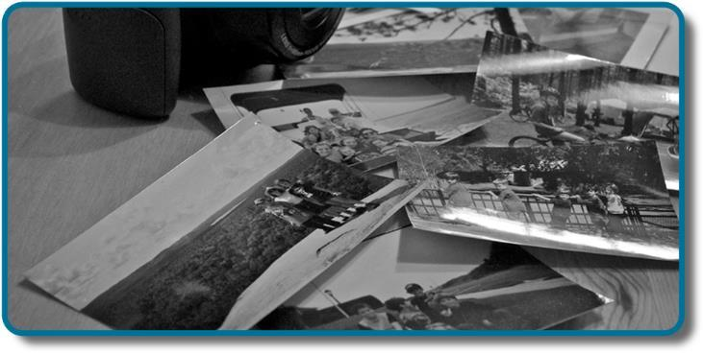
MEMORY
The study of memory looks at some of the following questions:
How do we process and store information?
Are there different types of memory?
How do we retrieve memories?
Why do we forget?
Photographs can trigger our memories and bring past experiences back to life. (credit: modification of work by Cory Zanker)

Slide 3
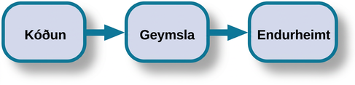
HOW MEMORY FUNCTIONS
Memory is an information processing system like a computer. It is a set of processes used to encode, store and retrieve information over different periods of time.
Encoding involves the input of information into the memory system.
Storage is the retention of the encoded information.
Retrieval, is getting the information out of memory and back into awareness.

Slide 4
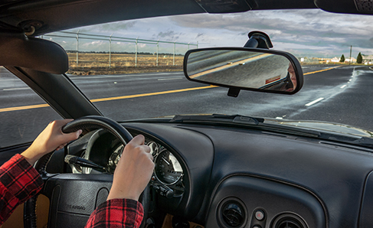
ENCODING
When the brain receives information from the environment it:
Labels/codes it.
Organizes it with other similar information.
Connects new concepts to existing concepts.
Encoding occurs through 2 types of processing:
Automatic processing – encoding of details like time, space, frequency, and the meaning of words.
Usually done without conscious awareness.
E.g. remembering WHEN you last studied.
Effortful processing – encoding of details that takes time and effort.
E.g. WHAT you last studied, learning new skills.
When you first learn new skills such as driving a car, you have to put forth effort and attention to encode information about driving. Once you know how to drive, you can encode additional information about this skill automatically.
(credit: Robert Couse-Baker)

Slide 5
TYPES OF ENCODING
Semantic encoding – encoding of words and their meanings.
Most effective form of encoding. Attaching meaning to information makes it easier to recall later.
Involves a deeper level of processing.
Visual encoding – encoding of images.
Words that create a mental image, such as car, dog and book (concrete words) are easier to recall than words such as level, truth and value (abstract words).
Acoustic encoding – encoding of sounds.
Self-reference effect – the tendency for an individual to have better memory for information that relates to oneself in comparison to material that has less personal relevance.

Slide 6
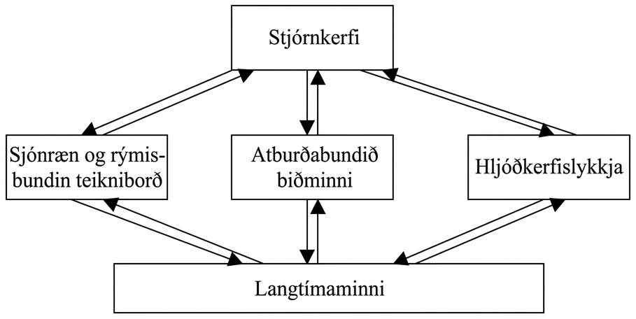
STORAGE: BADDELEY & HITCH MODEL
Baddeley and Hitch proposed a model of storage where short-term memory has different forms depending on the type of information received.
Storing memories is like opening different files on a computer and adding information.
3 short-term systems:
Visuospatial sketchpad
Episodic buffer
Phonological loop.
According to the model, a central executive supervises the flow of information between the systems.
(Credit: mercercognitivepsychology)

Slide 7
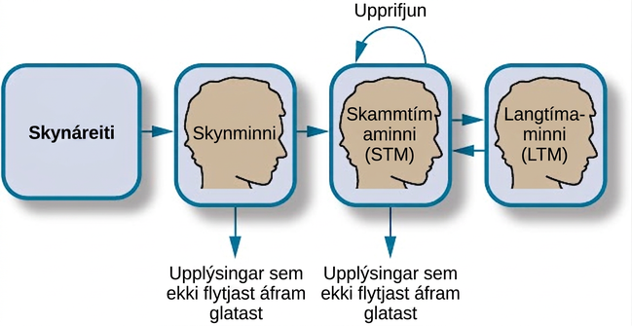
STORAGE: A-S MODEL
Storage is the creation of a permanent record of information.
Atkinson-Shiffrin Model of Memory
Information passes through three distinct stages in order for it to be stored in long-term memory.
Based on the belief that memories are processed the same way that a computer processes information.

Slide 8
SENSORY MEMORY
Sensory memory – storage of brief sensory events, such as sights, sounds, and tastes.
Stored for up to a couple of seconds.
First step of processing stimuli from the environment.
If the information is not important, it is discarded.
If the information is valuable then it moves into our short-term memory.

Slide 9
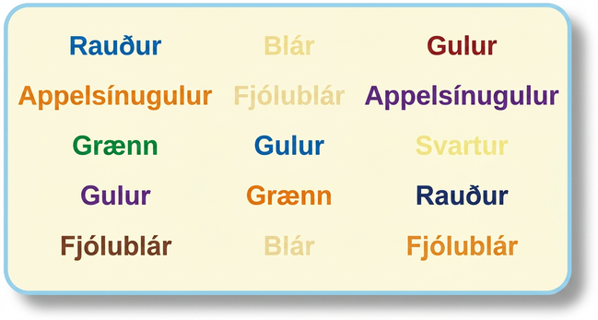
THE STROOP EFFECT
The Stroop effect was discovered while studying sensory memory and describes why it is difficult for us to name a color when the word and the color of the word are different.

Slide 10
SHORT-TERM MEMORY (STM)
Short-term memory/working memory – a temporary storage system that processes incoming sensory memory.
Lasts about 20 seconds.
Capacity is usually about 7 items +/-2 (discovered by George Miller).
Short-term memories are either discarded or stored in long-term memory.
Memory consolidation – Transfer of STM to long-term memory.
One way memory consolidation can be achieved is through rehearsal.
Rehearsal – the conscious repetition of information to be remembered.
Notes:
RECALL EXERCISE:
Read each string of numbers out loud and have student write down what they can remember after each string to determine longest string of numbers they can remember.
9754, 68259, 913825, 5316842, 86951372, 719384273
6419, 67148, 648327, 5963827, 51739826, 163875942

Slide 11
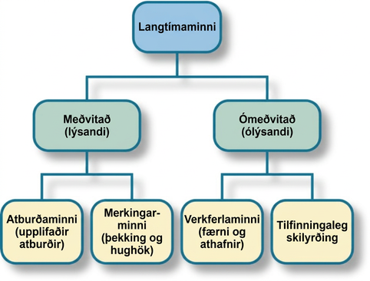
LONG-TERM MEMORY (LTM)
LTM is the continuous storage of information.
It has no limit and is like the information you store on the hard drive of a computer.
There are two components of long-term memory: explicit and implicit.

Slide 12
LTM: EXPLICIT MEMORY
Explicit (declarative) memory – memories of facts and events we can consciously remember and recall/declare.
Explicit memories include two types:
Semantic – knowledge about words, concepts and language.
Knowing who the President is.
Episodic – information about events we have personally experienced.
Remembering your 5th birthday party.
The what, where, when of an event.
Also called autobiographical memory.
A small number of people (including actress Marilu Henner) have a highly superior autobigraphical memory known as hyperthymesia.

Slide 13
LTM: IMPLICIT MEMORIES
Implicit memory - memories that are not part of our consciousness.
Formed through behaviors.
Procedural – stores information about how to do things.
Skills and actions.
E.g. how to ride a bike, tie your shoe laces, drive.
Implicit memory also includes behaviors learned through emotional conditioning.
You might have a fear of spiders but not consciously remember why or what occurred to condition that fear.

Slide 14
RETRIEVAL
How to you get information back out of storage?
Retrieval – the act of getting information out of memory storage and back into conscious awareness.
Retrieval is needed for everyday functioning (e.g. knowing how to drive to work, or how perform your job once you get there).
3 ways to retrieve information:
Recall – being able to access information without cues.
Used for an essay test.
Recognition – being able to identify information that you have previously learned after encountering it again.
Used for a multiple choice test.
Relearning – Learning information that you previously learned.
After learning Spanish in high school, you might forget how to speak it if you do not use it. However, if you try to relearn it, you will learn it quicker than the first time.

Slide 15
PARTS OF THE BRAIN INVOLVED IN MEMORY
Karl Lashley and Engrams
Karl Lashley was looking for evidence of an engram – the group of neurons that serve as the “physical representation of memory”.
Studied parts of the brain involved in memory by making lesions in the brains of animals such as rats and monkeys.
Trained rats to learn their way around a maze and then made lesions to try to remove the memory.
Lashley was unable to find evidence of an engram. The rats were still able to remember their way around the maze so he formulated a new hypothesis.
Equipotentiality hypothesis – if part of one area of the brain involved in memory is damaged, another part of the same area can take over that memory function.
Eric Kandel
Studied the synapse and its role in controlling the flow of information through neural circuits needed to store memories.

Slide 16
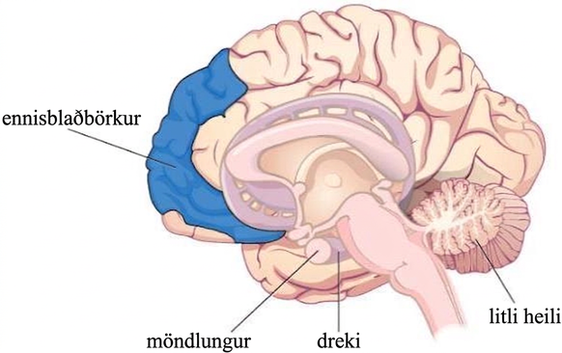
PARTS OF THE BRAIN INVOLVED IN MEMORY
Scientists have now identified different parts of the brain involved in memory.

Slide 17
PARTS OF THE BRAIN INVOLVED IN MEMORY
Amygdala
Involved in fear and fear memories (memory storage is influenced by stress hormones).
Processes emotional information important in encoding memories at a deeper level and memory consolidation.
Hippocampus
Associated with explicit memory, recognition memory and spatial memory.
Projects information to cortical regions that give memories meaning and connect them with other memories.
Involved in memory consolidation.
Damage leads to an inability to process new declarative memories.
Patient H.M:
Had both temporal lobes removed (including hippocami) to help control his seizures.
Declarative memory was significantly effected.
Could not form new semantic knowledge or episodic memories.

Slide 18
PARTS OF THE BRAIN INVOLVED IN MEMORY
Cerebellum
Plays a role in processing procedural memories, such as how to play the piano and classical conditioning.
Damage prevents classical conditioning such as an eye-blink in response to a puff of air.
Prefrontal cortex
Appears to be involved in remembering semantic tasks.
PET scans show activation in the left inferior prefrontal cortex when completing semantic tasks.
Encoding is associated with left frontal activity.
Retrieval of information is associated with the right frontal region.

Slide 19
NEUROTRANSMITTERS
Communication among neurons via neurotransmitters is critical for developing new memories.
Repeated neuron activity → increased neurotransmitters in the synapse → stronger synaptic connections. (This is how memory consolidation occurs).
Neurotransmitters involved in memory:
Epinephrine
Dopamine
Serotonin
Glutamate
Acetylcholine
Arousal Theory – strong emotions trigger the formation of strong memories and weaker emotional experiences form weaker memories.
Strong emotional experiences can trigger the release of neurotransmitters which strengthen memory.
Evidenced by flashbulb memories - an exceptionally clear recollection of an important emotional event.

Slide 20
FLASH BULB MEMORY
Flash bulb memory – a record of an atypical and unusual event that has very strong emotional associations.
Depending on the age and awareness/interests of the person, certain flashbulb memories can act as generational reference points. Examples include:
The assassinations of President John F. Kennedy, Martin Luther King Jr., Malcolm X, or Robert Kennedy.
The first humans landing on the Moon
The attacks of September 11, 2001
Flashbulb memory formation may depend on cultural reference and personal investment/involvement.
A national leader suddenly resigning may become a flashbulb memory for those citizens only.
An athlete suddenly retiring may become a flashbulb memory for fans of that sport or team.
9/11 is the most recent flashbulb memory that has been extensively researched.

Slide 21
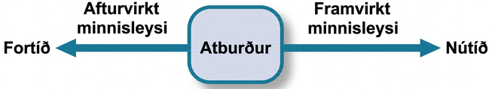
AMNESIA
Amnesia – the loss of long-term memory that occurs as the result of disease, physical trauma, or psychological trauma.
There are 2 common types:
Anterograde amnesia – inability to remember new information after point of trauma.
Commonly caused by brain trauma.
Hippocampus is usually affected – causes inability to transfer information from STM to LTM.
Retrograde amnesia – loss of memory (partial or complete) for events that occurred prior to the trauma.

Slide 22
MEMORY CONSTRUCTION &
RECONSTRUCTION
Construction – formulation of new memories.
Reconstruction – process of bringing up old memories.
When we retrieve memories, we tend to unintentionally alter and modify them, resulting in inaccuracies and distortions.
Suggestibility
Suggestibility is the effects of misinformation from external sources that leads to the creation of false memories.
Can cause people to claim to remember something that was only a suggestion someone made.
Memories are fragile making them vulnerable to the power of suggestion.
An important area of study has been the role of suggestibility in eyewitness testimonies.

Slide 23
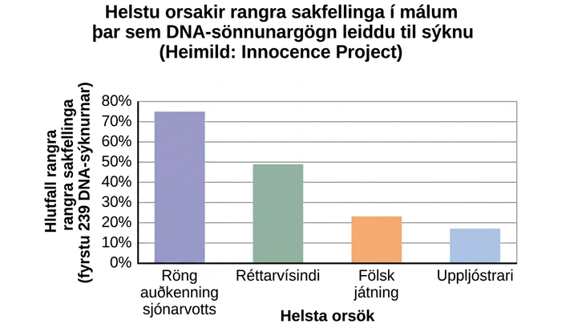
EYEWITNESS MISIDENTIFICATION
Eyewitness identification and testimony is often used in the prosecution of criminals.
Research suggests that suggestive police identification procedures can lead to alterations in an eyewitnesses memory leading to misidentification.
In studying cases where DNA evidence has exonerated people from crimes, the Innocence Project discovered that eyewitness misidentification is the leading cause of wrongful convictions (Benjamin N. Cardozo School of Law, Yeshiva University, 2009).

Slide 24
THE MISINFORMATION EFFECT
Elizabeth Loftus
Studied false memories.
Misinformation effect paradigm – after exposure to incorrect information, a person may misremember the original event.
Study (1974):
Asked college students to estimate the speed of cars using different forms of questions.
Participants were shown films of car accidents and were asked to play the tole of eyewitness and describe what happened.
Were asked, “About how fast were the cars going when they (smashed, collided, bumped, hit, contacted) each other?”
Participants that heard the word smashed estimated that the cars were travelling a lot faster than those that heard the word contacted.
If they heard the word glass, they were more than twice as likely to say they remember seeing glass (a false memory).
The implied meaning of the word used influenced the participants memory of the accident.

Slide 25
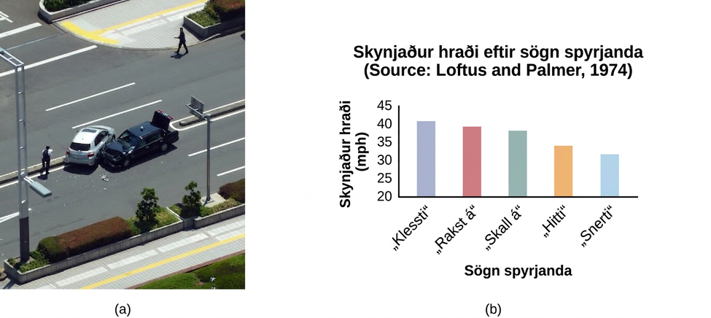
LOFTUS STUDY
When people are asked leading questions about an event, their memory of the event may be altered.
Figure 8.13 (credit a: modification of work by Rob Young)

Slide 26
REPRESSED & RECOVERED MEMORIES
A controversial topic within psychology is the idea that whole events can be repressed or falsely recalled.
False memory syndrome – recall of false autobiographical memories.
Repressed memories:
Some psychologist believe it is possible to completely repress traumatic childhood memories such as sexual abuse.
Can lead to psychological distress in adulthood.
Some believe that these can be recalled through hypnosis and guided imagery techniques.
Loftus challenges the idea of repressed memories and questions if recalled memories are accurate or whether the processes of questioning and suggestibility leads to the misinformation effect.
How can suggestibility be avoided when questioning eyewitnesses?

Slide 27
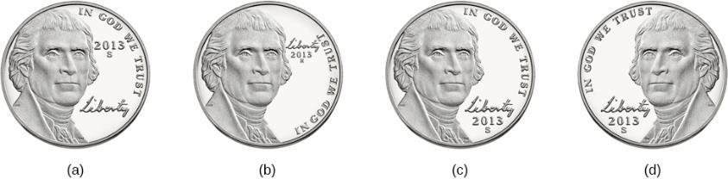
WHY DO WE FORGET?
Forgetting – loss of information from long-term memory.
Encoding Failure
Encoding failure occurs when the memory is never stored in our memory in the first place.
Successful encoding requires effort and attention.
Can you tell which coin is the accurate depiction of a US nickel?
Most American’s cannot tell which one because we do not encode the specific details, we just know enough to differentiate it from other coins.
Notes:
The correct answer is C.

Slide 28
MEMORY ERRORS
Schacter’s 7 sins of memory
Forgetting type:
Transience – Accessibility of memory decreases over time (storage decay).
Absentmindedness – Forgetting caused by lapses in attention.
Blocking – Accessibility of information is temporarily blocked (aka tip-of-the-tongue phenomenon).
Distortion type:
Misattribution – Source of memory is confused.
Suggestibility – False memories.
Bias – Memories distorted by current belief system.
Intrusion type:
Persistence – Inability to forget undesirable memories.

Slide 29
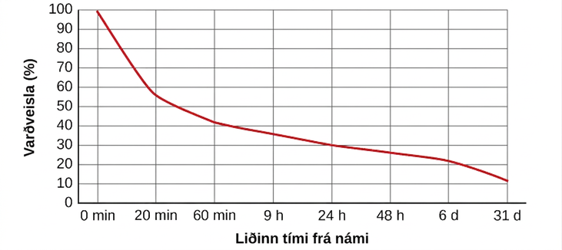
TRANSIENCE/STORAGE DECAY
Overtime, unused information tends to fade away.
Ebbinghaus (1885)
Studied the process of memorization.
The Ebbinghaus forgetting curve shows how quickly memory for new information decays.
50% after 20 minutes.
70% after 24 hours.

Slide 30
BIAS
According to Schacter, your feelings and view of the world can distort your memory of past events.
Stereotypical bias - involves racial and gender biases.
After presenting people with a list of names, they more frequently incorrectly remembered typical African American names to be associated with the occupation basketball player, and typical white names to be associated with the occupation politician.
Egocentric bias – involves enhancing our memories of the past.
People remember events in a way that makes them look better.
Hindsight bias – the tendency to think an outcome was inevitable after the fact.
Thinking you knew it all along.

Slide 31
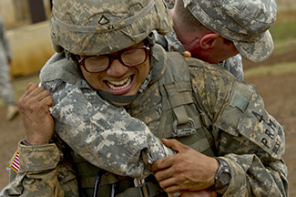
PERSISTENCE
Many veterans of military conflicts involuntarily recall unwanted, unpleasant memories.
(credit: Department of Defense photo by U.S. Air Force Tech. Sgt. Michael R. Holzworth)

Slide 32
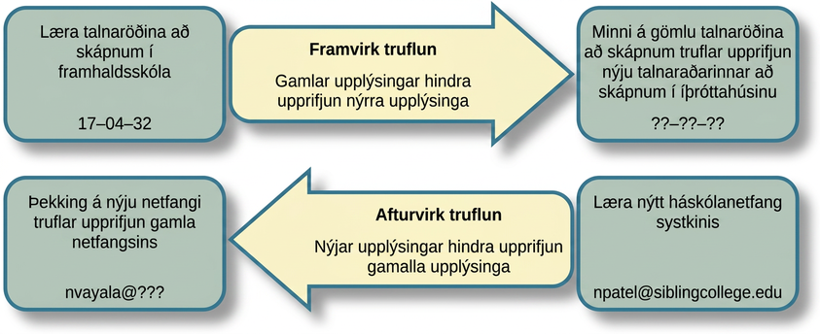
INTERFERENCE
Sometimes forgetting is caused by a failure to retrieve information. This can be due to interference, either retroactive or proactive.

Slide 33
WAYS TO ENHANCE MEMORY
Rehearsal – conscious repetition of information to be remembered.
Chunking – organizing information into manageable bits or chunks.
E.g. Separating phone numbers into 3 chunks.
Elaborative rehearsal – technique in which you think about the meaning of the new information and its relation to knowledge already stored in your memory.
Mnemonic devices – memory aids that help us organize information for encoding.
E.g. One way to remember the order of planets is the name MR. VEM J. SON.
Other techniques can include:
Expressive writing.
Saying words aloud.

Slide 34
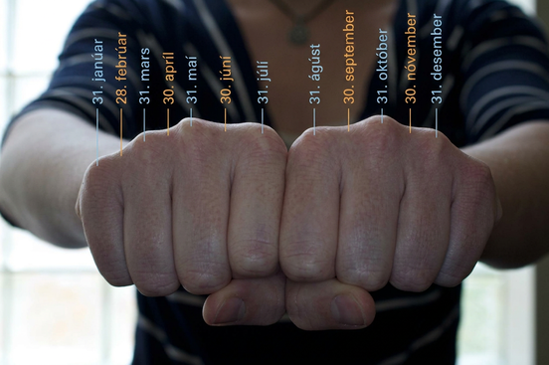
MNEMONIC DEVICES
This is a knuckle mnemonic to help you remember the number of days in each month. Months with 31days are represented by the protruding knuckles and shorter months fall in the spots between knuckles.
(credit: modification of work by Cory Zanker)

Slide 35

HOW TO STUDY EFFECTIVELY
Memory techniques can be useful when studying for class.
Use elaborative rehearsal – link information to other information/memories to make it more meaningful.
Apply the self-reference effect – make information personally meaningful to YOU.
Don’t forget the forgetting curve – keep studying to prevent storage decay.
Rehearse.
Be aware of interference – study without distractions.
Keep moving – aerobic exercise promotes neurogenesis (growth of new brain cells in the hippocampus).
Get enough sleep – the brain consolidates memories while sleeping.
Make use of mnemonic devices.
(credit: Barry Pousman)

