Slide 1


Psychology 2e
Chapter 3 BIOPSYCHOLOGY
PowerPoint Image Slideshow

Slide 2
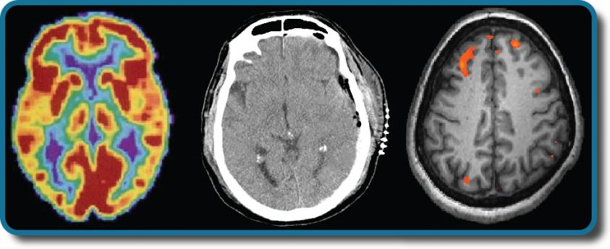
Biopsychology
Biopsychology explores the biological mechanisms that underlie behavior.
Among many things, it studies:
Genetics - focusing on how inherited genes can affect not just the physiological, but psychological traits of a person.
The structure and function of the nervous system.
How the nervous system interacts with the endocrine system.
Different brain imaging techniques provide scientists with insight into different aspects of how the human brain functions. Left to right, PET scan (positron emission tomography), CT scan (computed tomography), and fMRI (functional magnetic resonance imaging) are three types of scans. (credit “left”: modification of work by Health and Human Services Department, National Institutes of Health; credit “center”: modification of work by “Aceofhearts1968”/Wikimedia Commons; credit “right”: modification of work by Kim J, Matthews NL, Park S.)

Slide 3
HUMAN GENETICS
Studying human genetics can help researchers understand the biological basis underlying the different behaviors, thoughts and reactions of humans.
Why do two people infected by the same disease have different outcomes?
Are there genetic components to psychological disorders, such as depression?
How are genetic diseases passed through family lines?

Slide 4
THEORY OF EVOLUTION
Charles Darwin explored the concept of inheritance of traits throughout generations in his theory of evolution through natural selection.
The organisms that are better suited for their environment will survive and reproduce, while those that are poorly suited for their environment will die off.
Characteristics and behaviors that impact survival and reproduction:
Those that help protect against predators.
Those that increase access to food.
Those that help to offspring alive.
”It is not the strongest of the species that survives, nor the most intelligent that survives. It is the one that is most adaptable to change.” – Charles Darwin

Slide 5
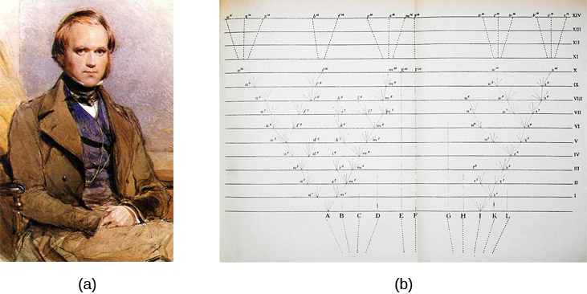
Charles darwin
In 1859, Charles Darwin proposed his theory of evolution by natural selection in his book, On the Origin of Species.
The book contains just one illustration: this diagram that shows how species evolve over time through natural selection.

Slide 6
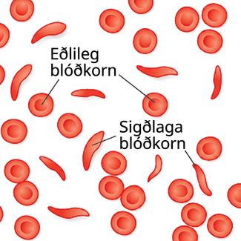
Theory of Evolution
So why have certain genetic diseases that cause people to die not become less common?
Example: Sickle cell anemia
A genetic condition in which red blood cells take on a crescent-like shape affecting how they function.
Causes many people to die at an early age but it is still common among people of African descent.
Carriers of only one copy of the sickle cell gene are thought to be immune from malaria, a deadly disease which is common in Africa.
In this example, carrying the gene makes a person better suited for their environment.
Normal blood cells travel freely through the blood vessels, while sickle-shaped cells form blockages preventing blood flow.

Slide 7
GENETIC VARIATION
The genetic difference between individuals.
Contributes to a species’ adaptation to its environment.
Begins when an egg (containing 23 chromosomes) is fertilized by a sperm (containing 23 chromosomes).
Chromosome - long strand of genetic information known as DNA.
Deoxyribonucleic acid (DNA) - helix-shaped molecule made of nucleotide base pairs.
In each chromosome, sequences of DNA make up genes.
Gene - sequence of DNA that controls or partially controls physical characteristics known as traits (eye color, hair color etc).
A gene may have multiple possible variations or alleles (a specific version of a gene).
A specific gene may code for hair color and the different alleles of that gene affect what the hair color will be.

Slide 8
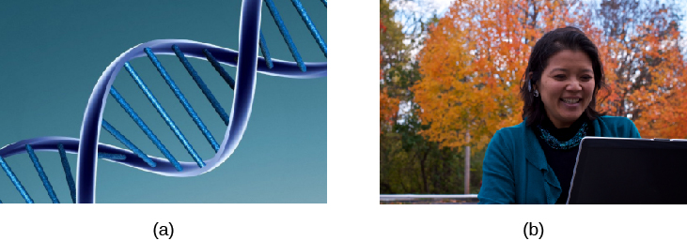
Genotype vs phenotype
Genotype refers to the genetic makeup of an individual based on the genetic material (DNA) inherited from one’s parents.
Phenotype describes an individual’s observable characteristics, such as hair color, skin color, height, and build. (credit a: modification of work by Caroline Davis; credit b: modification of work by Cory Zanker)

Slide 9
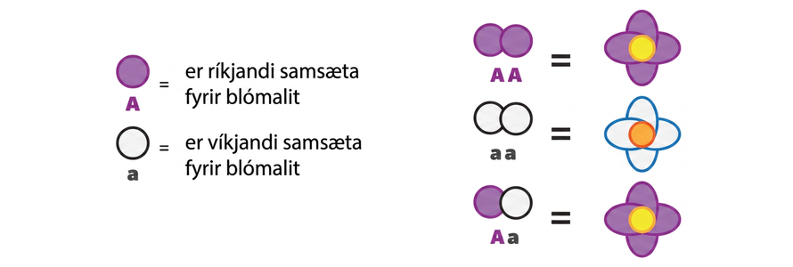
DOMINANT V RECESSIVE ALLELES
The majority inheritable traits are controlled by more than just one gene and in such cases, they are known as polygenic traits.
Some traits are controlled by one gene.
Alleles can be dominant or recessive. In the example below, A is the dominant allele for flower color (purple) and a is the recessive allele for flower color (white).
Possession of a dominant allele will always result in expression of that phenotype. This could be inherited from one parent (Aa) or both parents (AA).
The phenotype of a recessive allele will only be physically expressed if the person is homozygous for that allele, meaning they inherited a recessive allele from BOTH parents (aa).
Heterozygous - consisting of two different alleles (Aa).
Homozygous - consisting of two identical alleles (AA/aa).
(Credit: B4FA)

Slide 10
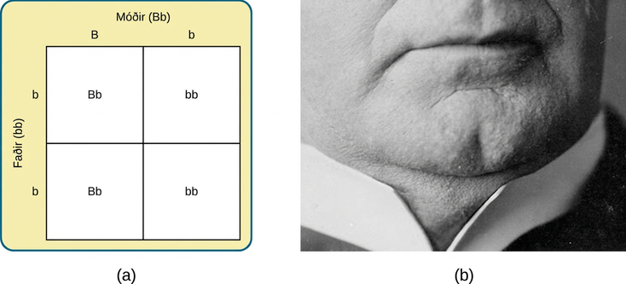
Punnett squares
A Punnett square is a tool used to predict how genes will interact in the production of offspring. The capital B represents the dominant allele, and the lowercase b represents the recessive allele. In the example of the cleft chin, where B is cleft chin (dominant allele), wherever a pair contains the dominant allele, B, you can expect a cleft chin phenotype. You can expect a smooth chin phenotype only when there are two copies of the recessive allele, bb.
A cleft chin, shown here, is an inherited trait.

Slide 11
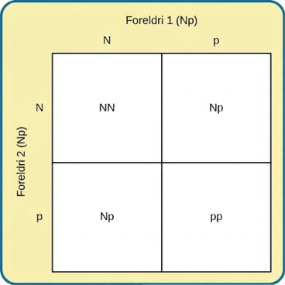
Punnett Squares
In this Punnett square, N represents the dominant allele, and p represents the recessive allele that is associated with PKU.
If two individuals mate who are both heterozygous (Np) for the allele associated with PKU, their offspring have a 25% chance of expressing the PKU phenotype.
Where do harmful genes like PKU come from?
Some are the result of mutations.
Mutations - sudden, permanent change in a gene.
Many mutations are harmful but some can also be beneficial.
In this Punnett square, N represents the normal allele, and p represents the recessive allele that is associated with PKU. If two individuals mate who are both heterozygous for the allele associated with PKU, their offspring have a 25% chance of expressing the PKU phenotype.

Slide 12
GENE-ENVIRONMENT INTERACTIONS
Nature and nurture work together like complex pieces of a human puzzle.
The interaction of our environment and genes makes us the individuals we are.
There are many different ways to look at this interaction:
Range of reaction - asserts our genes set the boundaries within which we can operate, and our environment interacts with the genes to determine where in that range we will fall.
Genetic environmental correlation - view of gene-environment interaction that asserts our genes affect our environment, and our environment influences the expression of our genes.
Epigenetics - study of gene-environment interactions such as how the same genotype leads to different phenotypes.

Slide 13
NEURON STRUCTURE
The function of a neuron is aided by specific aspects of its structure.
Its semi-permeable membrane allows smaller molecules or molecules without an electrical charge to pass through it, while stopping larger or highly charged molecules.
Incoming electrical signals from other neurons are received by the dendrites which then send the signal down the axon.

Slide 14
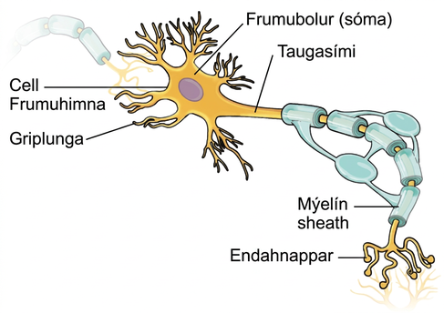
Figure 3.8
This illustration shows a prototypical neuron, which is being myelinated.
Axons are covered in a myelin sheath made of a fatty substance that insulates axons and allows the signal to travel down the axon quicker.
At the end of the axons are terminal buttons which contain synaptic vessels (storage sites for chemical messengers called neurotransmitters).

Slide 15
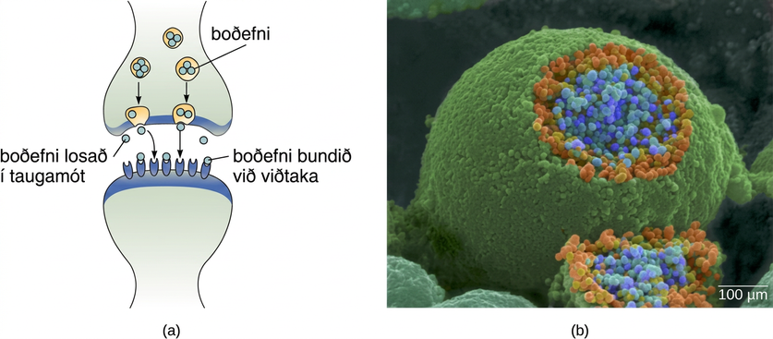
The synapse
The synapse is the space between the terminal button of one neuron and the dendrite of another neuron.
In this pseudo-colored image from a scanning electron microscope, a terminal button (green) has been opened to reveal the synaptic vesicles (orange and blue) inside. Each vesicle contains about 10,000 neurotransmitter molecules. (credit b: modification of work by Tina Carvalho, NIH-NIGMS; scale-bar data from Matt Russell)

Slide 16
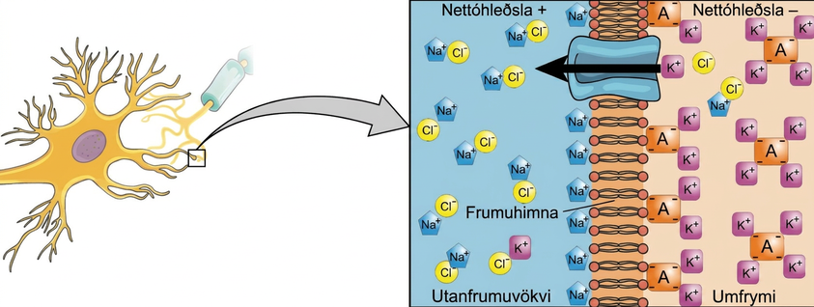
Figure 3.10
At resting potential, Na⁺ (blue pentagons) is more highly concentrated outside the cell in the extracellular fluid (shown in blue), whereas K⁺ (purple squares) is more highly concentrated near the membrane in the cytoplasm or intracellular fluid. Other molecules, such as chloride ions (yellow circles) and negatively charged proteins (brown squares), help contribute to a positive net charge in the extracellular fluid and a negative net charge in the intracellular fluid.

Slide 17
ACTION POTENTIAL
Neurotransmitters from nearby neurons attach to receptors on dendrites causing the membrane potential to change.
  Depolarization – membrane potential becomes less negative making the neuron more likely to fire (excitation).
  Hyperpolarization – membrane potential becomes more negative making the neuron less likely to fire (inhibition).
If the level of charge reaches the threshold of excitation an action potential will occur. Ion channels open causing Na+ to rush into the cell and the inside to momentarily become more positive.
  Threshold of excitation – level of charge in the membrane that causes the neuron to become active.
  Action Potential – an electrical signal.
  Action potentials act on an all-or-none principle - the incoming signal is either sufficient to reach the threshold of excitation or it is not.

Slide 18
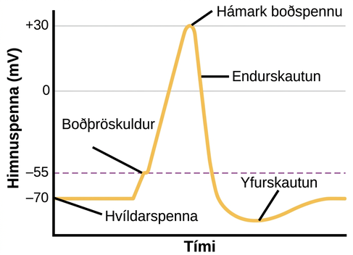
Action potential
During the action potential, the electrical charge across the membrane changes dramatically.

Slide 19
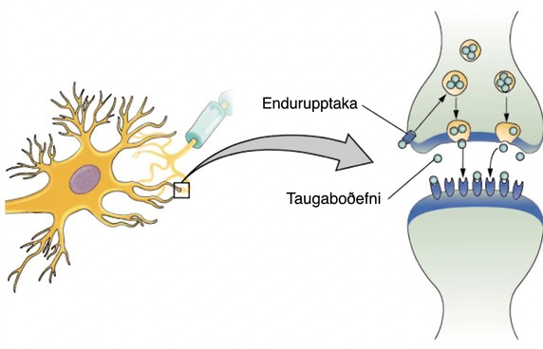
Reuptake
Once an action potential has occurred, excess neurotransmitters in the synapse either drift away, are broken down or are reabsorbed.
Reuptake involves moving a neurotransmitter from the synapse back into the axon terminal from which it was released.
Reuptake involves moving a neurotransmitter from the synapse back into the axon terminal from which it was released.

Slide 20
NEUROTRANSMITTERS
Neurotransmitter – chemical messenger of the nervous system.
Different neurons release different types of neurotransmitters that have many different functions.
Biological perspective - view that psychological disorders like depression and schizophrenia are associated with imbalances in one or more neurotransmitter systems.
Acetylcholine – muscle action and memory.
Beta-endorphin – pain and pleasure.
Dopamine – mood, sleep, and learning.
Norepinephrine – Heart, intestines, and alertness.
Serotonin – mood and sleep.

Slide 21
DRUGS
Psychotropic medication - drugs that treat psychiatric symptoms by restoring neurotransmitter balance.
Agonist - drug that mimics or strengthens the effects of a neurotransmitter.
Antagonist - drug that blocks or impedes the normal activity of a given neurotransmitter.
Agonist/antagonist drugs are prescribed to correct neurotransmitter imbalances.
E.g. Parkinson’s disease is associated with low levels of dopamine. Dopamine agonists are often prescribed as one form of treatment.
Schizophrenia on the other hand is associated with too much dopamine. Many antipsychotic drugs are therefore dopamine antagonists.

Slide 22
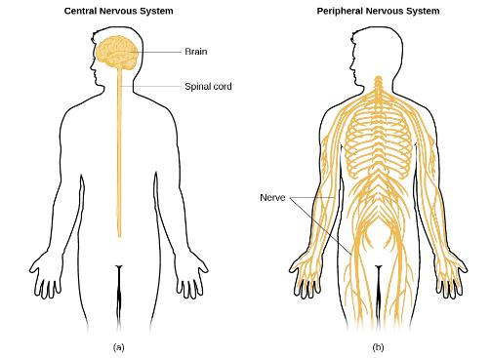
Parts of the nervous system
The nervous system is divided into two major parts:
the Central Nervous System and
the Peripheral Nervous System.

Slide 23
THE PERIPHERAL NERVOUS SYSTEM
The Peripheral nervous system is made up of two different parts:
1. Somatic nervous system - relays sensory and motor information to and from the CNS.
2. Autonomic nervous system - controls our internal organs and glands and can be divided into the Sympathetic and Parasympathetic nervous systems.
Sympathetic nervous system - involved in stress-related activities and functions; prepares us for fight or flight.
  Fight or flight response - activation of the sympathetic division of the autonomic nervous system, allowing access to energy reserves and heightened sensory capacity so that we might fight off a given threat or run away to safety.
Parasympathetic nervous system - associated with routine, day-to-day operations of the body under relaxed conditions.
  Rest and restore response – relaxes the body after fight or flight (aka rest and digest).
The Sympathetic and Parasympathetic nervous systems complement each other to maintain homeostasis, a state of equilibrium in the body.

Slide 24
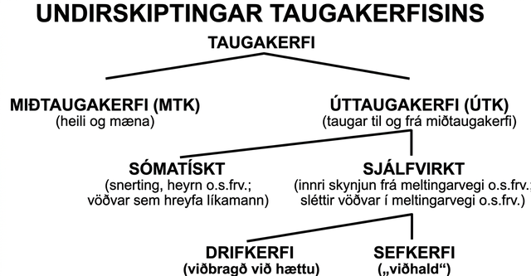
SUBDIVISIONS OF THE NERVOUS SYSTEM
(Credit: Indiana.edu)

Slide 25
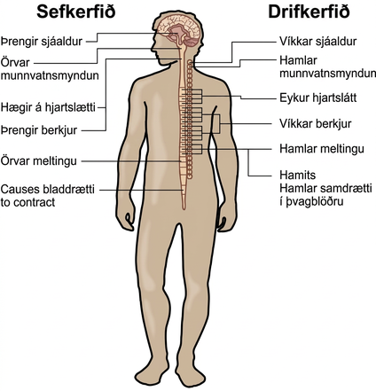
The autonomic nervous systems
The sympathetic and parasympathetic divisions of the autonomic nervous system have the opposite effects on various systems.

Slide 26
THE BRAIN AND SPINAL CORD
THE BRAIN
Comprised of billions of interconnected neurons and glia.
Bilateral (two-sided).
Can be separated into distinct lobes but all areas interact with one another.
THE SPINAL CORD
Delivers messages to and from the brain.
Has its own system of reflexes.
The top merges with the brain stem and the bottom ends just below the ribs
Functionally organized into 30 segments, each connected to a specific part of the body through the PNS.
Sensory nerves bring messages in and up to the brain; motor nerves send messages out to the muscles and organs.
In moments of survival, automatic reflexes allow motor commands to be initiated without sending signals from sensory nerves to the brain first, allowing for very quick reactions.

Slide 27
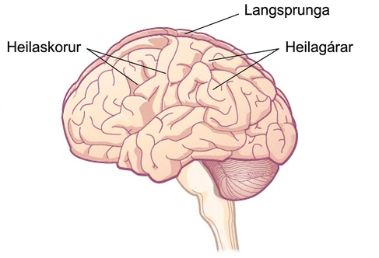
The two hemispheres
Lateralization - concept that each hemisphere of the brain is associated with specialized functions.
The left hemisphere controls the right side of the body.
The right hemisphere controls the left side of the body.
The surface of the brain is covered with gyri and sulci. A deep sulcus is called a fissure, such as the longitudinal fissure that divides the brain into left and right hemispheres. (credit: modification of work by Bruce Blaus)

Slide 28
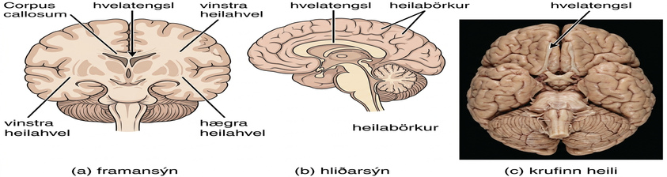
The corpus callosum
(a, b) The corpus callosum connects the left and right hemispheres of the brain. (c) A scientist spreads this dissected sheep brain apart to show the corpus callosum between the hemispheres. (credit c: modification of work by Aaron Bornstein)

Slide 29
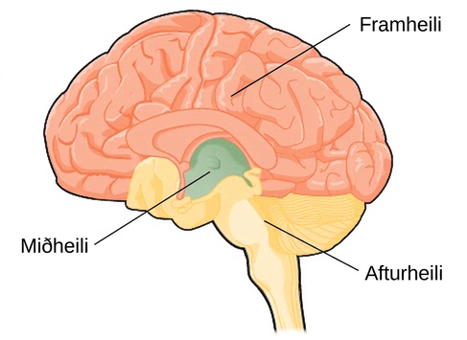
FOREBRAIN, MIDBRAIN & HINDBRAIN
The brain and its parts can be divided into three main categories: the forebrain, midbrain, and hindbrain.

Slide 30
FOREBRAIN STRUCTURES
The forebrain is the largest part of the brain.
It contains:
The cerebral cortex – higher level processes
Thalamus - sensory relay
Hypothalamus - homeostasis
Pituitary gland – master gland of the endocrine system
Limbic system – emotion and memory circuit

Slide 31
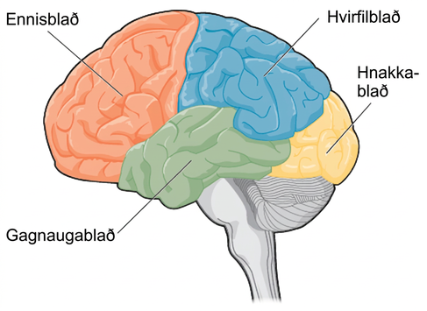
CEREBRAL CORTEX:
LOBES OF THE BRAIN
Cerebral cortex - surface of the brain that is associated with out highest mental capabilities such as consciousness, thought, emotion, reasoning, language and memory.
It can be broken up into four lobes, each with a different function.

Slide 32
THE FRONTAL LOBE
Involved in executive functioning (planning, organization, judgement, attention, reasoning), motor control, emotion, and language.
It contains:
The Motor cortex - strip of cortex involved in planning and coordinating movement.
The Prefrontal cortex - responsible for higher-level cognitive functioning.
Broca’s area - region in the left hemisphere that is essential for language production.
Damage to Broca’s area leads to difficulties producing language.
.
Damage to the Frontal Lobe: Phineas Gage
While working as a railroad foreman, an accident caused an iron rod to penetrate through Gage’s skull and frontal lobe. After the accident, people noticed changes in his personality.
Before the accident - Well-mannered and soft-spoken.
After the accident - Started behaving in odd and inappropriate ways.
These changes were consistent with loss of impulse control (a function of the frontal lobe).

Slide 33
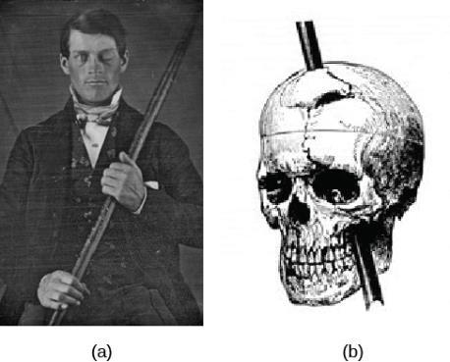
Phineas gage
Phineas Gage holds the iron rod that penetrated his skull in an 1848 railroad construction accident.
Gage’s prefrontal cortex was severely damaged in the left hemisphere. The rod entered Gage’s face on the left side, passed behind his eye, and exited through the top of his skull, before landing about 80 feet away. (credit a: modification of work by Jack and Beverly Wilgus)

Slide 34
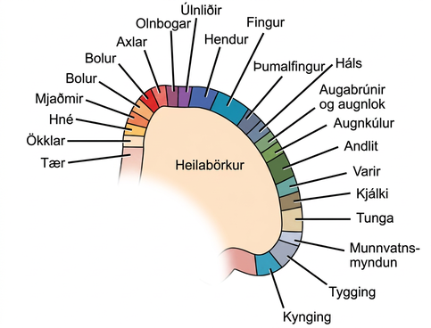
THE PARIETAL LOBE
Involved in processing various sensory and perceptual information.
Contains the primary somatosensory cortex.
Somatosensory cortex – essential for processing sensory information from across the body, such as touch, temperature, and pain.
Organized topographically.

Slide 35
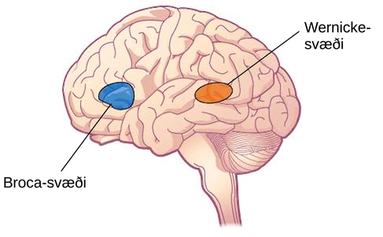
THE TEMPORAL LOBE
Associated with hearing, memory, emotion and some aspects of language.
Located on the side of the head (near the temples).
It contains:
The Auditory cortex - strip of cortex in the temporal lobe that is responsible for processing auditory information.
Wernicke’s area - important for speech comprehension.
Damage to Wernicke’s area results in difficulty understanding language.
Figure 3.21 Damage to either Broca’s area or Wernicke’s area can result in language deficits. The types of deficits are very different, however, depending on which area is affected.

Slide 36
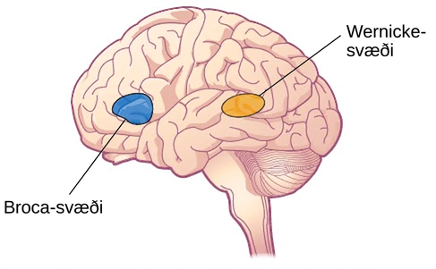
Figure 3.21
Damage to either Broca’s area or Wernicke’s area can result in language deficits. The types of deficits are very different, however, depending on which area is affected.

Slide 37
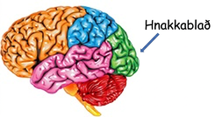
THE OCCIPITAL LOBE
Associated with visual processing.
Contains the primary visual cortex which is responsible for interpreting incoming visual information.
Organized retinotopically.
(Credit: The brain made simple)

Slide 38
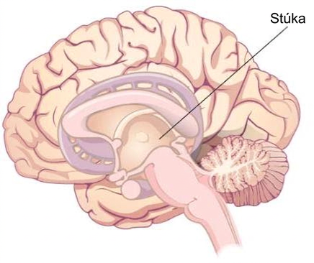
The thalamus
The thalamus serves as the relay center of the brain where most senses (excluding smell) are routed before being directed to other areas of the brain for processing.
The thalamus serves as the relay center of the brain where most senses are routed for processing.

Slide 39
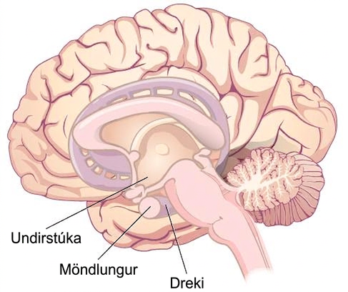
THE LIMBIC SYSTEM
The Limbic system is involved in mediating emotional response and memory.
It is made up of a number of different structures, some of the most important ones being:
Amygdala - involved in our experience of emotion and tying emotional meaning to our memories. Involved in processing fear.
Hippocampus - structure associated with learning and memory (in particular spatial memory).
Hypothalamus – regulates homeostatic processes including body temperature, appetite and blood pressure.

Slide 40

Figure 3.23
The limbic system is involved in mediating emotional response and memory.

Slide 41
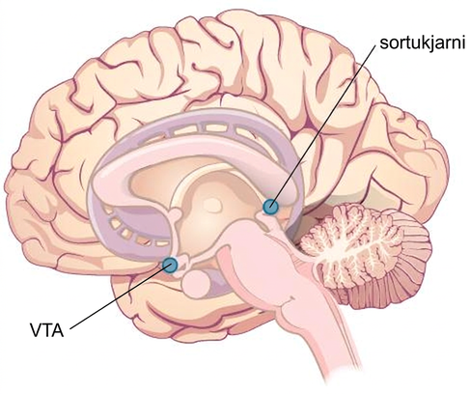
THE MIDBRAIN
Reticular formation - important in regulating the sleep/wake cycle, arousal, alertness, and motor activity.
Substantia Nigra - where dopamine is produced; involved in control of movement.
Ventral tegmental area (VTA) - where dopamine is produced; associated with mood, reward, and addiction.
Degeneration of the Substantia Nigra and VTA is involved in Parkinson’s disease.

Slide 42
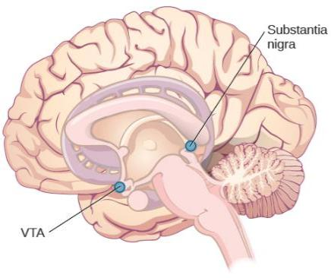
Figure 3.24
The substantia nigra and ventral tegmental area (VTA) are located in the midbrain.

Slide 43
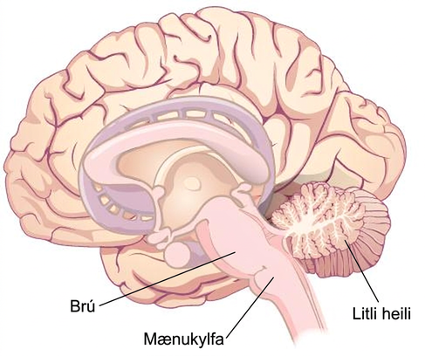
THE HINDBRAIN
Medulla - controls automated processes like breathing, blood pressure, and heart rate.
Pons - connects the brain and the spinal cord; involved in regulating brain activity during sleep.
Cerebellum - controls our balance, coordination, movement, and motor skills, and it is thought to be important in processing some types of memory.
These 3 structures combined are known as the brain stem.

Slide 44

Figure 3.25
The pons, medulla, and cerebellum make up the hindbrain.

Slide 45
BRAIN IMAGING
Techniques Involving Radiation
CT Scan
PET Scan
Techniques Involving Magnetic Fields
MRI
FMRI
Techniques Involving Electrical Activity
EEG

Slide 46
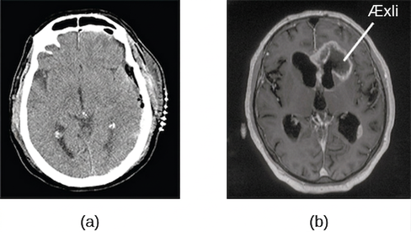
Computerized tomography (CT) scan
Involves x-rays and creates an image through x-rays passing through varied densities within the brain.
A CT scan be used to show brain tumors.
A CT scan can be used to show brain tumors. (a) The image on the left shows a healthy brain, whereas (b) the image on the right indicates a brain tumor in the left frontal lobe. (credit a: modification of work by “Aceofhearts1968”/Wikimedia Commons; credit b: modification of work by Roland Schmitt et al)

Slide 47
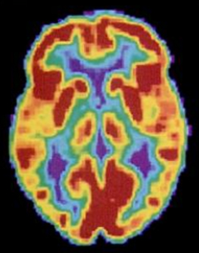
Positron emission tomography (PET) scan
A PET scan is helpful for showing activity in different parts of the brain. (credit: Health and Human Services Department, National Institutes of Health)
Involves injecting individuals with a mildly radioactive substance and monitoring changes in blood flow to different regions of the brain.
A PET scan is helpful for showing activity in different parts of the brain.

Slide 48
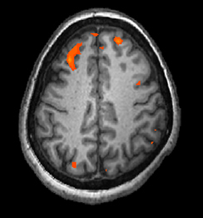
Mri and Fmri
Magnetic resonance imaging (MRI) - magnetic fields used to produce a picture of the tissue being imaged.
Functional magnetic resonance imaging (fMRI) - MRI that show changes in metabolic activity over time.
An fMRI shows activity in the brain over time. This image represents a single frame from an fMRI. (credit: modification of work by Kim J, Matthews NL, Park S.)

Slide 49
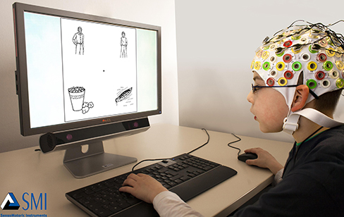
Electroencephalography (EEG)
Involves recording the electrical activity of the brain via electrodes on the scalp.
Using caps with electrodes, modern EEG research can study the precise timing of overall brain activities by tracking amplitude and frequency of brainwaves.
Using caps with electrodes, modern EEG research can study the precise timing of overall brain activities. (credit: SMI Eye Tracking)

Slide 50
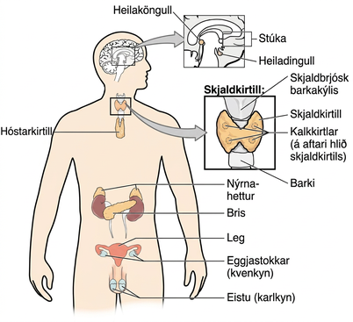
THE ENDOCRINE SYSTEM
A series of glands that produce hormones to regulate normal body functions.
The Hypothalamus links the nervous system and endocrine system by controlling the pituitary gland.
Pituitary gland – serves as the master gland, controlling the secretions of all other glands.
Thyroid – secretes Thyroxine which regulates growth, metabolism and appetite
Adrenal gland - secretes hormones involved in the stress response.
Gonad - secretes sex hormones, which are important for successful reproduction, and regulate sexual motivation and behavior.
Pancreas - secretes hormones that regulate blood sugar.

Slide 51
THE ENDOCRINE SYSTEM
The major glands of the endocrine system are shown.

Slide 52
neurotransmitters
Major Neurotransmitters and How They Affect Behavior
Neurotransmitter | Involved in | Potential Effect on Behavior
Acetylcholine | Muscle action, memory | Increased arousal, enhanced cognition
Beta-endorphin | Pain, pleasure | Decreased anxiety, decreased tension
Dopamine | Mood, sleep, learning | Increased pleasure, suppressed appetite
Gamma-aminobutyric acid (GABA) | Brain function, sleep | Decreased anxiety, decreased tension
Glutamate | Memory, learning | Increased learning, enhanced memory
Norepinephrine | Heart, intestines, alertness | Increased arousal, suppressed appetite
Serotonin | Mood, sleep | Modulated mood, suppressed appetite

