Slide 1


PSYCHOLOGY 2e
Chapter 13 INDUSTRIAL-ORGANIZATIONAL PSYCHOLOGY
PowerPoint Image Slideshow

Slide 2

WHAT IS INDUSTRIAL-ORGANIZATIONAL PSYCHOLOGY?
A branch of psychology that studies how human behavior and psychology effect work and how they are affected by work.
Industrial-Organizational psychologists work in:
Academia
Government
Consulting firms
Business
(credit: “left”: modification of work by Cory Zanker; credit “center”: modification of work by “@Saigon”/Flickr; credit “right”: modification of work by Daniel Lobo)

Slide 3
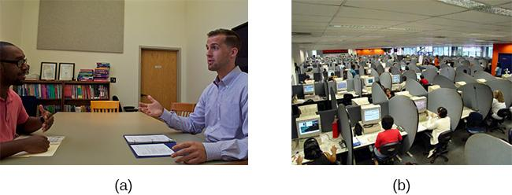
AREAS OF INDUSTRIAL-ORGANIZATIONAL
PSYCHOLOGY
Industrial Psychology
Studies job characteristics, applicant characteristics, and how to match them; also studies employee training and performance appraisal.
Focuses on hiring and maintaining employees.
Considers issues of legality regarding discrimination in hiring.
Organizational Psychology
Studies interactions between people working in organizations and effects of those interactions on productivity.
Interested in worker satisfaction, motivation, commitment, management and leadership styles, social norms and role expectations.
Considers harassment and workplace violence.
(credit a: modification of work by Cory Zanker; credit b: modification of work by Vitor Lima)

Slide 4
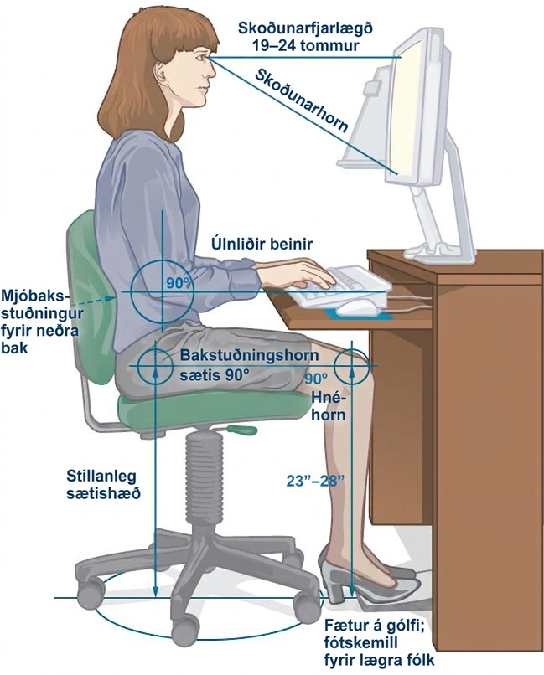
AREAS OF INDUSTRIAL-ORGANIZATIONAL
PSYCHOLOGY
Human Factors Psychology
Studies how workers interact with the tools of work and how to design those tools to optimize workers’ productivity, safety, and health.
Known as Ergonomics in Europe.
Tools of work can include interaction with a machine, work station, information displays, and the local environment (e.g., lighting).
Figure 13.3

Slide 5
HISTORICAL DEVELOPMENT
Early 20th Century
James Cattell, Hugo Munsterberg, Walter Dill Scott:
Students of Wilhelm Wundt.
Conducted research focusing on what is now called industrial psychology.
Cattell - founded the Psychological Corporation, a psychological consulting company.
Munsterberg – published Psychology and Industrial Efficiency (1913), which covered employee selection, employee training, and effective advertising.
Scott – one of the first psychologists to apply psychology to advertising, management, and personnel selection. Published the first books to describe the use of psychology in the business world.
WW1
Robert Yerkes:
Organized a group that developed methods for screening and selecting enlisted men.
Developed the Army Alpha test to measure mental abilities.
Scott and Walter Bingham:
Organized a group with the goal to develop selection methods for officers.

Slide 6
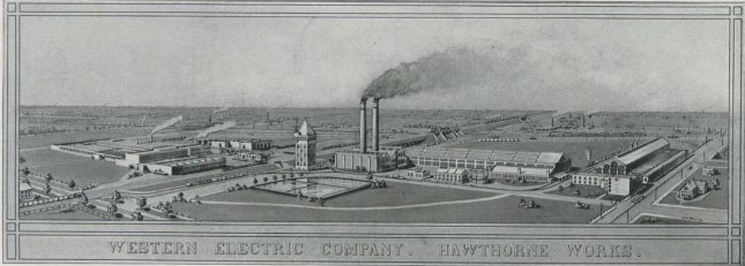
HISTORICAL DEVELOPMENT
Elton Mayo
Conducted studies at Western Electric’s Hawthorne Work (1929-1932).
Explored interpersonal relations, motivation, and organizational dynamics.
Examined how human interaction factors enhanced or decreased productivity.
Origin of organizational psychology.
Researchers reported that any changes they made to variables resulted in increased productivity.

Slide 7
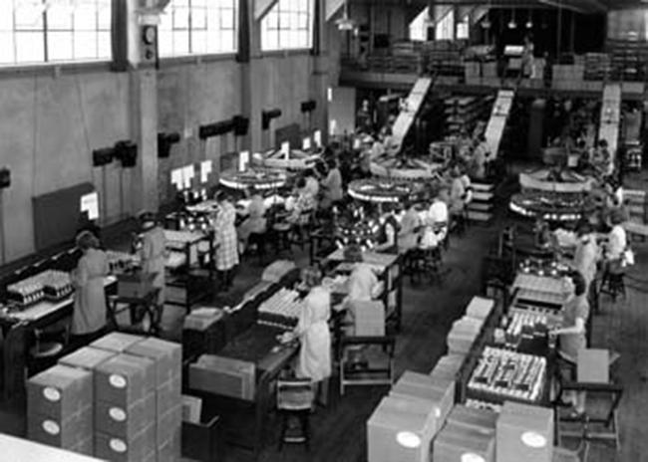
HAWTHORNE EFFECT
Years after Mayo’s study, researchers analyzed the results and noticed that employees performed better when researchers or supervisors observed and interacted with them.
Suggested that productivity increased because people’s performance changes when they are being observed.
Hawthorne Effect - The increase in performance of individuals who are noticed, watched, and paid attention to by researchers or supervisors.

Slide 8
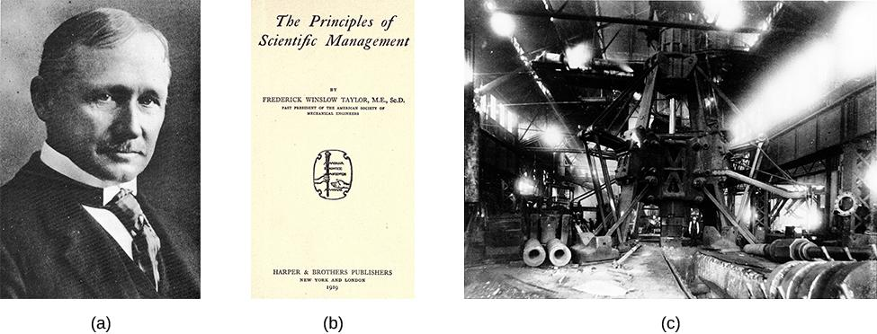
HISTORICAL DEVELOPMENT
Kurt Lewin (1930s)
Researched effects of leadership styles, team structure, and team dynamics.
Studied group interactions, cooperation, competition, and communication.
Coined the term group dynamics.
Frederick Taylor
Frederick Taylor (1911) strived to engineer workplaces to increase productivity.
The Principles of Scientific Management – examines management styles, personnel selection and training.
(credit c: modification of work by “Kheel Center, Cornell University”/Flickr)

Slide 9
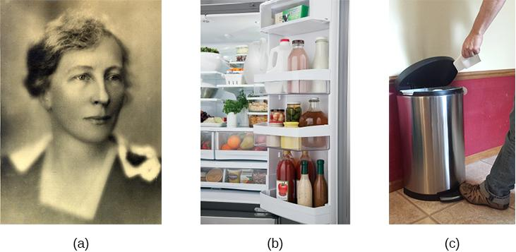
HISTORICAL DEVELOPMENT
Lilian Gilbreth – The Mother of Modern Management
Strove to find ways to increase productivity.
Studied efficiency improvements that reduced the number of motions required to perform a task and were applicable in the workplace, home, and other areas.
Credited with the idea of putting shelves on the inside of refrigerator doors and foot-pedal-operated garbage cans.
Investigated employee fatigue and time management stress.
Found many employees were motivated by money and job satisfaction.
(credit b: modification of work by “Goedeker’s”/Flickr; credit c: modification of work by Kerry Ceszyk)

Slide 10
SELECTING EMPLOYEES
Job Advertising
Job analysis – accurately describing the task/job.
Task-oriented – lists in detail the tasks that will be performed for the job.
Worker-oriented – describes characteristics required of the worker to successfully perform the job (e.g., knowledge, skills, abilities).
O*Net – database of previously compiled job analyses for different jobs and occupations.
Candidate Analysis and Testing
Can involve testing, interviews, and work samples, or exercises.
Personality tests can be used to identify personality characteristics of the candidate and match those personality characteristics that would ensure good performance on the job.
Other tests can include IQ tests, integrity tests, and physical tests, such as drug tests or physical fitness tests.

Slide 11
INTERVIEWS
Interviews can be influenced by social factors and body language such as the degree of similarity of the applicant to the interviewer and nonverbal behaviors (e.g., hand gestures, head nodding, and smiling).
Research found that lack of eye contact and smiling lead to lower applicant ratings.
Unstructured interview:
Different questions for different candidates.
Questions are usually unspecified beforehand.
Structured interview:
Same questions for every candidate.
Questions are prepared in advance.
Standardized rating system for each response.
More effective at predicting subsequent job performance of the job candidate.

Slide 12

TRAINING
Orientation:
Training usually begins with an orientation period during which a new employee learns about company policies, practices, and culture.
Educates the new employee about the organizational culture, the values, visions, hierarchies, norms and ways the company’s employees interact.
Mentoring:
Experienced employee guides the work of a new employee.
Mentors may be formally assigned or develop informally.
Research on mentoring:
Mentoring positively affected protégés compensation, and number of promotions compared with non-mentored employees.
Protégés were more satisfied with their careers and had greater job satisfaction.
(credit: Cory Zanker)

Slide 13
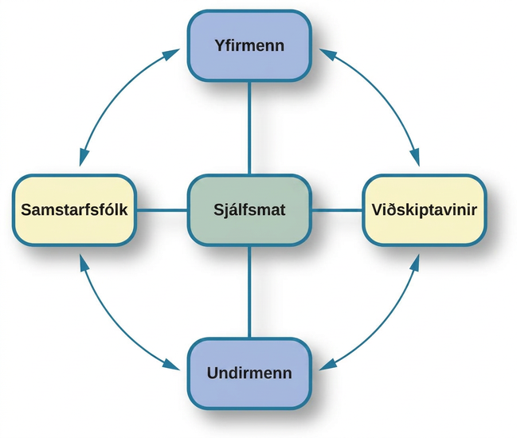
EVALUATING EMPLOYEES
Industrial-organizational psychologists are often involved in designing performance-appraisal systems for organizations.
Aim to make evaluations as fair and positive as possible, and decrease subjectivity.
Performance appraisals – evaluation of an employee’s success or lack of success at performing the duties of the job.
Often used to motivate employees to improve performance and expand areas of competence.
350-degree Feedback Appraisal:
Supervisors, customers, direct reports, peers, and the employee himself rate an employee’s performance.
Provides different perspectives of employees job performance.
Often fail to accomplish their purpose because they are used incorrectly.
Figure 13.9

Slide 14
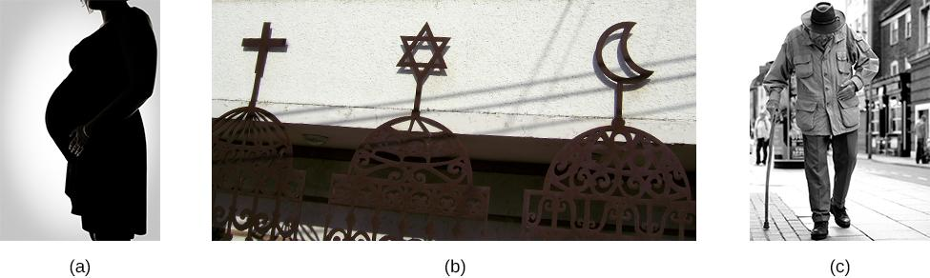
BIAS & PROTECTION IN HIRING
Selecting candidates based on group membership, when it does not directly affect potential job performance, is discriminatory.
Many laws exist to prevent hiring based on various group-membership criteria.
Pregnancy, religion, and age are some of the criteria on which hiring decisions cannot legally be made.
Did you know it is illegal for a potential employer to ask your age in an interview?
Figure 13.10 (credit a: modification of work by Sean McGrath; credit b: modification of work by Ze’ev Barkan; credit c: modification of work by David Hodgson)

Slide 15
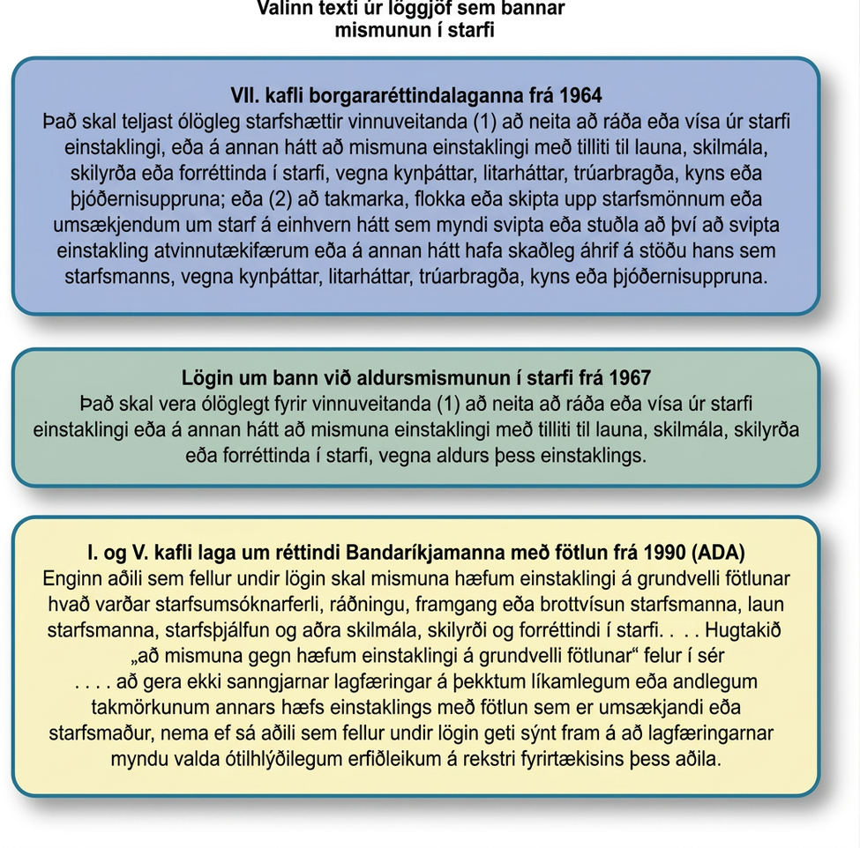
THE U.S. EQUAL EMPLOYMENT
OPPORTUNITY (EEOC)
Responsible for enforcing federal laws that make it illegal to discriminate against a job applicant or an employee because of the person’s race, color, religion, sex (including pregnancy), national origin, age (40 or older), disability, or genetic information.

Slide 16
THE U.S. EQUAL EMPLOYMENT
OPPORTUNITY (EEOC)
Equal Pay Act – requires equal pay for men and women in the same workplace who are performing equal work.
Title VII of the Civil Rights Act (1964) – makes it illegal to treat individuals unfavorably because of their race or color of their skin.
Pregnancy Discrimination Act (1978) – prohibits job discrimination of a woman because she is pregnant as long as she can perform the work required.
Americans with Disabilities Act - Employers cannot discriminate against any individual based on a disability.
Disability – a physical or mental impairment that limits one or more major life activities such as hearing, walking, and breathing.
Has been expanded to include individuals with alcoholism, former drug use, obesity, or psychiatric disabilities.
Bona Fide Occupational Qualification (BFOQ) - Requirement of certain occupations for which denying an individual employment would otherwise violate the law, such as requirements concerning religion or sex.
In some cases, religion, national origin, age, and sex are bona fide occupational qualifications.

Slide 17

JOB SATISFACTION
Results from how we think about our work (cognition) and how we feel about our work (affect).
Influenced by the work itself, our personality, and our culture.
Measured using questionnaires that employees complete.
Can be measured at a global level (general satisfaction with work) or at the level of specific factors (which aspects of the job lead to satisfaction).
(Credit: Linkedin)

Slide 18
JOB SATISFACTION
Factors Involved in Job Satisfaction:
Autonomy – Individual responsibility, control over decisions.
Work Content – Variety, challenge, role clarity. (Most strongly predictive of overall job satisfaction).
Communication – Feedback.
Financial rewards – Salary and benefits. (Weak correlation with job satisfaction).
Growth and development – Personal growth, training, education.
Promotion – Career advancement opportunity.
Coworkers – Professional relations or adequacy.
Supervision and feedback – Support, recognition, fairness.
Workload – Time pressure, tedium.
Work demands – Extra work requirements, insecurity of position.

Slide 19
JOB STRESS
Caused by specific stressors in an occupation.
Leads to poor health, job performance, and family life.
Stressors include:
Having to fill multiple roles.
Workplace role ambiguity.
Lack of career progress.
Lack of job security.
Lack of control over work outcomes.
Isolation.
Work overload.
Discrimination.
Harassment
Bullying.

Slide 20
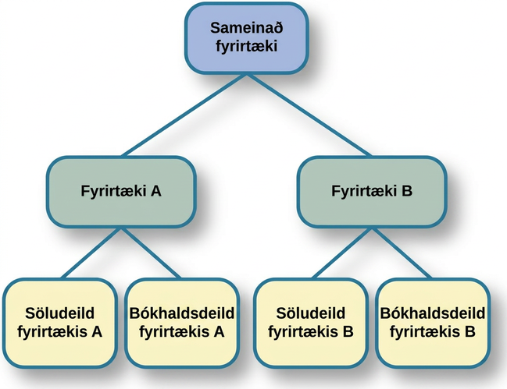
THREATS TO JOB SECURITY
Downsizing – process in which an organization tries to achieve greater overall efficiency by reducing the number of employees.
I-0 psychologists may be involved in how the news is delivered and how laid-off and retained employees are supported.
Corporate Mergers - the joining of two organizations.
Acquisition – one organization purchases another.
Often leads to cuts due to duplication of core functions, like sales and accounting, at each company.
Research focuses on understanding employee reactions and practical recommendations for managing organizational changes.

Slide 21
WORK-FAMILY BALANCE
Work-family balance – occurs when people juggle the demands of work life with the demands of family life.
Greenhaus & Beutell (1985):
Three sources of work-family conflicts:
Time devoted to work makes → difficult to fulfill requirements of family, or vice versa.
Strain from participation in work → difficult to fulfill requirements of family, or vice versa.
Specific behaviors required by work → difficult to fulfill requirements of family, or vice versa.
Ways to decrease work-family conflict:
Support in the home – emotional and practical.
  Practical support found to be the most effective.
Workplace support – understanding supervisors, flextime, leave with pay, and telecommuting.
Telecommuting – employees’ ability to set their own hours allowing them to work from home at different parts of the day.
  Telecommuting was found to make the conflict worse.

Slide 22
MANAGEMENT & ORGANIZATIONAL
STRUCTURE
Douglas McGregor (1960)
Combined scientific management and human relations into the notion of leadership behavior.
Scientific management – theory of management that analyzes and synthesized workflows with the main objective of improving economic efficiency, especially labor productivity.
Identified two different styles of managers.
Theory X – manager assumes workers are inherently lazy and unproductive; managers must have control and use punishments.
Theory Y – manager assumes workers are people who seek to work hard and productively; managers and workers can find creative solutions to problems; workers do not need to be controlled and punished.

Slide 23
Theory X and Theory Y
Theory X and Theory Y Management Styles
Theory X | Theory Y
People dislike work and avoid it. | People enjoy work and find it natural.
People avoid responsibility. | People are more satisfied when given responsibility.
People want to be told what to do. | People want to take part in setting their own work goals.
Goals are achieved through rules and punishments. | Goals are achieved through enticements and rewards.

Slide 24
MANAGEMENT & ORGANIZATIONAL STRUCTURE
Donald Clifton
Researched how an organization can best use an individual’s strengths.
Argued that our strengths provide the greatest opportunity for growth.
Strength-Based Management – approach that focuses on employees strengths.
Bass (1985)
Transactional leadership
characteristic of leaders who focus on supervision and organizational goals achieved through a system of rewards and punishments
maintenance of the organizational status quo.
Transformational leadership
charismatic role models,
inspirational (optimistic about goal attainment),
intellectually stimulating (encourage critical thinking and problem solving), and
individually considerate and who seek to change the organization.

Slide 25
GOALS, TEAMWORK & WORK TEAMS
Team-Based Approach:
Many companies structure their organization so that work can be delegated to work teams.
Work team – group of people within an organization or company given a specific task to achieve together.
Brings together diverse skills, experience, and expertise.
Do not always deliver greater productivity.
Why do some teams work well while others do not?
Social loafing.
Poor communication.
Poor decision-making skills due to conformity effects.
Conflict with the group.
Team halo effect - teams are given credit for their success but individuals within a team are blamed for team failures.

Slide 26
GOALS, TEAMWORK & WORK TEAMS
Teams and Gender Diversity
Cons – Diversity can introduce communication and interpersonal-relationship problems.
Pros – Diversity can increase the team’s skill set.
Hoogendoom, Oosterbeek, & van Praag (2013):
Found that gender-balanced teams performed better than predominantly male teams.
Did not identify which mechanism accounted for performance improvement.
Types of Teams
Problem resolution teams – created for the purpose of solving a particular problem.
Creative teams – used to develop innovative possibilities or solutions.
Tactical teams – used to execute a well-defined plan or objective.
Research on the virtual team:
Examines how groups of geographically disparate people brought together using digital communications technology function.

Slide 27
ORGANIZATIONAL CULTURE
Organizational Culture – the values, visions, hierarchies, norms, and interactions among its employees.
How an organization is run, how it operates, and how it makes decisions.
Ostroff, Kinicki & Tamkins (2003)
Three layers in organizational culture:
Observable artifacts – symbols of language (jargon, slang, humor), narratives (stories and legends), and practices (rituals) that represent the underlying cultural assumptions.
Espoused values – concepts/beliefs that management or entire organization endorses.
Basic assumptions – usually unobservable and unquestioned.
Diversity training – educates participants about cultural differences with the goal of improving teamwork.
Aims to reduce prejudice.

Slide 28
SEXUAL HARASSMENT
Most organizations have developed sexual harassment policies that define harassment and procedures to prevent and address it when it occurs.
Sexual harassment – sexually-based behavior that is knowingly unwanted and has an adverse effect on a person’s employment status, interferes with a person’s job performance, or creates a hostile or intimidating work environment.
Types of sexual harassment:
Quid pro quo – you give something to get something.
  Organizational rewards are offered in exchange for sexual favors.
The threat of withholding a reward if a sexual request is refused.
Hostile environment sexual harassment – employee experiences conditions in the workplace considered hostile/intimidating (e.g., environment allowing offensive language or sexually explicit images).

Slide 29
VIOLENCE IN THE WORKPLACE
Workplace violence – violence or the threat of violence against workers; can occur inside or outside the workplace.
Includes physical violence, harassment, intimidation, or other disruptive behavior.
Ranges from threats and verbal abuse to physical assaults and homicide.
Warning signs – intimidating behavior, threats, sabotaging equipment, or radical changes in a coworker’s behavior.
Feelings of being treated unfairly, unjustly, or disrespectfully are significant triggers.
  Procedural justice – fairness of the processes by which outcomes are determined in conflicts with or among employees.
Greenberg & Barling (1999):
History of aggression and amount of alcohol consumed → accurate predictors of violence against a coworker.
Feelings of being unfairly treated or untrusted → predictors of aggression against a supervisor.
Job security and alcohol consumption → predictors of aggression against a subordinate.
Every year, nearly 2 million workers are physically assaulted or threatened with assault.

Slide 30
HUMAN FACTORS PSYCHOLOGY
Studies the integration (physical, cognitive or both) of the human-machine interface in the workplace.
Concerned with researching and designing machines that fit human requirements.
Involved in the development of regulations and principles of test design – often related to safety.
Areas of Study
Attention – includes vigilance and monitoring, recognizing signals in noise, mental resources, and divided attention.
How is attention maintained? What about tasks maintains attention? How to design systems to support attention?
Cognitive engineering – includes human software interactions in complex automated systems, especially decision-making processes of workers as they are supported by the software system.
How do workers use and obtain information provided by software?
Task analysis – breaking down the elements of a task.
How can a task be performed more efficiently? How can a task be performed more safely?
Cognitive task analysis – breaking down the elements of a cognitive task.
How are decisions made?

Slide 31
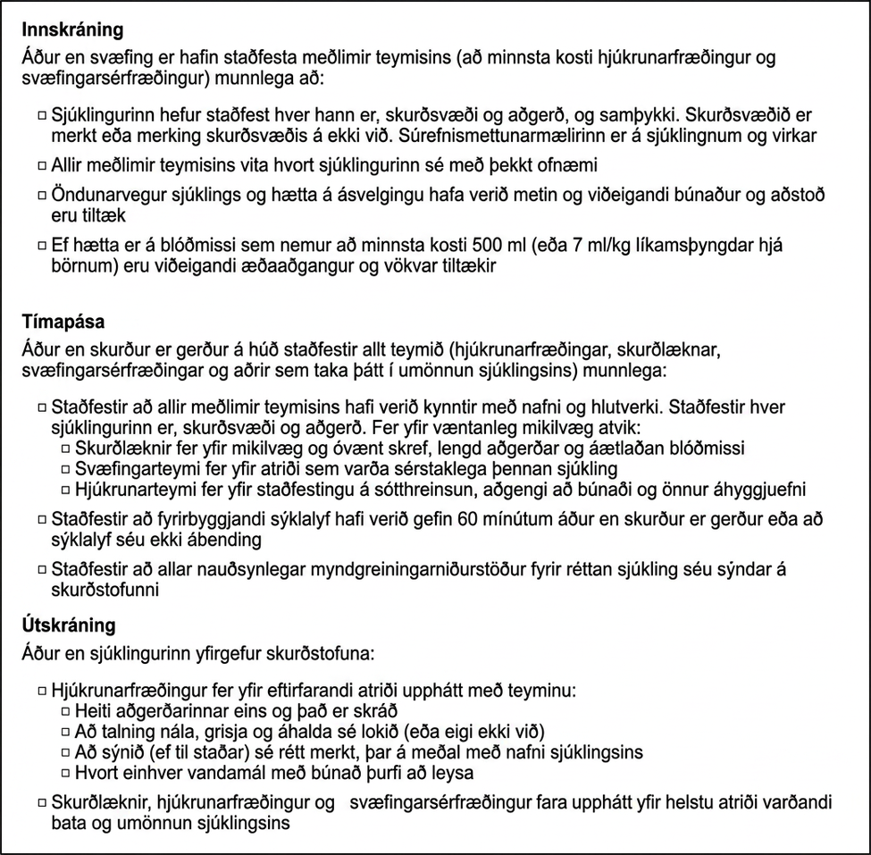
WORK PLACE SAFETY
Checklists:
Used to reduce accidents in the workplace.
E.g. Pilots are required to go through a detailed checklist of the different parts of the aircraft before takeoff to ensure that all essential equipment is working correctly.
Time limits on operating equipment:
Limits how long an operator, such as a pilot or truck driver, is allowed to operate the equipment.
World Health Organization (WHO) surgical checklist.

