Slide 1

Tölfræði
Kafli 13 F-dreifing og einþátta dreifigreining

Slide 2
Yfirlit kafla
One-Way ANOVA
F-dreifingin og F-hlutfallið
Staðreyndir um F-dreifinguna
Próf fyrir tvö dreifni
Lab: One-Way ANOVA

Slide 3
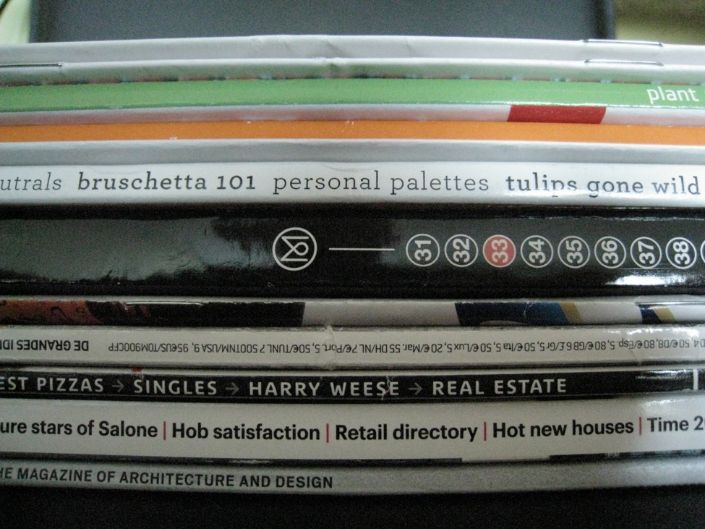
Figure 13.1
Einþátta dreifigreining er notuð til að meta upplýsingar úr nokkrum hópum.
Notes:
This is a photo of magazine spines. The magazines cover various topics like plants, food, and architecture.

Slide 4
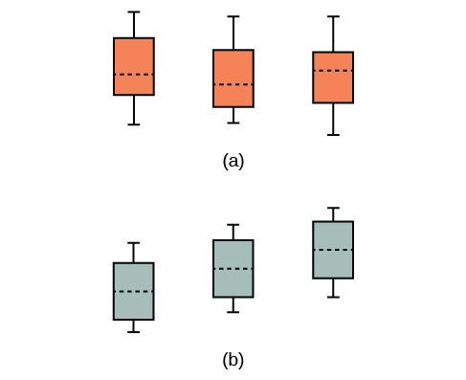
Figure 13.2
(a) Við höfnum ekki H0 þar sem hún gæti verið sönn. Öll meðaltölin eru nokkurn veginn eins; munurinn gæti stafað af slembibreytileika. (b) Við höfnum H0 þar sem meðaltölin eru ekki öll eins; munurinn er of mikill til að geta stafað af slembibreytileika.
Notes:
The first illustration shows three vertical boxplots with equal means. The second illustration shows three vertical boxplots with unequal means.

Slide 5
Table 13.1
Uppspretta breytileika | Kvaðratsumma (SS) | Frígráður (df) | Mean Square (MS) | F
Þáttur (Between) | SS(Factor) | k – 1 | MS(Factor) = SS(Factor)/(k – 1) | F = MS(Factor)/MS(Error)
Skekkja (Within) | SS(Error) | n – k | MS(Error) = SS(Error)/(n – k)
Samtals | SS(Total) | n – 1

Slide 6
Table 13.2
Plan 1: n₁ = 4 | Plan 2: n₂ = 3 | Plan 3: n₃ = 3
5 | 3.5 | 8
4.5 | 7 | 4
4 |  | 3.5
3 | 4.5

Slide 7
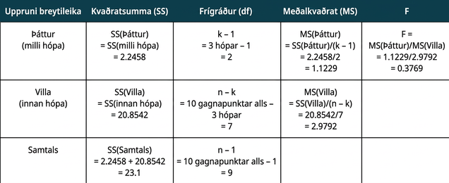
Table 13.3
Notes:
Table 13.3; Columns: Source of Variation, Sum of Squares (SS), Degrees of Freedom (df), Mean Square (MS), F; Row 1: Factor (Between), SS(Factor) = SS(Between) = 2.2458, k – 1 = 3 groups – 1 = 2, MS(Factor) = SS(Factor)/(k – 1) = 2.2458/2 = 1.1229, F = MS(Factor)/MS(Error) = 1.1229/2.9792 = 0.3769; Row 2: Error (Within), SS(Error) = SS(Within) = 20.8542, n – k = 10 total data – 3 groups = 7, MS(Error) = SS(Error)/(n – k) = 20.8542/7 = 2.9792, ; Row 3: Total, SS(Total) = 2.2458 + 20.8542 = 23.1, n – 1 = 10 total data – 1 = 9, ,

Slide 8
Table 13.4
Óþakið: n₁ = 3 | Jarðþekja: n₂ = 3 | Plast: n₃ = 3 | Hálmur: n₄ = 3 | Molta: n₅ = 3
2,625 | 5,348 | 6,583 | 7,285 | 6,277
2,997 | 5,682 | 8,560 | 6,897 | 7,818
4,915 | 5,482 | 3,830 | 9,230 | 8,677

Slide 9
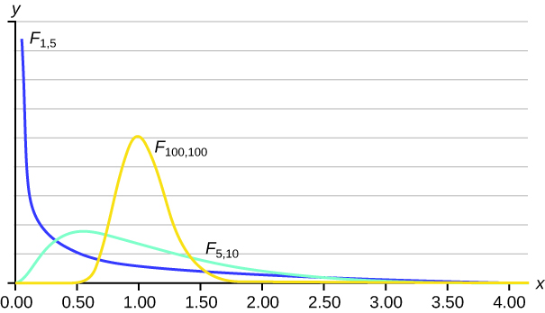
Figure 13.3
Notes:
The curve one the left is a nonsymmetrical F distribution curve skewed to the right, more values in the right tail and the peak is closer to the left. This curve is different from the graph on the right because of the different dfs. The curve on the right shows a nonsymmetrical F distribution curve skewed to the right. This curve is different from the graph on the left because of the different dfs. Because its dfs are larger, it more closely resembles a normal distribution curve.

Slide 10
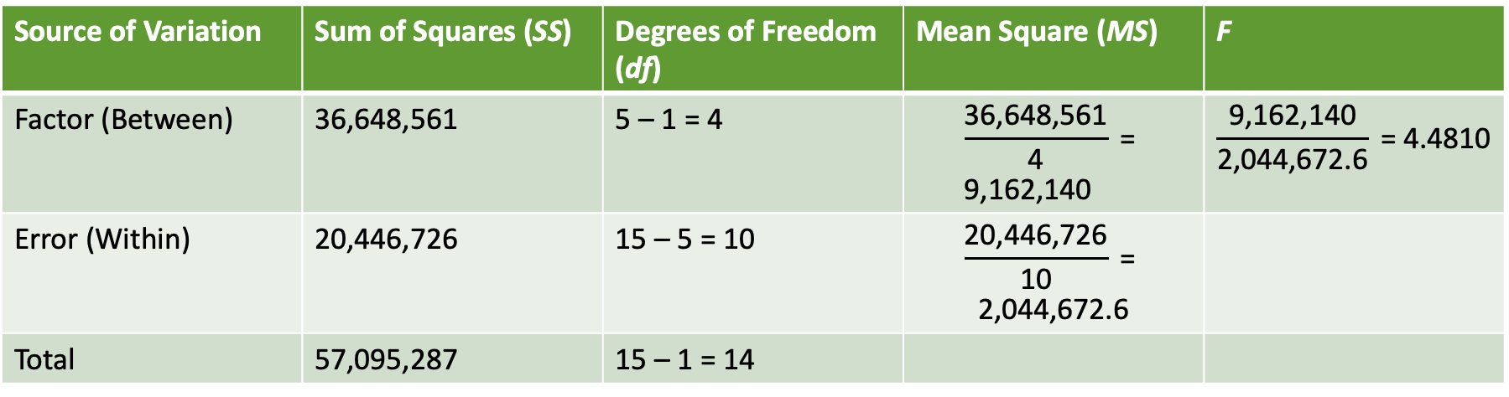
Table 13.5
Uppspretta breytileika | Kvaðratsumma (SS) | Frígráður (df) | Mean Square (MS) | F
Factor (Between) | 36,648,561 | 5 – 1 = 4 | $$\frac{\text{36,648,561}}{\text{4}}\text{ = 9,162,140}$$ | $$\frac{\text{9,162,140}}{\text{2,044,672.6}}\text{ = 4.4810}$$
Error (Within) | 20,446,726 | 15 – 5 = 10 | $$\frac{\text{20,446,726}}{\text{10}}\text{ = 2,044,672.6}$$
Samtals | 57,095,287 | 15 – 1 = 14

Slide 11
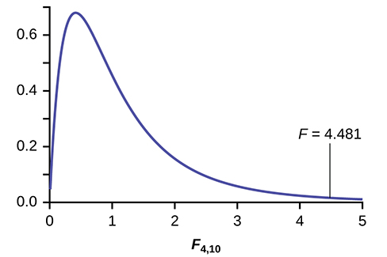
Figure 13.4
Notes:
This graph shows a nonsymmetrical F distribution curve. The horizontal axis extends from 0 - 5, and the vertical axis ranges from 0 - 0.7. The curve is strongly skewed to the right.

Slide 12
Table 13.6
Conc = 0.6 | Conc = 0.8 | Conc = 1.0 | Conc = 1.2 | Conc = 1.4
9 | 16 | 22 | 30 | 27
66 | 93 | 147 | 199 | 168
98 | 82 | 120 | 148 | 132

Slide 13
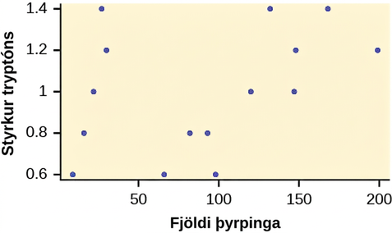
Figure 13.5
Notes:
This graph is a scatterplot for the data provided. The horizontal axis is labeled 'Colony counts' and extends from 0 - 200. The vertical axis is labeled 'Tryptone concentrations' and extends from 0.6 - 1.4.

Slide 14
Tafla 13.7 Meðaleinkunnir fjögurra kvenfélaga
Sorority 1 | Sorority 2 | Sorority 3 | Sorority 4
2.17 | 2.63 | 2.63 | 3.79
1.85 | 1.77 | 3.78 | 3.45
2.83 | 3.25 | 4.00 | 3.08
1.69 | 1.86 | 2.55 | 2.26
3.33 | 2.21 | 2.45 | 3.18

Slide 15
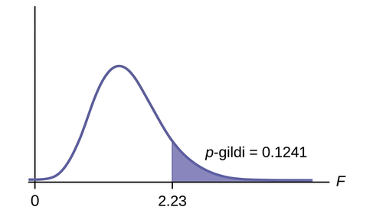
Figure 13.6
Notes:
This graph shows a nonsymmetrical F distribution curve with values of 0 and 2.23 on the x-axis representing the test statistic of sorority grade averages. The curve is slightly skewed to the right, but is approximately normal. A vertical upward line extends from 2.23 to the curve and the area to the right of this is shaded to represent the p-value.

Slide 16
Tafla 13.8 Meðaleinkunnir fjögurra íþróttaliða
Körfubolti | Hafnabolti | Íshokkí | Lacrosse
3.6 | 2.1 | 4.0 | 2.0
2.9 | 2.6 | 2.0 | 3.6
2.5 | 3.9 | 2.6 | 3.9
3.3 | 3.1 | 3.2 | 2.7
3.8 | 3.4 | 3.2 | 2.5

Slide 17
Table 13.9
Plöntur Tommys | Plöntur Töru | Plöntur Nicks
24 | 25 | 23
21 | 31 | 27
23 | 23 | 22
30 | 20 | 30
23 | 28 | 20

Slide 18
Table 13.10
 | Plöntur Tommys | Plöntur Töru | Plöntur Nicks
Úrtaksmeðaltal | 24.2 | 25.4 | 24.4
Úrtaksdreifni | 11.7 | 18.3 | 16.3

Slide 19
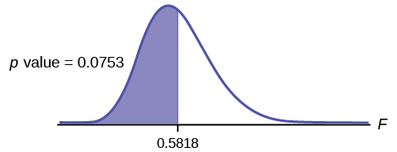
Figure 13.7
Notes:
This graph shows a nonsymmetrical F distribution curve. The curve is slightly skewed to the right, but is approximately normal. The value 0.5818 is marked on the vertical axis to the right of the curve's peak. A vertical upward line extends from 0.5818 to the curve and the area to the left of this line is shaded to represent the p-value.

Slide 20
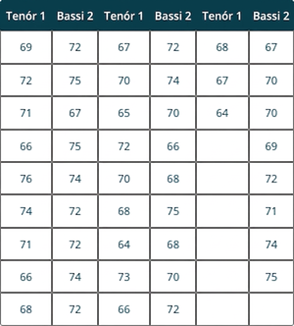
Table 13.11
Notes:
Table 13.11; Columns: Tenor1, Bass2, Tenor1, Bass2, Tenor1, Bass2; Row 1: 69, 72, 67, 72, 68, 67; Row 2: 72, 75, 70, 74, 67, 70; Row 3: 71, 67, 65, 70, 64, 70; Row 4: 66, 75, 72, 66, , 69; Row 5: 76, 74, 70, 68, , 72; Row 6: 74, 72, 68, 75, , 71; Row 7: 71, 72, 64, 68, , 74; Row 8: 66, 74, 73, 70, , 75; Row 9: 68, 72, 66, 72, ,

Slide 21
Table 13.12
Ávextir | Grænmeti | Brauð

Slide 22
Leyfi
Þetta OpenStax stoðefni er © Rice University samkvæmt CC BY-NC-SA 4.0 International leyfi; það má afrita eða breyta eingöngu í óviðskiptalegum tilgangi, en vísa verður til OpenStax og Rice University og tilgreina allar breytingar. Öllum aðlögunum verður að deila samkvæmt sams konar leyfi.

