Slide 1

Tölfræði
Kafli 11 Kí-kvaðratdreifingin

Slide 2
Yfirlit kaflans
Staðreyndir um kí-kvaðratdreifinguna
Mátpróf
Óhæðnispróf
Einsleitnipróf
Samanburður á kí-kvaðratprófum
Próf á einu dreifni
Verkefni 1: Kí-kvaðrat mátpróf
Verkefni 2: Kí-kvaðrat óhæðnispróf

Slide 3
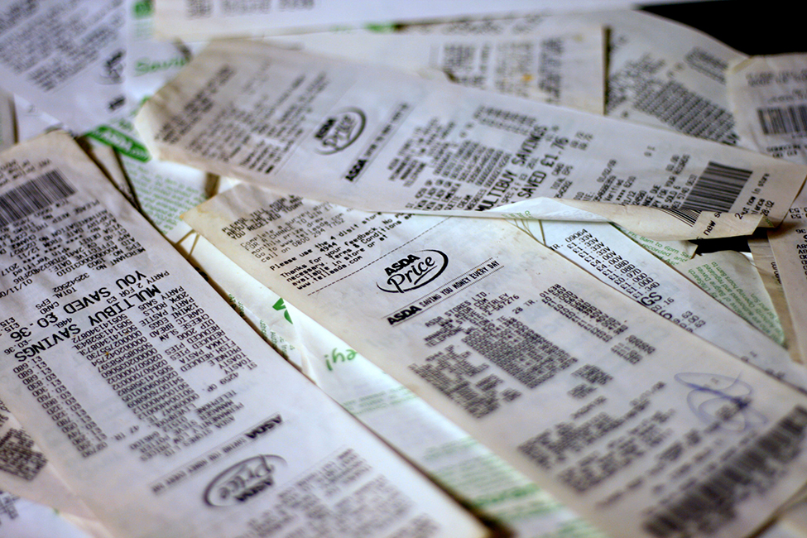
Figure 11.1
Kí-kvaðratdreifinguna má nota til að finna tengsl milli tveggja þátta, til dæmis matvöruverðs í mismunandi verslunum. (mynd: Pete/flickr)
Notes:
This is a photo of a pile of grocery store receipts. The items and prices are blurred.

Slide 4
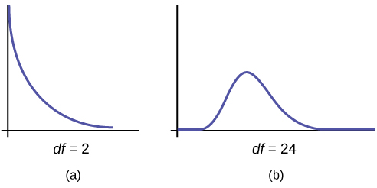
Figure 11.2
Notes:
Part (a) shows a chi-square curve with 2 degrees of freedom. It is nonsymmetrical and slopes downward continually. Part (b) shows a chi-square curve with 24 df. This nonsymmetrical curve does have a peak and is skewed to the right. The graphs illustrate that different degrees of freedom produce different chi-square curves.

Slide 5
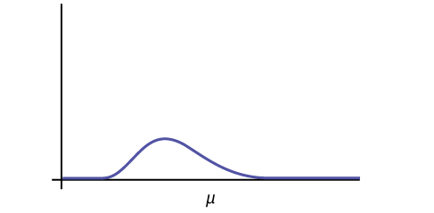
Figure 11.3
Notes:
This is a nonsymmetrical chi-square curve which is skewed to the right. The mean, m, is labeled on the horizontal axis and is located to the right of the curve's peak.

Slide 6
Table 11.1
Fjöldi fjarvista á önn | Væntur fjöldi nemenda
0–2 | 50
3–5 | 30
6–8 | 12
9–11 | 6
12+ | 2

Slide 7
Table 11.2
Fjöldi fjarvista á önn | Raunfjöldi nemenda
0–2 | 35
3–5 | 40
6–8 | 20
9–11 | 1
12+ | 4

Slide 8
Table 11.3
Fjöldi fjarvista á önn | Væntur fjöldi nemenda
0–2 | 50
3–5 | 30
6–8 | 12
9+ | 8

Slide 9
Table 11.4
Fjöldi fjarvista á önn | Raunfjöldi nemenda
0–2 | 35
3–5 | 40
6–8 | 20
9+ | 5

Slide 10
Table 11.5
Framleitt magn | Fjöldi gallaðra eintaka
0–100 | 5
101–200 | 6
201–300 | 7
301–400 | 8
401–500 | 10

Slide 11
Table 11.6
Framleitt magn | Fjöldi gallaðra eintaka
0–100 | 5
101–200 | 7
201–300 | 8
301–400 | 9
401–500 | 11

Slide 12
Tafla 11.7 Vikudagur þegar starfsmenn voru oftast fjarverandi
 | Mánudagur | Þriðjudagur | Miðvikudagur | Fimmtudagur | Föstudagur
Fjöldi fjarvista | 15 | 12 | 9 | 9 | 15

Slide 13
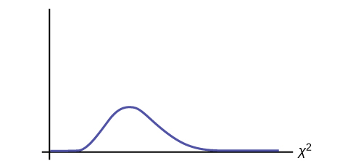
Figure 11.4
Notes:
This is a blank nonsymmetrical chi-square curve for the test statistic of the days of the week absent.

Slide 14
Table 11.8
 | Sunnudagur | Mánudagur | Þriðjudagur | Miðvikudagur | Fimmtudagur | Föstudagur | Laugardagur
Fjöldi nemenda | 11 | 8 | 10 | 7 | 10 | 5 | 5

Slide 15
Table 11.9
Fjöldi sjónvarpstækja | Prósenta
0 | 10
1 | 16
2 | 55
3 | 11
4+ | 8

Slide 16
Table 11.10
Fjöldi sjónvarpstækja | Tíðni
0 | 66
1 | 119
2 | 340
3 | 60
4+ | 15
 | Total = 600

Slide 17
Table 11.11
Fjöldi sjónvarpstækja | Prósenta | Vænt tíðni
0 | 10 | (0.10)(600) = 60
1 | 16 | (0.16)(600) = 96
2 | 55 | (0.55)(600) = 330
3 | 11 | (0.11)(600) = 66
fleiri en 3 | 8 | (0.08)(600) = 48

Slide 18
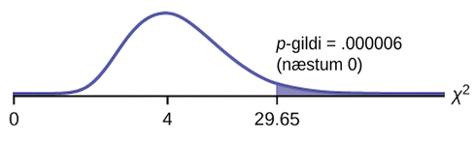
Figure 11.5
Notes:
This is a nonsymmetric chi-square curve with values of 0, 4, and 29.65 labeled on the horizontal axis. The value 4 coincides with the peak of the curve. A vertical upward line extends from 29.65 to the curve, and the region to the right of this line is shaded. The shaded area is equal to the p-value.

Slide 19
Table 11.12
Fjöldi gæludýra | Prósenta
0 | 18
1 | 25
2 | 30
3 | 18
4+ | 9

Slide 20
Table 11.13
Fjöldi gæludýra | Tíðni
0 | 210
1 | 240
2 | 320
3 | 140
4+ | 90

Slide 21
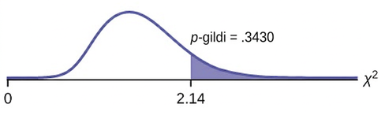
Figure 11.6
Notes:
This is a nonsymmetrical chi-square curve with values of 0 and 2.14 labeled on the horizontal axis. A vertical upward line extends from 2.14 to the curve and the region to the right of this line is shaded. The shaded area is equal to the p-value.

Slide 22
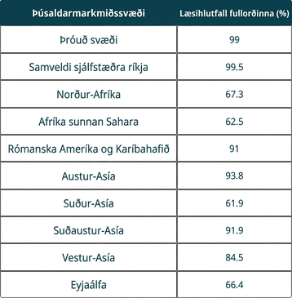
Table 11.14
Notes:
Table 11.14; Columns: MDG Region, Adult Literacy Rate (%); Row 1: Developed regions, 99; Row 2: Commonwealth of Independent States, 99.5; Row 3: Northern Africa, 67.3; Row 4: Sub-Saharan Africa, 62.5; Row 5: Latin America and the Caribbean, 91; Row 6: Eastern Asia, 93.8; Row 7: Southern Asia, 61.9; Row 8: Southeastern Asia, 91.9; Row 9: Western Asia, 84.5; Row 10: Oceania, 66.4

Slide 23
Tafla 11.15 Fjöldi vinnustunda á viku eftir tegund sjálfboðaliða (mæld gildi)
Tegund sjálfboðaliða | 1–3 klukkustundir | 4–6 klukkustundir | 7–9 klukkustundir | Samtals í röð
Nemendur í tveggja ára háskólanámi | 111 | 96 | 48 | 255
Four-year College Students | 96 | 133 | 61 | 290
Non-students | 91 | 150 | 53 | 294
Samtals í dálki | 298 | 379 | 162 | 839
Taflan sýnir mæld (O) gildi (gögn).

Slide 24
Tafla 11.16 Fjöldi klukkustunda unnar á viku eftir tegund sjálfboðaliða (vænt gildi)
Tegund sjálfboðaliða | 1-3 Hours | 4–6 klukkustundir | 7-9 Hours
Nemendur í tveggja ára háskóla | 90.57 | 115.19 | 49.24
Four-Year College Students | 103 | 131 | 56
Ekki nemendur | 104.42 | 132.81 | 56.77
Taflan sýnir vænt (E) gildi (gögn).

Slide 25
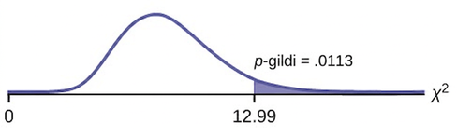
Figure 11.7
Notes:
Nonsymmetrical chi-square curve with values of 0 and 12.99 on the x-axis representing the test statistic of number of hours worked by volunteers of different types. A vertical upward line extends from 12.99 to the curve and the area to the right of this is equal to the p-value.

Slide 26
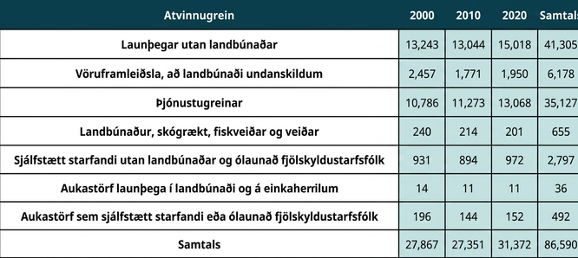
Table 11.17
Notes:
Table 11.17; Columns: Industry Sector, 2000, 2010, 2020, Total; Row 1: Non-agriculture Wage and Salary, 13,243, 13,044, 15,018, 41,305; Row 2: Goods-producing, Excluding Agriculture, 2,457, 1,771, 1,950, 6,178; Row 3: Services-providing, 10,786, 11,273, 13,068, 35,127; Row 4: Agriculture, Forestry, Fishing, and Hunting, 240, 214, 201, 655; Row 5: Non-agriculture Self-employed and Unpaid Family Worker, 931, 894, 972, 2,797; Row 6: Secondary Wage and Salary Jobs in Agriculture and Private Household Industries, 14, 11, 11, 36; Row 7: Secondary Jobs as a Self-employed or Unpaid Family Worker, 196, 144, 152, 492; Row 8: Total, 27,867, 27,351, 31,372, 86,590

Slide 27
Tafla 11.18 Þörf fyrir námsárangur eftir kvíðastigi
Þörf fyrir námsárangur | Mikill kvíði | Med-High kvíði | Miðlungs kvíði | Med-Low kvíði | Lítill kvíði | Raðarsamtala
Mikil þörf | 35 | 42 | 53 | 15 | 10 | 155
Miðlungs þörf | 18 | 48 | 63 | 33 | 31 | 193
Lítil þörf | 4 | 5 | 11 | 15 | 17 | 52
Dálksamtala | 57 | 95 | 127 | 63 | 58 | 400

Slide 28
Tafla 11.19 Dreifing búsetufyrirkomulags hjá körlum og konum í háskóla
 | Stúdentagarður | Íbúð | Hjá foreldrum | Annað
Karlar | 72 | 84 | 49 | 45
Konur | 91 | 86 | 88 | 35

Slide 29
Table 11.20
 | Sportbíll | Fólksbíll | Hlaðbakur | Pallbíll | Van/SUV
Fjölskylda | 5 | 15 | 35 | 17 | 28
Einhleypur | 45 | 65 | 37 | 46 | 7

Slide 30
Table 11.21
 | Perez | Chung | Stevens
Fyrir | 167 | 128 | 135
Eftir | 214 | 197 | 225

Slide 31
Table 11.22
Tegund samþykktrar umsóknar | Brown | Columbia | Cornell | Dartmouth | Penn | Yale
Almenn umsókn | 2,115 | 1,792 | 5,306 | 1,734 | 2,685 | 1,245
Bindandi snemmbúin umsókn | 577 | 627 | 1,228 | 444 | 1,195 | 761

Slide 32
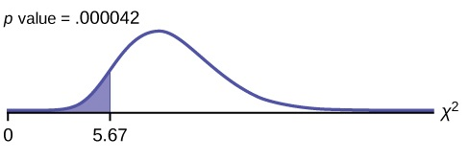
Figure 11.8
Notes:
This is a nonsymmetrical chi-square curve with values of 0 and 5.67 labeled on the horizontal axis. The point 5.67 lies to the left of the peak of the curve. A vertical upward line extends from 5.67 to the curve and the region to the left of this line is shaded. The shaded area is equal to the p-value.

Slide 33
Table 11.23
__________ | __________ | __________ | __________ | __________
__________ | __________ | __________ | __________ | __________
__________ | __________ | __________ | __________ | __________
__________ | __________ | __________ | __________ | __________
__________ | __________ | __________ | __________ | __________
__________ | __________ | __________ | __________ | __________

Slide 34
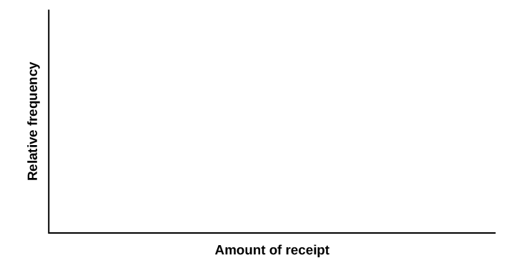
Figure 11.9
Notes:
Blank graph with relative frequency on vertical

Slide 35
Table 11.24
Fimmta | Mæld | Vænt
1st
2nd
3rd
4th
5th

Slide 36
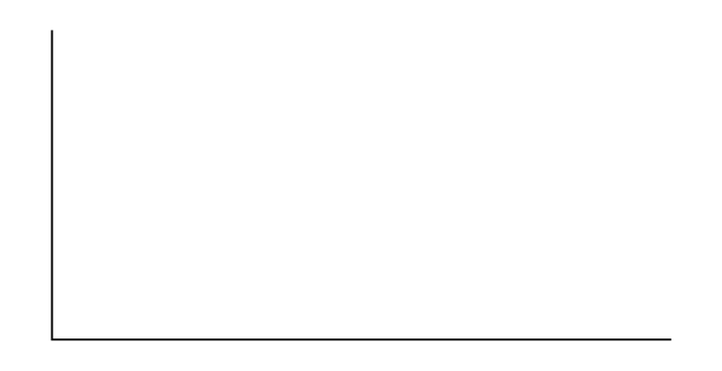
Figure 11.10
Notes:
Blank graph with vertical and horizontal axes.

Slide 37
Table 11.25
Reitur | Mæld | Vænt
1st
2nd
3rd
4th
5th
6th

Slide 38
Figure 11.11
Notes:
Blank graph with vertical and horizontal axes.

Slide 39
Tafla 11.26 Uppáhaldstegund snarls
 | Sælgæti og sætindi (nammi og bakkelsi) | Ís | Snakk og saltkringlur | Ávextir og grænmeti | Samtals
Karl
Kona
Samtals

Slide 40
Figure 11.12
Notes:
Blank graph with vertical and horizontal axes.

Slide 41
Leyfi
Þetta stoðefni frá OpenStax er © Rice University samkvæmt CC BY-NC-SA 4.0 International leyfi. Heimilt er að fjölfalda það eða breyta því eingöngu í óviðskiptalegum tilgangi, en vísa verður til OpenStax og Rice University og taka fram allar breytingar. Öllum aðlögunum skal deilt með sama leyfistegund.

