Slide 1

Tölfræði
Chapter 3 Probability Topics

Slide 2
Efnisyfirlit kafla
Hugtök
Óháðir og sundurlægir atburðir
Tvær grunnreglur líkinda
Krosstöflur
Trémyndir og Venn-myndir
Líkindaefni

Slide 3
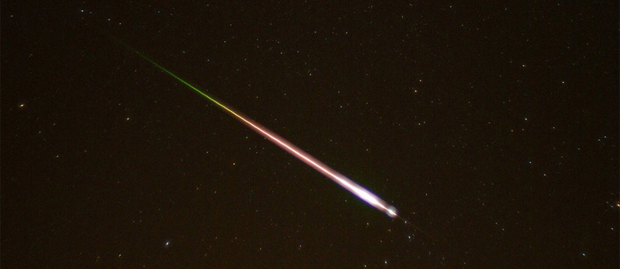
Figure 3.1
Loftsteinadrífur eru sjaldgæfar, en hægt er að reikna líkurnar á að þær eigi sér stað. (mynd: Navicore/flickr)
Notes:
This is a photo taken of the night sky. A meteor and its tail are shown entering the earth's atmosphere.

Slide 4
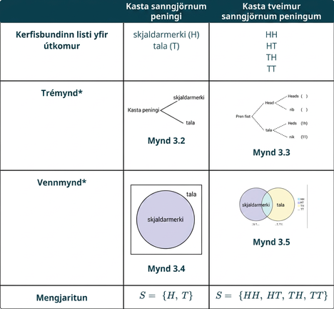
Table 3.1
Notes:
Table 3.1; Columns: , Flipping a Fair Coin, Flipping Two Fair Coins; Row 1: Systematic List of Outcomes, heads (H)tails (T), HHHTTHTT; Row 2: Tree Diagram*, Figure
3.2, Figure
3.3; Row 3: Venn Diagram*, Figure
3.4, Figure
3.5; Row 4: Set Notation, S= {
H, T
}, S= {
HH, HT, TH, TT
}

Slide 5
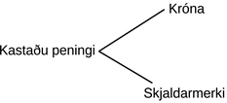
Figure 3.2
Notes:
A simple tree diagram illustrates the two possible outcomes of flipping a coin: Heads or Tails, demonstrating a basic concept in probability.

Slide 6
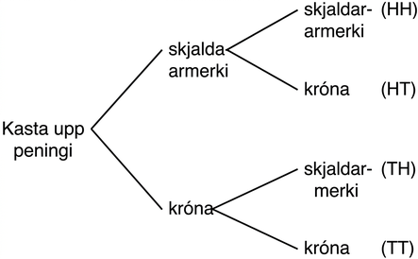
Figure 3.3
Notes:
A tree diagram illustrates the possible outcomes of flipping a coin two times. The outcomes are Heads-Heads (HH), Heads-Tails (HT), Tails-Heads (TH), and Tails-Tails (TT).

Slide 7
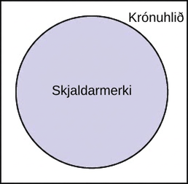
Figure 3.4
Notes:
A diagram illustrating the outcomes of a coin flip, with 'Heads' occupying a large circular region and 'Tails' represented by the smaller surrounding area.

Slide 8
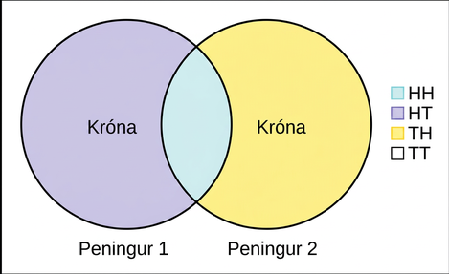
Figure 3.5
Notes:
A Venn diagram illustrates the outcomes of flipping two coins. The left circle represents 'Heads on Coin 1' (HT, HH), the right 'Heads on Coin 2' (TH, HH). The overlap (HH) shows heads on both. A legend clarifies HH, HT, TH, and TT.

Slide 9
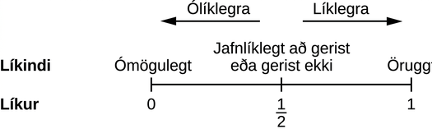
Figure 3.6
Notes:
Image shows a number line from zero to one with a tick and label at one half. Tick zero represents the probability of an impossible event. Tick one represents the probability of a certain event. Tick one half represents the probability of an event that is equally likely to happen or not. Above the number line, an arrow points from one half toward zero showing that as probability moves closer to zero events are less likely. An arrow points from one half toward one showing that as probability moves closer to one events are more likely.

Slide 10
Table 3.2
 | Right-Handed | Left-Handed
Karlar | 43 | 9
Konur | 44 | 4

Slide 11
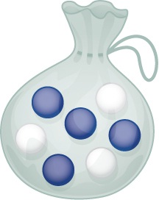
Figure 3.7
Notes:
Drawing of a transparent drawstring bag containing four blue marbles and three white marbles.

Slide 12
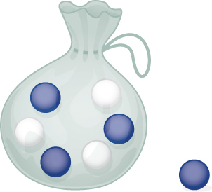
Figure 3.8
Notes:
Drawing of a transparent drawstring bag containing three blue marbles and three white marbles. One blue marble is shown to the side of the bag.

Slide 13
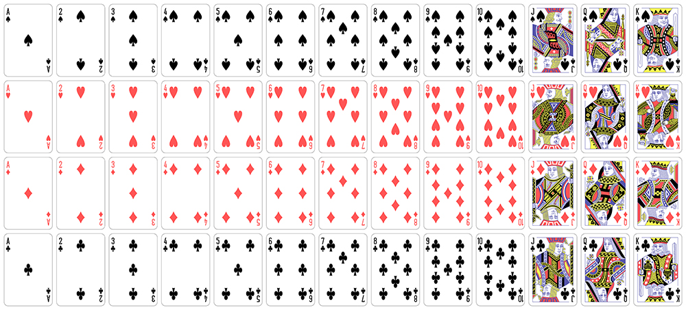
Figure 3.9
Notes:
This image shows a complete set of playing cards arranged in four rows. Each row contains the cards in one suit; row one shows clubs, row two shows diamonds, row three shows hearts, and row four shows spades. First card in each row is an ace displaying one suit symbol, the next cards are numbered two through ten, and each card displays the corresponding number of symbols. The last three cards in each row show are labeled jack, queen, and king.

Slide 14
Table 3.3
 | Hraðakstursbrot á síðasta ári | Ekkert hraðakstursbrot á síðasta ári | Samtals
Notar farsíma við akstur | 25 | 280 | 305
Notar ekki farsíma við akstur | 45 | 405 | 450
Samtals | 70 | 685 | 755

Slide 15
Table 3.4
 | Meiðsli á síðasta ári | Engin meiðsli á síðasta ári | Samtals
Teygir | 55 | 295 | 350
Teygir ekki | 231 | 219 | 450
Samtals | 286 | 514 | 800

Slide 16
Table 3.5 Hiking Area Preference
Kyn | Strandlengjan | Nálægt vötnum og lækjum | Á fjallstindum | Samtals
Kona | 18 | 16 | ___ | 45
Karl | ___ | ___ | 14 | 55
Samtals | ___ | 41 | ___ | ___

Slide 17
Table 3.6 Hiking Area Preference
Kyn | Strandlengjan | Nálægt vötnum og lækjum | Á fjallstindum | Samtals
Kona | 18 | 16 | 11 | 45
Karl | 16 | 25 | 14 | 55
Samtals | 34 | 41 | 25 | 100

Slide 18
Table 3.7
Kyn | Vatnastígur | Hæðastígur | Skógarstígur | Samtals
Kona | 45 | 38 | 27 | 110
Karl | 26 | 52 | 12 | 90
Samtals | 71 | 90 | 39 | 200

Slide 19
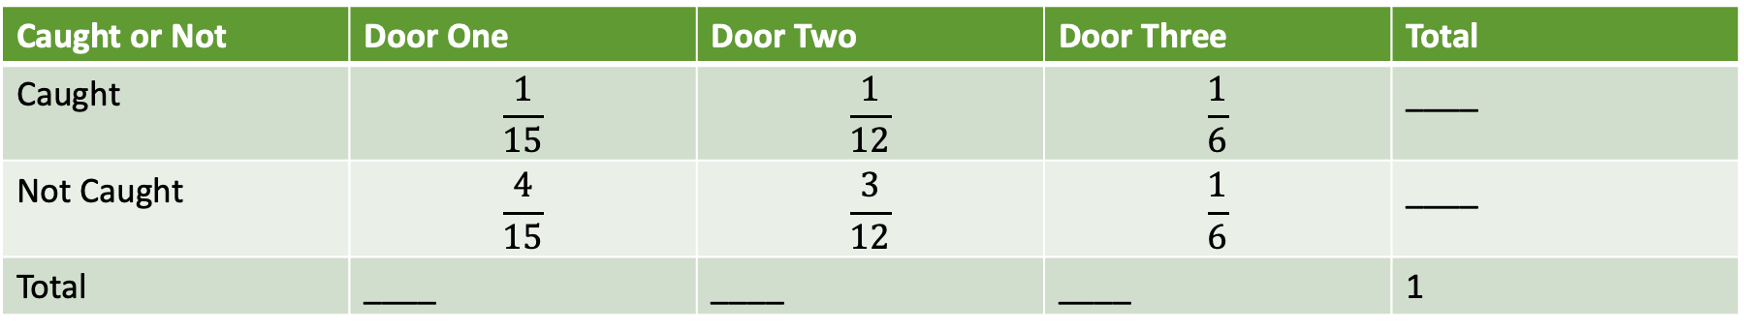
Table 3.8 Door Choice
Gripinn eða ekki | Dyr eitt | Dyr tvö | Dyr þrjú | Samtals
Gripinn | $$\frac{1}{15}$$ | $$\frac{1}{12}$$ | $$\frac{1}{6}$$ | ____
Ekki gripinn | $$\frac{4}{15}$$ | $$\frac{3}{12}$$ | $$\frac{1}{6}$$ | ____
Samtals | ____ | ____ | ____ | 1

Slide 20
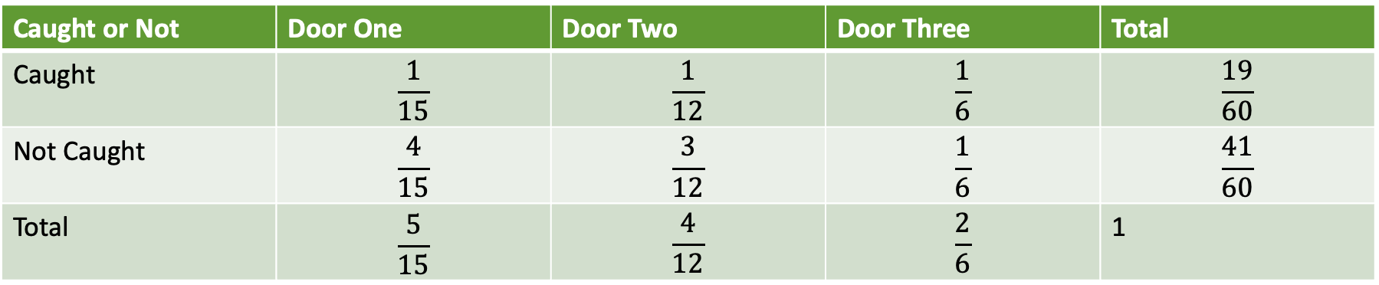
Table 3.9 Door Choice
Náðist eða ekki | Hurð eitt | Hurð tvö | Hurð þrjú | Samtals
Náðist | $$\frac{1}{15}$$ | $$\frac{1}{12}$$ | $$\frac{1}{6}$$ | $$\frac{19}{60}$$
Náðist ekki | $$\frac{4}{15}$$ | $$\frac{3}{12}$$ | $$\frac{1}{6}$$ | $$\frac{41}{60}$$
Samtals | $$\frac{5}{15}$$ | $$\frac{4}{12}$$ | $$\frac{2}{6}$$ | 1

Slide 21
Tafla 3.10 Afbrotatíðni í Bandaríkjunum á hverja 100.000 íbúa 2008–2011
Ár | Afbrot A | Afbrot B | Afbrot C | Afbrot D | Samtals
2008 | 145.7 | 732.1 | 29.7 | 314.7
2009 | 133.1 | 717.7 | 29.1 | 259.2
2010 | 119.3 | 701 | 27.7 | 239.1
2011 | 113.7 | 702.2 | 26.8 | 229.6
Samtals

Slide 22
Table 3.11
Aldur | Hávaxinn | Meðalhár | Lágvaxinn | Samtölur
Under 18 | 18 | 28 | 14
18–50 | 20 | 51 | 28
51+ | 12 | 25 | 9
Samtölur

Slide 23
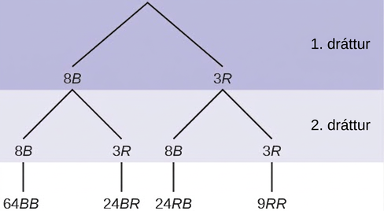
Figure 3.10
Total = 64 + 24 + 24 + 9 = 121.
Notes:
This is a tree diagram with branches showing frequencies of each draw. The first branch shows two lines: 8B and 3R. The second branch has a set of two lines (8B and 3R) for each line of the first branch. Multiply along each line to find 64BB, 24BR, 24RB, and 9RR.

Slide 24
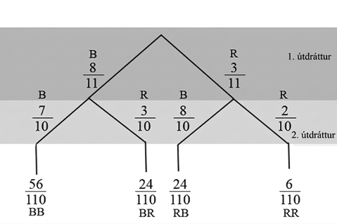
Figure 3.11
Notes:
Image shows a tree diagram with two levels the first level shows two branches. The first level represents the first draw of a marble. The left branch is labeled eight B and the right branch is labeled three R. The second level represents the second draw, two additional branches extend from the end of first level’s branches. The left branch of each is labeled eight B and the right branch is labeled three R

Slide 25
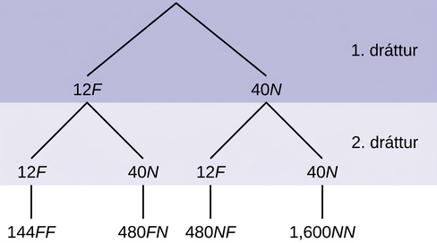
Figure 3.12
Notes:
This is a tree diagram with branches showing frequencies of each draw. The first branch shows two lines: 12F and 40N. The second branch has a set of two lines (12F and 40N) for each line of the first branch. Multiply along each line to find 144FF, 480FN, 480NF, and 1,600NN.

Slide 26
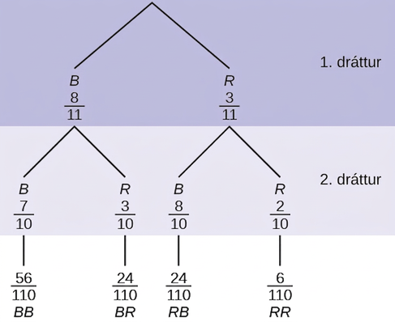
Figure 3.13
Total = 56+24+24+6 110 = 110 110 =1 .
Notes:
This is a tree diagram with branches showing probabilities of each draw. The first branch shows 2 lines: B 8/11 and R 3/11. The second branch has a set of 2 lines for each first branch line. Below B 8/11 are B 7/10 and R 3/10. Below R 3/11 are B 8/10 and R 2/10. Multiply along each line to find BB 56/110, BR 24/110, RB 24/110, and RR 6/110.

Slide 27
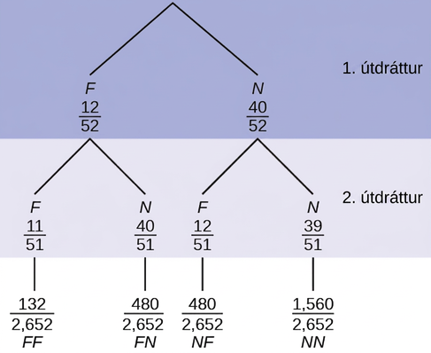
Figure 3.14
Notes:
This is a tree diagram with branches showing frequencies of each draw. The first branch shows 2 lines: F 12/52 and N 40/52. The second branch has a set of 2 lines (F 11/52 and N 40/51) for each line of the first branch. Multiply along each line to find FF 121/2652, FN 480/2652, NF 480/2652, and NN 1560/2652.

Slide 28
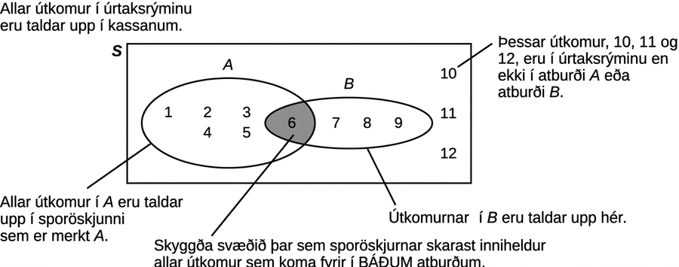
Figure 3.15
Notes:
Image shows a Venn diagram consisting of two overlapping ovals inside a rectangle. The left oval is labeled A and the right is labeled B. The rectangle is labeled S. Annotations explain that Every outcome in the sample space is listed in the box. The shaded, overlapping area contains any outcome that appears in both events. This area contains six. All outcomes in A are listed in the oval labeled A. The values one, two, three, four, and five lie inside A, but outside the overlapping region. All outcomes in B are listed in the oval labeled B. The values seven, eight, and nine lie inside B, but outside the overlapping region. The outcomes ten, eleven, and twelve are in the sample space, but not in the events A or B, so these are listed in the region inside the rectangle and outside the ovals.

Slide 29
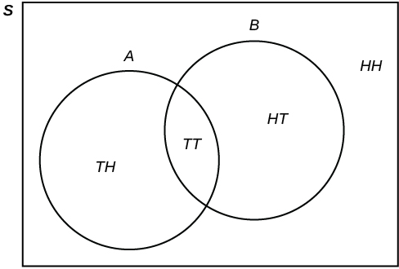
Figure 3.16
Notes:
This is a venn diagram. An oval representing set A contains Tails + Heads and Tails + Tails. An oval representing set B also contains Tails + Tails, along with Heads + Tails. The universe S contains Heads + Heads, but this value is not contained in either set A or B.

Slide 30
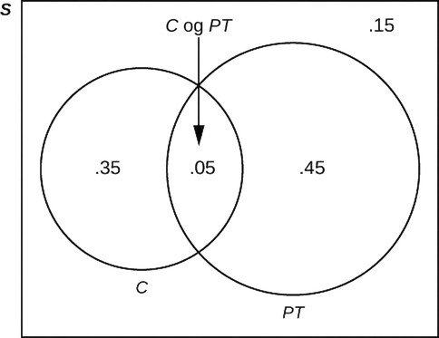
Figure 3.17
Notes:
Image shows a Venn diagram consisting of two overlapping circles inside a rectangle. The left oval is labeled C and the right is labeled PT. The rectangle is labeled S. The overlapping region is labeled C and PT and contains the probability five hundredths. The region inside C, but outside the overlapping region, contains the probability thirty-five hundredths. The region inside B, but outside the overlapping region, contains the probability forty-five hundredths. The probability fifteen hundredths is listed in the region inside the rectangle and outside the ovals.

Slide 31
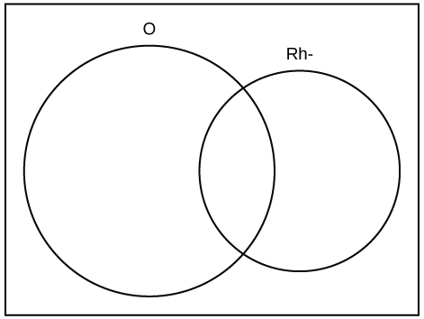
Figure 3.18
Notes:
This is an empty Venn diagram showing two overlapping circles. The left circle is labeled O and the right circle is labeled RH-.

Slide 32
Table 3.12 Population
Litur | Fjöldi
Yellow (Y)
Green (G)
Blue (BL)
Brown (B)
Orange (O)
Red (R)

Slide 33
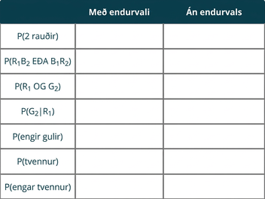
Table 3.13 Theoretical Probabilities
Notes:
Table 3.13 Theoretical Probabilities; Columns: , With Replacement, Without Replacement; Row 1: P(2 reds), , ; Row 2: P(R1B2 OR B1R2), , ; Row 3: P(R1 AND G2), , ; Row 4: P(G2|R1), , ; Row 5: P(no yellows), , ; Row 6: P(doubles), , ; Row 7: P(no doubles), ,

Slide 34
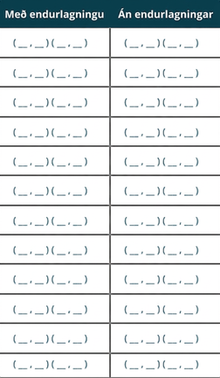
Tafla 3.14 Raunmældar niðurstöður
Notes:
Table 3.14 Empirical Results; Columns: With Replacement, Without Replacement; Row 1: ( __ , __ ) ( __ , __ ), ( __ , __ ) ( __ , __ ); Row 2: ( __ , __ ) ( __ , __ ), ( __ , __ ) ( __ , __ ); Row 3: ( __ , __ ) ( __ , __ ), ( __ , __ ) ( __ , __ ); Row 4: ( __ , __ ) ( __ , __ ), ( __ , __ ) ( __ , __ ); Row 5: ( __ , __ ) ( __ , __ ), ( __ , __ ) ( __ , __ ); Row 6: ( __ , __ ) ( __ , __ ), ( __ , __ ) ( __ , __ ); Row 7: ( __ , __ ) ( __ , __ ), ( __ , __ ) ( __ , __ ); Row 8: ( __ , __ ) ( __ , __ ), ( __ , __ ) ( __ , __ ); Row 9: ( __ , __ ) ( __ , __ ), ( __ , __ ) ( __ , __ ); Row 10: ( __ , __ ) ( __ , __ ), ( __ , __ ) ( __ , __ ); Row 11: ( __ , __ ) ( __ , __ ), ( __ , __ ) ( __ , __ ); Row 12: ( __ , __ ) ( __ , __ ), ( __ , __ ) ( __ , __ )

Slide 35
Tafla 3.15 Raunlíkur
Notes:
Table 3.15 Empirical Probabilities; Columns: , With Replacement, Without Replacement; Row 1: P(2 reds), , ; Row 2: P(R1B2 OR B1R2), , ; Row 3: P(R1 AND G2), , ; Row 4: P(G2|R1), , ; Row 5: P(no yellows), , ; Row 6: P(doubles), , ; Row 7: P(no doubles), ,

Slide 36
Notkunarleyfi
Þetta stoðefni frá OpenStax er © Rice University og gefið út með alþjóðlegu CC BY-NC-SA 4.0 notkunarleyfi; það má afrita eða breyta eingöngu í óhagnaðarskyni, en vísa verður til OpenStax og Rice University og tilgreina allar breytingar. Öllum aðlögunum verður að deila með sams konar notkunarleyfi.

