Slide 1
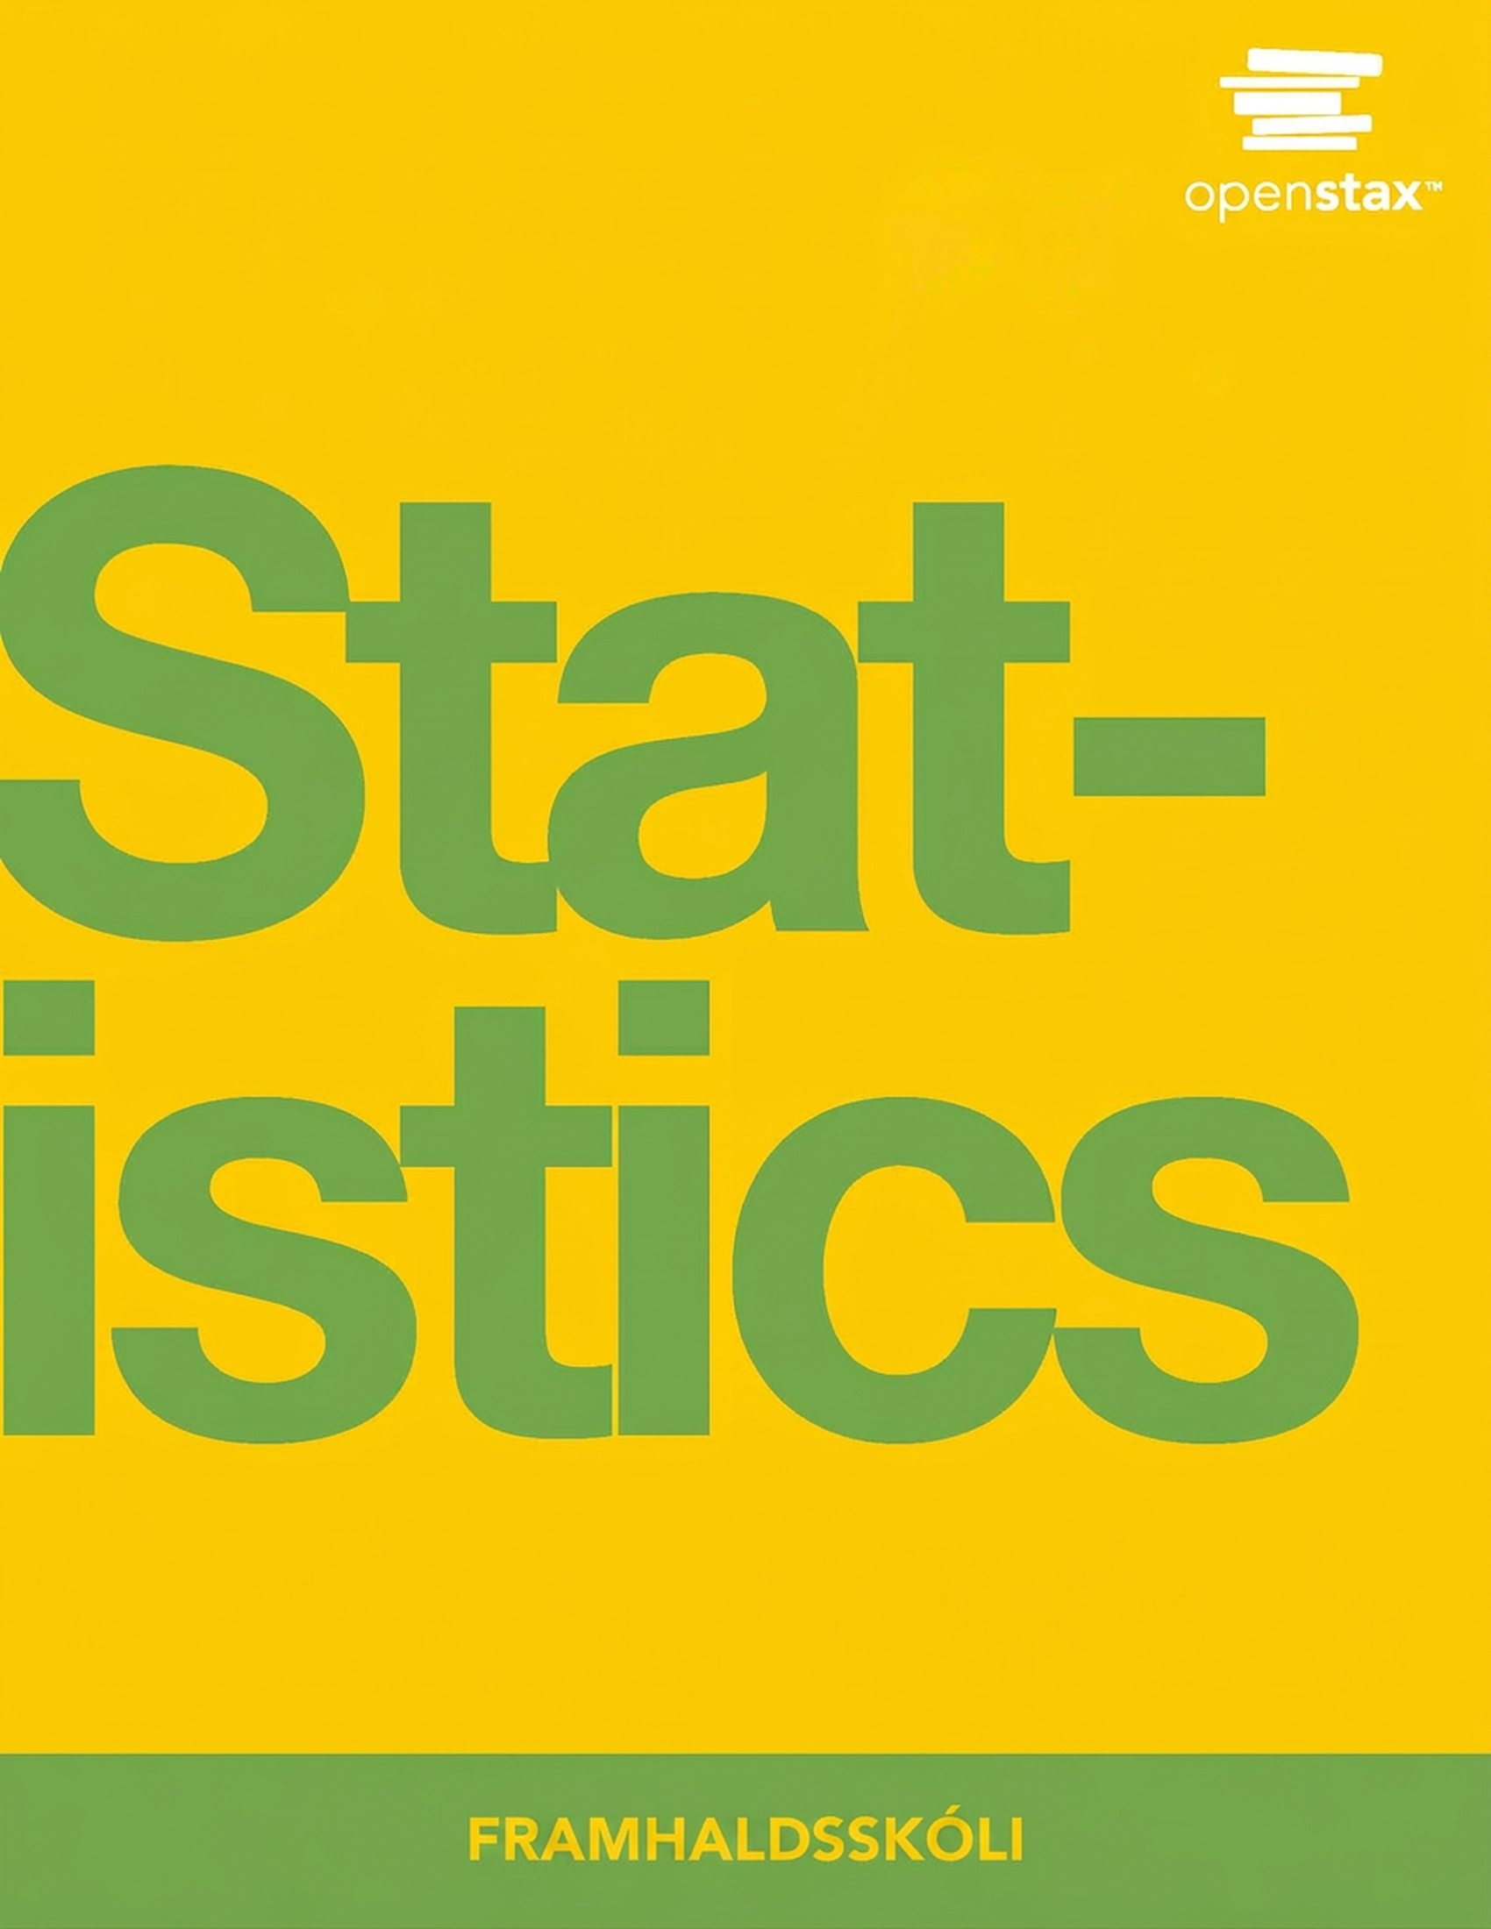
Tölfræði
12. kafli Línuleg aðhvarfsgreining og fylgni

Slide 2
Efnisyfirlit kaflans
Línulegar jöfnur
Aðhvarfsjafnan
Marktektarpróf fyrir fylgnistuðulinn (valkvætt)
Prediction (Optional)
Útlagar
Aðhvarfsgreining (fjarlægð frá skóla) (valkvætt)
Regression (Textbook Cost) (Optional)
Regression (Fuel Efficiency) (Optional)

Slide 3

Figure 12.1
Línuleg aðhvarfsgreining og fylgni geta hjálpað þér að kanna hvort laun bifvélavirkja tengist starfsreynslu hans. (mynd: Joshua Rothhaas)
Notes:
This is a photo of a car mechanic’s shop. There are three United States Postal Services trucks being serviced, and one not being serviced.

Slide 4
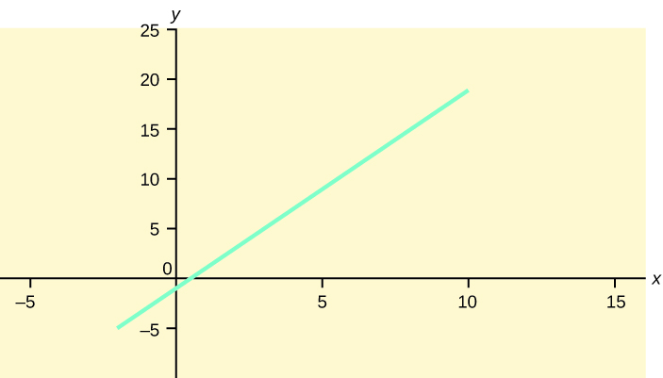
Figure 12.2
Notes:
Graph of the equation y = -1 + 2x. This is a straight line that crosses the y-axis at -1 and is sloped up and to the right, rising 2 units for every one unit of run.

Slide 5
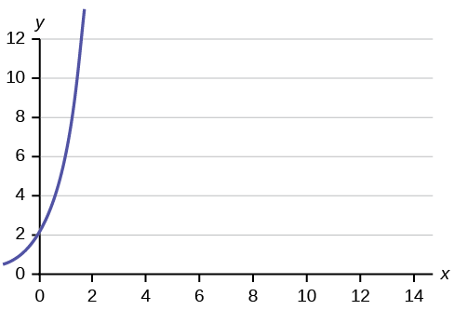
Figure 12.3
Notes:
This is a graph of an equation. The x-axis is labeled in intervals of 2 from 0 - 14; the y-axis is labeled in intervals of 2 from 0 - 12. The equation's graph is a curve that crosses the y-axis at 2 and curves upward and to the right.

Slide 6
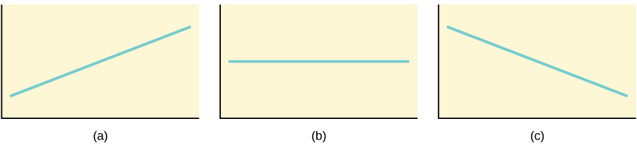
Figure 12.4
Þrjú möguleg gröf fyrir y = a + bx. (a) Ef b > 0 hallar línan upp til hægri. (b) Ef b = 0 er línan lárétt. (c) Ef b < 0 hallar línan niður til hægri.
Notes:
Three possible graphs of the equation y = a + bx. For the first graph, (a), b > 0 and so the line slopes upward to the right. For the second, b = 0 and the graph of the equation is a horizontal line. In the third graph, (c), b < 0 and the line slopes downward to the right.

Slide 7
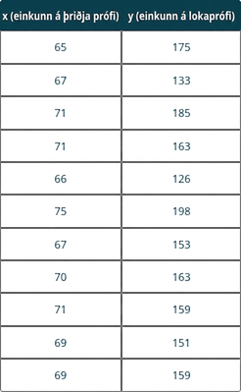
Table 12.1
Notes:
Table 12.1; Columns: x (third exam score), y (final exam score); Row 1: 65, 175; Row 2: 67, 133; Row 3: 71, 185; Row 4: 71, 163; Row 5: 66, 126; Row 6: 75, 198; Row 7: 67, 153; Row 8: 70, 163; Row 9: 71, 159; Row 10: 69, 151; Row 11: 69, 159

Slide 8
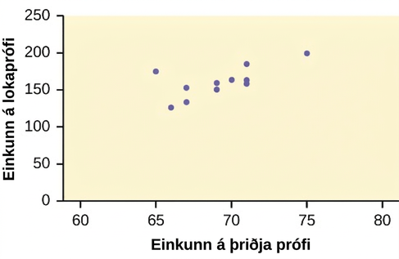
Figure 12.5
Með x- og y-hnitunum í töflunni merkjum við punktana inn á graf og búum þannig til dreifirit sem sýnir einkunnir á lokaprófi út frá einkunnum á þriðja prófi.
Notes:
This is a scatter plot of the data provided. The third exam score is plotted on the x-axis, and the final exam score is plotted on the y-axis. The points form a strong, positive, linear pattern.

Slide 9
Table 12.2
x (depth) | y (hámarksköfunartími)
50 | 80
60 | 55
70 | 45
80 | 35
90 | 25
100 | 22

Slide 10
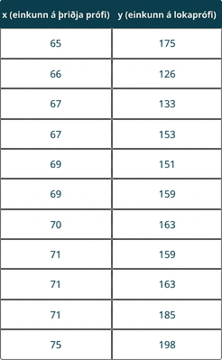
Table 12.3
Notes:
Table 12.3; Columns: x (third exam score), y (final exam score); Row 1: 65, 175; Row 2: 66, 126; Row 3: 67, 133; Row 4: 67, 153; Row 5: 69, 151; Row 6: 69, 159; Row 7: 70, 163; Row 8: 71, 159; Row 9: 71, 163; Row 10: 71, 185; Row 11: 75, 198

Slide 11
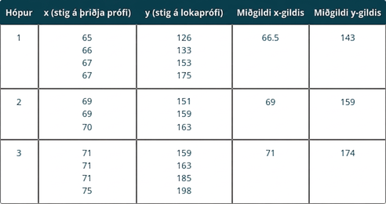
Table 12.4
Notes:
Table 12.4; Columns: Group, x (third exam score), y (final exam score), Median x value, Median y value; Row 1: 1, 65666767, 126133153175, 66.5, 143; Row 2: 2, 696970, 151159163, 69, 159; Row 3: 3, 71717175, 159163185198, 71, 174

Slide 12
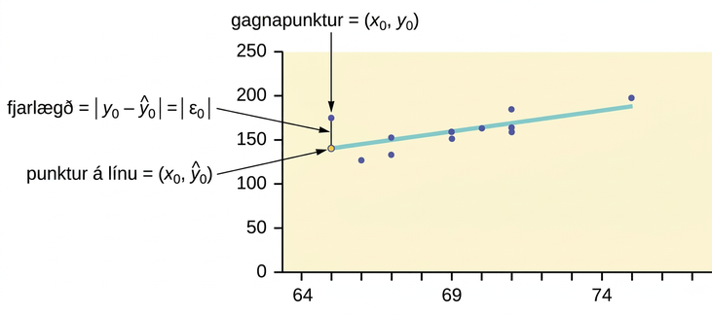
Figure 12.6
Notes:
The scatter plot of exam scores with a line of best fit. One data point is highlighted along with the corresponding point on the line of best fit. Both points have the same x-coordinate. The distance between these two points illustrates how to compute the sum of squared errors.

Slide 13
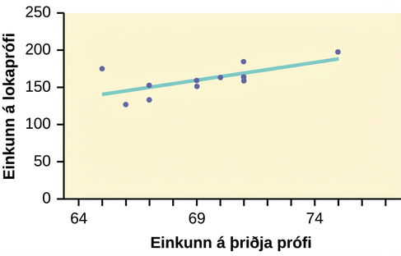
Figure 12.7
Notes:
The scatter plot of exam scores with a line of best fit. One data point is highlighted along with the corresponding point on the line of best fit.

Slide 14
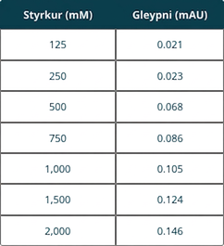
Table 12.5

Slide 15
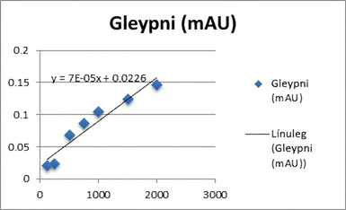
Figure 12.8
Notes:
This shows a scatter plot with a line of best fit. The scatter plot has points plotted at (0.021, 125), (0.023, 250), (0.068, 500), (0.086, 750), (0.105, 1000), (0.124, 1500), and (0.146, 2000), and is labeled y = 7E-05x + 0.0226.

Slide 16
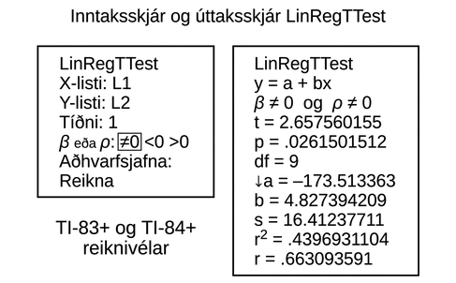
Figure 12.9
Notes:
1. Image of calculator input screen for LinRegTTest with input matching the instructions above. 2.Image of corresponding output calculator output screen for LinRegTTest: Output screen shows: Line 1. LinRegTTest; Line 2. y = a + bx; Line 3. beta does not equal 0 and rho does not equal 0; Line 4. t = 2.657560155; Line 5. df = 9; Line 6. a = 173.513363; Line 7. b = 4.827394209; Line 8. s = 16.41237711; Line 9. r squared = .4396931104; Line 10. r = .663093591

Slide 17
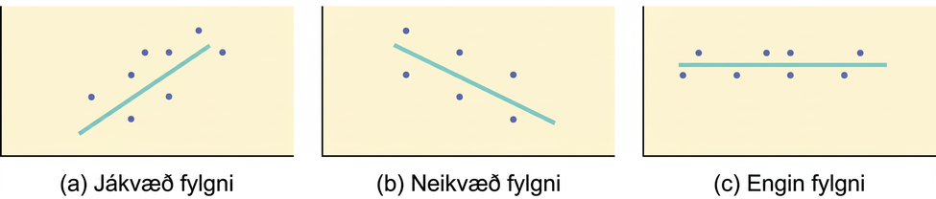
Figure 12.10
(a) Dreifirit sem sýnir gögn með jákvæða fylgni: 0 < r < 1. (b) Dreifirit sem sýnir gögn með neikvæða fylgni: –1 < r < 0. (c) Dreifirit sem sýnir gögn án fylgni: r = 0.
Notes:
Three scatter plots with lines of best fit. The first scatterplot shows points ascending from the lower left to the upper right. The line of best fit has positive slope. The second scatter plot shows points descending from the upper left to the lower right. The line of best fit has negative slope. The third scatter plot of points form a horizontal pattern. The line of best fit is a horizontal line.

Slide 18
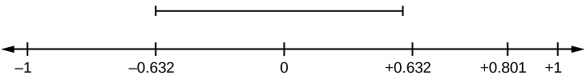
Figure 12.11
r er ekki á bilinu frá –0.632 til 0.632 og því er r marktækt.
Notes:
Horizontal number line with values of -1, -0.632, 0, 0.632, 0.801, and 1. A dashed line above values -0.632, 0, and 0.632 indicates not significant values.

Slide 19
Figure 12.12
r = –0.624 og –0.624 < –0.532. Því er r marktækt.
Notes:
Horizontal number line with values of -0.624, -0.532, and 0.532.

Slide 20
Figure 12.13
–0.811 < r = 0.776 < 0.811. Því er r ekki marktækt.
Notes:
Horizontal number line with values -0.924, -0.532, and 0.532.

Slide 21
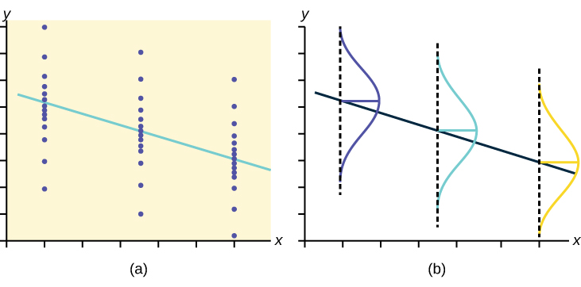
Figure 12.14
Fyrir hvert x-gildi eru y-gildin normaldreifð um línuna með sama staðalfráviki. Fyrir hvert x-gildi liggur meðaltal y-gildanna á aðhvarfslínunni. Fleiri y-gildi liggja nálægt línunni en dreifast fjær henni.
Notes:
The left graph shows three sets of points. Each set falls in a vertical line. The points in each set are normally distributed along the line — they are densely packed in the middle and more spread out at the top and bottom. A downward sloping regression line passes through the mean of each set. The right graph shows the same regression line plotted. A vertical normal curve is shown for each line.

Slide 22
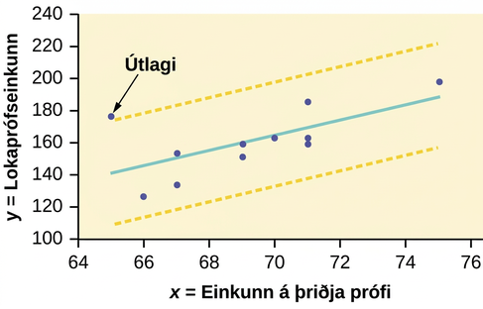
Figure 12.15
Notes:
The scatter plot of exam scores with a line of best fit.Two yellow dashed lines run parallel to the line of best fit. The dashed lines run above and below the best fit line at equal distances. One data point falls outside the boundary created by the dashed lines—it is an outlier.

Slide 23
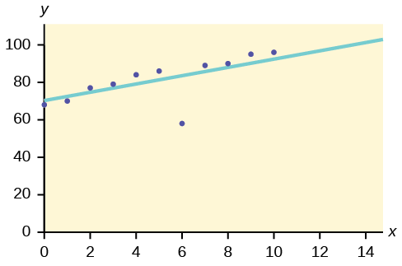
Figure 12.16
Notes:
Figure 2 shows a graph that is labeled 0 through 100 on the Y axis going up by 20, and 0 though 14 on the X axis going up by 2. The plotted spots on the graph show (y0,x66)

Slide 24
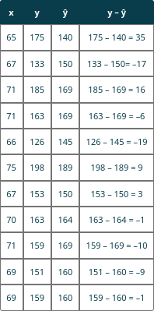
Table 12.6
Notes:
Table 12.6; Columns: x, y, ŷ, y – ŷ; Row 1: 65, 175, 140, 175 – 140 = 35; Row 2: 67, 133, 150, 133 – 150= –17; Row 3: 71, 185, 169, 185 – 169 = 16; Row 4: 71, 163, 169, 163 – 169 = –6; Row 5: 66, 126, 145, 126 – 145 = –19; Row 6: 75, 198, 189, 198 – 189 = 9; Row 7: 67, 153, 150, 153 – 150 = 3; Row 8: 70, 163, 164, 163 – 164 = –1; Row 9: 71, 159, 169, 159 – 169 = –10; Row 10: 69, 151, 160, 151 – 160 = –9; Row 11: 69, 159, 160, 159 – 160 = –1

Slide 25
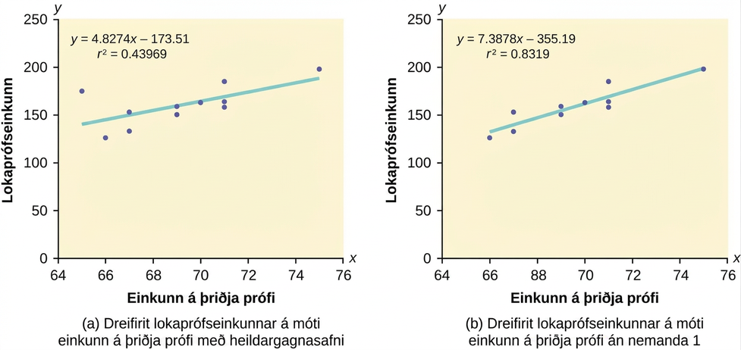
Figure 12.17
Notes:
This shows two scatter plots, each with a line of best fit. Each is labeled final exam score on the y-axis and third exam score on the x-axis. The part (a) scatter plot includes the complete data set and has points plotted at (65, 175), (66, 126), (67, 133), (67, 153), (69, 151), (69, 159), (70, 163), (71, 159), (71, 163), (71, 185), and (75, 198). The part (a) scatter plot is labeled y = 4.8274x – 173.51 and R2 = 0.43969. The part (b) scatter plot is missing the student 1 data point and has points plotted at (66, 126), (67, 133), (67, 153), (69, 151), (69, 159), (70, 163), (71, 159), (71, 163), (71, 185), and (75, 198). The part (b) scatter plot is labeled y = 7.3878x – 355.19 and R2 = 0.8319.

Slide 26
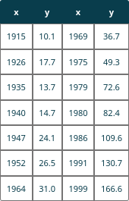
Table 12.7
Notes:
Table 12.7; Columns: x, y, x, y; Row 1: 1915, 10.1, 1969, 36.7; Row 2: 1926, 17.7, 1975, 49.3; Row 3: 1935, 13.7, 1979, 72.6; Row 4: 1940, 14.7, 1980, 82.4; Row 5: 1947, 24.1, 1986, 109.6; Row 6: 1952, 26.5, 1991, 130.7; Row 7: 1964, 31.0, 1999, 166.6

Slide 27
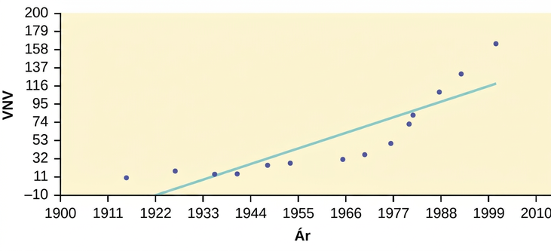
Figure 12.18
Notes:
Scatter plot and line of best fit of the consumer price index data, on the y-axis, and year data, on the x-axis.

Slide 28
Table 12.8
Ár | PCINC | Ár | PCINC
1870 | 340 | 1920 | 1,050
1880 | 499 | 1930 | 1,170
1890 | 592 | 1940 | 1,364
1900 | 757 | 1950 | 1,836
1910 | 927 | 1960 | 2,132

Slide 29
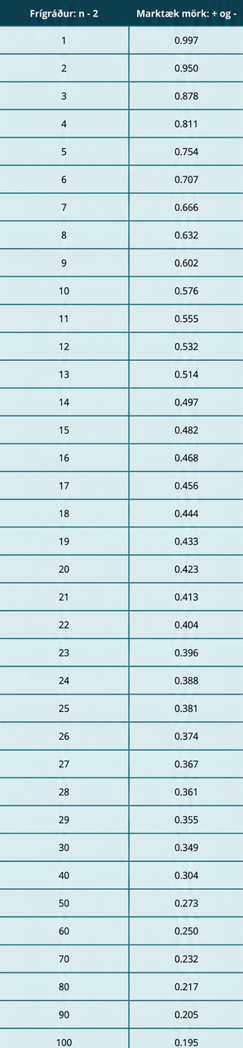
Table 12.9
Notes:
Table 12.9; Columns: Degrees of Freedom: n – 2, Critical Values: + and –; Row 1: 1, 0.997; Row 2: 2, 0.950; Row 3: 3, 0.878; Row 4: 4, 0.811; Row 5: 5, 0.754; Row 6: 6, 0.707; Row 7: 7, 0.666; Row 8: 8, 0.632; Row 9: 9, 0.602; Row 10: 10, 0.576; Row 11: 11, 0.555; Row 12: 12, 0.532; Row 13: 13, 0.514; Row 14: 14, 0.497; Row 15: 15, 0.482; Row 16: 16, 0.468; Row 17: 17, 0.456; Row 18: 18, 0.444; Row 19: 19, 0.433; Row 20: 20, 0.423; Row 21: 21, 0.413; Row 22: 22, 0.404; Row 23: 23, 0.396; Row 24: 24, 0.388; Row 25: 25, 0.381; Row 26: 26, 0.374; Row 27: 27, 0.367; Row 28: 28, 0.361; Row 29: 29, 0.355; Row 30: 30, 0.349; Row 31: 40, 0.304; Row 32: 50, 0.273; Row 33: 60, 0.250; Row 34: 70, 0.232; Row 35: 80, 0.217; Row 36: 90, 0.205; Row 37: 100, 0.195

Slide 30
Table 12.10
Fjarlægð frá skóla | Kostnaður við námsgögn á þessari önn

Slide 31
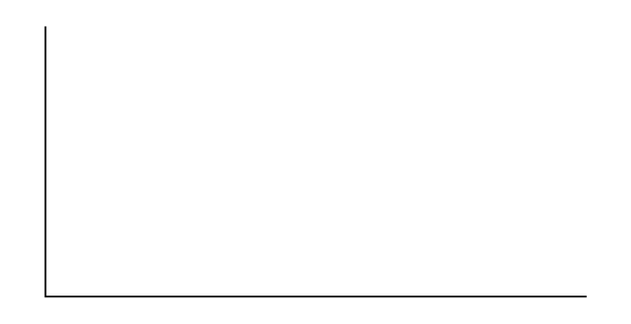
Figure 12.19
Notes:
Blank graph with vertical and horizontal axes.

Slide 32
Figure 12.20
Notes:
Blank graph with vertical and horizontal axes.

Slide 33
Table 12.11
Blaðsíðufjöldi | Verð kennslubókar

Slide 34
Figure 12.21
Notes:
Blank graph with vertical and horizontal axes.

Slide 35
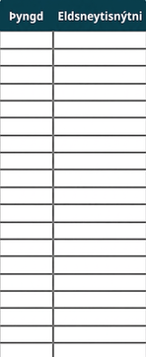
Table 12.12
Notes:
Table 12.12; Columns: Weight, Fuel Efficiency; Row 1: , ; Row 2: , ; Row 3: , ; Row 4: , ; Row 5: , ; Row 6: , ; Row 7: , ; Row 8: , ; Row 9: , ; Row 10: , ; Row 11: , ; Row 12: , ; Row 13: , ; Row 14: , ; Row 15: , ; Row 16: , ; Row 17: , ; Row 18: , ; Row 19: ,

Slide 36
Figure 12.22
Notes:
Blank graph with vertical and horizontal axes.

Slide 37
Notkunarleyfi
Þetta ítarefni frá OpenStax er © Rice University og gefið út samkvæmt CC BY-NC-SA 4.0 International notkunarleyfi. Heimilt er að fjölfalda það eða breyta því eingöngu í óhagnaðarskyni, en vísa verður til OpenStax og Rice University og tilgreina allar breytingar. Öllum aðlögunum skal deilt samkvæmt sams konar notkunarleyfi.

