Slide 1

Tölfræði
Chapter 8 Confidence Intervals

Slide 2
Efnisyfirlit kafla
Meðaltal eins þýðis með normaldreifingu
Meðaltal eins þýðis með t-dreifingu Students
Hlutfall í þýði
Confidence Interval (Home Costs)
Öryggisbil (fæðingarstaður)
Öryggisbil (hæð kvenna)

Slide 3
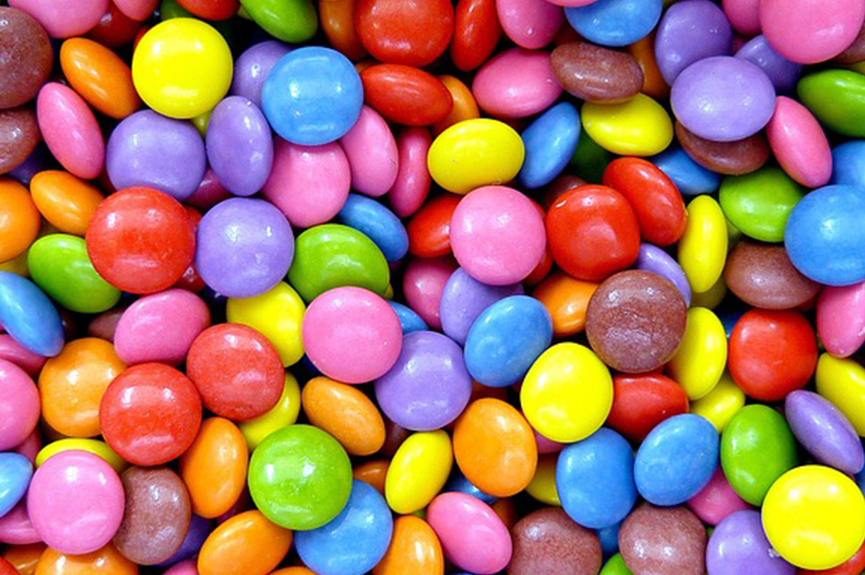
Figure 8.1
Hefur þú einhvern tíma velt fyrir þér hver meðalfjöldi súkkulaðimola í poka úr matvöruverslun er? Þú getur notað öryggisbil til að svara þessari spurningu. (mynd: comedy_nose/flickr)
Notes:
This is a photo of M&Ms piled together. The M&Ms are red, blue, green, yellow, orange and brown.

Slide 4
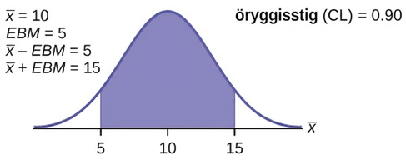
Figure 8.2
Notes:
This is a normal distribution curve. The peak of the curve coincides with the point 10 on the horizontal axis. The points 5 and 15 are labeled on the axis. Vertical lines are drawn from these points to the curve, and the region between the lines is shaded. The shaded region has area equal to 0.90.

Slide 5
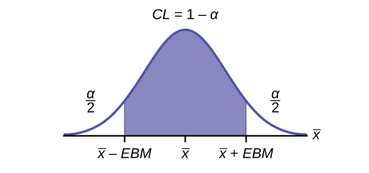
Figure 8.3
Notes:
This is a normal distribution curve. The peak of the curve coincides with the point x-bar on the horizontal axis. The points x-bar - EBM and x-bar + EBM are labeled on the axis. Vertical lines are drawn from these points to the curve, and the region between the lines is shaded. The shaded region has area equal to 1 - a and represents the confidence level. Each unshaded tail has area a/2.

Slide 6
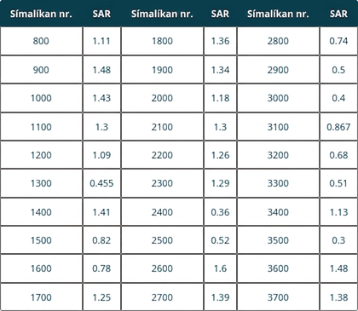
Table 8.1
Notes:
Table 8.1; Columns: Phone Model #, SAR, Phone Model #, SAR, Phone Model #, SAR; Row 1: 800, 1.11, 1800, 1.36, 2800, 0.74; Row 2: 900, 1.48, 1900, 1.34, 2900, 0.5; Row 3: 1000, 1.43, 2000, 1.18, 3000, 0.4; Row 4: 1100, 1.3, 2100, 1.3, 3100, 0.867; Row 5: 1200, 1.09, 2200, 1.26, 3200, 0.68; Row 6: 1300, 0.455, 2300, 1.29, 3300, 0.51; Row 7: 1400, 1.41, 2400, 0.36, 3400, 1.13; Row 8: 1500, 0.82, 2500, 0.52, 3500, 0.3; Row 9: 1600, 0.78, 2600, 1.6, 3600, 1.48; Row 10: 1700, 1.25, 2700, 1.39, 3700, 1.38

Slide 7
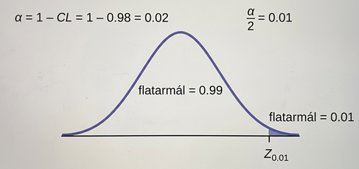
Figure 8.4
Notes:
This is a normal distribution curve. The point z0.01 is labeled at the right edge of the curve and the region to the right of this point is shaded. The area of this shaded region equals 0.01. The unshaded area equals 0.99.

Slide 8
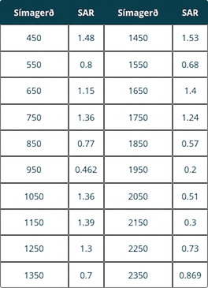
Table 8.2
Notes:
Table 8.2; Columns: Phone Model, SAR, Phone Model, SAR; Row 1: 450, 1.48, 1450, 1.53; Row 2: 550, 0.8, 1550, 0.68; Row 3: 650, 1.15, 1650, 1.4; Row 4: 750, 1.36, 1750, 1.24; Row 5: 850, 0.77, 1850, 0.57; Row 6: 950, 0.462, 1950, 0.2; Row 7: 1050, 1.36, 2050, 0.51; Row 8: 1150, 1.39, 2150, 0.3; Row 9: 1250, 1.3, 2250, 0.73; Row 10: 1350, 0.7, 2350, 0.869

Slide 9
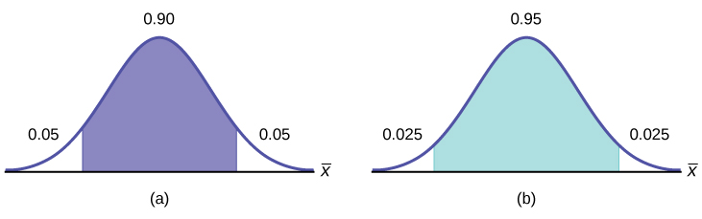
Figure 8.5
Notes:
Part (a) shows a normal distribution curve. A central region with area equal to 0.90 is shaded. Each unshaded tail of the curve has area equal to 0.05. Part (b) shows a normal distribution curve. A central region with area equal to 0.95 is shaded. Each unshaded tail of the curve has area equal to 0.025.

Slide 10
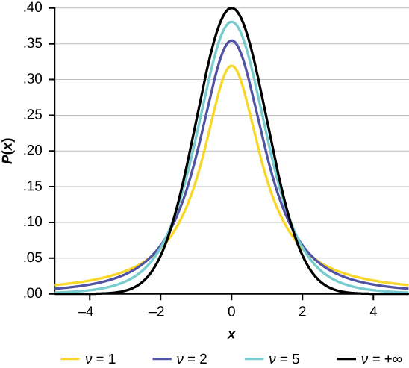
Figure 8.6
Notes:
A graph showing a bell shaped curve of normal distribution with two vertical lines to the left and right of center. The vertical line to the left is labeled 6244 and the vertical line to the right is labeled 11014. The area between the vertical lines is shaded purple. The horizontal axis is unlabeled. There are three tick marks on the horizontal axis at the bottom of the vertical lines and at a point equidistant between the lines. The tick mark in the center of the bell curve is labeled 8629.

Slide 11
Table 8.3
79 | 145 | 147 | 160 | 116 | 100 | 159 | 151 | 156 | 126
137 | 83 | 156 | 94 | 121 | 144 | 123 | 114 | 139 | 99

Slide 12
Table 8.4
0 | 3 | 1 | 20 | 9
5 | 10 | 1 | 10 | 4
14 | 2 | 4 | 4 | 5

Slide 13
Table 8.5
__________ | __________ | __________ | __________ | __________
__________ | __________ | __________ | __________ | __________
__________ | __________ | __________ | __________ | __________
__________ | __________ | __________ | __________ | __________
__________ | __________ | __________ | __________ | __________
__________ | __________ | __________ | __________ | __________
__________ | __________ | __________ | __________ | __________

Slide 14
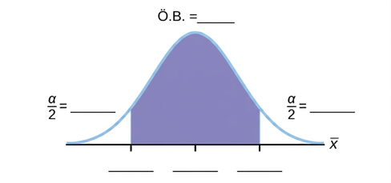
Figure 8.7
Notes:
Normal distribution curve with two vertical upward lines from the x-axis to the curve. The confidence interval is between these two lines. The residual areas are on either side.

Slide 15
Table 8.6
Öryggisstig | EBM/Error Bound | Öryggisbil
50%
80%
95%
99%

Slide 16
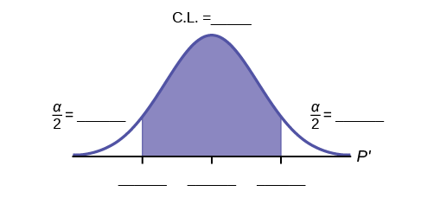
Figure 8.8
Notes:
Normal distribution curve with two vertical upward lines from the x-axis to the curve. The confidence interval is between these two lines. The residual areas are on either side.

Slide 17
Table 8.7
Öryggisstig | EBP/Error Bound | Öryggisbil
50%
80%
95%
99%

Slide 18
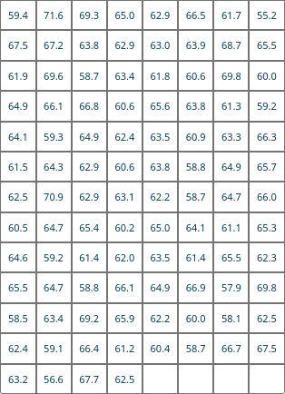
Tafla 8.8 Hæð 100 kvenna (í tommum)
Notes:
Table 8.8 Heights of 100 Women (in Inches); Row 1: 59.4, 71.6, 69.3, 65.0, 62.9, 66.5, 61.7, 55.2; Row 2: 67.5, 67.2, 63.8, 62.9, 63.0, 63.9, 68.7, 65.5; Row 3: 61.9, 69.6, 58.7, 63.4, 61.8, 60.6, 69.8, 60.0; Row 4: 64.9, 66.1, 66.8, 60.6, 65.6, 63.8, 61.3, 59.2; Row 5: 64.1, 59.3, 64.9, 62.4, 63.5, 60.9, 63.3, 66.3; Row 6: 61.5, 64.3, 62.9, 60.6, 63.8, 58.8, 64.9, 65.7; Row 7: 62.5, 70.9, 62.9, 63.1, 62.2, 58.7, 64.7, 66.0; Row 8: 60.5, 64.7, 65.4, 60.2, 65.0, 64.1, 61.1, 65.3; Row 9: 64.6, 59.2, 61.4, 62.0, 63.5, 61.4, 65.5, 62.3; Row 10: 65.5, 64.7, 58.8, 66.1, 64.9, 66.9, 57.9, 69.8; Row 11: 58.5, 63.4, 69.2, 65.9, 62.2, 60.0, 58.1, 62.5; Row 12: 62.4, 59.1, 66.4, 61.2, 60.4, 58.7, 66.7, 67.5; Row 13: 63.2, 56.6, 67.7, 62.5, , , ,

Slide 19
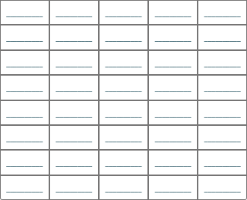
Tafla 8.9 90 prósenta öryggisbil
Notes:
Table 8.9 90 percent Confidence Intervals; Row 1: __________, __________, __________, __________, __________; Row 2: __________, __________, __________, __________, __________; Row 3: __________, __________, __________, __________, __________; Row 4: __________, __________, __________, __________, __________; Row 5: __________, __________, __________, __________, __________; Row 6: __________, __________, __________, __________, __________; Row 7: __________, __________, __________, __________, __________; Row 8: __________, __________, __________, __________, __________

Slide 20
Leyfi
Þetta fylgiefni frá OpenStax er © Rice University og gefið út með alþjóðlega CC BY-NC-SA 4.0 leyfinu; heimilt er að afrita það eða breyta því eingöngu í óviðskiptalegum tilgangi, en vísa verður til OpenStax og Rice University og tilgreina allar breytingar. Öllum aðlögunum verður að deila með sama leyfisskilmála.

