Slide 1

Tölfræði
Kafli 10 Tilgátuprófun með tveimur úrtökum

Slide 2
Yfirlit kafla
Tvö þýðismeðaltöl með óþekktum staðalfrávikum
Tvö þýðismeðaltöl með þekktum staðalfrávikum
Samanburður á tveimur óháðum þýðishlutföllum
Matched or Paired Samples (Optional)
Tilgátuprófun fyrir tvö meðaltöl og tvö hlutföll

Slide 3
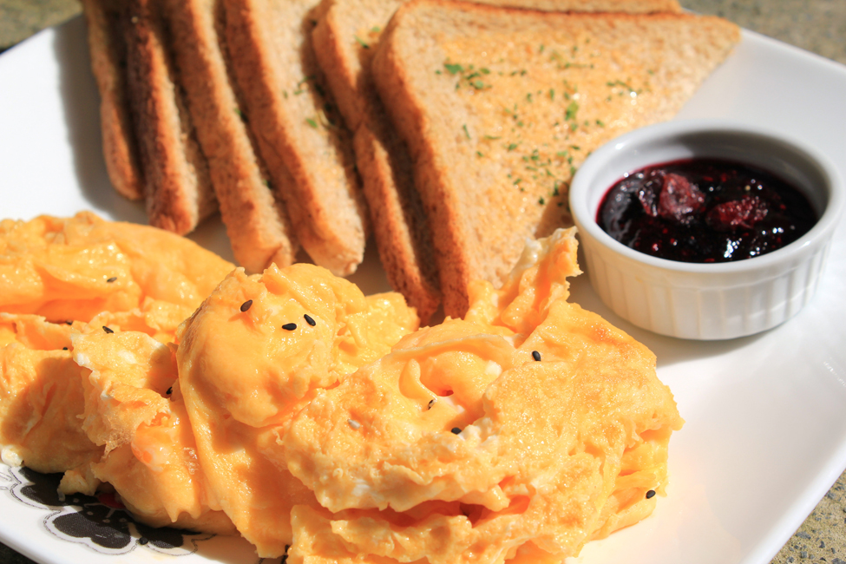
Figure 10.1
Ef þú vilt prófa fullyrðingu sem varðar tvo hópa (tegundir morgunverðar sem borðaðar eru austan og vestan við Mississippi-fljót) má nota örlítið aðra aðferð við tilgátuprófun. (mynd: Chloe Lim)
Notes:
This is a photo of a plate with a large pile of eggs in the foreground and six slices of toast in the background. There is a small dish of red jam sitting near the toast on the plate.

Slide 4
Table 10.1
 | Úrtaksstærð | Meðalfjöldi klukkustunda í íþróttum á dag | Úrtaksstaðalfrávik
Stúlkur | 9 | 2 | 0.866
Drengir | 16 | 3.2 | 1.00

Slide 5
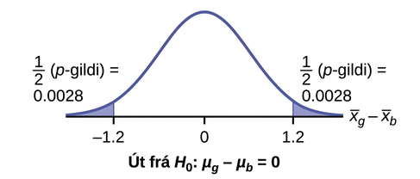
Figure 10.2
Notes:
This is a normal distribution curve representing the difference in the average amount of time girls and boys play sports all day. The mean is equal to zero, and the values -1.2, 0, and 1.2 are labeled on the horizontal axis. Two vertical lines extend from -1.2 and 1.2 to the curve. The region to the left of x = -1.2 and the region to the right of x = 1.2 are shaded to represent the p-value. The area of each region is 0.0028.

Slide 6
Table 10.2
 | Úrtaksstærð | Úrtaksmeðaltal | Úrtaksstaðalfrávik
Þýði A | 25 | 5 | 1
Þýði B | 16 | 4.7 | 1.2

Slide 7
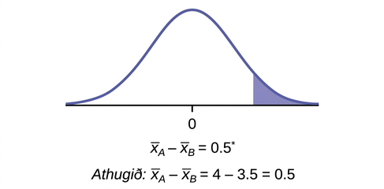
Figure 10.3
Notes:
This is a normal distribution curve with mean equal to 0. A vertical line near the tail of the curve to the right of zero extends from the axis to the curve. The region under the curve to the right of the line is shaded.

Slide 8
Table 10.3 Online Class
67.6 | 41.2 | 85.3 | 55.9 | 82.4 | 91.2 | 73.5 | 94.1 | 64.7 | 64.7
70.6 | 38.2 | 61.8 | 88.2 | 70.6 | 58.8 | 91.2 | 73.5 | 82.4 | 35.5
94.1 | 88.2 | 64.7 | 55.9 | 88.2 | 97.1 | 85.3 | 61.8 | 79.4 | 79.4

Slide 9
Tafla 10.4 Staðnám
77.9 | 95.3 | 81.2 | 74.1 | 98.8 | 88.2 | 85.9 | 92.9 | 87.1 | 88.2
69.4 | 57.6 | 69.4 | 67.1 | 97.6 | 85.9 | 88.2 | 91.8 | 78.8 | 71.8
98.8 | 61.2 | 92.9 | 90.6 | 97.6 | 100 | 95.3 | 83.5 | 92.9 | 89.4

Slide 10
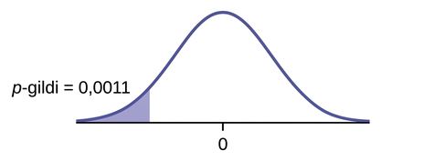
Figure 10.4
Notes:
This is a normal distribution curve with mean equal to zero. A vertical line near the tail of the curve to the left of zero extends from the axis to the curve. The region under the curve to the left of the line is shaded representing p-value = 0.0011.

Slide 11
Tafla 10.5 Staðlaðar áhrifastærðir Cohens
Áhrifastærð | d
Lítil | 0.2
miðlungs | 0.5
Stór | 0.8

Slide 12
Table 10.6 Northeast
94.2 | 75.2 | 69.6 | 52.0 | 48.0 | 41.9 | 36.4 | 33.4 | 31.5 | 27.6
77.3 | 71.9 | 67.5 | 50.6 | 46.2 | 38.4 | 35.2 | 33.0 | 28.7 | 26.5
76.3 | 71.7 | 56.3 | 48.7 | 43.2 | 37.6 | 33.7 | 31.8 | 28.5 | 26.0

Slide 13
Table 10.7 West
126.0 | 70.6 | 65.2 | 51.4 | 45.5 | 37.0 | 33.0 | 29.6 | 23.7 | 22.6
116.1 | 70.6 | 58.2 | 51.2 | 43.2 | 36.0 | 31.4 | 28.7 | 23.5 | 21.6
78.2 | 68.2 | 55.6 | 50.3 | 39.0 | 34.1 | 31.0 | 25.3 | 23.4 | 21.5

Slide 14
Table 10.8
Bón | Úrtaksmeðaltal fjölda mánaða sem gólfbón endist | Þýðisstaðalfrávik
1 | 3 | 0.33
2 | 2.9 | 0.36

Slide 15
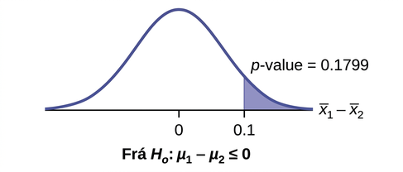
Figure 10.5
Notes:
This is a normal distribution curve with mean equal to zero. The values 0 and 0.1 are labeled on the horiztonal axis. A vertical line extends from 0.1 to the curve. The region under the curve to the right of the line is shaded to represent p-value = 0.1799.

Slide 16
Table 10.9
Vél | Úrtaksmeðaltal snúningshraða á mínútu | Þýðisstaðalfrávik
1 | 1,500 | 50
2 | 1,600 | 60

Slide 17
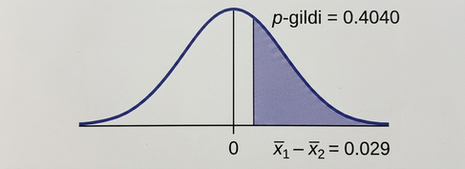
Figure 10.6
Notes:
This is a normal distribution curve with mean equal to zero. A vertical line to the right of zero extends from the axis to the curve. The region under the curve to the right of the line is shaded representing p-value = 0.4955.

Slide 18
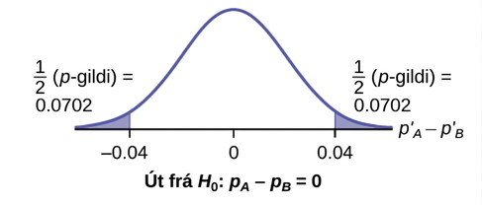
Figure 10.7
Notes:
Normal distribution curve of the difference in the percentages of adult patients who don't react to medication A and B after 30 minutes. The mean is equal to zero, and the values -0.04, 0, and 0.04 are labeled on the horizontal axis. Two vertical lines extend from -0.04 and 0.04 to the curve. The region to the left of -0.04 and the region to the right of 0.04 are each shaded to represent 1/2(p-value) = 0.0702.

Slide 19
Table 10.10
 | Karlar | Konur
Sendu textaskilaboð | 183 | 156
Heildarfjöldi í könnun | 2231 | 2169

Slide 20
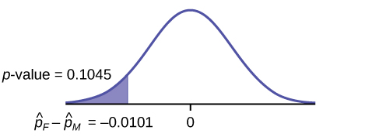
Figure 10.8
Notes:
This is a normal distribution curve with mean equal to zero. A vertical line near the tail of the curve to the left of zero extends from the axis to the curve. The region under the curve to the left of the line is shaded representing p-value = 0.1045.

Slide 21
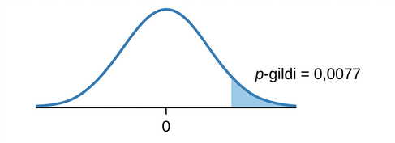
Figure 10.9
Notes:
This is a normal distribution curve with mean equal to zero. A vertical line near the tail of the curve to the right of zero extends from the axis to the curve. The region under the curve to the right of the line is shaded representing p-value = 0.00004.

Slide 22
Table 10.11
Þátttakandi: | A | B | C | D | E | F | G | H
Fyrir | 6.6 | 6.5 | 9.0 | 10.3 | 11.3 | 8.1 | 6.3 | 11.6
Eftir | 6.8 | 2.4 | 7.4 | 8.5 | 8.1 | 6.1 | 3.4 | 2.0

Slide 23
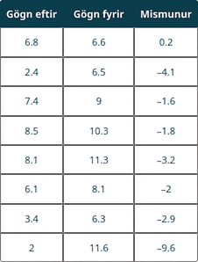
Table 10.12
Notes:
Table 10.12; Columns: After Data, Before Data, Difference; Row 1: 6.8, 6.6, 0.2; Row 2: 2.4, 6.5, –4.1; Row 3: 7.4, 9, –1.6; Row 4: 8.5, 10.3, –1.8; Row 5: 8.1, 11.3, –3.2; Row 6: 6.1, 8.1, –2; Row 7: 3.4, 6.3, –2.9; Row 8: 2, 11.6, –9.6

Slide 24
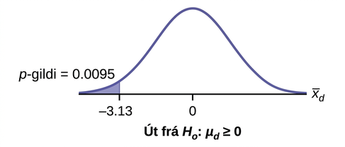
Figure 10.10
Notes:
Normal distribution curve of the average difference of sensory measurements with values of -3.13 and 0. A vertical upward line extends from -3.13 to the curve, and the p-value is indicated in the area to the left of this value.

Slide 25
Table 10.13
Þátttakandi | A | B | C | D | E | F | G | H | I
Fyrir | 209 | 210 | 205 | 198 | 216 | 217 | 238 | 240 | 222
Eftir | 199 | 207 | 189 | 209 | 217 | 202 | 211 | 223 | 201

Slide 26
Table 10.14
Þyngd (í pundum) | Player 1 | Player 2 | Player 3 | Player 4
Þyngd sem lyft var fyrir námskeiðið | 205 | 241 | 338 | 368
Þyngd sem lyft var eftir námskeiðið | 295 | 252 | 330 | 360

Slide 27
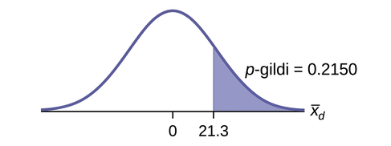
Figure 10.11
Notes:
Normal distribution curve with values of 0 and 21.3. A vertical upward line extends from 21.3 to the curve and the p-value is indicated in the area to the right of this value.

Slide 28
Table 10.15
SAT-stig | Student 1 | Student 2 | Student 3 | Student 4
Stig fyrir námskeið | 1840 | 1960 | 1920 | 2150
Stig eftir námskeið | 1920 | 2160 | 2200 | 2100

Slide 29
Table 10.16
Vegalengd (í fetum) með | Student 1 | Student 2 | Student 3 | Student 4 | Student 5 | Student 6 | Student 7
Ríkjandi hendi | 30 | 26 | 34 | 17 | 19 | 26 | 20
Veikari hendi | 28 | 14 | 27 | 18 | 17 | 26 | 16

Slide 30
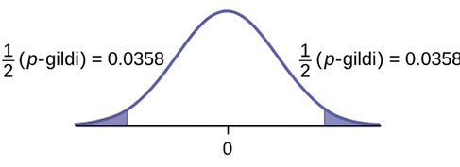
Figure 10.12
Notes:
This is a normal distribution curve with mean equal to zero. Both the right and left tails of the curve are shaded. Each tail represents 1/2(p-value) = 0.0358.

Slide 31
Table 10.17
 | Player 1 | Player 2 | Player 3 | Player 4 | Player 5
Ríkjandi hönd | 120 | 111 | 135 | 140 | 125
Off-Hand | 105 | 109 | 98 | 111 | 99

Slide 32
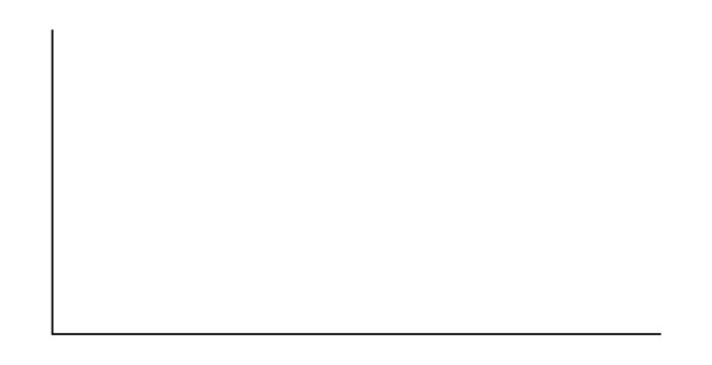
Figure 10.13
Notes:
This is a blank graph template. The vertical and horizontal axes are unlabeled.

Slide 33
Figure 10.14
Notes:
This is a blank graph template. The vertical and horizontal axes are unlabeled.

Slide 34
Figure 10.15
Notes:
This is a blank graph template. The vertical and horizontal axes are unlabeled.

Slide 35
Figure 10.16
Notes:
This is a blank graph template. The vertical and horizontal axes are unlabeled.

Slide 36
Leyfi
Þetta stoðefni frá OpenStax er © Rice University og gefið út með CC BY-NC-SA 4.0 International leyfi; það má afrita eða breyta eingöngu í óhagnaðarskyni, en tilgreina verður OpenStax og Rice University sem höfunda og geta skal allra breytinga. Öllum aðlögunum verður að deila með sams konar leyfi.

