Slide 1

Tölfræði
Chapter 5 Continuous Random Variables

Slide 2
Yfirlit kafla
Samfelld líkindaföll
Jafna dreifingin
Veldisdreifingin (valkvætt)
Samfelld dreifing

Slide 3
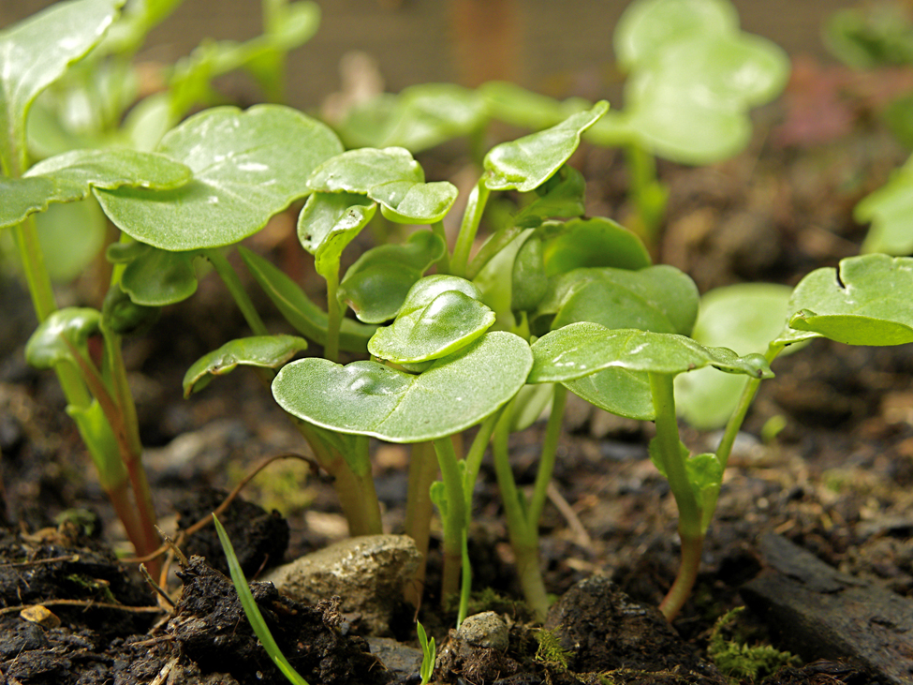
Figure 5.1
Hæðir þessara radísuplantna eru samfelldar slembistærðir. (mynd: Rev Stan)
Notes:
The image shows radish plants of various heights sprouting out of dirt.

Slide 4
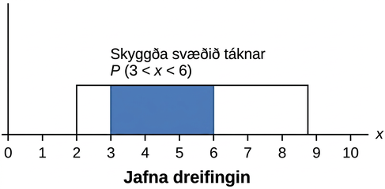
Figure 5.2
Grafið sýnir jafna dreifingu þar sem svæðið milli x = 3 og x = 6 er skyggt til að tákna líkurnar á að gildi slembistærðarinnar X liggi á bilinu frá þremur til sex.
Notes:
This graph shows a uniform distribution. The horizontal axis ranges from 0 to 10. The distribution is modeled by a rectangle extending from x = 2 to x = 8.8. A region from x = 3 to x = 6 is shaded inside the rectangle. The shaded area represents P(3 x < 6).

Slide 5
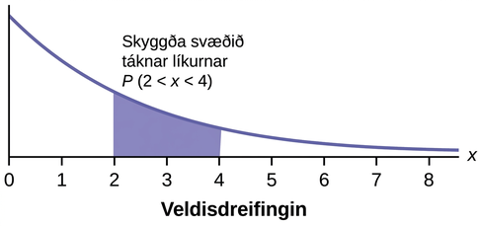
Figure 5.3
Grafið sýnir veldisdreifingu þar sem svæðið milli x = 2 og x = 4 er skyggt til að tákna líkurnar á að gildi slembistærðarinnar X liggi á bilinu frá tveimur til fjögurra.
Notes:
A graph illustrating an exponential distribution, where the shaded area under the curve between x=2 and x=4 represents the probability P(2 < x < 4).

Slide 6
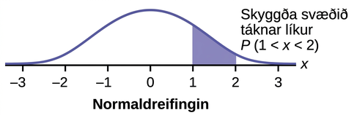
Figure 5.4
Grafið sýnir staðlaða normaldreifingu þar sem svæðið milli x = 1 og x = 2 er skyggt til að tákna líkurnar á að gildi slembistærðarinnar X liggi á bilinu frá einum til tveggja.
Notes:
This graph shows an exponential distribution. The graph slopes downward. It begins at a point on the y-axis and approaches the x-axis at the right edge of the graph. The region under the graph from x = 2 to x = 4 is shaded to represent P(2 < x < 4).

Slide 7
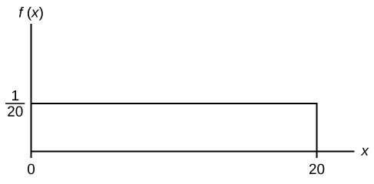
Figure 5.5
Notes:
This shows the graph of the function f(x) = 1/20. A horiztonal line ranges from the point (0, 1/20) to the point (20, 1/20). A vertical line extends from the x-axis to the end of the line at point (20, 1/20) creating a rectangle.

Slide 8
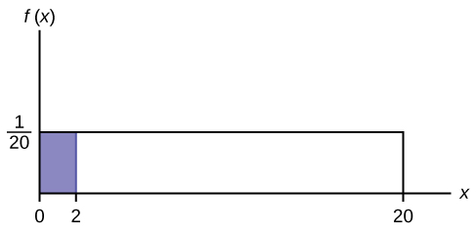
Figure 5.6
Notes:
This shows the graph of the function f(x) = 1/20. A horiztonal line ranges from the point (0, 1/20) to the point (20, 1/20). A vertical line extends from the x-axis to the end of the line at point (20, 1/20) creating a rectangle. A region is shaded inside the rectangle from x = 0 to x = 2.

Slide 9
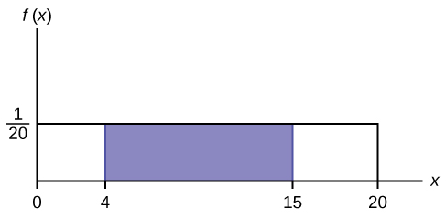
Figure 5.7
Notes:
This shows the graph of the function f(x) = 1/20. A horiztonal line ranges from the point (0, 1/20) to the point (20, 1/20). A vertical line extends from the x-axis to the end of the line at point (20, 1/20) creating a rectangle. A region is shaded inside the rectangle from x = 4 to x = 15.

Slide 10
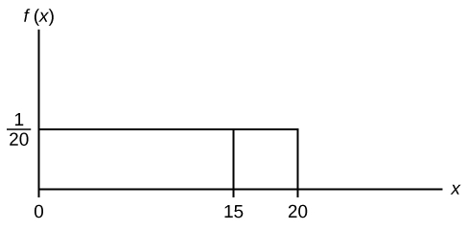
Figure 5.8
Notes:
This shows the graph of the function f(x) = 1/20. A horiztonal line ranges from the point (0, 1/20) to the point (20, 1/20). A vertical line extends from the x-axis to the end of the line at point (20, 1/20) creating a rectangle. A vertical line extends from the horizontal axis to the graph at x = 15.

Slide 11
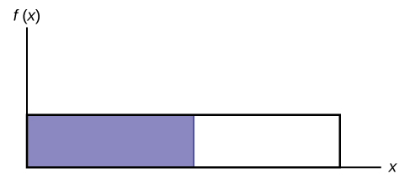
Figure 5.9
Notes:
This shows the graph of the function f(x) = 1/20. A horiztonal line ranges from the point (0, 1/20) to the point (20, 1/20). A vertical line extends from the x-axis to the end of the line at point (20, 1/20) creating a rectangle. The area to the left of a value, x, is shaded.

Slide 12
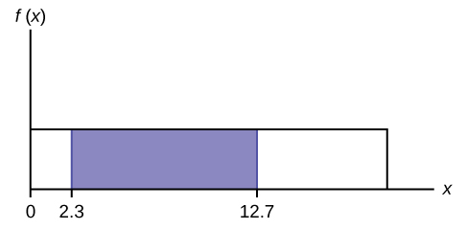
Figure 5.10
Notes:
This shows the graph of the function f(x) = 1/20. A horiztonal line ranges from the point (0, 1/20) to the point (20, 1/20). A vertical line extends from the x-axis to the end of the line at point (20, 1/20) creating a rectangle. A region is shaded inside the rectangle from x = 2.3 to x = 12.7

Slide 13
Table 5.1
10.4 | 19.6 | 18.8 | 13.9 | 17.8 | 16.8 | 21.6 | 17.9 | 12.5 | 11.1 | 4.9
12.8 | 14.8 | 22.8 | 20.0 | 15.9 | 16.3 | 13.4 | 17.1 | 14.5 | 19.0 | 22.8
1.3 | 0.7 | 8.9 | 11.9 | 10.9 | 7.3 | 5.9 | 3.7 | 17.9 | 19.2 | 9.8
5.8 | 6.9 | 2.6 | 5.8 | 21.7 | 11.8 | 3.4 | 2.1 | 4.5 | 6.3 | 10.7
8.9 | 9.4 | 9.4 | 7.6 | 10.0 | 3.3 | 6.7 | 7.8 | 11.6 | 13.8 | 18.6

Slide 14
Table 5.2
1 | 12 | 4 | 10 | 4 | 14 | 11
7 | 11 | 4 | 13 | 2 | 4 | 6
3 | 10 | 0 | 12 | 6 | 9 | 10
5 | 13 | 4 | 10 | 14 | 12 | 11
6 | 10 | 11 | 0 | 11 | 13 | 2

Slide 15
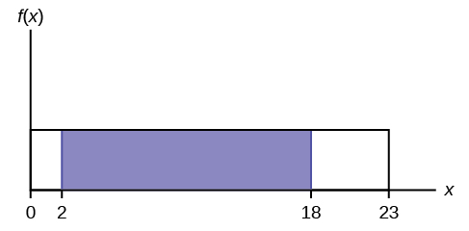
Figure 5.11
Notes:
This graph shows a uniform distribution. The horizontal axis ranges from 0 to 15. The distribution is modeled by a rectangle extending from x = 0 to x = 15. A region from x = 2 to x = 18 is shaded inside the rectangle.

Slide 16
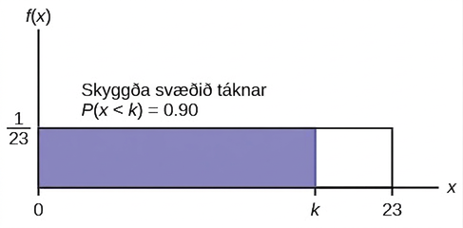
Figure 5.12
Notes:
This shows the graph of the function f(x) = 1/15. A horiztonal line ranges from the point (0, 1/15) to the point (15, 1/15). A vertical line extends from the x-axis to the end of the line at point (15, 1/15) creating a rectangle. A region is shaded inside the rectangle from x = 0 to x = k. The shaded area represents P(x < k) = 0.90.

Slide 17
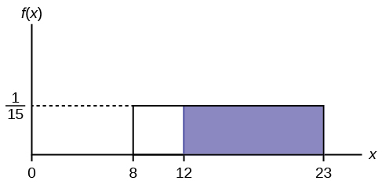
Figure 5.13
Notes:
f(X)=1/15 graph displaying a boxed region consisting of a horizontal line extending to the right from point 1/15 on the y-axis, a vertical upward line from points 8 and 23 on the x-axis, and the x-axis. A shaded region from points 12-23 occurs within this area.

Slide 18
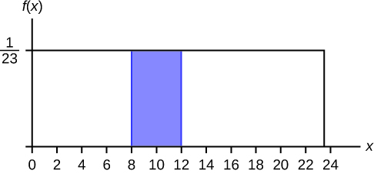
Figure 5.14
Notes:
This shows the graph of the function f(x) = 1/23. A horizontal line ranges from the point (0, 1/23) to the point (23, 1/23). A vertical line extends from the x-axis to the end of the line at point (23, 1/23) creating a rectangle. A shaded region occurs with vertical lines that extend from the horizontal axis to the graph at x = 8 and x = 12.

Slide 19
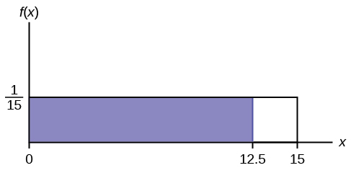
Figure 5.15
Notes:
This shows the graph of the function f(x) = 1/15. A horiztonal line ranges from the point (0, 1/15) to the point (15, 1/15). A vertical line extends from the x-axis to the end of the line at point (15, 1/15) creating a rectangle. A region is shaded inside the rectangle from x = 0 to x = 12.5.

Slide 20
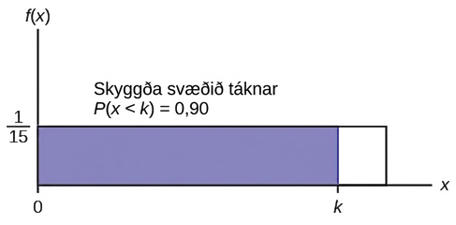
Figure 5.16
Notes:
f(X)=1/15 graph displaying a boxed region consisting of a horizontal line extending to the right from point 1/15 on the y-axis, a vertical upward line from an arbitrary point on the x-axis, and the x and y-axes. A shaded region from points 0-k occurs within this area. The area of this probability region is equal to 0.90.

Slide 21
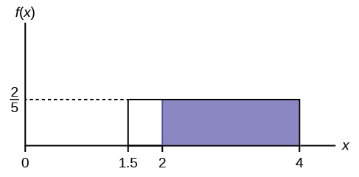
Figure 5.17
Notes:
f(X)=2/5 graph displaying a boxed region consisting of a horizontal line extending to the right from point 2/5 on the y-axis, a vertical upward line from points 1.5 and 4 on the x-axis, and the x-axis. A shaded region from points 2-4 occurs within this area.

Slide 22
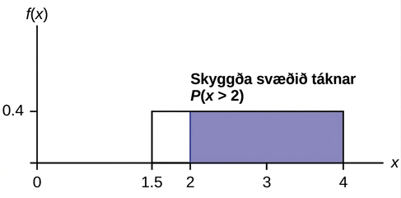
Figure 5.18
Jöfn dreifing frá 1.5 til fjögurra, þar sem skyggða svæðið frá tveimur til fjögurra táknar líkurnar á að viðgerðartíminn x sé meiri en tveir
Notes:
This shows the graph of the function f(x) = 0.4. A horiztonal line ranges from the point (1.5, 0.4) to the point (4, 0.4). Vertical lines extend from the x-axis to the graph at x = 1.5 and x = 4 creating a rectangle. A region is shaded inside the rectangle from x = 2 to x = 4.

Slide 23
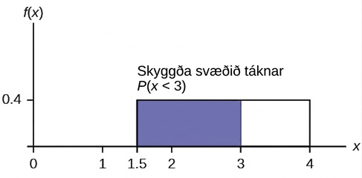
Figure 5.19
Jöfn dreifing frá 1.5 til fjögurra, þar sem skyggða svæðið frá 1.5 til þriggja táknar líkurnar á að viðgerðartíminn x sé minni en þrír
Notes:
This shows the graph of the function f(x) = 0.4. A horiztonal line ranges from the point (1.5, 0.4) to the point (4, 0.4). Vertical lines extend from the x-axis to the graph at x = 1.5 and x = 4 creating a rectangle. A region is shaded inside the rectangle from x = 1.5 to x = 3.

Slide 24
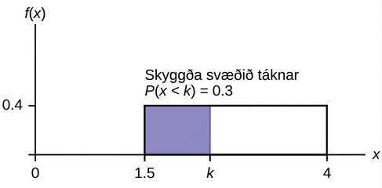
Figure 5.20
Jöfn dreifing frá 1.5 til 4, þar sem svæði að flatarmáli 0.30 er skyggt vinstra megin og táknar stystu 30 prósent viðgerðartímanna.
Notes:
This shows the graph of the function f(x) = 0.4. A horiztonal line ranges from the point (1.5, 0.4) to the point (4, 0.4). Vertical lines extend from the x-axis to the graph at x = 1.5 and x = 4 creating a rectangle. A region is shaded inside the rectangle from x = 1.5 to x = k. The shaded area represents P(x < k) = 0.3.

Slide 25
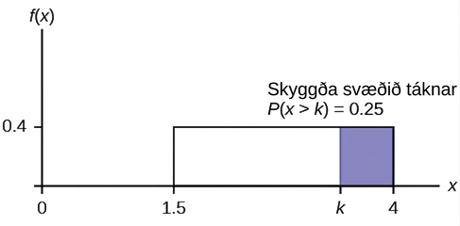
Figure 5.21
Jöfn dreifing frá 1.5 til 4, þar sem svæði að flatarmáli 0.25 er skyggt hægra megin og táknar lengstu 25 prósent viðgerðartímanna.
Notes:
A graph with an x and an f(x) axis is shown. A box is drawn on the graph between 1.5 and 4 on the x axis, and 0 and 0.4 on the f(x) axis. The box is shaded blue from measurement k to 4. Text above the box says “shaded area represents P(x>k)=0.25.

Slide 26
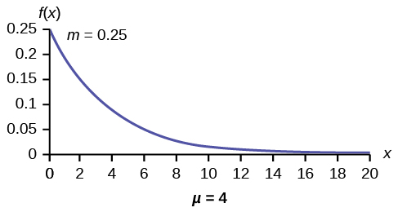
Figure 5.22
Notes:
Exponential graph with increments of 2 from 0-20 on the x-axis of μ = 4 and increments of 0.05 from 0.05-0.25 on the y-axis of m = 0.25. The curved line begins at the top at point (0, 0.25) and curves down to point (20, 0). The x-axis is equal to a continuous random variable.

Slide 27
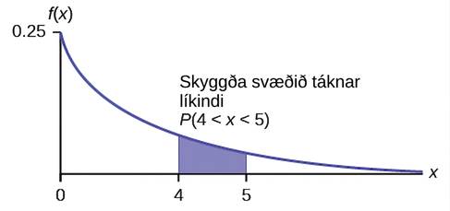
Figure 5.23
Notes:
Exponential graph with the curved line beginning at point (0, 0.25) and curves down towards point (∞, 0). Two vertical upward lines extend from points 4 and 5 to the curved line. The probability is in the area between points 4 and 5.

Slide 28
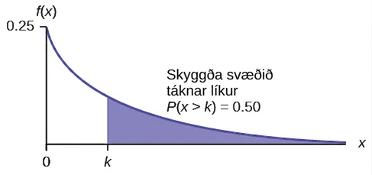
Figure 5.24
Notes:
Exponential graph with the curved line beginning at point (0, 0.25) and curves down towards point (∞, 0). A vertical upward line extends from point k to the curved line. The probability area from 0-k is equal to 0.50.

Slide 29
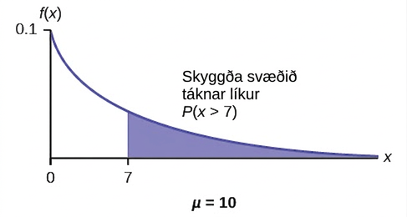
Figure 5.25
Notes:
Exponential graph with the curved line beginning at point (0, 0.1) and curves down towards point (∞, 0). A vertical upward line extends from point 1 to the curved line. The probability area occurs from point 1 to the end of the curve. The x-axis is equal to the amount of time a computer part lasts.

Slide 30
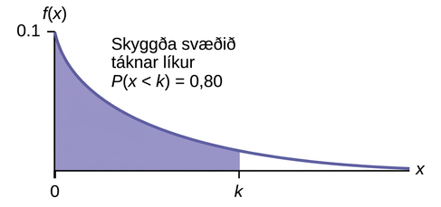
Figure 5.26
Notes:
Exponential graph with the curved line beginning at point (0, 0.1) and curves down towards point (∞, 0). A vertical upward line extends from point k to the curved line. k is the 80th percentile. The probability area from 0-k is equal to 0.80.

Slide 31
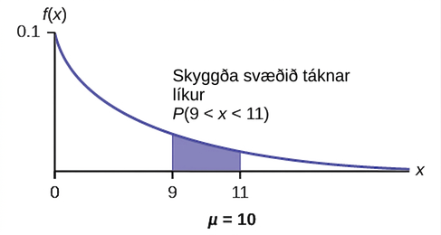
Figure 5.27
Notes:
Exponential graph with the curved line beginning at point (0, 0.1) and curves down towards point (∞, 0). Two vertical upward lines extend from point 9 and 11 to the curved line. The probability area occurs between point 9 and 11.

Slide 32
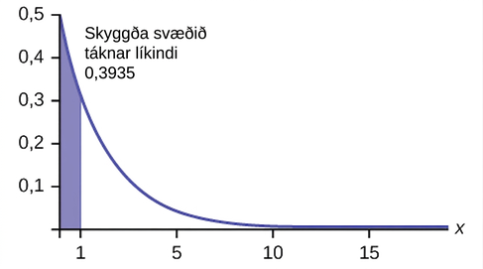
Figure 5.28
Notes:
A line graph is shown. The x axis measures values from 0 to 15 in increments of 5. The y axis measures values from 0 to 0.5 in increments of 0.1. Line starts from x, y coordinates of 0, 0.5, and then takes a steep curve downwards before leveling out at the x,y coordinates of 15, 0. The segment of the graph from 0 to 1 on the x axis is shaded. Text above the graph reads “shaded area represents probability 0.3935”.

Slide 33
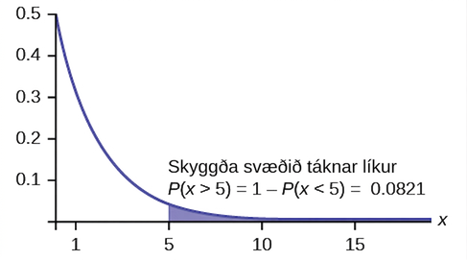
Figure 5.29
Notes:
A line graph is shown. The x axis measures values from 0 to 15 in increments of 5. The y axis measures values from 0 to 0.5 in increments of 0.1. Line starts from x, y coordinates of 0, 0.5, and then takes a steep curve downwards before leveling out at the x,y coordinates of 15, 0. The segment of the graph from 5 to 15 on the x axis is shaded. Text above the graph reads “shaded area represents probability P(x>5)=1-P(x<5)=0.0821”.

Slide 34
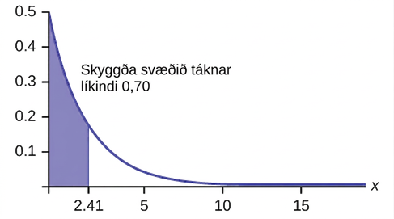
Figure 5.30
Notes:
A line graph is shown. The x axis measures values from 0 to 15 in increments of 5. The y axis measures values from 0 to 0.5 in increments of 0.1. Line starts from x, y coordinates of 0, 0.5, and then takes a steep curve downwards before leveling out at the x,y coordinates of 15, 0. The segment of the graph from 0 to 2.41 on the x axis is shaded. Text above the graph reads “shaded area represents probability 0.70”.

Slide 35
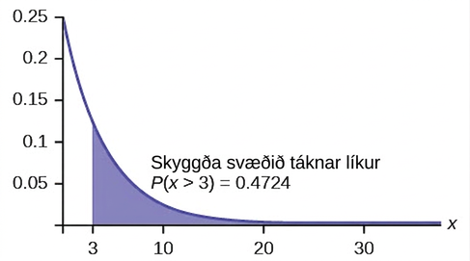
Figure 5.31
Notes:
This graph shows an exponential distribution. The graph slopes downward. It begins at the point (0, 0.25) on the y-axis and approaches the x-axis at the right edge of the graph. The region under the graph to the right of x = 3 is shaded to represent P(x > 3) = 0.4724.

Slide 36
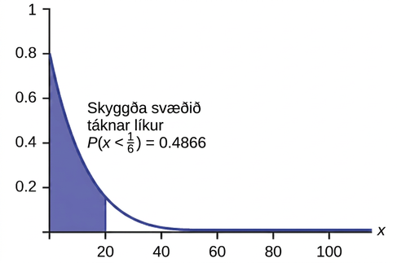
Figure 5.32
Notes:
This graph shows an exponential distribution. The graph slopes downward. It begins at the point (0, 0.8) on the y-axis and approaches the x-axis at the right edge of the graph. The region under the graph to the left of x = 20 is shaded to represent P(x < 1/6) = 0.4866.

Slide 37

Table 5.3
Notes:
Table 5.3; Row 1: __________, __________, __________, __________, __________; Row 2: __________, __________, __________, __________, __________; Row 3: __________, __________, __________, __________, __________; Row 4: __________, __________, __________, __________, __________; Row 5: __________, __________, __________, __________, __________; Row 6: __________, __________, __________, __________, __________; Row 7: __________, __________, __________, __________, __________; Row 8: __________, __________, __________, __________, __________; Row 9: __________, __________, __________, __________, __________; Row 10: __________, __________, __________, __________, __________

Slide 38
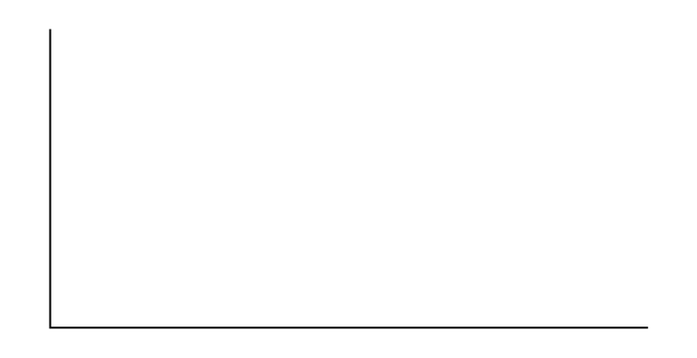
Figure 5.33
Notes:
Blank graph with relative frequency on the vertical axis and X on the horizontal axis.

Slide 39
Figure 5.34
Notes:
Blank graph with relative frequency on the vertical axis and X on the horizontal axis.

Slide 40
Leyfi
Þetta stoðefni frá OpenStax er © Rice University og er gefið út samkvæmt alþjóðlega leyfinu CC BY-NC-SA 4.0; heimilt er að afrita það eða breyta því eingöngu í óviðskiptalegum tilgangi, en geta verður OpenStax og Rice University og taka fram allar breytingar. Öllum aðlögunum verður að deila með sams konar leyfi.

