Slide 1

Tölfræði
Kafli 9 Tilgátuprófun með einu úrtaki

Slide 2
Yfirlit kafla
Núlltilgáta og gagntilgáta
Niðurstöður og villur af gerð I og gerð II
Dreifing sem þarf við tilgátuprófun
Sjaldgæfir atburðir, úrtakið, ákvörðun og ályktun
Viðbótarupplýsingar og heil dæmi um tilgátupróf
Tilgátuprófun fyrir eitt meðaltal og eitt hlutfall

Slide 3

Figure 9.1
Hægt er að nota tilgátupróf til að meta hvort fullyrðing hundaræktanda um að hver Dalmatíuhundur hafi 35 bletti sé tölfræðilega rökstudd. (mynd: Robert Neff)
Notes:
This is a picture of a Dalmation dog covered in black spots. He is wearing a red color, appears to be in a nature setting, and there is a spout of water from a water fountain in the foreground.

Slide 4
Table 9.1
H₀ | H_{a}
equal (=) | ekki jafnt og (≠) or stærra en (>) or minna en (<)
stærra en eða jafnt og (≥) | minna en (<)
minna en eða jafnt og (≤) | meira en (>)

Slide 5
Table 9.2
AÐGERÐ | H₀ ER Í RAUN | ...
 | Sönn | Ósönn
Hafna ekki H₀ | Rétt niðurstaða | Villa af gerð II
Hafna H₀ | Villa af gerð I | Rétt niðurstaða

Slide 6
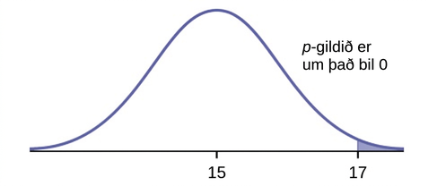
Figure 9.2
Notes:
Normal distribution curve on average bread heights with values 15, as the population mean, and 17, as the point to determine the p-value, on the x-axis.

Slide 7
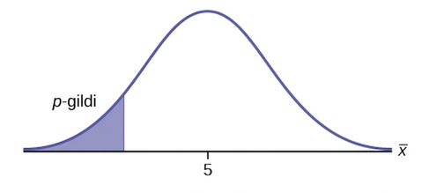
Figure 9.3
Notes:
Normal distribution curve of a single population mean with a value of 5 on the x-axis and the p-value points to the area on the left tail of the curve.

Slide 8
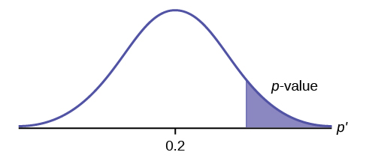
Figure 9.4
Notes:
Normal distribution curve of a single population proportion with the value of 0.2 on the x-axis. The p-value points to the area on the right tail of the curve.

Slide 9
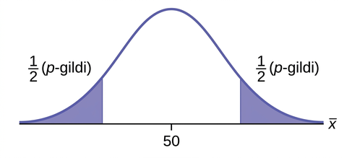
Figure 9.5
Notes:
Normal distribution curve of a single population mean with a value of 50 on the x-axis. The p-value formulas, 1/2(p-value), for a two-tailed test is shown for the areas on the left and right tails of the curve.

Slide 10
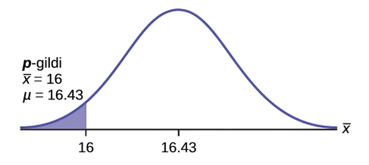
Figure 9.6
Notes:
Normal distribution curve for the average time to swim the 25-yard freestyle with values 16, as the sample mean, and 16.43 on the x-axis. A vertical upward line extends from 16 on the x-axis to the curve. An arrow points to the left tail of the curve.

Slide 11
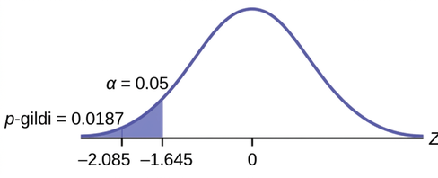
Figure 9.7
Notes:
Distribution curve comparing the α to the p-value. Values of -2.15 and -1.645 are on the x-axis. Vertical upward lines extend from both of these values to the curve. The p-value is equal to 0.0158 and points to the area to the left of -2.15. α is equal to 0.05 and points to the area between the values of -2.15 and -1.645.

Slide 12
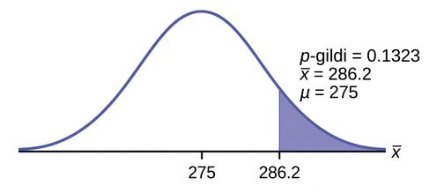
Figure 9.8
Notes:
Normal distribution curve of the average weight lifted by football players with values of 275 and 286.2 on the x-axis. A vertical upward line extends from 286.2 to the curve. The p-value points to the area to the right of 286.2.

Slide 13
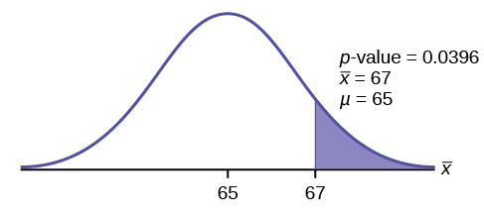
Figure 9.9
Notes:
Normal distribution curve of average scores on the first statistic tests with 65 and 67 values on the x-axis. A vertical upward line extends from 67 to the curve. The p-value points to the area to the right of 67.

Slide 14
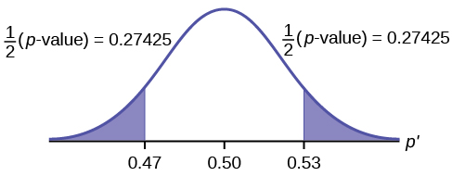
Figure 9.10
Notes:
Normal distribution curve of the percent of first time brides who are younger than the groom with values of 0.47, 0.50, and 0.53 on the x-axis. Vertical upward lines extend from 0.47 and 0.53 to the curve. 1/2(p-values) are calculated for the areas on outsides of 0.47 and 0.53.

Slide 15
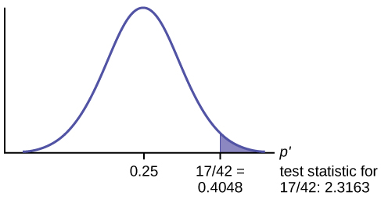
Figure 9.11
Notes:
Normal distribution graph of the proportion of fleas killed by the new shampoo with values of 0.25 and 0.4048 on the x-axis. A vertical upward line extends from 0.4048 to the curve and the area to the left of this is shaded in. The test statistic of the sample proportion is listed.

Slide 16
Table 9.3
Alfa | Ákvörðun | Rök fyrir ákvörðun
0.01 | Hafna ekki $H_{0}$ | α < p-value

Slide 17
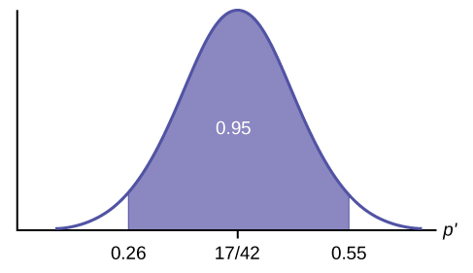
Figure 9.12
Notes:
Normal distribution graph of the proportion of fleas killed by the new shampoo with values of 0.26, 17/42, and 0.55 on the x-axis. A vertical upward line extends from 0.26 and 0.55. The area between these two points is equal to 0.95.

Slide 18
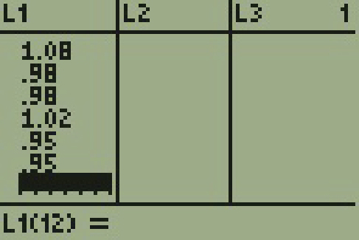
Figure 9.13
Notes:
The display of a T I 83 calculator is shown with three columns. The first column is L1 with the following values 1.08, .98, .98, 1.02, .95, .95. The second column is labeled L2 with no values listed. The third column is labeled L3 with no values. There is a 1 on the top row on the far right side of the screen.

Slide 19

Figure 9.14
Notes:
The display of a T I 83 calculator is shown. The display is titled T Test. The display shows 6 rows. The first row reads Inpt colon data stats and data is highlighted. The second row reads mu not 1. The third row reads List L1. The fourth row reads Freq 1. The fifth row reads mu with the following options does not equal mu not, less than mu not, greater than mu not greater than mu not is highlighted. The sixth row reads Calculate Draw and neither option is highlighted.

Slide 20
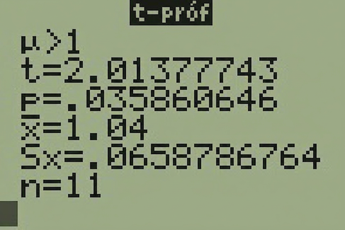
Figure 9.15
Notes:
The display of a T I 83 calculator is shown. The display is titled T Test. The display shows 6 rows. The first row reads mu greater than 1. The second row reads t equals 2.01377743. The third row reads p equals .035860646. The fourth row reads x bar equals 1.04. The fifth row reads S sub x equals .0658786764. The sixth row reads n equals 11.

Slide 21
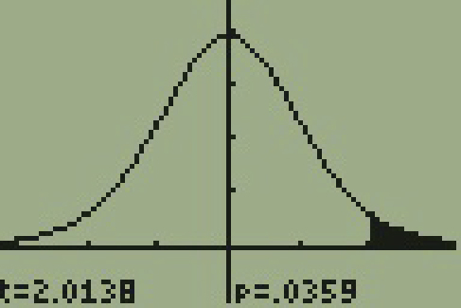
Figure 9.16
Notes:
The display of a T I 83 calculator is shown. The display is a bell shaped curve of normal distribution. The vertical axis has four tickmarks evenly spaced out and the top of the bell curve is at the fourth tick mark. The horizontal axis has two tick marks on each side of the bell curve. The area to the right of the second tick mark on the right portion of the curve is shaded. At the bottom of the display it is shown that t equals 2.0138 and that p equals .0359.

Slide 22
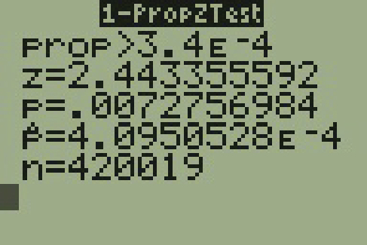
Figure 9.17
Notes:
The display of a T I 83 calculator is shown. The display is titled One Prop Z Test. The display shows 5 rows. The first row reads prop greater than 3.4 E negative 4. The second row reads z equals 2.443355592. The third row reads p equals .0072756984. The fourth row reads p bar equals 4.0950528 E negative 4. The fifth row reads n equals 420019.

Slide 23
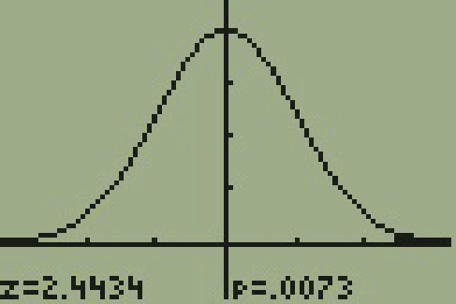
Figure 9.18
Notes:
The display of a T I 83 calculator is shown. The display is a bell shaped curve of normal distribution. The vertical axis has four tickmarks evenly spaced out and the top of the bell curve is at the fourth tick mark. The horizontal axis has two tick marks on each side of the bell curve. The area to the right of the second tick mark on the right portion of the curve is shaded. At the bottom of the display it is shown that t equals 2.4434 and that p equals .0073.

Slide 24
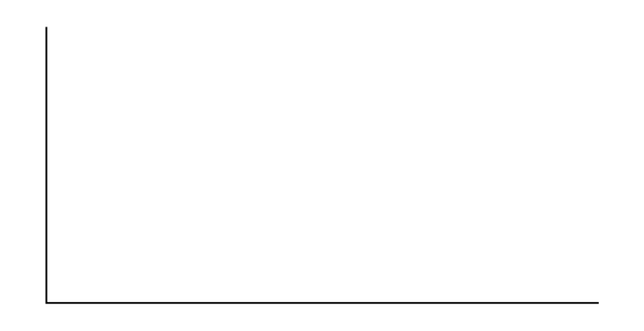
Figure 9.19
Notes:
Blank graph with vertical and horizontal axes.

Slide 25
Figure 9.20
Notes:
Blank graph with vertical and horizontal axes.

Slide 26
Figure 9.21
Notes:
Blank graph with vertical and horizontal axes.

Slide 27
Notkunarleyfi
Þetta fylgiefni frá OpenStax er © Rice University og gefið út samkvæmt alþjóðlega CC BY-NC-SA 4.0 notkunarleyfinu; það má afrita eða breyta eingöngu í óhagnaðarskyni, en eigna verður OpenStax og Rice University efnið og tilgreina allar breytingar. Sérhver aðlögun verður að vera dreift samkvæmt sams konar notkunarleyfi.

