Slide 1

Tölfræði
Chapter 2 Descriptive Statistics

Slide 2
Yfirlit kafla
Stöngul- og laufrit, línurit og súlurit
Stuðlarit, tíðnimarghyrningar og tímaraðarit
Mælikvarðar á staðsetningu gagna
Kassarit
Mælikvarðar á miðju gagna
Skekkja og meðaltal, miðgildi og tíðasta gildi
Mælikvarðar á dreifingu gagna
Lýsandi tölfræði

Slide 3
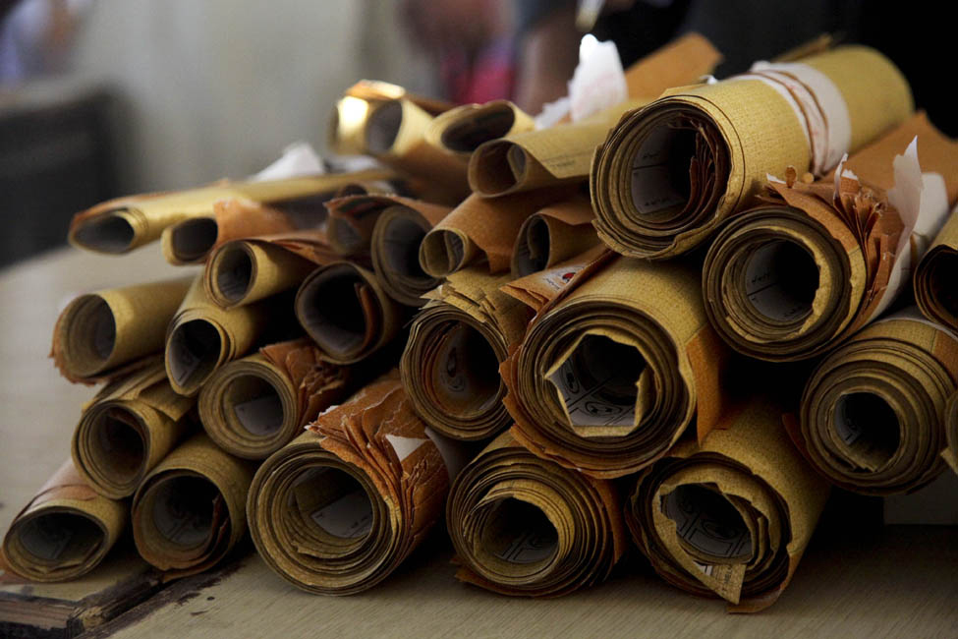
Figure 2.1
Þegar gagnamagn er mikið þarf að skipuleggja gögnin á skynsamlegan hátt. Þessir kjörseðlar úr kosningu eru rúllaðir saman með sambærilegum seðlum til að halda þeim skipulögðum. (mynd: William Greeson)
Notes:
This photo shows about 26 rolls of paper piled together. The rolls are different sizes.

Slide 4
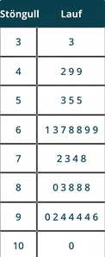
Tafla 2.1 Stöngul- og laufrit
Notes:
Table 2.1 Stem-and-Leaf Graph; Columns: Stem, Leaf; Row 1: 3, 3; Row 2: 4, 2 9 9; Row 3: 5, 3 5 5; Row 4: 6, 1 3 7 8 8 9 9; Row 5: 7, 2 3 4 8; Row 6: 8, 0 3 8 8 8; Row 7: 9, 0 2 4 4 4 4 6; Row 8: 10, 0

Slide 5
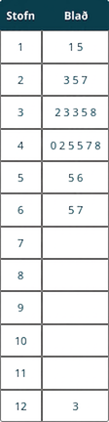
Table 2.2
Notes:
Table 2.2; Columns: Stem, Leaf; Row 1: 1, 1 5; Row 2: 2, 3 5 7; Row 3: 3, 2 3 3 5 8; Row 4: 4, 0 2 5 5 7 8; Row 5: 5, 5 6; Row 6: 6, 5 7; Row 7: 7, ; Row 8: 8, ; Row 9: 9, ; Row 10: 10, ; Row 11: 11, ; Row 12: 12, 3

Slide 6
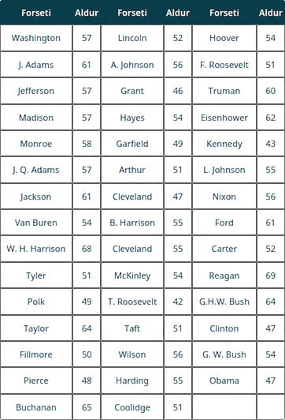
Table 2.3 Presidential Ages at Inauguration
Notes:
Table 2.3 Presidential Ages at Inauguration; Columns: President, Age, President, Age, President, Age; Row 1: Washington, 57, Lincoln, 52, Hoover, 54; Row 2: J. Adams, 61, A. Johnson, 56, F. Roosevelt, 51; Row 3: Jefferson, 57, Grant, 46, Truman, 60; Row 4: Madison, 57, Hayes, 54, Eisenhower, 62; Row 5: Monroe, 58, Garfield, 49, Kennedy, 43; Row 6: J. Q. Adams, 57, Arthur, 51, L. Johnson, 55; Row 7: Jackson, 61, Cleveland, 47, Nixon, 56; Row 8: Van Buren, 54, B. Harrison, 55, Ford, 61; Row 9: W. H. Harrison, 68, Cleveland, 55, Carter, 52; Row 10: Tyler, 51, McKinley, 54, Reagan, 69; Row 11: Polk, 49, T. Roosevelt, 42, G.H.W. Bush, 64; Row 12: Taylor, 64, Taft, 51, Clinton, 47; Row 13: Fillmore, 50, Wilson, 56, G. W. Bush, 54; Row 14: Pierce, 48, Harding, 55, Obama, 47; Row 15: Buchanan, 65, Coolidge, 51, ,

Slide 7
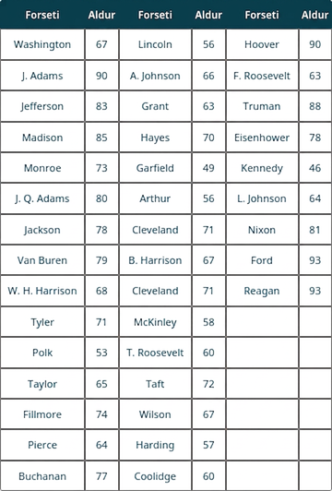
Table 2.4 Presidential Age at Death
Notes:
Table 2.4 Presidential Age at Death; Columns: President, Age, President, Age, President, Age; Row 1: Washington, 67, Lincoln, 56, Hoover, 90; Row 2: J. Adams, 90, A. Johnson, 66, F. Roosevelt, 63; Row 3: Jefferson, 83, Grant, 63, Truman, 88; Row 4: Madison, 85, Hayes, 70, Eisenhower, 78; Row 5: Monroe, 73, Garfield, 49, Kennedy, 46; Row 6: J. Q. Adams, 80, Arthur, 56, L. Johnson, 64; Row 7: Jackson, 78, Cleveland, 71, Nixon, 81; Row 8: Van Buren, 79, B. Harrison, 67, Ford, 93; Row 9: W. H. Harrison, 68, Cleveland, 71, Reagan, 93; Row 10: Tyler, 71, McKinley, 58, , ; Row 11: Polk, 53, T. Roosevelt, 60, , ; Row 12: Taylor, 65, Taft, 72, , ; Row 13: Fillmore, 74, Wilson, 67, , ; Row 14: Pierce, 64, Harding, 57, , ; Row 15: Buchanan, 77, Coolidge, 60, ,

Slide 8
Table 2.5
Aldur við embættistöku |  | Aldur við andlát
9 9 8 7 7 7 6 3 2 | 4 | 6 9
8 7 7 7 7 6 6 6 5 5 5 5 4 4 4 4 4 2 1 1 1 1 1 0 | 5 | 3 6 6 7 7 8
9 5 4 4 2 1 1 1 0 | 6 | 0 0 3 3 4 4 5 6 7 7 7 8
 | 7 | 0 0 1 1 1 4 7 8 8 9
 | 8 | 0 1 3 5 8
 | 9 | 0 0 3 3

Slide 9
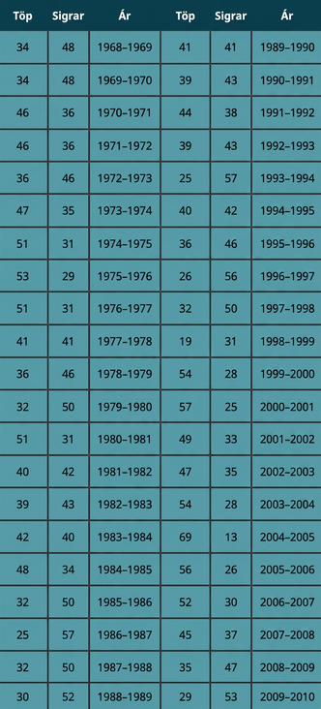
Table 2.6
Notes:
Table 2.6; Columns: Losses, Wins, Year, Losses, Wins, Year; Row 1: 34, 48, 1968–1969, 41, 41, 1989–1990; Row 2: 34, 48, 1969–1970, 39, 43, 1990–1991; Row 3: 46, 36, 1970–1971, 44, 38, 1991–1992; Row 4: 46, 36, 1971–1972, 39, 43, 1992–1993; Row 5: 36, 46, 1972–1973, 25, 57, 1993–1994; Row 6: 47, 35, 1973–1974, 40, 42, 1994–1995; Row 7: 51, 31, 1974–1975, 36, 46, 1995–1996; Row 8: 53, 29, 1975–1976, 26, 56, 1996–1997; Row 9: 51, 31, 1976–1977, 32, 50, 1997–1998; Row 10: 41, 41, 1977–1978, 19, 31, 1998–1999; Row 11: 36, 46, 1978–1979, 54, 28, 1999–2000; Row 12: 32, 50, 1979–1980, 57, 25, 2000–2001; Row 13: 51, 31, 1980–1981, 49, 33, 2001–2002; Row 14: 40, 42, 1981–1982, 47, 35, 2002–2003; Row 15: 39, 43, 1982–1983, 54, 28, 2003–2004; Row 16: 42, 40, 1983–1984, 69, 13, 2004–2005; Row 17: 48, 34, 1984–1985, 56, 26, 2005–2006; Row 18: 32, 50, 1985–1986, 52, 30, 2006–2007; Row 19: 25, 57, 1986–1987, 45, 37, 2007–2008; Row 20: 32, 50, 1987–1988, 35, 47, 2008–2009; Row 21: 30, 52, 1988–1989, 29, 53, 2009–2010

Slide 10
Table 2.7
Fjöldi áminninga til unglings | Tíðni
0 | 2
1 | 5
2 | 8
3 | 14
4 | 7
5 | 4

Slide 11
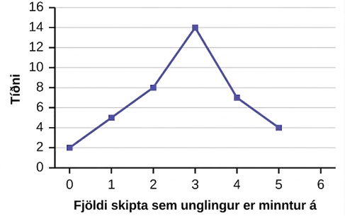
Figure 2.2
Notes:
A line graph showing the number of times a teenager needs to be reminded to do chores on the x-axis and frequency on the y-axis.

Slide 12
Table 2.8
Fjöldi heimsókna í verslun | Tíðni
0 | 7
1 | 10
2 | 14
3 | 9

Slide 13
Table 2.9
Age-Groups | Fjöldi notenda vefsvæðis | Hlutfall (%) notenda vefsvæðis
13–25 | 65,082,280 | 45%
26–44 | 53,300,200 | 36%
45–64 | 27,885,100 | 19%

Slide 14
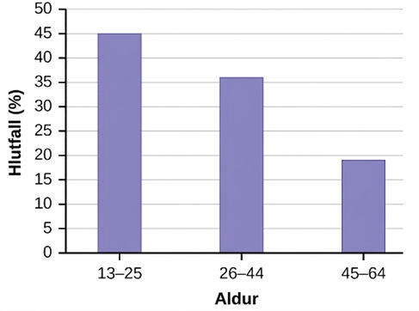
Figure 2.3
Notes:
This is a bar graph that matches the supplied data. The x-axis shows age groups, and the y-axis shows the percentages of Facebook users.

Slide 15
Table 2.10
Age-Groups | Fjöldi fólks | Hlutfall mannfjölda
Börn | 67,059 | 19%
Working-age adults | 152,198 | 43%
Eftirlaunaþegar | 131,662 | 38%

Slide 16
Table 2.11
Race/Ethnicity | Hópur nemenda í AP-prófum | Heildarhópur nemenda
1 = Asian, Asian American, or Pacific Islander | 10.3% | 5.7%
2 = Black or African American | 9.0% | 14.7%
3 = Hispanic or Latino | 17.0% | 17.6%
4 = American Indian or Alaska Native | 0.6% | 1.1%
5 = White | 57.1% | 59.2%
6 = Not reported/other | 6.0% | 1.7%

Slide 17
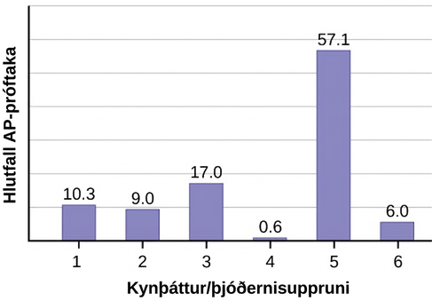
Figure 2.4
Notes:
This is a bar graph that matches the supplied data. The x-axis shows race and ethnicity, and the y-axis shows the percentages of AP examinees.

Slide 18
Table 2.12
Kjördæmi | Hópur skráðra kjósenda | Heildarmannfjöldi borgarinnar
1 | 15.5% | 19.4%
2 | 12.2% | 15.6%
3 | 9.8% | 9.0%
4 | 17.4% | 18.5%
5 | 22.8% | 20.7%
6 | 22.3% | 16.8%

Slide 19
Table 2.13
 | Hundar | Kettir | Fiskar | Samtals
Karlar | 4 | 2 | 2 | 8
Konur | 4 | 6 | 2 | 12
Samtals | 8 | 8 | 4 | 20

Slide 20
Table 2.14
 | Hundar | Kettir | Fiskar | Samtals
Karlar | 4 | 2 | 2 | 8
Konur | 4 | 6 | 2 | 12
Samtals | 8 | 8 | 4 | 20

Slide 21
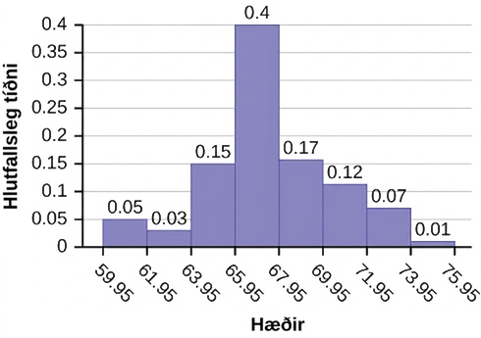
Figure 2.5
Notes:
Histogram consists of 8 bars with the y-axis in increments of 0.05 from 0-0.4 and the x-axis in intervals of 2 from 59.95-75.95.

Slide 22
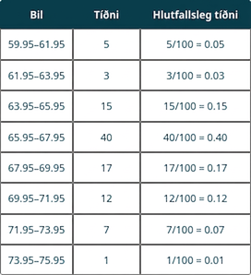
Table 2.15
Notes:
Table 2.15; Columns: Interval, Frequency, Relative Frequency; Row 1: 59.95–61.95, 5, 5/100 = 0.05; Row 2: 61.95–63.95, 3, 3/100 = 0.03; Row 3: 63.95–65.95, 15, 15/100 = 0.15; Row 4: 65.95–67.95, 40, 40/100 = 0.40; Row 5: 67.95–69.95, 17, 17/100 = 0.17; Row 6: 69.95–71.95, 12, 12/100 = 0.12; Row 7: 71.95–73.95, 7, 7/100 = 0.07; Row 8: 73.95–75.95, 1, 1/100 = 0.01

Slide 23
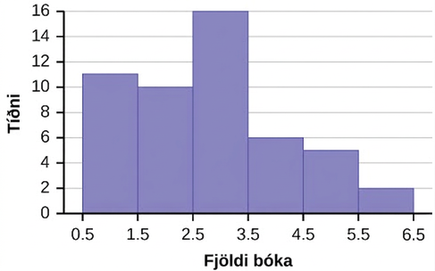
Figure 2.6
Notes:
Histogram consists of 6 bars with the y-axis in increments of 2 from 0-16 and the x-axis in intervals of 1 from 0.5-6.5.

Slide 24
Table 2.16
Fjöldi klukkustunda sem bekkjarfélagar mínir vörðu í tölvuleiki um helgar
9.95 | 10 | 2.25 | 16.75 | 0
19.5 | 22.5 | 7.5 | 15 | 12.75
5.5 | 11 | 10 | 20.75 | 17.5
23 | 21.9 | 24 | 23.75 | 18
20 | 15 | 22.9 | 18.8 | 20.5

Slide 25
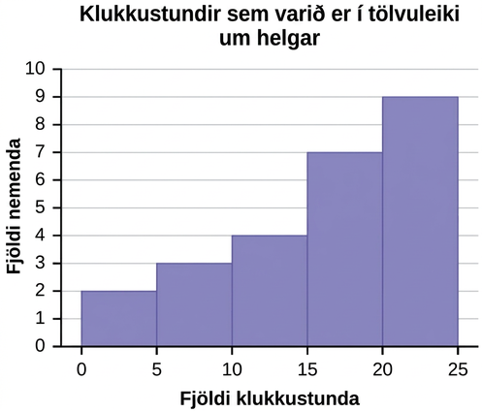
Figure 2.7
Notes:
This is a histogram that matches the supplied data. The x-axis consists of 5 bars in intervals of 5 from 0 to 25. The y-axis is marked in increments of 1 from 0 to 10. The x-axis shows the number of hours spent playing video games on the weekends, and the y-axis shows the number of students.

Slide 26
Table 2.17
Tíðnidreifing einkunna á lokaprófi í stærðfræðigreiningu
Neðri mörk | Efri mörk | Tíðni | Uppsöfnuð tíðni
49.5 | 59.5 | 5 | 5
59.5 | 69.5 | 10 | 15
69.5 | 79.5 | 30 | 45
79.5 | 89.5 | 40 | 85
89.5 | 99.5 | 15 | 100

Slide 27
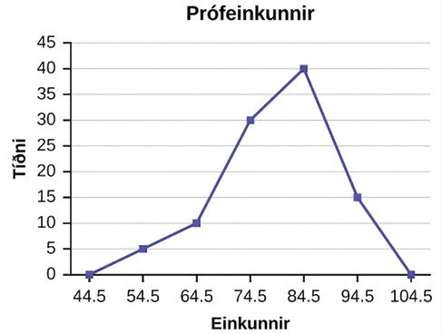
Figure 2.8
Notes:
A frequency polygon was constructed from the frequency table below.

Slide 28
Table 2.18
Aldur við embættistöku | Tíðni
41.5–46.5 | 4
46.5–51.5 | 11
51.5–56.5 | 14
56.5–61.5 | 9
61.5–66.5 | 4
66.5–71.5 | 2

Slide 29
Table 2.19
Tíðnidreifing einkunna á lokaprófi í stærðfræðigreiningu
Neðri mörk | Efri mörk | Tíðni | Uppsöfnuð tíðni
49.5 | 59.5 | 5 | 5
59.5 | 69.5 | 10 | 15
69.5 | 79.5 | 30 | 45
79.5 | 89.5 | 40 | 85
89.5 | 99.5 | 15 | 100

Slide 30
Table 2.20
Tíðnidreifing lokaeinkunna í stærðfræðigreiningu
Neðri mörk | Efri mörk | Tíðni | Safntíðni
49.5 | 59.5 | 10 | 10
59.5 | 69.5 | 10 | 20
69.5 | 79.5 | 30 | 50
79.5 | 89.5 | 45 | 95
89.5 | 99.5 | 5 | 100

Slide 31
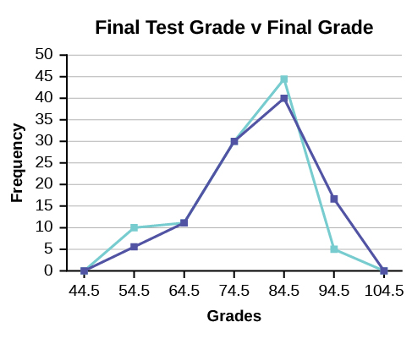
Figure 2.9
Notes:
This is an overlay frequency polygon that matches the supplied data. The x-axis shows the grades, and the y-axis shows the frequency.

Slide 32
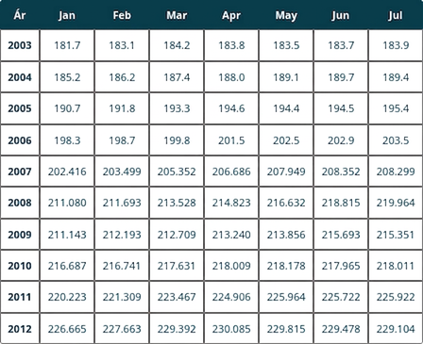
Table 2.21
Notes:
Table 2.21; Columns: Year, Jan, Feb, Mar, Apr, May, Jun, Jul; Row 1: 2003, 181.7, 183.1, 184.2, 183.8, 183.5, 183.7, 183.9; Row 2: 2004, 185.2, 186.2, 187.4, 188.0, 189.1, 189.7, 189.4; Row 3: 2005, 190.7, 191.8, 193.3, 194.6, 194.4, 194.5, 195.4; Row 4: 2006, 198.3, 198.7, 199.8, 201.5, 202.5, 202.9, 203.5; Row 5: 2007, 202.416, 203.499, 205.352, 206.686, 207.949, 208.352, 208.299; Row 6: 2008, 211.080, 211.693, 213.528, 214.823, 216.632, 218.815, 219.964; Row 7: 2009, 211.143, 212.193, 212.709, 213.240, 213.856, 215.693, 215.351; Row 8: 2010, 216.687, 216.741, 217.631, 218.009, 218.178, 217.965, 218.011; Row 9: 2011, 220.223, 221.309, 223.467, 224.906, 225.964, 225.722, 225.922; Row 10: 2012, 226.665, 227.663, 229.392, 230.085, 229.815, 229.478, 229.104

Slide 33
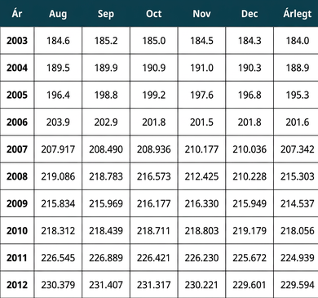
Table 2.22
Notes:
Table 2.22; Columns: Year, Aug, Sep, Oct, Nov, Dec, Annual; Row 1: 2003, 184.6, 185.2, 185.0, 184.5, 184.3, 184.0; Row 2: 2004, 189.5, 189.9, 190.9, 191.0, 190.3, 188.9; Row 3: 2005, 196.4, 198.8, 199.2, 197.6, 196.8, 195.3; Row 4: 2006, 203.9, 202.9, 201.8, 201.5, 201.8, 201.6; Row 5: 2007, 207.917, 208.490, 208.936, 210.177, 210.036, 207.342; Row 6: 2008, 219.086, 218.783, 216.573, 212.425, 210.228, 215.303; Row 7: 2009, 215.834, 215.969, 216.177, 216.330, 215.949, 214.537; Row 8: 2010, 218.312, 218.439, 218.711, 218.803, 219.179, 218.056; Row 9: 2011, 226.545, 226.889, 226.421, 226.230, 225.672, 224.939; Row 10: 2012, 230.379, 231.407, 231.317, 230.221, 229.601, 229.594

Slide 34
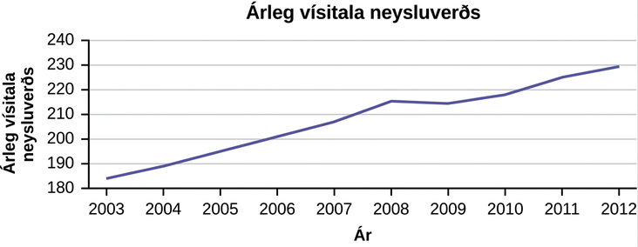
Figure 2.10
Árlegu upphæðirnar eru merktar inn fyrir hvert ár. Síðan eru samliggjandi punktar tengdir með línu.
Notes:
This is a times series graph that matches the supplied data. The x-axis shows years from 2003 to 2012, and the y-axis shows the annual CPI.

Slide 35
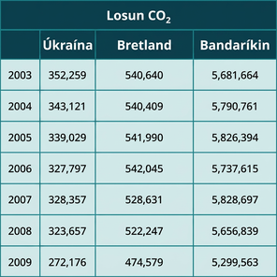
Table 2.23
Notes:
Table 2.23; Table heading row 1 columns: CO2 Emissions; Table heading row 2 columns: , Ukraine, United Kingdom, United States; Row 1: 2003, 352,259, 540,640, 5,681,664; Row 2: 2004, 343,121, 540,409, 5,790,761; Row 3: 2005, 339,029, 541,990, 5,826,394; Row 4: 2006, 327,797, 542,045, 5,737,615; Row 5: 2007, 328,357, 528,631, 5,828,697; Row 6: 2008, 323,657, 522,247, 5,656,839; Row 7: 2009, 272,176, 474,579, 5,299,563

Slide 36
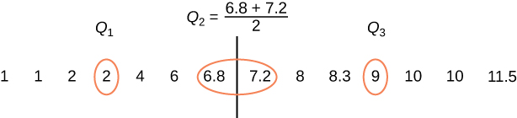
Figure 2.11
Notes:
A number line is shown including the numbers 1, 1, 2, 2, 4, 6, 6.8, 7.23, 8, 8.3, 9, 10, 10, and 11.5. The following numbers are circled in red: 2, 6.8, 7.2 and 9. There is a line between 6.8 and 7.2. Q1 is located above the second number 2. Q 3 is located above the number 9. The equation Q 2 is equal to 6.8 plus 7.2 over 2 is located above the middle of the number line.

Slide 37
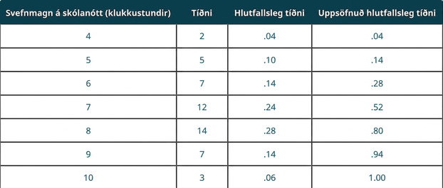
Table 2.24
Notes:
Table 2.24; Columns: Amount of Sleep per School Night (Hours), Frequency, Relative Frequency, Cumulative Relative Frequency; Row 1: 4, 2, .04, .04; Row 2: 5, 5, .10, .14; Row 3: 6, 7, .14, .28; Row 4: 7, 12, .24, .52; Row 5: 8, 14, .28, .80; Row 6: 9, 7, .14, .94; Row 7: 10, 3, .06, 1.00

Slide 38
Table 2.25
Tími á leiðinni (klukkustundir) | Tíðni | Hlutfallstíðni | Uppsöfnuð hlutfallstíðni
2 | 12 | .30 | .30
3 | 14 | .35 | .65
4 | 10 | .25 | .90
5 | 4 | .10 | 1.00

Slide 39

Figure 2.12
Notes:
A number line is shown including the numbers 0, 0, 10, 20, 30, 30, 30, 40, 45, 60, 60, 60, 90, 120, and 300. The following numbers are circled: 20, 40, and 60. The number 40 is encapsulated by 2 vertical lines.

Slide 40
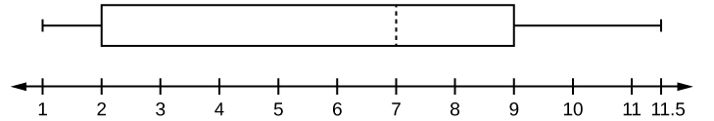
Figure 2.13
Notes:
Horizontal boxplot's first whisker extends from the smallest value, 1, to the first quartile, 2, the box begins at the first quartile and extends to the third quartile, 9, a vertical dashed line is drawn at the median, 7, and the second whisker extends from the third quartile to the largest value of 11.5.

Slide 41
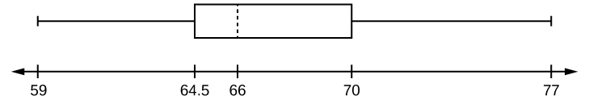
Figure 2.14
Notes:
Horizontal boxplot with first whisker extending from smallest value, 59, to Q1, 64.5, box beginning from Q1 to Q3, 70, median dashed line at Q2, 66, and second whisker extending from Q3 to largest value, 77.

Slide 42
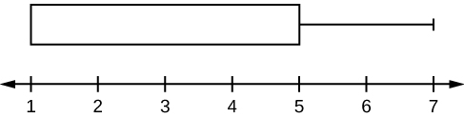
Figure 2.15
Notes:
Horizontal boxplot box begins at the smallest value and Q1, 1, until the Q3 and median, 5, no median line is designated, and has its lone whisker extending from the Q3 to the largest value, 7.

Slide 43
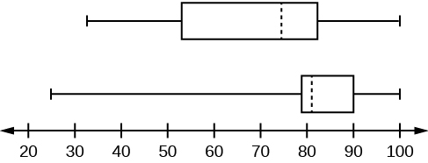
Figure 2.16
Notes:
Two box plots over a number line from 0 to 100. The top plot shows a whisker from 32 to 56, a solid line at 56, a dashed line at 74.5, a solid line at 82.5, and a whisker from 82.5 to 99. The lower plot shows a whisker from 25.5 to 78, solid line at 78, dashed line at 81, solid line at 89, and a whisker from 89 to 98.

Slide 44
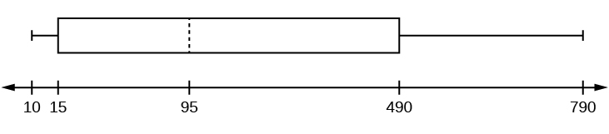
Figure 2.17
Notes:
This graph and whisker plot shows the numbers 10, 15, 95, 490, and 790 represented on a line plot. The markings are from 10 to 790 with the range being from 15 to 490 and the median being 95.

Slide 45
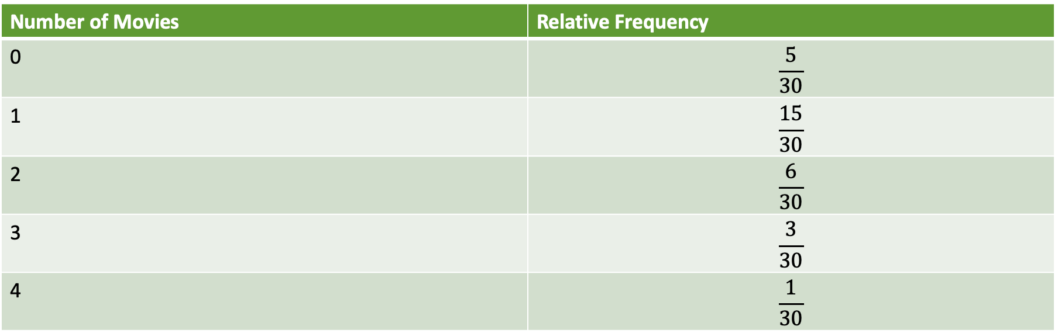
Table 2.26
Fjöldi kvikmynda | Hlutfallstíðni
0 | $$\frac{5}{30}$$
1 | $$\frac{15}{30}$$
2 | $$\frac{6}{30}$$
3 | $$\frac{3}{30}$$
4 | $$\frac{1}{30}$$

Slide 46
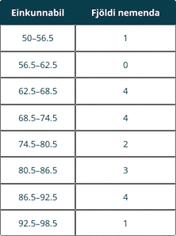
Table 2.27
Notes:
Table 2.27; Columns: Grade Interval, Number of Students; Row 1: 50–56.5, 1; Row 2: 56.5–62.5, 0; Row 3: 62.5–68.5, 4; Row 4: 68.5–74.5, 4; Row 5: 74.5–80.5, 2; Row 6: 80.5–86.5, 3; Row 7: 86.5–92.5, 4; Row 8: 92.5–98.5, 1

Slide 47
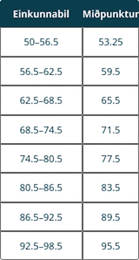
Table 2.28
Notes:
Table 2.28; Columns: Grade Interval, Midpoint; Row 1: 50–56.5, 53.25; Row 2: 56.5–62.5, 59.5; Row 3: 62.5–68.5, 65.5; Row 4: 68.5–74.5, 71.5; Row 5: 74.5–80.5, 77.5; Row 6: 80.5–86.5, 83.5; Row 7: 86.5–92.5, 89.5; Row 8: 92.5–98.5, 95.5

Slide 48
Table 2.29
Klukkustundir sem unglingar verja í tölvuleiki | Fjöldi unglinga
0–3.5 | 3
3.5–7.5 | 7
7.5–11.5 | 12
11.5–15.5 | 7
15.5–19.5 | 9

Slide 49
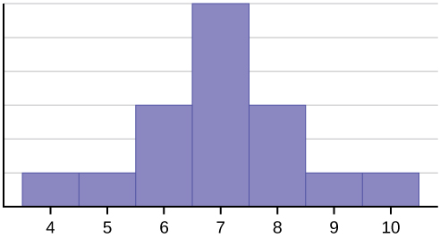
Figure 2.18
Notes:
This histogram matches the supplied data. It consists of 7 adjacent bars with the x-axis split into intervals of 1 from 4 to 10. The heighs of the bars peak in the middle and taper symmetrically to the right and left.

Slide 50
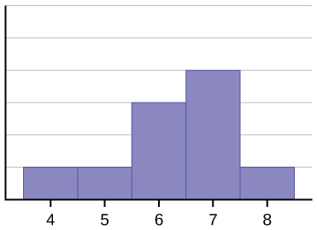
Figure 2.19
Notes:
This histogram matches the supplied data. It consists of 5 adjacent bars with the x-axis split into intervals of 1 from 4 to 8. The peak is to the right, and the heights of the bars taper down to the left.

Slide 51
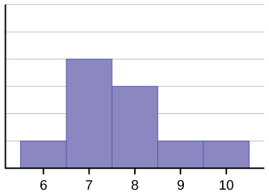
Figure 2.20
Notes:
This histogram matches the supplied data. It consists of 5 adjacent bars with the x-axis split into intervals of 1 from 6 to 10. The peak is to the left, and the heights of the bars taper down to the right.

Slide 52
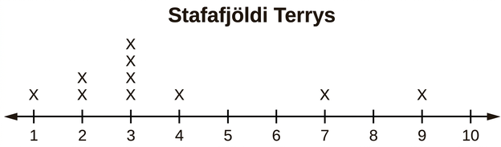
Figure 2.21
Dreifing Terrys er hægri-skekkt (jákvætt skekkt).
Notes:
This dot plot matches the supplied data for Terry. The plot uses a number line from 1 to 10. It shows one x over 1, two x's over 2, four x's over 3, one x over 4, one x over 7, and one x over 9. There are no x's over the numbers 5, 6, 8, and 10.

Slide 53
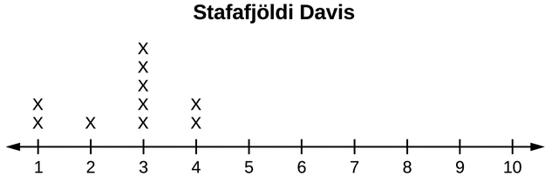
Figure 2.22
Dreifing Davis er vinstri-skekkt (neikvætt skekkt).
Notes:
This dot plot matches the supplied data for Davi. The plot uses a number line from 1 to 10. It shows two x's over 1, one x over 2, five x's over 3, and two x's over 4. There are no x's over the numbers 5, 6, 7, 8, 9, and 10.

Slide 54
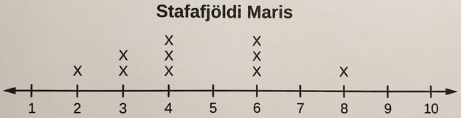
Figure 2.23
Dreifing Maris er samhverf.
Notes:
This dot plot matches the supplied data for Mari. The plot uses a number line from 1 to 10. It shows one x over 2, two x's over 3, three x's over 4, three x's over 6, and one x over 8. There are no x's over the numbers 1, 5, 7, 9, and 10.

Slide 55
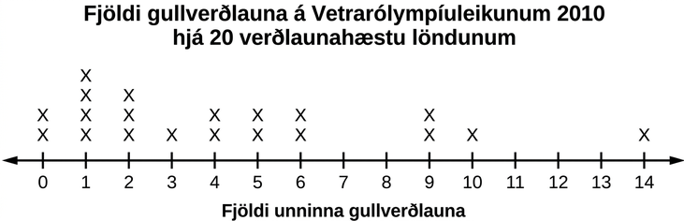
Figure 2.24
Notes:
This dot plot matches the supplied data. The plot uses a number line from 0 to 14. It shows two x's over 0, four x's over 1, three x's over 2, one x over 3, two x's over the number 4, 5, 6, and 9, and 1 x each over 10 and 14. There are no x's over the numbers 7, 8, 11, 12, and 13.

Slide 56
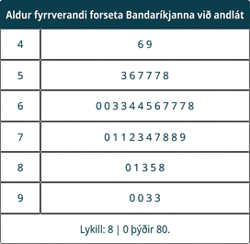
Table 2.30
Notes:
Table 2.30; Columns: The Ages at Which Former U.S. Presidents Died; Row 1: 4, 6 9; Row 2: 5, 3 6 7 7 7 8; Row 3: 6, 0 0 3 3 4 4 5 6 7 7 7 8; Row 4: 7, 0 1 1 2 3 4 7 8 8 9; Row 5: 8, 0 1 3 5 8; Row 6: 9, 0 0 3 3; Row 7: Key: 8|0 means 80.

Slide 57
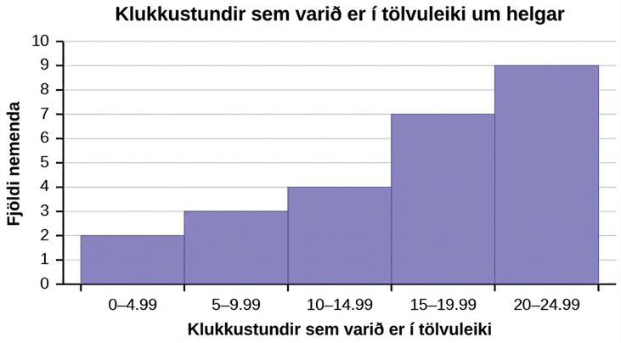
Figure 2.25
Notes:
This is a histogram titled Hours Spent Playing Video Games on Weekends. The x-axis shows the number of hours spent playing video games with bars showing values at intervals of 5. The y-axis shows the number of students. The first bar for 0 - 4.99 hours has a height of 2. The second bar from 5 - 9.99 has a height of 3. The third bar from 10 - 14.99 has a height of 4. The fourth bar from 15 - 19.99 has a height of 7. The fifth bar from 20 - 24.99 has a height of 9.

Slide 58
Table 2.31
Matvöruverslun | Staðalfrávik þýðis, σ | Einstaklingsgildi, x | Meðaltal þýðis, μ
Matvöruverslun A | 2 minutes | 7, 1 | 5
Matvöruverslun B | 4 minutes |  | 5

Slide 59
Figure 2.26
Notes:
This shows a number line in intervals of 1 from 0 to 7.

Slide 60
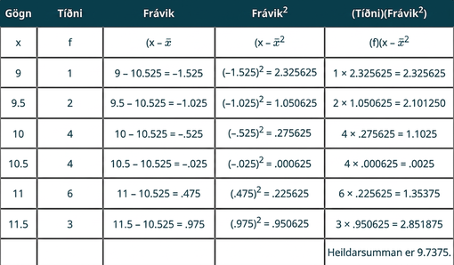
Table 2.32
Notes:
Table 2.32; Columns: Data, Frequency, Deviations, Deviations2, (Frequency)(Deviations2); Row 1: x, f, (x –
x
¯
), (x –
x
¯
)2, (f)(x –
x
¯
)2; Row 2: 9, 1, 9 – 10.525 = –1.525, (–1.525)2 = 2.325625, 1 × 2.325625 = 2.325625; Row 3: 9.5, 2, 9.5 – 10.525 = –1.025, (–1.025)2 = 1.050625, 2 × 1.050625 = 2.101250; Row 4: 10, 4, 10 – 10.525 = –.525, (–.525)2 = .275625, 4 × .275625 = 1.1025; Row 5: 10.5, 4, 10.5 – 10.525 = –.025, (–.025)2 = .000625, 4 × .000625 = .0025; Row 6: 11, 6, 11 – 10.525 = .475, (.475)2 = .225625, 6 × .225625 = 1.35375; Row 7: 11.5, 3, 11.5 – 10.525 = .975, (.975)2 = .950625, 3 × .950625 = 2.851875; Row 8: , , , , The total is 9.7375.

Slide 61
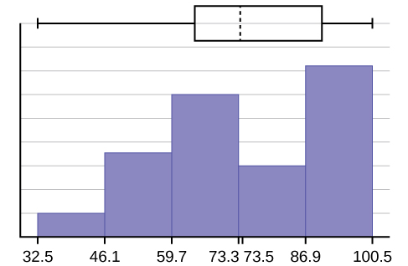
Figure 2.27
Notes:
A hybrid image displaying both a histogram and box plot described in detail in the answer solution above.

Slide 62
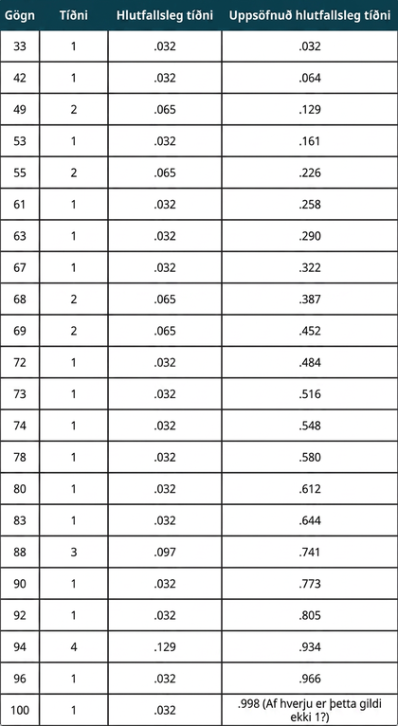
Table 2.33
Notes:
Table 2.33; Columns: Data, Frequency, Relative Frequency, Cumulative Relative Frequency; Row 1: 33, 1, .032, .032; Row 2: 42, 1, .032, .064; Row 3: 49, 2, .065, .129; Row 4: 53, 1, .032, .161; Row 5: 55, 2, .065, .226; Row 6: 61, 1, .032, .258; Row 7: 63, 1, .032, .290; Row 8: 67, 1, .032, .322; Row 9: 68, 2, .065, .387; Row 10: 69, 2, .065, .452; Row 11: 72, 1, .032, .484; Row 12: 73, 1, .032, .516; Row 13: 74, 1, .032, .548; Row 14: 78, 1, .032, .580; Row 15: 80, 1, .032, .612; Row 16: 83, 1, .032, .644; Row 17: 88, 3, .097, .741; Row 18: 90, 1, .032, .773; Row 19: 92, 1, .032, .805; Row 20: 94, 4, .129, .934; Row 21: 96, 1, .032, .966; Row 22: 100, 1, .032, .998 (Why isn't this value 1?)

Slide 63
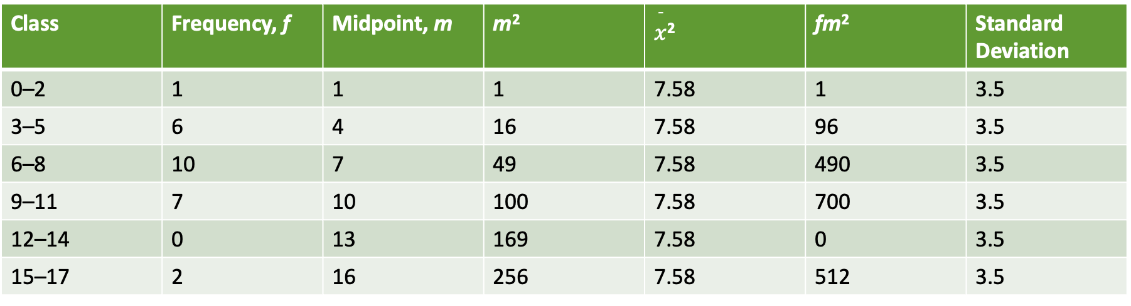
Table 2.34
Flokkur | Tíðni, f | Miðpunktur, m | m² | $\overset{¯}{x}$² | fm² | Staðalfrávik
0–2 | 1 | 1 | 1 | 7.58 | 1 | 3.5
3–5 | 6 | 4 | 16 | 7.58 | 96 | 3.5
6–8 | 10 | 7 | 49 | 7.58 | 490 | 3.5
9–11 | 7 | 10 | 100 | 7.58 | 700 | 3.5
12–14 | 0 | 13 | 169 | 7.58 | 0 | 3.5
15–17 | 2 | 16 | 256 | 7.58 | 512 | 3.5

Slide 64
Table 2.35
Flokkur | Tíðni, f
0–2 | 1
3–5 | 6
6–8 | 10
9–11 | 7
12–14 | 0
15–17 | 2

Slide 65
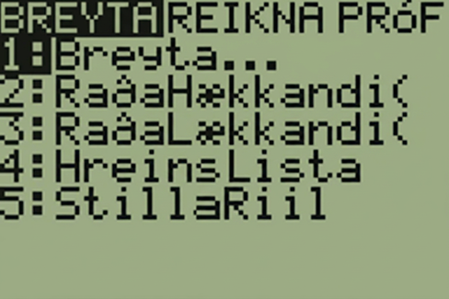
Figure 2.28
Notes:
Figure three shows the words edit, calc, tests on the top of a calculator. 1: edit 2: sort A 3: Sort D, 4:Clr List, and 5:Set up Editor

Slide 66
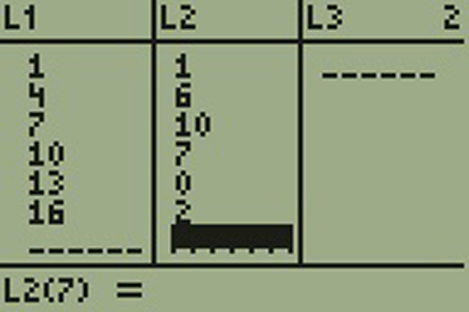
Figure 2.29
Notes:
Figure 4 shows three columns: L1. L2.and L3. L1 shows the numbers 1, 4, 7, 10, 13 and 16. L2 shows the numbers 1, 6, 10, 7, 0, 2. L3 shows nothing. There is an unsolved equation L2 multiplied by 7 = blank.

Slide 67
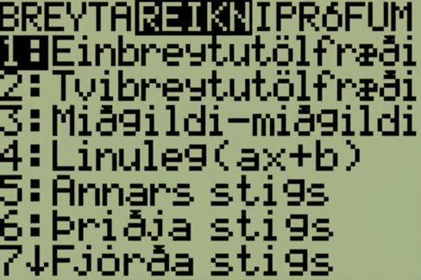
Figure 2.30
Notes:
Figure 5 shows edit, calc, and tests. Calc is highlighted. It then shows the following options. 1: 1-var stats, 2: 2-var stats, 3: med-med, 4: LinReg (ax+b), 5: QuadReg, 6: CubicReg, 7 QuartReg.

Slide 68
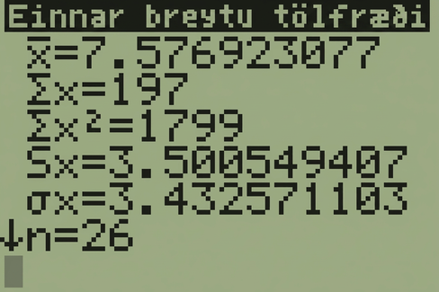
Figure 2.31
Notes:
This calculator screen shows the following calculator steps. In line 1, X bar is equal to 7.576923077. In line 2, uppercase sigma x is equal to 197. In line 3, uppercase sigma x squared is equal to 1799. In line 4, capital S of x is equal to 3.500549407. In line 5, lowercase sigma of x is equal to 3.432571103. In line 6, n preceded by a downward-facing arrow is equal to 26.

Slide 69
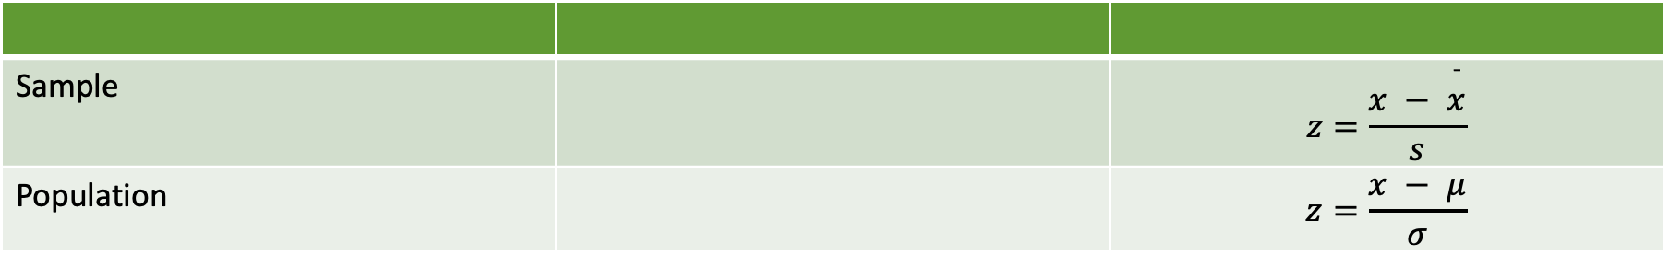
Table 2.36
Úrtak |  | $$z=\frac{x − \overset{¯}{x}}{s}$$
Þýði |  | $$z=\frac{x − μ}{σ}$$

Slide 70
Table 2.37
Nemandi | GPA | Meðal-GPA skóla | Staðalfrávik skóla
John | 2.85 | 3.0 | .7
Ali | 77 | 80 | 10

Slide 71
Table 2.38
Sundmaður | Tími (sekúndur) | Meðaltími liðs | Staðalfrávik liðs
Angie | 26.2 | 27.2 | .8
Beth | 27.3 | 30.1 | 1.4

Slide 72
Table 2.39 Survey Results
_____ | _____ | _____ | _____ | _____
_____ | _____ | _____ | _____ | _____
_____ | _____ | _____ | _____ | _____
_____ | _____ | _____ | _____ | _____
_____ | _____ | _____ | _____ | _____
_____ | _____ | _____ | _____ | _____

Slide 73
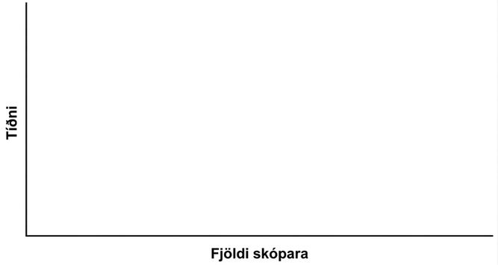
Figure 2.32
Notes:
A blank graph template for use with this problem.

Slide 74
Leyfi
Þetta OpenStax-ítarefni er © Rice University og gefið út með alþjóðlega CC BY-NC-SA 4.0 leyfinu. Heimilt er að fjölfalda það eða breyta því eingöngu í óviðskiptalegum tilgangi, en vísa þarf til OpenStax og Rice University og taka fram allar breytingar. Hvers kyns aðlögun skal deilt með sams konar leyfi.

