Slide 1

Tölfræði
Kafli 6 Normaldreifingin

Slide 2
Efnisyfirlit kaflans
Stöðluð normaldreifing
Notkun normaldreifingar
Normaldreifing - hringtímar
Normaldreifing - lengd litlafingurs

Slide 3
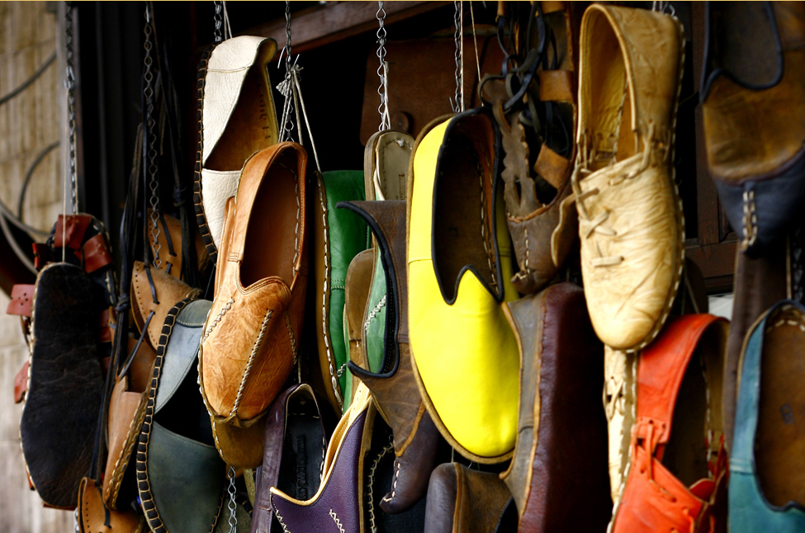
Figure 6.1
Ef nógu margir eru spurðir um skóstærð sína kemur í ljós að graf gagnanna er í laginu eins og bjöllukúrfa og má lýsa þeim sem normaldreifðum. (mynd: Ömer Ünlϋ)
Notes:
This photo shows many different pairs of shoes in various colors. The shoes appear to be hanging from a wall by cords.

Slide 4
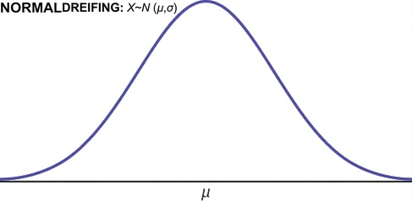
Figure 6.2
Notes:
This shows the graph of a normal distribution bell curve labeled NORMAL: X ~ N (μ, σ).

Slide 5
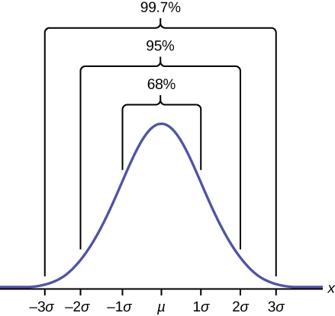
Figure 6.3
Notes:
This graph shows a bell-shaped curve for the plot line. The highest point of the bell occurs at the following point on the x axis where a greek lowercase letter mu is found on the x axis. The next highest points at the bar coincide with negative 1 sigma to the left and 1 sigma to the right. These points comprise 68 percent of the total distribution of the bell curve. Moving out toward the next lowest points on the bell we find negative 2 sigma on the left and positive 2 sigma on the right. These points comprise 95 percent of the total distribution of the bell curve. Moving out to the outermost points on the bell we find negative 3 sigma to the extreme left and positive 3 sigma to the extreme right. These points comprise 99.7 percent of the total distribution of the bell curve.

Slide 6
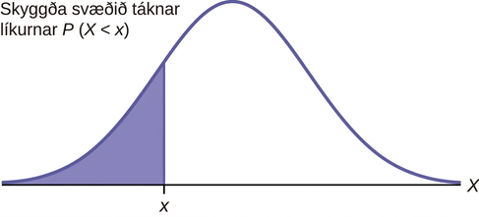
Figure 6.4
Notes:
This shows a normal distribution bell curve in which the area represented by the probability P(X < x) is shaded.

Slide 7
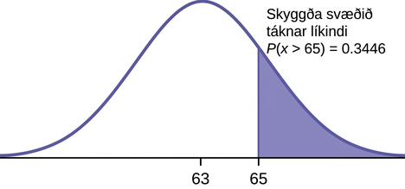
Figure 6.5
Notes:
This shows a normal distribution bell curve graph in which the area representing the probability P(x > 65) = 0.3446 is shaded.

Slide 8
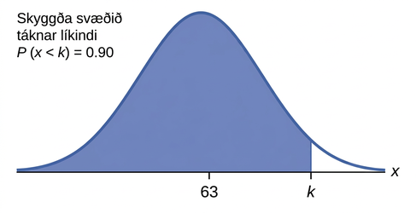
Figure 6.6
Notes:
This is a normal distribution curve. The peak of the curve coincides with the point 63 on the horizontal axis. A point, k, is labeled to the right of 63. A vertical line extends from k to the curve. The area under the curve to the left of k is shaded. This represents the probability that x is less than k: P(x < k) = 0.90

Slide 9
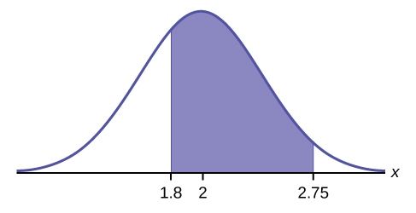
Figure 6.7
Notes:
This is a normal distribution curve. The peak of the curve coincides with the point 2 on the horizontal axis. The values 1.8 and 2.75 are also labeled on the x-axis. Vertical lines extend from 1.8 and 2.75 to the curve. The area between the lines is shaded.

Slide 10
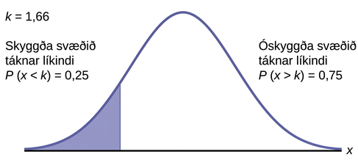
Figure 6.8
Notes:
This is a normal distribution curve. The area under the left tail of the curve is shaded. The shaded area shows that the probability that x is less than k is 0.25. It follows that k = 1.67.

Slide 11
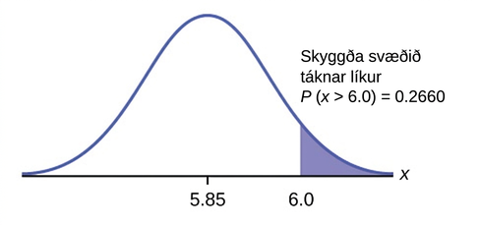
Figure 6.9
Notes:
This is a normal distribution curve. The peak of the curve coincides with the point 2 on the horizontal axis. The values 1.8 and 2.75 are also labeled on the x-axis. Vertical lines extend from 1.8 and 2.75 to the curve. The area between the lines is shaded.

Slide 12
Table 6.1
_______ | _______ | _______ | _______ | _______ | _______
_______ | _______ | _______ | _______ | _______ | _______
_______ | _______ | _______ | _______ | _______ | _______
_______ | _______ | _______ | _______ | _______ | _______
_______ | _______ | _______ | _______ | _______ | _______
_______ | _______ | _______ | _______ | _______ | _______

Slide 13
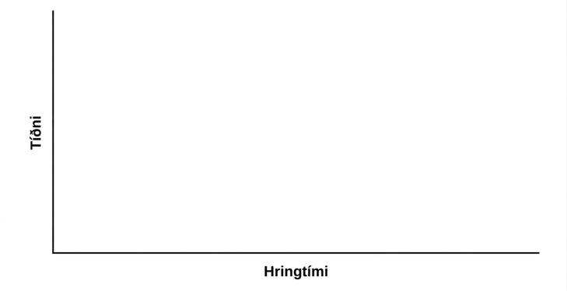
Figure 6.10
Notes:
Blank graph with relative frequency on the vertical axis and lap time on the horizontal axis.

Slide 14
Table 6.2
_______ | _______ | _______ | _______ | _______
_______ | _______ | _______ | _______ | _______
_______ | _______ | _______ | _______ | _______
_______ | _______ | _______ | _______ | _______
_______ | _______ | _______ | _______ | _______
_______ | _______ | _______ | _______ | _______

Slide 15

Figure 6.11
Notes:
Blank graph with frequency on the vertical axis and length of finger on the horizontal axis.

Slide 16
Leyfi
Þetta OpenStax-fylgiefni er © Rice University samkvæmt CC BY-NC-SA 4.0 International-leyfi. Heimilt er að afrita það eða breyta því eingöngu í óviðskiptalegum tilgangi, en vísa verður til OpenStax og Rice University og tilgreina allar breytingar. Sérhver aðlögun verður að vera gefin út með sams konar leyfi.

