Slide 1

Tölfræði
Kafli 1 Úrtak og gögn

Slide 2
Yfirlit kafla
Skilgreiningar á tölfræði, líkindum og lykilhugtökum
Gögn, úrtaka og breytileiki í gögnum og úrtökum
Tíðni, tíðnitöflur og mælistig
Tilraunahönnun og siðfræði
Tilraun í gagnasöfnun
Úrtökutilraun

Slide 3
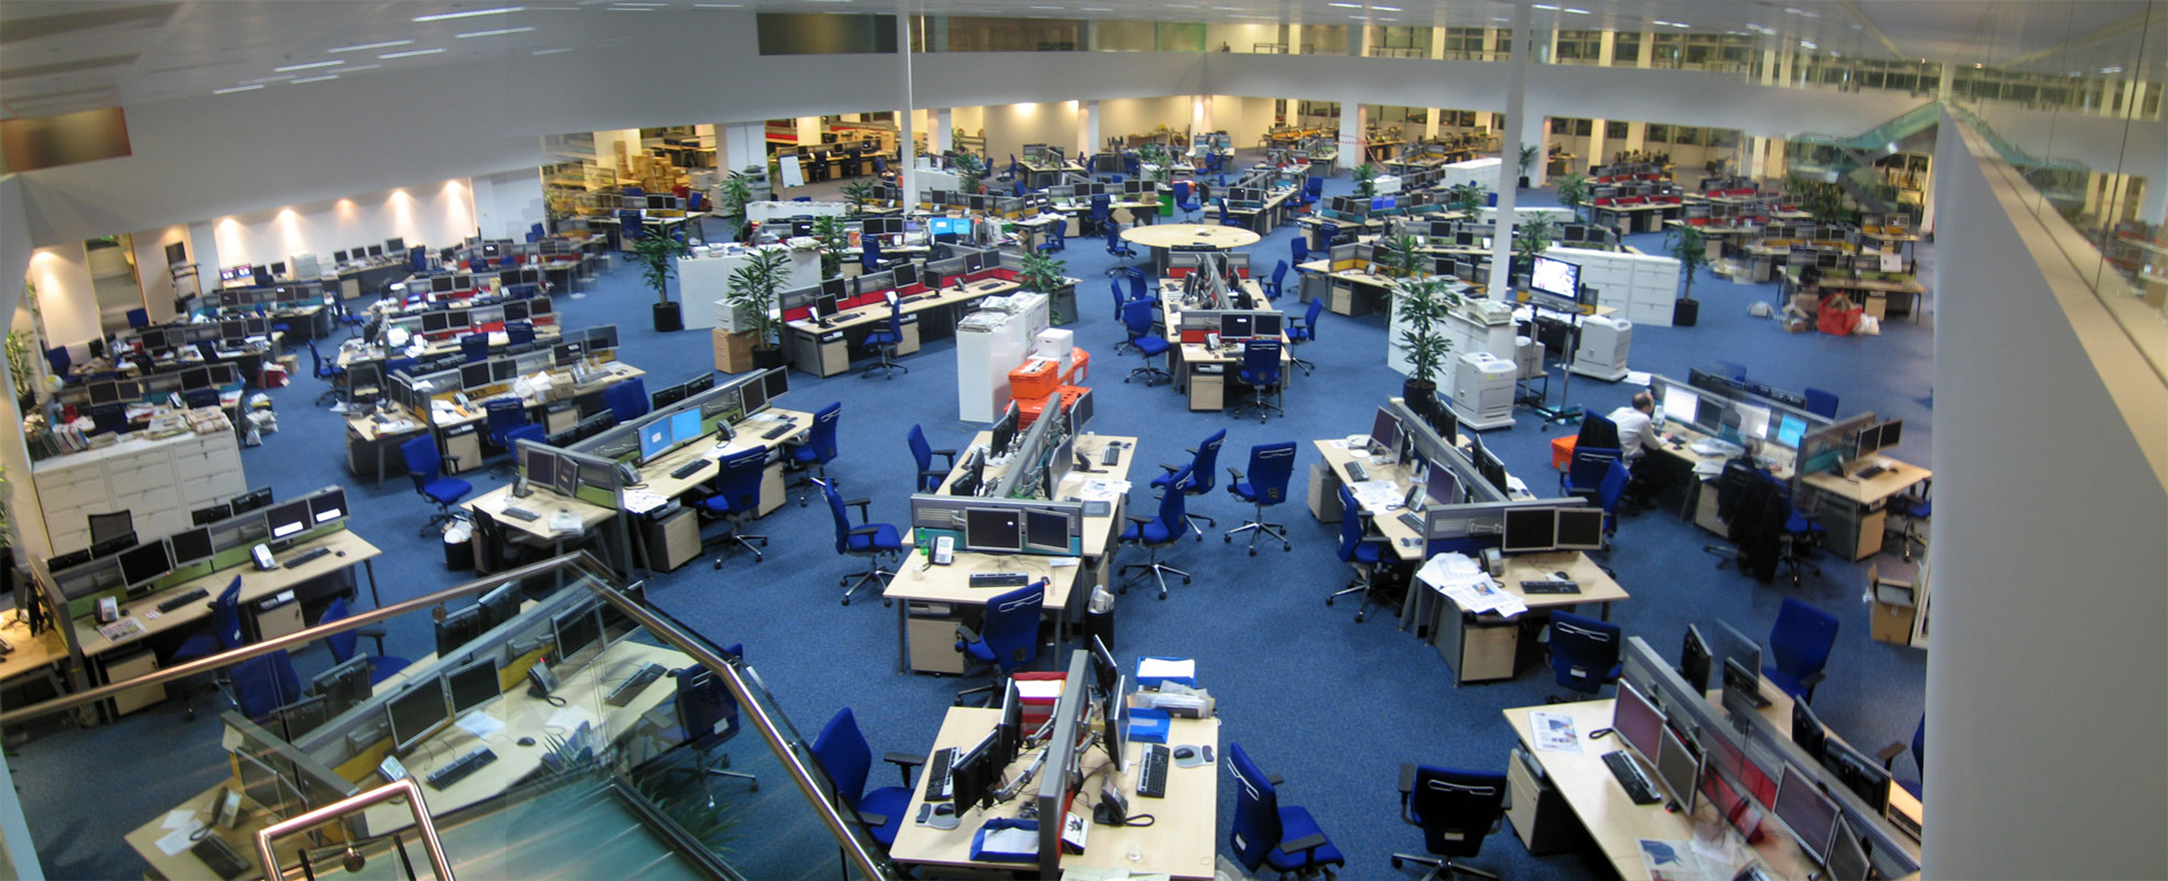
Figure 1.1
Við rekumst á tölfræði í daglegu lífi oftar en okkur er líklega ljóst og úr mörgum ólíkum áttum, til dæmis í fréttum. (David Sim)
Notes:
This photo shows a large open news room with enough space to seat about 200 employees.

Slide 4
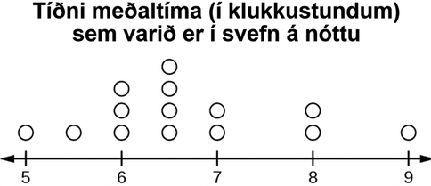
Figure 1.2
Notes:
This is a dot plot showing average hours of sleep. The number line is marked in intervals of 1 from 5 to 9. Dots above the line show 1 person reporting 5 hours, 1 with 5.5, 3 with 6, 4 with 6.5, 2 with 7, 2 with 8, and 1 with 9 hours.

Slide 5
Table 1.1
Hraði bíla við árekstur | Staðsetning ökumanns (i.e., dummies)
35 miles/hour | Framsæti

Slide 6
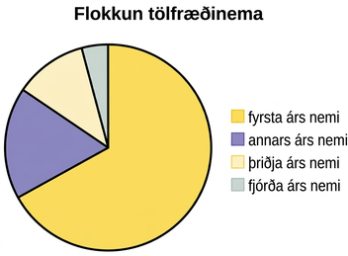
Figure 1.3
Notes:
This is a pie chart showing the class classification of statistics students. The chart has 4 sections labeled Freshman, Sophomore, Junior, Senior. A question is asked below the pie chart: what type of data does this graph show?

Slide 7
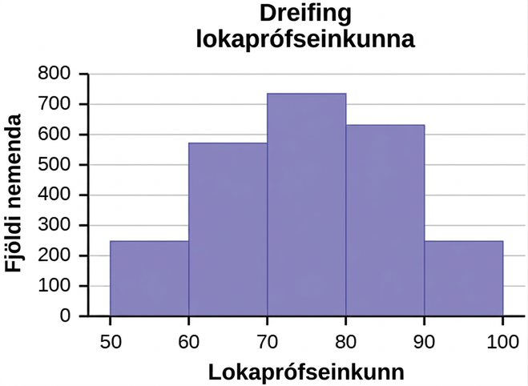
Figure 1.4
Notes:
This histogram consists of 5 bars with the x-axis marked at intervals of 3 from 50 - 100, and the y-axis in increments of 100 from 0 - 800. The height of bars shows the number of students in each interval.

Slide 8
Table 1.2 Fall Term 2007 (Census day)
De Anza College |  |  |  | Foothill College
 | Fjöldi | Prósent |  |  | Fjöldi | Prósent
Í fullu námi | 9,200 | 40.90% |  | Í fullu námi | 4,059 | 28.60%
Í hlutanámi | 13,296 | 59.10% |  | Í hlutanámi | 10,124 | 71.40%
Samtals | 22,496 | 100% |  | Samtals | 14,183 | 100%

Slide 9
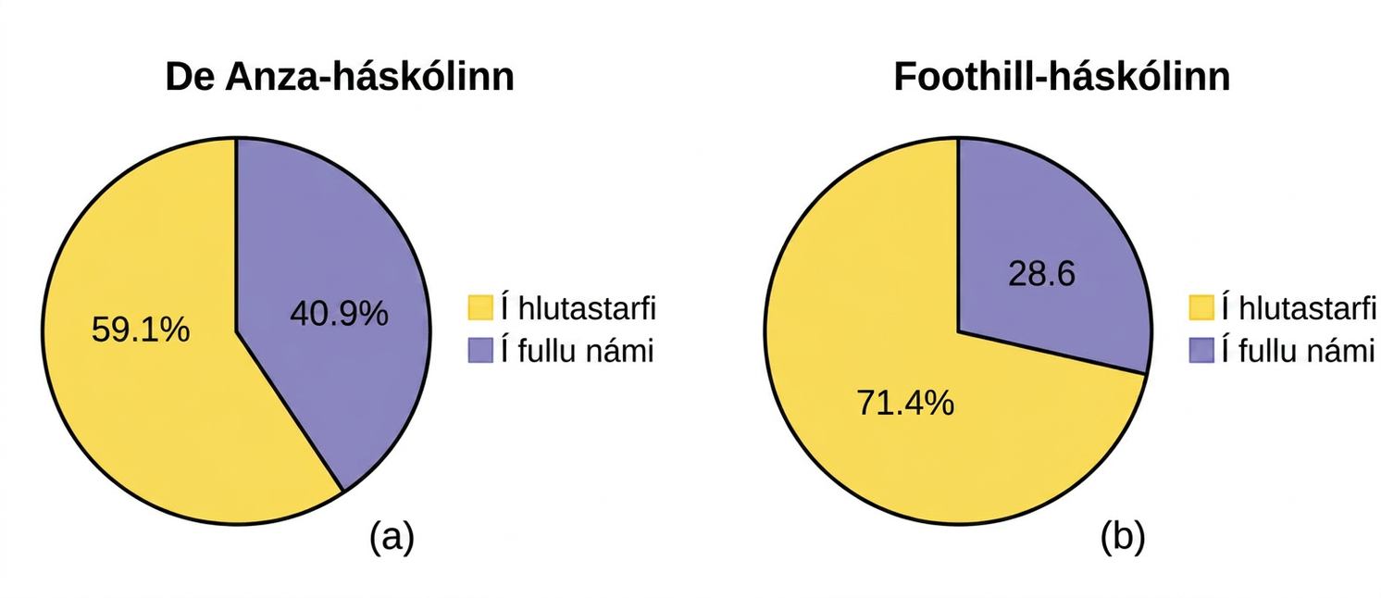
Figure 1.5
Notes:
Example shows two pie charts. First: De Anza College shows 59.1% of individuals work part time and 40.9% work full time. Second: Foothill College 71.4% work Part time and 28.6% work full time.

Slide 10
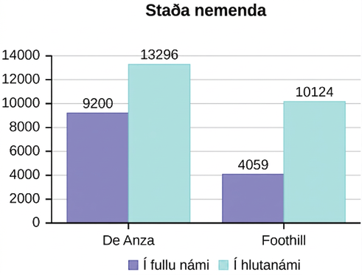
Figure 1.6
Notes:
Example is a bar graph depicting student full time and part time status. De Anza shows there are more part time students than full time, and for Foothill there are more Part time than full time.

Slide 11
Table 1.3 De Anza College Year 2010
Characteristic/Category | Prósent
Nemendur í tæknigreinum | 40.9%
Students studying non-technical subjects | 48.6%
Nemendur sem hyggjast flytja sig yfir í fjögurra ára háskólanám | 61.0%
SAMTALS | 150.5%

Slide 12
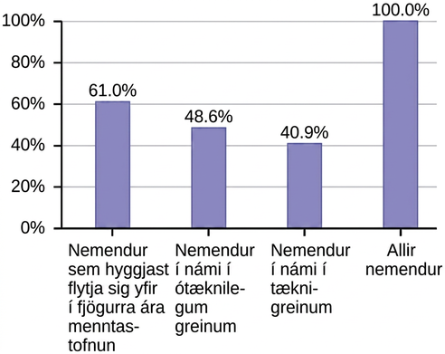
Figure 1.7
Notes:
Figure shows the ethnicity of students within the college. Asian students have 36.1%, Black 5.8%, Filipino 5.3%, Native American 0.6%, Pacific Islander 1.0%, and white students with 24.5%.

Slide 13
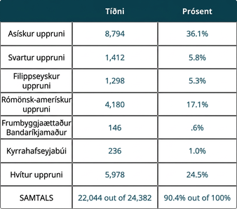
Tafla 1.4 Þjóðernisuppruni nemenda við De Anza College haustönn 2007 (manntalsdagur)
Notes:
Table 1.4 Ethnicity of Students at De Anza College Fall Term 2007 (Census Day); Columns: , Frequency, Percent; Row 1: Asian, 8,794, 36.1%; Row 2: Black, 1,412, 5.8%; Row 3: Filipino, 1,298, 5.3%; Row 4: Hispanic, 4,180, 17.1%; Row 5: Native American, 146, .6%; Row 6: Pacific Islander, 236, 1.0%; Row 7: White, 5,978, 24.5%; Row 8: TOTAL, 22,044 out of 24,382, 90.4% out of 100%

Slide 14
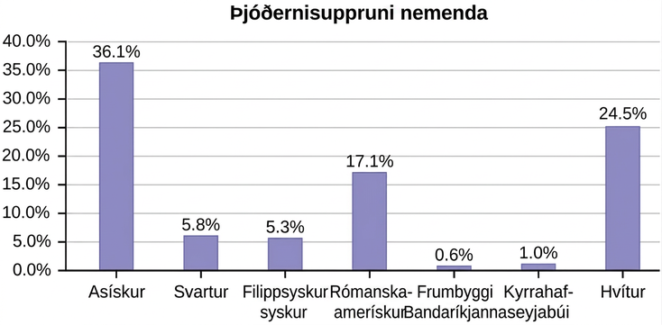
Figure 1.8
Notes:
Figure shows the ethnicity of students within the college. Asian students have 36.1%, Black 5.8%, Filipino 5.3%, Native American 0.6%, Pacific Islander 1.0%, and white students with 24.5%.

Slide 15
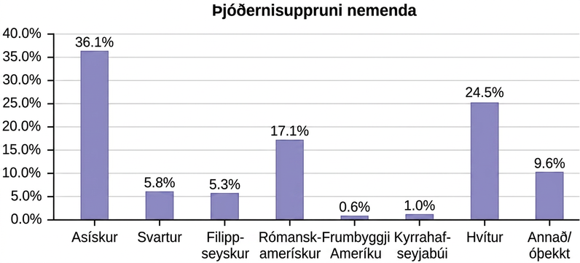
Figure 1.9
Notes:
This is a bar graph that depicts the ethnicity of students. Asian 36.1%, Black 5.8%, Filipino 5.3%, Hispanic 17.1%, Native American 0.6%, Pacific Islander 1.0%, white 24.5%, and other/unknown with 9.6%.

Slide 16
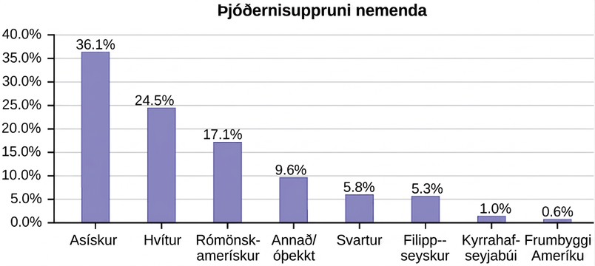
Figure 1.10
Notes:
This bar graph is graphed from largest to smallest ethnicity of students with Asian students with the largest number at 36.1%, white 24.5%, Hispanic 17.1%, Other/Unknown 9.6%, Black 5.8%, Filipino 5.3%, Pacific Islander 1.0%, Native American 0.6%.

Slide 17
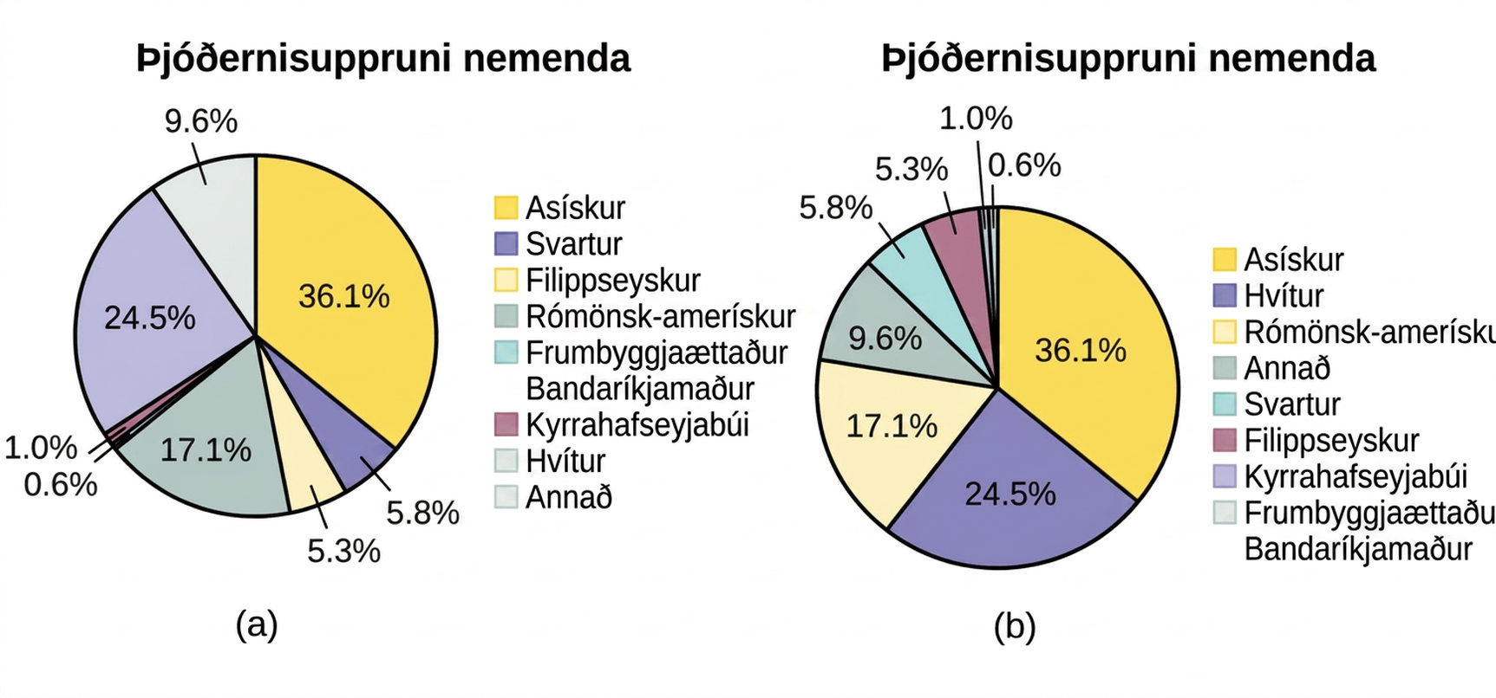
Figure 1.11
Notes:
Two pie charts labeled: Ethnicity of Students. The top one is divided: 36.1% Asian, 5.8% Black, 5.3% Filipino, 17.1% Hispanic, 0.6% Native American, 1.0% Pacific Islander, 24.5% White, and 9.6% Other. The bottom one is divided: 36.1% Asian, 24.5% White, 17.1% Hispanic, 9.6% Other, 5.8% Black, 5.3% Filipino, 1.0% Pacific Islander, 0.6% Native American.

Slide 18
Table 1.5
 | Fótbolti | Körfubolti | Tennis | Samtals
Karlar | 20 | 8 | 2 | 30
Konur | 5 | 7 | 8 | 20
Samtals | 25 | 15 | 10 | 50

Slide 19
Table 1.6
 | Fótbolti | Körfubolti | Tennis | Samtals
Karlar | 20 | 8 | 2 | 30
Konur | 5 | 7 | 8 | 20
Samtals | 25 | 15 | 10 | 50

Slide 20
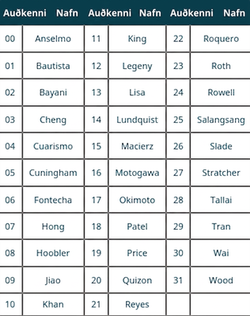
Table 1.7 Class Roster
Notes:
Table 1.7 Class Roster; Columns: ID, Name, ID, Name, ID, Name; Row 1: 00, Anselmo, 11, King, 22, Roquero; Row 2: 01, Bautista, 12, Legeny, 23, Roth; Row 3: 02, Bayani, 13, Lisa, 24, Rowell; Row 4: 03, Cheng, 14, Lundquist, 25, Salangsang; Row 5: 04, Cuarismo, 15, Macierz, 26, Slade; Row 6: 05, Cuningham, 16, Motogawa, 27, Stratcher; Row 7: 06, Fontecha, 17, Okimoto, 28, Tallai; Row 8: 07, Hong, 18, Patel, 29, Tran; Row 9: 08, Hoobler, 19, Price, 30, Wai; Row 10: 09, Jiao, 20, Quizon, 31, Wood; Row 11: 10, Khan, 21, Reyes, ,

Slide 21
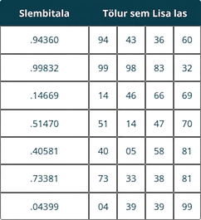
Table 1.8
Lisa myndaði tugabrotin í dálkinum Slembitala af handahófi. Síðan notaði hún hvern samliggjandi tölustaf í hverju tugabroti til að mynda tölurnar sem hún las. Sumar lesnu talnanna samsvara auðkennisnúmerum nemenda í bekknum hennar (t.d. 14 = Lundquist í töflu 1.7)
Notes:
Lisa randomly generated the decimals in the Random Number column. She then used each consecutive number in each decimal to make the numbers she read. Some of the read numbers correspond with the ID numbers given to the students in her class (e.g., 14 = Lundquist in Table 1.7)

Slide 22
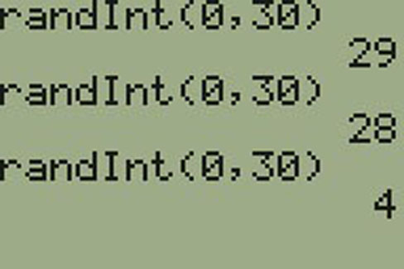
Figure 1.12
Notes:
This figure shows a sample of random numbers generated on a calculator. It should a RandInt (0,30) 29, randInt (0,30) 28, and randInt (0,30) 4

Slide 23
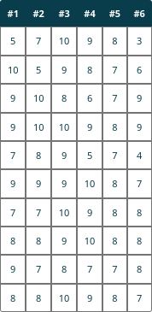
Table 1.9
Stig úr könnunum #1-6 hjá 10 nemendum í tölfræðinámskeiði. Hver könnun er af 10 stigum.

Slide 24
Table 1.10 First Experiment (20 rolls)
Hlið tenings | Tíðni
1
2
3
4
5
6

Slide 25
Table 1.11 Second Experiment (20 rolls)
Hlið tenings | Tíðni
1
2
3
4
5
6

Slide 26
Tafla 1.12 Tíðnitafla yfir vinnutíma nemenda
GAGNAGILDI | TÍÐNI
2 | 3
3 | 5
4 | 3
5 | 6
6 | 2
7 | 1

Slide 27
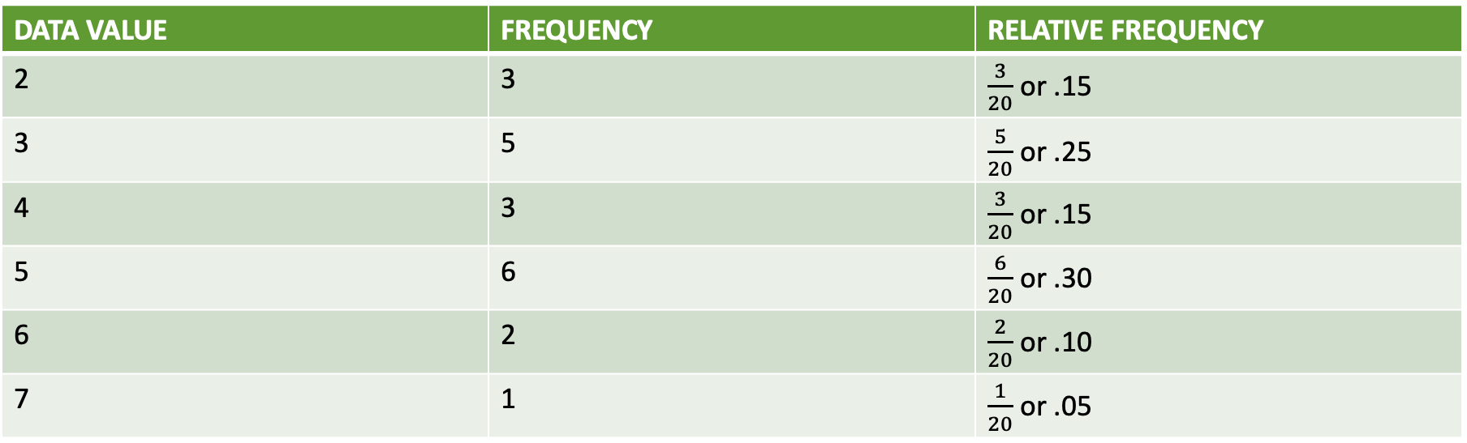
Tafla 1.13 Tíðnitafla yfir vinnutíma nemenda með hlutfallslegri tíðni
GAGNAGILDI | TÍÐNI | HLUTFALLSLEG TÍÐNI
2 | 3 | $\frac{3}{20}$ or .15
3 | 5 | $\frac{5}{20}$ or .25
4 | 3 | $\frac{3}{20}$ or .15
5 | 6 | $\frac{6}{20}$ or .30
6 | 2 | $\frac{2}{20}$ or .10
7 | 1 | $\frac{1}{20}$ or .05

Slide 28
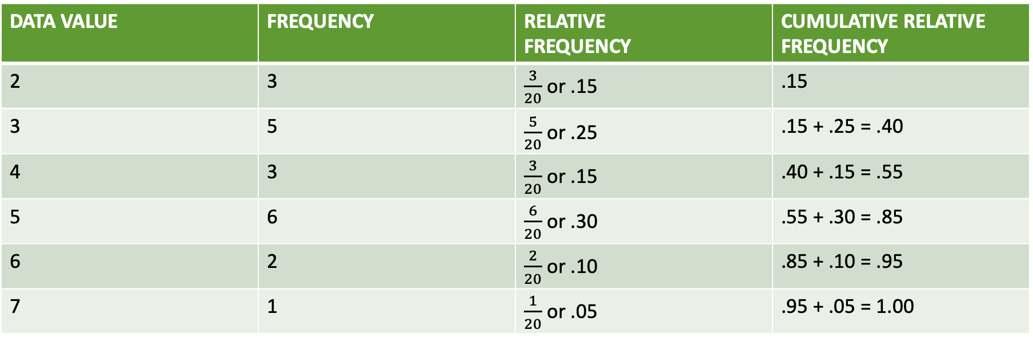
Tafla 1.14 Tíðnitafla yfir vinnustundir nemenda með hlutfallstíðni og uppsafnaða hlutfallstíðni
GAGNAGILDI | TÍÐNI | HLUTFALLSLEG TÍÐNI | UPPSÖFNUÐ HLUTFALLSLEG TÍÐNI
2 | 3 | $\frac{3}{20}$ or .15 | .15
3 | 5 | $\frac{5}{20}$ or .25 | .15 + .25 = .40
4 | 3 | $\frac{3}{20}$ or .15 | .40 + .15 = .55
5 | 6 | $\frac{6}{20}$ or .30 | .55 + .30 = .85
6 | 2 | $\frac{2}{20}$ or .10 | .85 + .10 = .95
7 | 1 | $\frac{1}{20}$ or .05 | .95 + .05 = 1.00

Slide 29
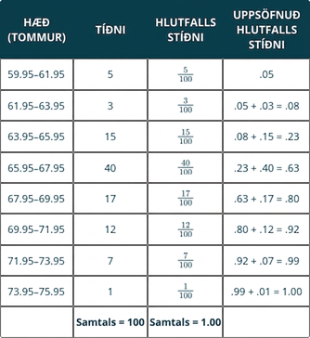
Tafla 1.15 Tíðnitafla yfir hæð knattspyrnumanna
Notes:
Table 1.15 Frequency Table of Soccer Player Height; Columns: HEIGHTS (INCHES), FREQUENCY, RELATIVE FREQUENCY, CUMULATIVE RELATIVE FREQUENCY; Row 1: 59.95–61.95, 5, 5
100
= .05, .05; Row 2: 61.95–63.95, 3, 3
100
= .03, .05 + .03 = .08; Row 3: 63.95–65.95, 15, 15
100
= .15, .08 + .15 = .23; Row 4: 65.95–67.95, 40, 40
100
= .40, .23 + .40 = .63; Row 5: 67.95–69.95, 17, 17
100
= .17, .63 + .17 = .80; Row 6: 69.95–71.95, 12, 12
100
= .12, .80 + .12 = .92; Row 7: 71.95–73.95, 7, 7
100
= .07, .92 + .07 = .99; Row 8: 73.95–75.95, 1, 1
100
= .01, .99 + .01 = 1.00; Row 9: , Total = 100, Total = 1.00,

Slide 30
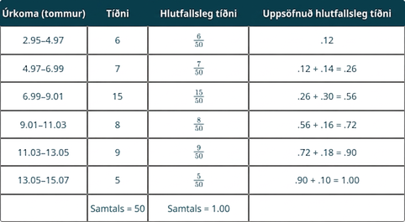
Table 1.16
Notes:
Table 1.16; Columns: Rainfall (Inches), Frequency, Relative Frequency, Cumulative Relative Frequency; Row 1: 2.95–4.97, 6, 6
50
= .12, .12; Row 2: 4.97–6.99, 7, 7
50
= .14, .12 + .14 = .26; Row 3: 6.99–9.01, 15, 15
50
= .30, .26 + .30 = .56; Row 4: 9.01–11.03, 8, 8
50
= .16, .56 + .16 = .72; Row 5: 11.03–13.05, 9, 9
50
= .18, .72 + .18 = .90; Row 6: 13.05–15.07, 5, 5
50
= .10, .90 + .10 = 1.00; Row 7: , Total = 50, Total = 1.00,

Slide 31
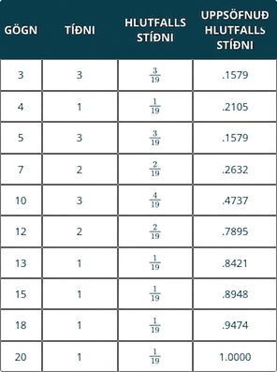
Tafla 1.17 Tíðni vegalengda í vinnuferðum
Notes:
Table 1.17 Frequency of Commuting Distances; Columns: DATA, FREQUENCY, RELATIVE FREQUENCY, CUMULATIVE RELATIVE FREQUENCY; Row 1: 3, 3, 3
19, .1579; Row 2: 4, 1, 1
19, .2105; Row 3: 5, 3, 3
19, .1579; Row 4: 7, 2, 2
19, .2632; Row 5: 10, 3, 4
19, .4737; Row 6: 12, 2, 2
19, .7895; Row 7: 13, 1, 1
19, .8421; Row 8: 15, 1, 1
19, .8948; Row 9: 18, 1, 1
19, .9474; Row 10: 20, 1, 1
19, 1.0000

Slide 32
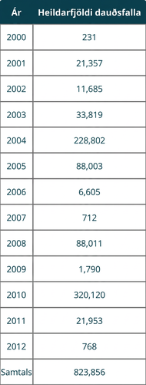
Table 1.18
Notes:
Table 1.18; Columns: Year, Total Number of Deaths; Row 1: 2000, 231; Row 2: 2001, 21,357; Row 3: 2002, 11,685; Row 4: 2003, 33,819; Row 5: 2004, 228,802; Row 6: 2005, 88,003; Row 7: 2006, 6,605; Row 8: 2007, 712; Row 9: 2008, 88,011; Row 10: 2009, 1,790; Row 11: 2010, 320,120; Row 12: 2011, 21,953; Row 13: 2012, 768; Row 14: Total, 823,856

Slide 33
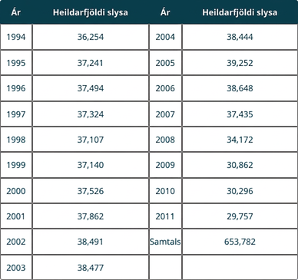
Table 1.19
Notes:
Table 1.19; Columns: Year, Total Number of Crashes, Year, Total Number of Crashes; Row 1: 1994, 36,254, 2004, 38,444; Row 2: 1995, 37,241, 2005, 39,252; Row 3: 1996, 37,494, 2006, 38,648; Row 4: 1997, 37,324, 2007, 37,435; Row 5: 1998, 37,107, 2008, 34,172; Row 6: 1999, 37,140, 2009, 30,862; Row 7: 2000, 37,526, 2010, 30,296; Row 8: 2001, 37,862, 2011, 29,757; Row 9: 2002, 38,491, Total, 653,782; Row 10: 2003, 38,477, ,

Slide 34
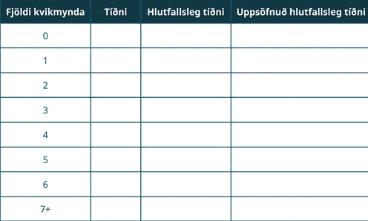
Tafla 1.20 Tíðni fjölda kvikmynda sem horft var á
Notes:
Table 1.20 Frequency of Number of Movies Viewed; Columns: Number of Movies, Frequency, Relative Frequency, Cumulative Relative Frequency; Row 1: 0, , , ; Row 2: 1, , , ; Row 3: 2, , , ; Row 4: 3, , , ; Row 5: 4, , , ; Row 6: 5, , , ; Row 7: 6, , , ; Row 8: 7+, , ,

Slide 35
Tafla 1.21 Tíðni fjölda kvikmynda sem horft var á
Fjöldi kvikmynda | Tíðni | Hlutfallstíðni | Uppsöfnuð hlutfallstíðni
0–1
2–3
4–5
6–7+

Slide 36
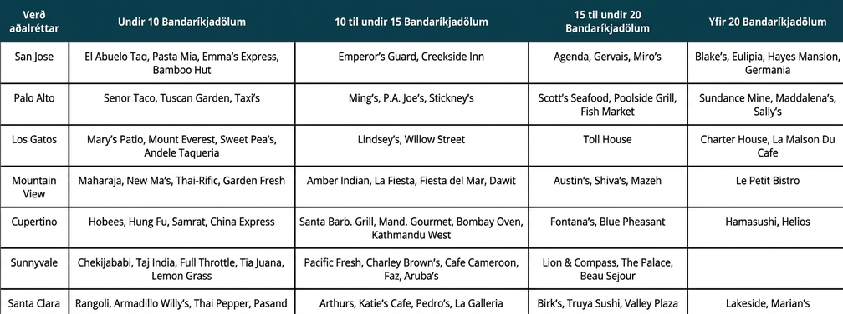
Tafla 1.22 Veitingastaðir í úrtakinu
Notes:
Table 1.22 Restaurants Used in Sample; Columns: Entree Cost, Under $10, $10 to under $15, $15 to under $20, Over $20; Row 1: San Jose, El Abuelo Taq, Pasta Mia, Emma’s Express, Bamboo Hut, Emperor’s Guard, Creekside Inn, Agenda, Gervais, Miro’s, Blake’s, Eulipia, Hayes Mansion, Germania; Row 2: Palo Alto, Senor Taco, Tuscan Garden, Taxi’s, Ming’s, P.A. Joe’s, Stickney’s, Scott’s Seafood, Poolside Grill, Fish Market, Sundance Mine, Maddalena’s, Sally's; Row 3: Los Gatos, Mary’s Patio, Mount Everest, Sweet Pea’s, Andele Taqueria, Lindsey’s, Willow Street, Toll House, Charter House, La Maison Du Cafe; Row 4: Mountain View, Maharaja, New Ma’s, Thai-Rific, Garden Fresh, Amber Indian, La Fiesta, Fiesta del Mar, Dawit, Austin’s, Shiva’s, Mazeh, Le Petit Bistro; Row 5: Cupertino, Hobees, Hung Fu, Samrat, China Express, Santa Barb. Grill, Mand. Gourmet, Bombay Oven, Kathmandu West, Fontana’s, Blue Pheasant, Hamasushi, Helios; Row 6: Sunnyvale, Chekijababi, Taj India, Full Throttle, Tia Juana, Lemon Grass, Pacific Fresh, Charley Brown’s, Cafe Cameroon, Faz, Aruba’s, Lion & Compass, The Palace, Beau Sejour, ; Row 7: Santa Clara, Rangoli, Armadillo Willy’s, Thai Pepper, Pasand, Arthur’s, Katie’s Cafe, Pedro’s, La Galleria, Birk’s, Truya Sushi, Valley Plaza, Lakeside, Mariani’s

Slide 37
Table 1.23
1. __________ | 6. __________ | 11. __________
2. __________ | 7. __________ | 12. __________
3. __________ | 8. __________ | 13. __________
4. __________ | 9. __________ | 14. __________
5. __________ | 10. __________ | 15. __________

Slide 38
Table 1.24
1. __________ | 6. __________ | 11. __________
2. __________ | 7. __________ | 12. __________
3. __________ | 8. __________ | 13. __________
4. __________ | 9. __________ | 14. __________
5. __________ | 10. __________ | 15. __________

Slide 39
Table 1.25
1. __________ | 6. __________ | 11. __________ | 16. __________
2. __________ | 7. __________ | 12. __________ | 17. __________
3. __________ | 8. __________ | 13. __________ | 18. __________
4. __________ | 9. __________ | 14. __________ | 19. __________
5. __________ | 10. __________ | 15. __________ | 20. __________

Slide 40
Table 1.26
1. __________ | 6. __________ | 11. __________ | 16. __________
2. __________ | 7. __________ | 12. __________ | 17. __________
3. __________ | 8. __________ | 13. __________ | 18. __________
4. __________ | 9. __________ | 14. __________ | 19. __________
5. __________ | 10. __________ | 15. __________ | 20. __________
 |  |  | 21. __________

Slide 41
Table 1.27
1. ________ | 6. ________ | 11. ________ | 16. ________ | 21. ________
2. ________ | 7. ________ | 12. ________ | 17. ________ | 22. ________
3. ________ | 8. ________ | 13. ________ | 18. ________ | 23. ________
4. ________ | 9. ________ | 14. ________ | 19. ________ | 24. ________
5. ________ | 10. ________ | 15. ________ | 20. ________ | 25. ________

Slide 42
Notkunarleyfi
Þetta ítarefni frá OpenStax er © Rice University og er gefið út með CC BY-NC-SA 4.0 International notkunarleyfi; heimilt er að fjölfalda það eða breyta því eingöngu í óviðskiptalegum tilgangi, en vísa þarf til OpenStax og Rice University og tilgreina allar breytingar. Öllum aðlögunum skal deilt með sams konar notkunarleyfi.

