Slide 1

Tölfræði
Chapter 4 Discrete Random Variables

Slide 2
Yfirlit kafla
Líkindadreifing fyrir strjála slembibreytu
Meðaltal eða væntigildi og staðalfrávik
Binomial Distribution (Optional)
Geometric Distribution (Optional)
Hypergeometric Distribution (Optional)
Poisson Distribution (Optional)
Discrete Distribution (Playing Card Experiment)
Discrete Distribution (Lucky Dice Experiment)

Slide 3
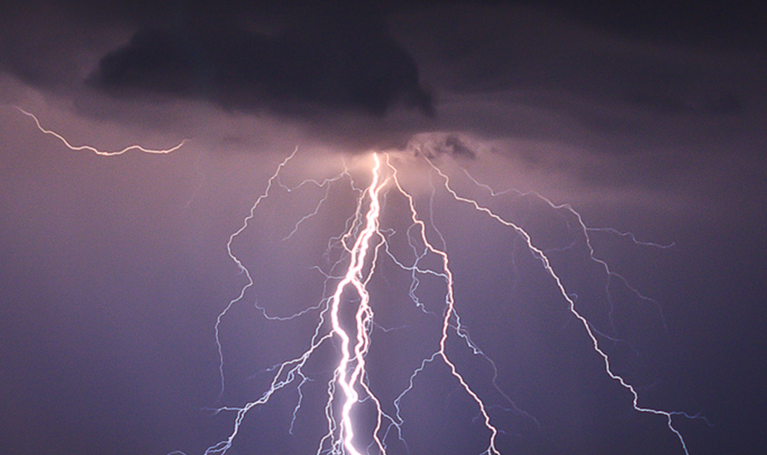
Figure 4.1
Nota má líkur og strjálar slembibreytur til að reikna líkurnar á því að eldingu slái fimm sinnum niður í hálftíma þrumuveðri. (mynd: Leszek Leszczynski)
Notes:
This photo shows branch lightening coming from a dark cloud and hitting the ground.

Slide 4
Table 4.1
x | Tíðni x | Hlutfallstíðni x

Slide 5
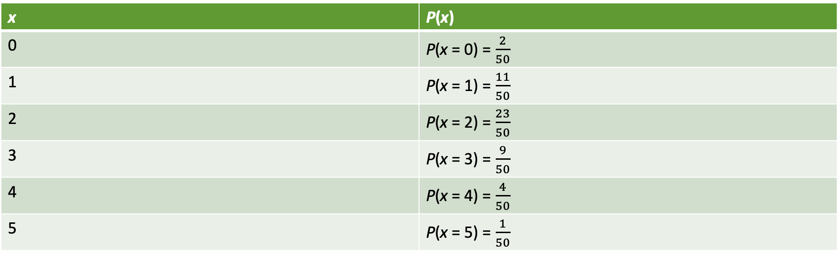
Table 4.2
x | P(x)
0 | P(x = 0) = $\frac{2}{50}$
1 | P(x = 1) = $\frac{11}{50}$
2 | P(x = 2) = $\frac{23}{50}$
3 | P(x = 3) = $\frac{9}{50}$
4 | P(x = 4) = $\frac{4}{50}$
5 | P(x = 5) = $\frac{1}{50}$

Slide 6

Table 4.3
X | P(x)
0 | P(x = 0) = $\frac{4}{50}$
1 | P(x = 1) = $\frac{8}{50}$
2 | P(x = 2) = $\frac{16}{50}$
3 | P(x = 3) = $\frac{14}{50}$
4 | P(x = 4) = $\frac{6}{50}$
5 | P(x = 5) = $\frac{2}{50}$

Slide 7
Table 4.4
x | P(x)
0 | .01
1 | .04
2 | .15
3 | .80

Slide 8
Table 4.5 Expected Value Table
x | P(x) | x*P(x)
0 | .2 | (0)(.2) = 0
1 | .5 | (1)(.5) = .5
2 | .3 | (2)(.3) = .6
Þessi tafla kallast væntigildistafla. Hún auðveldar útreikning á væntigildi, eða langtímameðaltali.

Slide 9
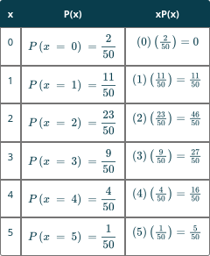
Table 4.6
Notes:
Table 4.6; Columns: x, P(x), xP(x); Row 1: 0, P(
x = 0
) =
2
50, (
0
)(
2
50
)=0; Row 2: 1, P(
x = 1
) =
11
50, (
1
)(
11
50
)=
11
50; Row 3: 2, P(
x = 2
) =
23
50, (
2
)(
23
50
)=
46
50; Row 4: 3, P(
x = 3
) =
9
50, (
3
)(
9
50
)=
27
50; Row 5: 4, P(
x = 4
) =
4
50, (
4
)(
4
50
)=
16
50; Row 6: 5, P(
x = 5
) =
1
50, (
5
)(
1
50
)=
5
50

Slide 10
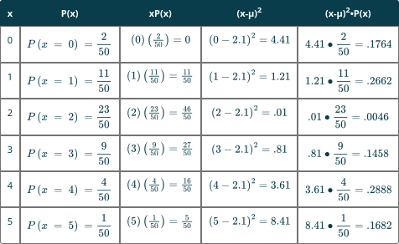
Table 4.7
Notes:
Table 4.7; Columns: x, P(x), xP(x), (x-µ)2, (x-µ)2•P(x); Row 1: 0, P(
x = 0
) =
2
50, (
0
)(
2
50
)=0, (0−2.1)
2
=4.41, 4.41•
2
50
=.1764; Row 2: 1, P(
x = 1
) =
11
50, (
1
)(
11
50
)=
11
50, (1−2.1)
2
=1.21, 1.21•
11
50
=.2662; Row 3: 2, P(
x = 2
) =
23
50, (
2
)(
23
50
)=
46
50, (2−2.1)
2
=.01, .01•
23
50
=.0046; Row 4: 3, P(
x = 3
) =
9
50, (
3
)(
9
50
)=
27
50, (3−2.1)
2
=.81, .81•
9
50
=.1458; Row 5: 4, P(
x = 4
) =
4
50, (
4
)(
4
50
)=
16
50, (4−2.1)
2
=3.61, 3.61•
4
50
=.2888; Row 6: 5, P(
x = 5
) =
1
50, (
5
)(
1
50
)=
5
50, (5−2.1)
2
=8.41, 8.41•
1
50
=.1682

Slide 11
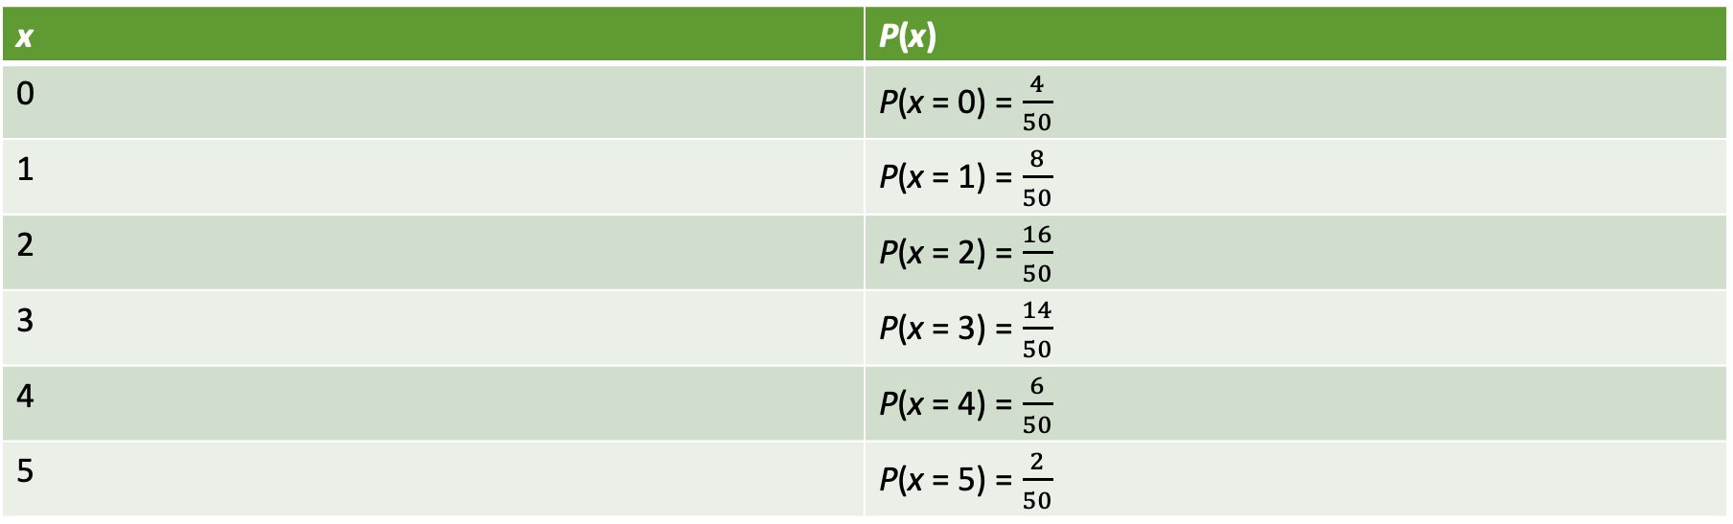
Table 4.8
x | P(x)
0 | P(x = 0) = $\frac{4}{50}$
1 | P(x = 1) = $\frac{8}{50}$
2 | P(x = 2) = $\frac{16}{50}$
3 | P(x = 3) = $\frac{14}{50}$
4 | P(x = 4) = $\frac{6}{50}$
5 | P(x = 5) = $\frac{2}{50}$

Slide 12
Table 4.9
 | x | P(x) | x*P(x)
Tap | –2 | .99999 | (–2)(.99999) = –1.99998
Hagnaður | 100,000 | .00001 | (100000)(.00001) = 1

Slide 13
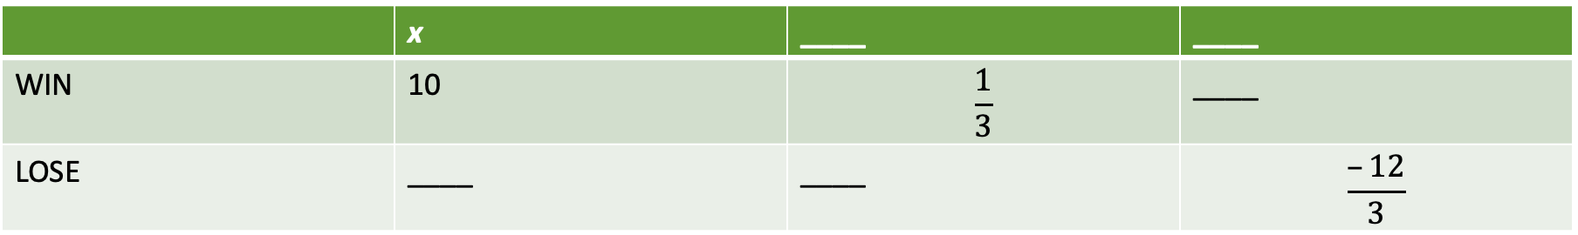
Table 4.10
 | x | ____ | ____
VINNA | 10 | $$\frac{1}{3}$$ | ____
TAPA | ____ | ____ | $$\frac{–12}{3}$$

Slide 14
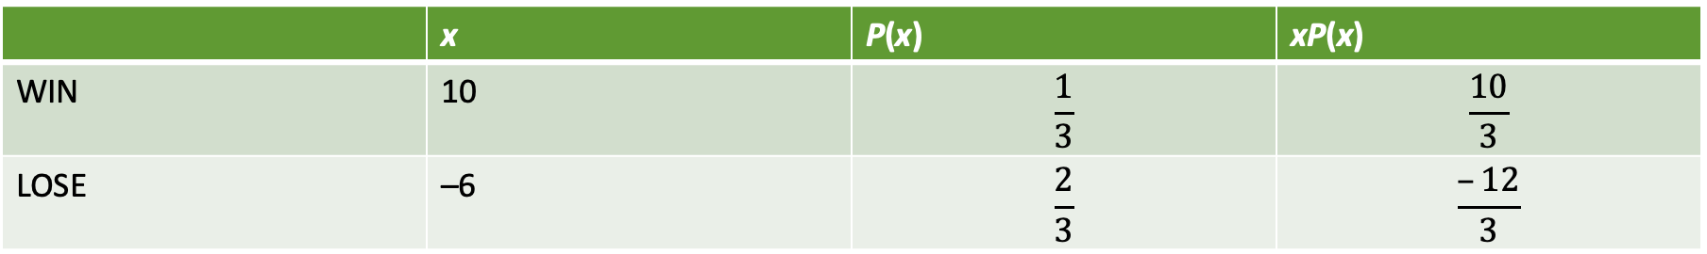
Table 4.11
 | x | P(x) | xP(x)
VINNA | 10 | $$\frac{1}{3}$$ | $$\frac{10}{3}$$
TAPA | –6 | $$\frac{2}{3}$$ | $$\frac{–12}{3}$$

Slide 15
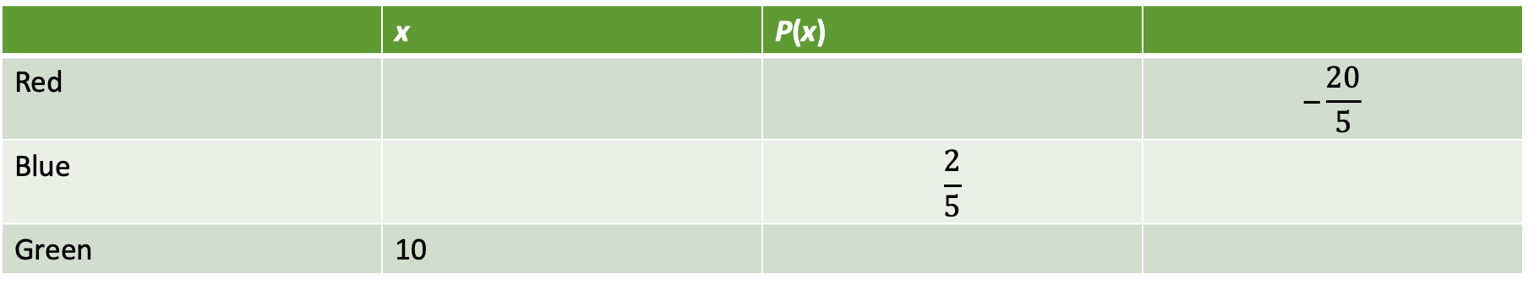
Table 4.12
 | x | P(x)
Rauður |  |  | $$\text{–}\frac{20}{5}$$
Blár |  | $$\frac{2}{5}$$
Grænn | 10

Slide 16
Table 4.13
(1, 1) | (1, 2) | (1, 3) | (1, 4) | (1, 5) | (1, 6)
(2, 1) | (2, 2) | (2, 3) | (2, 4) | (2, 5) | (2, 6)
(3, 1) | (3, 2) | (3, 3) | (3, 4) | (3, 5) | (3, 6)
(4, 1) | (4, 2) | (4, 3) | (4, 4) | (4, 5) | (4, 6)
(5, 1) | (5, 2) | (5, 3) | (5, 4) | (5, 5) | (5, 6)
(6, 1) | (6, 2) | (6, 3) | (6, 4) | (6, 5) | (6, 6)

Slide 17
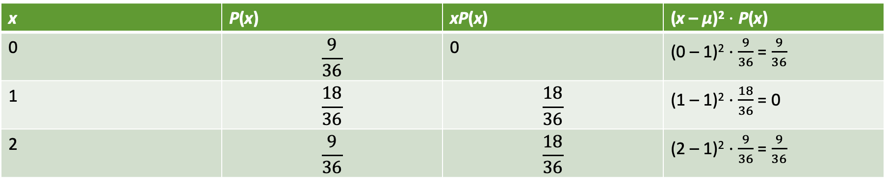
Table 4.14
x | P(x) | xP(x) | (x – μ)² $⋅$ P(x)
0 | $$\frac{9}{36}$$ | 0 | (0 – 1)² ⋅ $\frac{9}{36}$ = $\frac{9}{36}$
1 | $$\frac{18}{36}$$ | $$\frac{18}{36}$$ | (1 – 1)² ⋅ $\frac{18}{36}$ = 0
2 | $$\frac{9}{36}$$ | $$\frac{18}{36}$$ | (2 – 1)² ⋅ $\frac{9}{36}$ = $\frac{9}{36}$
Útreikningur á μ og σ.

Slide 18
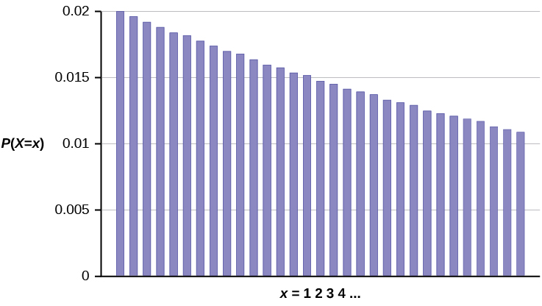
Figure 4.2
Notes:
This graph shows a geometric probability distribution. It consists of bars that peak at the left and slope downwards with each successive bar to the right. The values on the x-axis count the number of computer components tested until the defect is found. The y-axis is scaled from 0 to 0.02 in increments of 0.005.

Slide 19
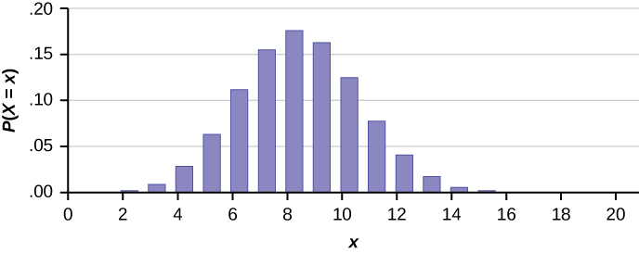
Figure 4.3
Notes:
This figure has the following on the X axis, P (uppercase X is equal to lowercase x). The Y axis ranges from point 00 to point 20. The x axis ranges from 0 to 20. The bars of the graph show a bell-shaped pattern, ranging from 2 to 14 with the highest bar at 8.

Slide 20
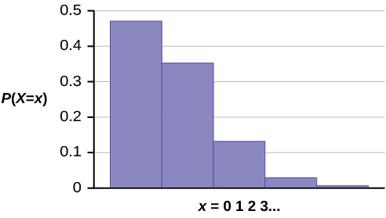
Figure 4.4
Notes:
This graphs shows a poisson probability distribution. It has 5 bars that decrease in height from left to right. The x-axis shows values in increments of 1 starting with 0, representing the number of calls Leah receives within 15 minutes. The y-axis ranges from 0 to 0.5 in increments of 0.1.

Slide 21
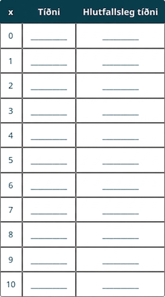
Table 4.15
Notes:
Table 4.15; Columns: x, Frequency, Relative Frequency; Row 1: 0, __________, __________; Row 2: 1, __________, __________; Row 3: 2, __________, __________; Row 4: 3, __________, __________; Row 5: 4, __________, __________; Row 6: 5, __________, __________; Row 7: 6, __________, __________; Row 8: 7, __________, __________; Row 9: 8, __________, __________; Row 10: 9, __________, __________; Row 11: 10, __________, __________

Slide 22
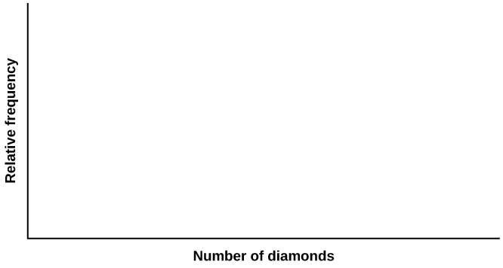
Figure 4.5
Notes:
This is a blank graph template. The x-axis is labeled Number of diamonds. The y-axis is labeled Relative frequency.

Slide 23
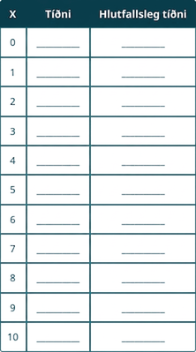
Table 4.16
Notes:
Table 4.16; Columns: X, Frequency, Relative Frequency; Row 1: 0, __________, __________; Row 2: 1, __________, __________; Row 3: 2, __________, __________; Row 4: 3, __________, __________; Row 5: 4, __________, __________; Row 6: 5, __________, __________; Row 7: 6, __________, __________; Row 8: 7, __________, __________; Row 9: 8, __________, __________; Row 10: 9, __________, __________; Row 11: 10, __________, __________

Slide 24
Figure 4.6
Notes:
This is a blank graph template. The x-axis is labeled Number of diamonds. The y-axis is labeled Relative frequency.

Slide 25

Table 4.17

Slide 26
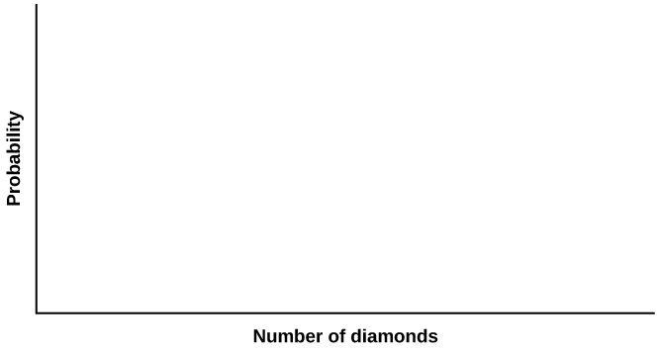
Figure 4.7
Notes:
This is a blank graph template. The x-axis is labeled Number of diamonds. The y-axis is labeled Probability.

Slide 27
Table 4.18
x | y | Tíðni | Hlutfallstíðni
0
1
2
3

Slide 28
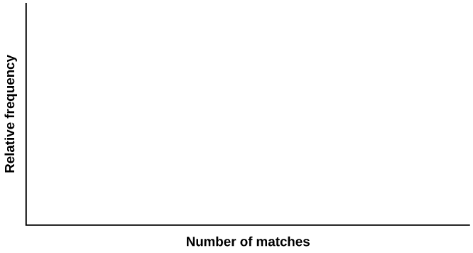
Figure 4.8
Notes:
This is a blank graph template. The x-axis is labeled Number of matches. The y-axis is labeled Relative frequency.

Slide 29
Table 4.19
x | y | P(x) = P(y)
0
1
2
3

Slide 30
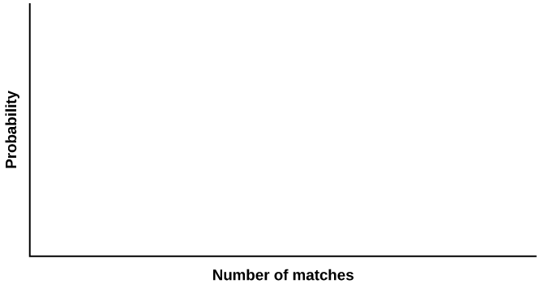
Figure 4.9
Notes:
This is a blank graph template. The x-axis is labeled Number of diamonds. The y-axis is labeled Probability.

