Slide 1

Tölfræði
Kafli 7 Höfuðmarkgildissetningin

Slide 2
Yfirlit kafla
Höfuðmarkgildissetningin fyrir úrtaksmeðaltöl
Höfuðmarkgildissetningin fyrir summur (valkvætt)
Notkun höfuðmarkgildissetningarinnar
Central Limit Theorem (Pocket Change)
Central Limit Theorem (Cookie Recipes)

Slide 3
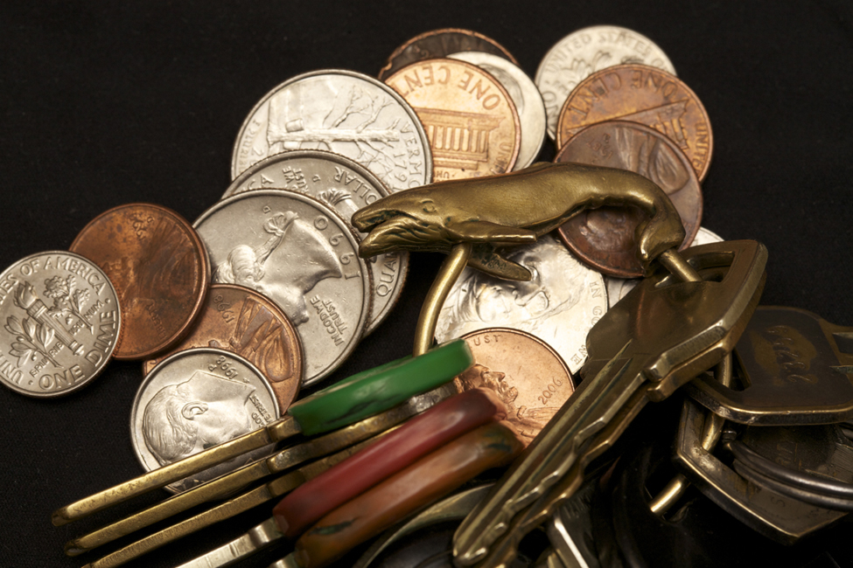
Figure 7.1
Ef þú vilt ákvarða dreifingu smápeninga sem fólk ber í vösunum og notar höfuðmarkgildissetninguna, að því gefnu að úrtakið sé nógu stórt, kemur í ljós að dreifingin er normaldreifð og bjöllulaga. (höfundur: John Lodder)
Notes:
This is a photo of change a set of keys in a pile. There appear to be five pennies, three quarters, four dimes, and two nickels. The key ring has a bronze whale on it and holds eleven keys.

Slide 4
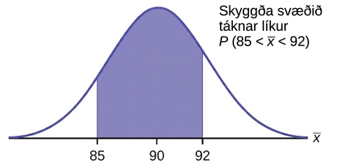
Figure 7.2
Notes:
This is a normal distribution curve. The peak of the curve coincides with the point 90 on the horizontal axis. The points 85 and 92 are labeled on the axis. Vertical lines are drawn from these points to the curve and the area between the lines is shaded. The shaded region represents the probability that 85 < x < 92.

Slide 5
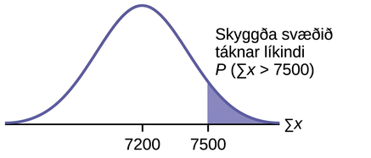
Figure 7.3
Notes:
This is a normal distribution curve. The peak of the curve coincides with the point 7200 on the horizontal axis. The point 7500 is also labeled. A vertical line extends from point 7500 to the curve. The area to the right of 7500 below the curve is shaded.

Slide 6
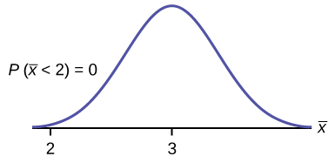
Figure 7.4
Notes:
This is a normal distribution curve over a horizontal axis. The peak of the curve coincides with the point 3 on the horizontal axis. A point, 2, is marked at the left edge of the curve.

Slide 7
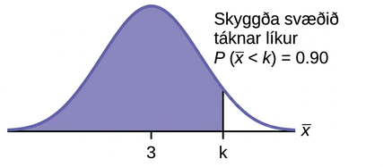
Figure 7.5
Notes:
This is a normal distribution curve. The peak of the curve coincides with the point 3 on the horizontal axis. A point, k, is labeled to the right of 3. A vertical line extends from k to the curve. The area under the curve to the left of k is shaded. The shaded area shows that P(x-bar < k) = 0.90.

Slide 8
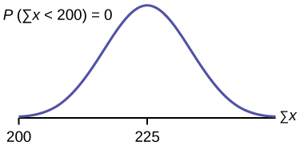
Figure 7.6
Notes:
This is a normal distribution curve over a horizontal axis. The peak of the curve coincides with the point 225 on the horizontal axis. A point, 200, is marked at the left edge of the curve.

Slide 9
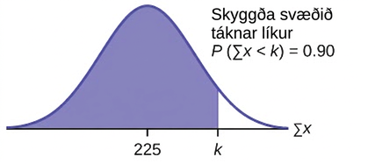
Figure 7.7
Notes:
This is a normal distribution curve. The peak of the curve coincides with the point 225 on the horizontal axis. A point, k, is labeled to the right of 225. A vertical line extends from k to the curve. The area under the curve to the left of k is shaded. The shaded area shows that P(sum of x < k) = 0.90.

Slide 10
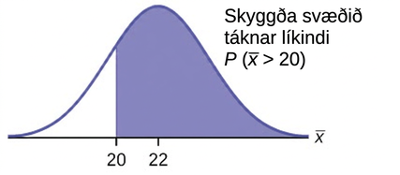
Figure 7.8
Notes:
This is a normal distribution curve. The peak of the curve coincides with the point 22 on the horizontal axis. A point, 20, is labeled to the left of 22. A vertical line extends from 20 to the curve. The area under the curve to the right of k is shaded. The shaded area shows that P(x-bar > 20).

Slide 11
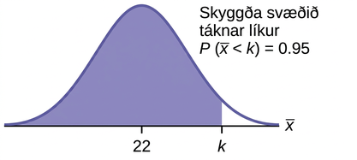
Figure 7.9
Notes:
This is a normal distribution curve. The peak of the curve coincides with the point 22 on the horizontal axis. A point, k, is labeled to the right of 22. A vertical line extends from k to the curve. The area under the curve to the left of k is shaded. The shaded area shows that P(x-bar < k) = 0.95.

Slide 12
Table 7.1
__________ | __________ | __________ | __________ | __________
__________ | __________ | __________ | __________ | __________
__________ | __________ | __________ | __________ | __________
__________ | __________ | __________ | __________ | __________
__________ | __________ | __________ | __________ | __________
__________ | __________ | __________ | __________ | __________

Slide 13
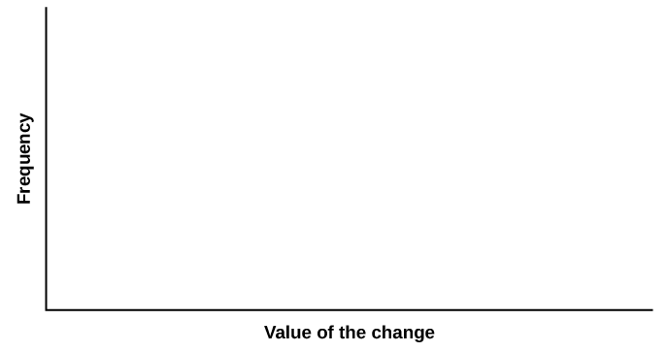
Figure 7.10
Notes:
Blank graph template. The horizontal axis is labeled Value of the change and the vertical axis is labeled Frequency.

Slide 14
Table 7.2
__________ | __________ | __________ | __________ | __________
__________ | __________ | __________ | __________ | __________
__________ | __________ | __________ | __________ | __________
__________ | __________ | __________ | __________ | __________
__________ | __________ | __________ | __________ | __________
__________ | __________ | __________ | __________ | __________

Slide 15
Figure 7.11
Notes:
This is a blank graph template. The horizontal axis is labeled Value of the change and the vertical axis is labeled Frequency.

Slide 16
Table 7.3
__________ | __________ | __________ | __________ | __________
__________ | __________ | __________ | __________ | __________
__________ | __________ | __________ | __________ | __________
__________ | __________ | __________ | __________ | __________
__________ | __________ | __________ | __________ | __________
__________ | __________ | __________ | __________ | __________

Slide 17
Figure 7.12
Notes:
This is a blank graph template. The horizontal axis is labeled Value of the change and the vertical axis is labeled Frequency.

Slide 18
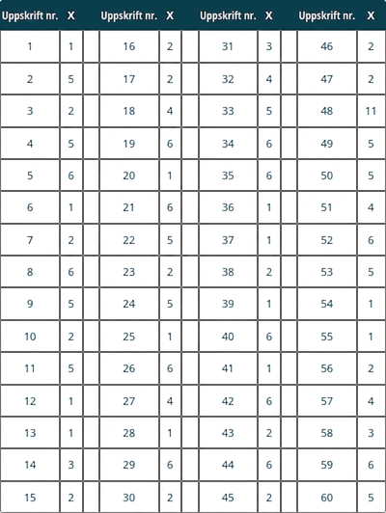
Table 7.4
Notes:
Table 7.4; Columns: Recipe #, X, , Recipe #, X, , Recipe #, X, , Recipe #, X; Row 1: 1, 1, , 16, 2, , 31, 3, , 46, 2; Row 2: 2, 5, , 17, 2, , 32, 4, , 47, 2; Row 3: 3, 2, , 18, 4, , 33, 5, , 48, 11; Row 4: 4, 5, , 19, 6, , 34, 6, , 49, 5; Row 5: 5, 6, , 20, 1, , 35, 6, , 50, 5; Row 6: 6, 1, , 21, 6, , 36, 1, , 51, 4; Row 7: 7, 2, , 22, 5, , 37, 1, , 52, 6; Row 8: 8, 6, , 23, 2, , 38, 2, , 53, 5; Row 9: 9, 5, , 24, 5, , 39, 1, , 54, 1; Row 10: 10, 2, , 25, 1, , 40, 6, , 55, 1; Row 11: 11, 5, , 26, 6, , 41, 1, , 56, 2; Row 12: 12, 1, , 27, 4, , 42, 6, , 57, 4; Row 13: 13, 1, , 28, 1, , 43, 2, , 58, 3; Row 14: 14, 3, , 29, 6, , 44, 6, , 59, 6; Row 15: 15, 2, , 30, 2, , 45, 2, , 60, 5

Slide 19
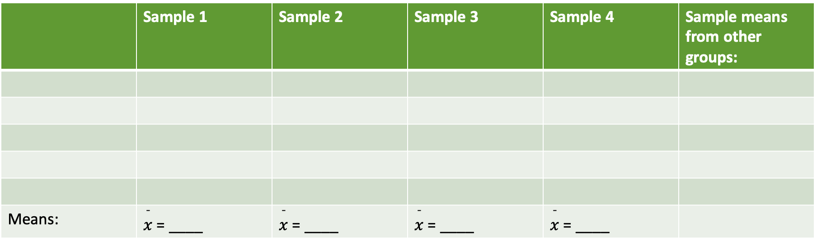
Table 7.5
 | Úrtak 1 | Úrtak 2 | Úrtak 3 | Úrtak 4 | Úrtaksmeðaltöl annarra hópa:
Meðaltöl: | $\overset{¯}{x}$ = ____ | $\overset{¯}{x}$ = ____ | $\overset{¯}{x}$ = ____ | $\overset{¯}{x}$ = ____

Slide 20
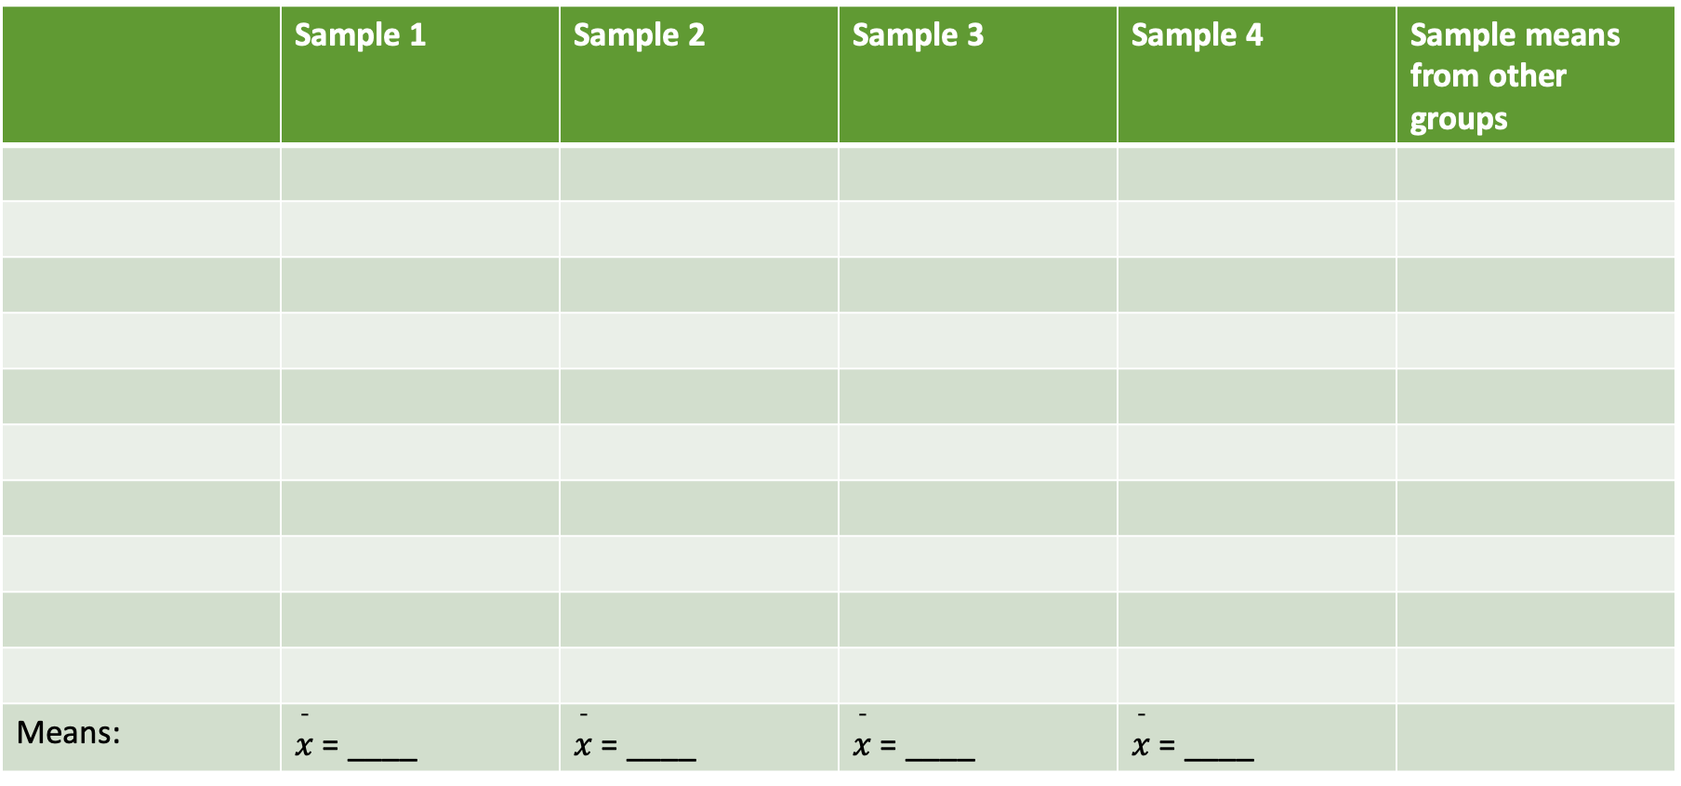
Table 7.6
 | Úrtak 1 | Úrtak 2 | Úrtak 3 | Úrtak 4 | Úrtaksmeðaltöl annarra hópa
Meðaltöl: | $\overset{¯}{x}$ = ____ | $\overset{¯}{x}$ = ____ | $\overset{¯}{x}$ = ____ | $\overset{¯}{x}$ = ____

Slide 21
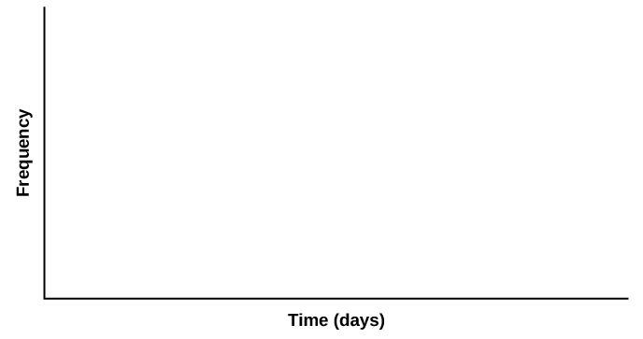
Figure 7.13
Notes:
This is a blank graph template. The horizontal axis is labeled Time (days) and the vertical axis is labeled Frequency.

Slide 22
Figure 7.14
Notes:
This is a blank graph template. The horizontal axis is labeled Time (days) and the vertical axis is labeled Frequency.

Slide 23
Figure 7.15
Notes:
This is a blank graph template. The horizontal axis is labeled Time (days) and the vertical axis is labeled Frequency.

Slide 24
Notkunarleyfi
Þetta fylgiefni frá OpenStax er © Rice University samkvæmt CC BY-NC-SA 4.0 International-notkunarleyfi; heimilt er að afrita það eða breyta því eingöngu í óhagnaðarskyni, en vísa verður til OpenStax og Rice University og geta þarf allra breytinga. Allar aðlaganir verða að vera birtar með sams konar notkunarleyfi.

